Slide 1
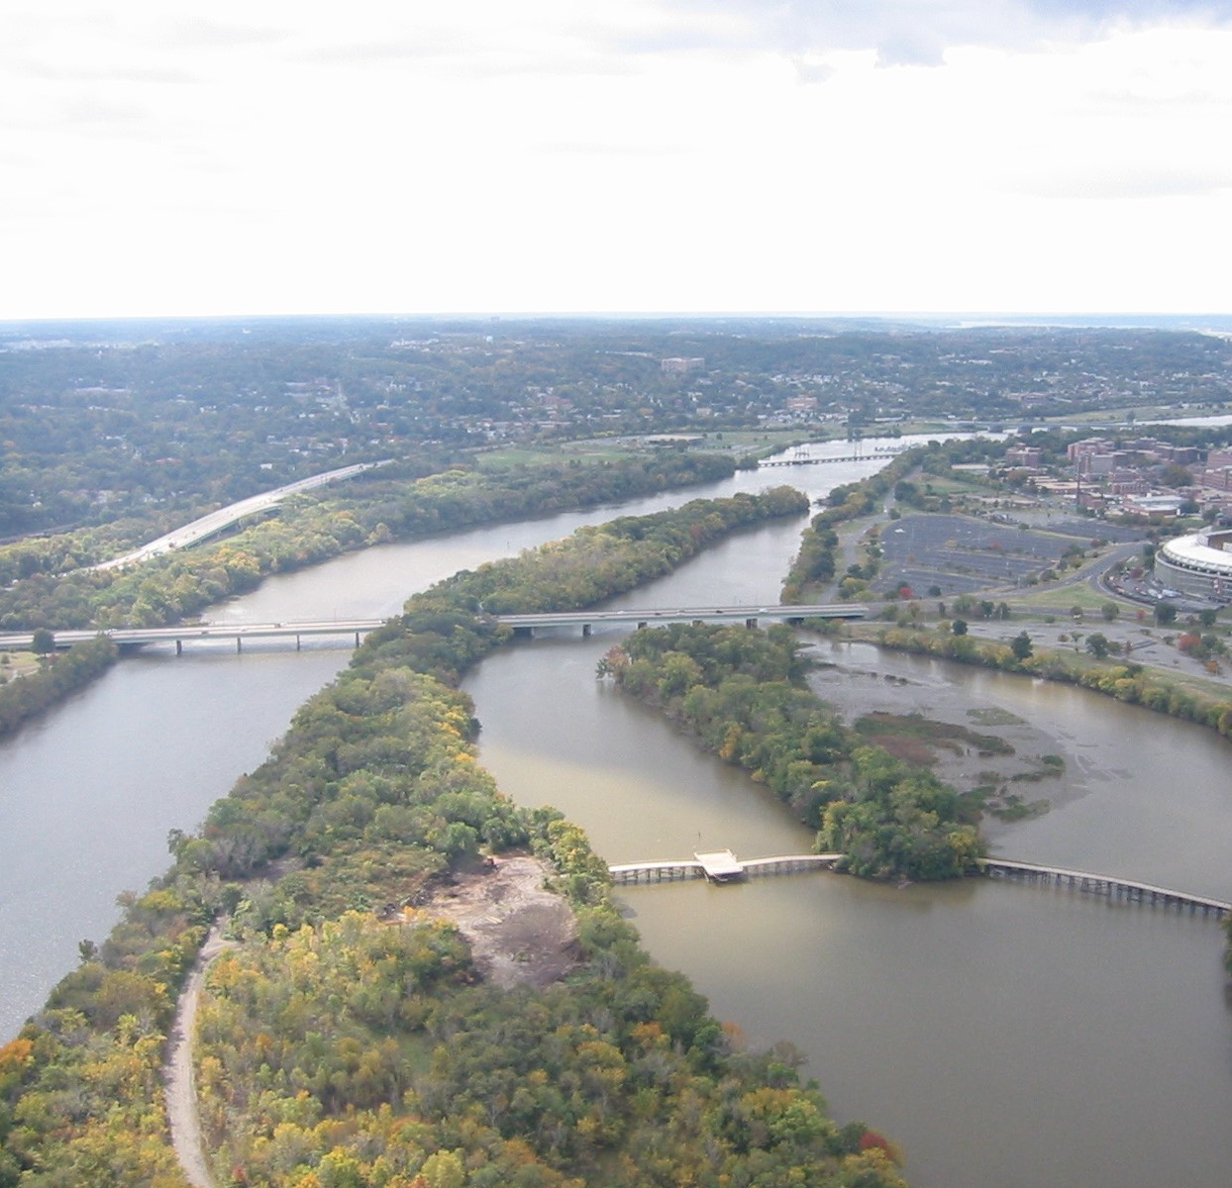
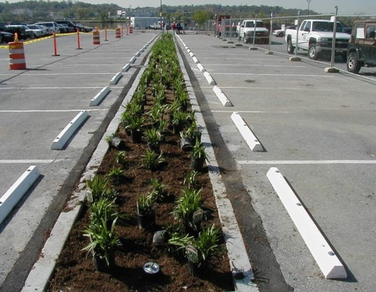
DOEE STORMWATER MANAGEMENT PLAN REVIEW PROCESS
James Dunbar
Senior Environmental Protection Specialist
Notes:
Hello, my name is James Dunbar, and I’ll be giving this training on the Stormwater Management Plan Review Process as part of our series of General Compliance Trainings. This training can be viewed at any point in the training series, though it references several other presentations in the series, such as our Stormwater Retention Credit and Off-site option training.

Slide 2
LEARNING OBJECTIVES
Familiarize users with all pieces of the DOEE stormwater management (SWM) plan review and construction processes from concept to completion
Identify where certain DOEE programs and other key process intersect with plan review and construction:
The Surface and Groundwater System (SGS)
Construction and maintenance inspections
Stormwater Retention Credit (SRC) trading market
RiverSmart Rewards
Note: limited to DOEE processes, does not discuss sister agency processes (DCRA, DC Water, DDOT, etc)
@DOEE_DC
Notes:
** Our primary learning objective is to familiarize you with every piece of the DOEE stormwater management plan review and construction process, from the very beginning at project concept to post-construction operation and maintenance. ** I also want to highlight where some other key processes and features interact with this overall process, such as the Surface and Groundwater System (or SGS), construction and maintenance inspections, Stormwater Retention Credit Market (or SRCs), and Riversmart Rewards. ** Keep in mind, though, this presentation is limited to DOEE process and does not cover processes held at other agencies, such as DCRA, DC Water, and DDOT.

Slide 3
STEPS IN PLAN REVIEW AND CONSTRUCTION PROCESS
Design the plan
Prepare submission
Compile plan documents
Input compliance data with the SGS
Submit plan and pay initial review fees
Plan comment and response cycle
Receive plan approval
Request and hold a preconstruction meeting
Construct the site with ongoing inspections
Submit as-built plan and Final Approval Notice (FAN)
Meet ongoing obligations and participate in financial incentive programs
Maintain BMPs with ongoing inspections and meet Offv
Participate in RiverSmart Rewards
@DOEE_DC
Notes:
First, we’ll do a big-picture look at the whole process from start to finish. Each of these items will get its own deeper dive. ** We start with designing the plan and preparing your submission to DOEE, ** which includes compiling all your plan documents ** and inputting compliance data into the SGS. ** Once compiled and uploaded, you pay initial review fees and submit the plan, where it will go into a plan reviewer’s queue. ** The reviewer will provide comments on the plan, the applicant will revise and resubmit, and we’ll repeat that cycle until there are no more comments, ** at which point the plan will receive approval. ** At this stage, the applicant should request a preconstruction meeting with our inspection team, which must take place prior to the start of work. ** During construction, the inspector will conduct drop-in inspections. Once the site is finished and fully stabilized, we’ll do a final inspection, ** at which point the inspector gives the go-ahead to put together the as-built package. The inspector reviews and approves the as-built package, ** and then we’re in the operations and maintenance phase of the project. ** Here is when it’s on the owner of the site to maintain your BMPs in accordance with your approved plan and meet your Off-site option if you chose that option, ** and where the owner may want to participate in some of our financial incentive programs like riversmart reward

Slide 4
1. DESIGN
Consultants coordinating:
Civil, geotechnical, and possibly structural engineers
Architect and landscape architect
Mechanical, electrical, and plumbing engineers
Existing and proposed conditions determine site constraints and BMP opportunities
Soil Survey
Topographic Survey
Geotechnical Report, including groundwater observations
Infiltration Testing depending on the proposed BMPs
Proposed site design
Consider a Pre-Development Review Meeting (PDRM) with DOEE reviewers (optional, but encouraged)
@DOEE_DC
Notes:
In the first step of this process, you’re fleshing out the project details and gathering up your consultants. ** ** The scope of a DOEE stormwater review is pretty broad and often touches on multiple disciplines beyond just civil engineering: geotechnical, structural, ** architect and landscape architect, ** and even your MEP engineers, especially if you have stormwater practices on rooftops that drain to lower levels. ** Now we determine constraints. Obviously you’ll need a site survey, although this may be less relevant if you have a lot-line to lot-line development, in which case it will probably be better to coordinate more heavily on the proposed building design. ** On a typical site you’ll need to conduct a soil survey, ** topographic survey, conduct a geotechnical report if you have any stormwater practices in the ground, and if you want to infiltrate runoff you will need infiltration test. Obviously you’ll need to know your proposed site design. ** At this stage, we recommend contacting DOEE to schedule a pre-development review meeting (or PDRM). You can meet with DOEE plan reviewers to go over the scope and proposed design of your project, run some questions past us, and confirm your understanding of how your project will be regulated. We are happy to take a look at projects even if all you’ve got is a brief scope of work and some markups on a Google Map image. We’ve found early coordination and establishing a shared understanding of a project helps the plan review process go smoother down the line when you submit fully for review at a later design stage.

Slide 5
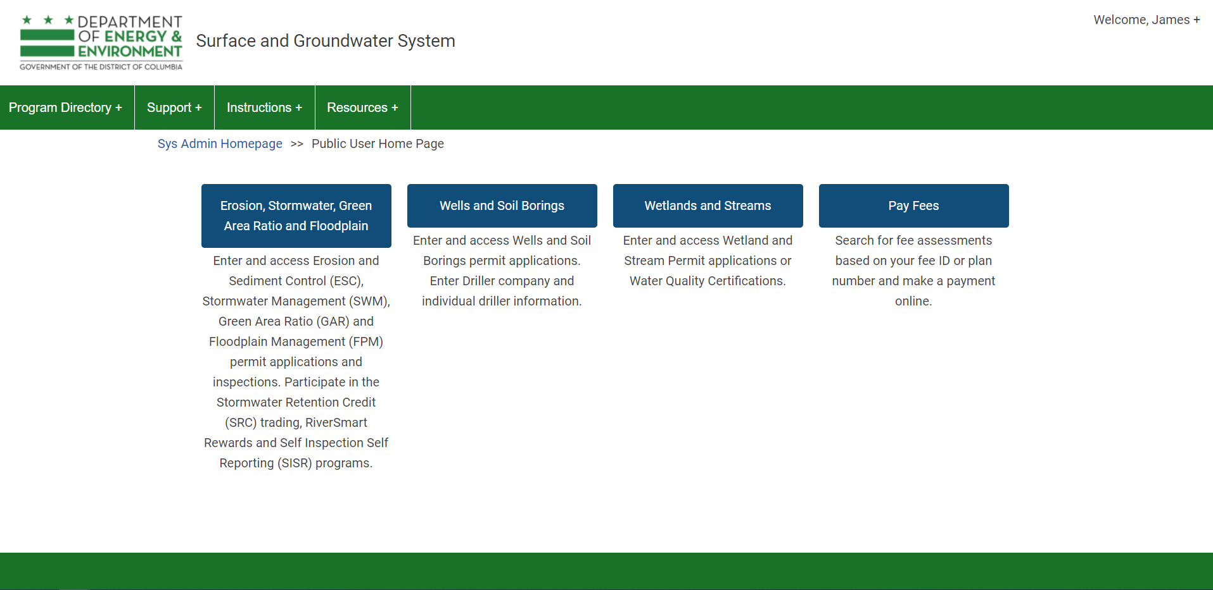
HOW TO REQUEST A PDRM
Log in to the SGS: doee.dc.gov/sgs
Click on the Erosion, Stormwater, Green Area Ratio, and Floodplain button
@DOEE_DC
Notes:
As a brief aside, I’ll show you where to go in the SGS to request a PDRM. First log in and go to the ESC, SWM, GAR, and Flood module

Slide 6
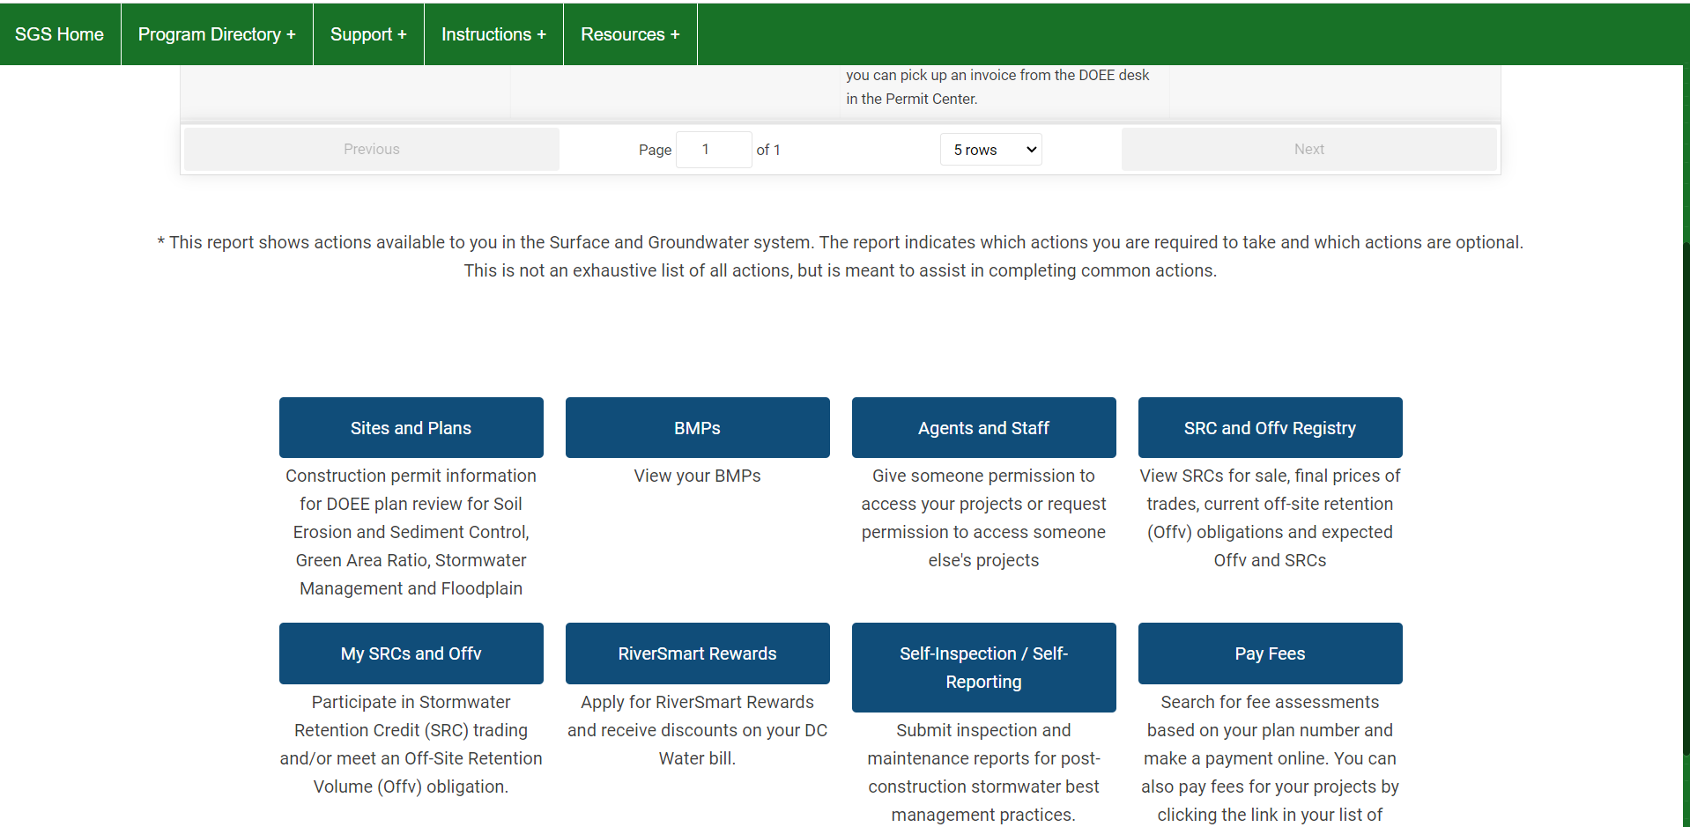
HOW TO REQUEST A PDRM
3. Scroll down, go to Sites and Plans
@DOEE_DC
Notes:
Next scroll down and go to sites and plans

Slide 7
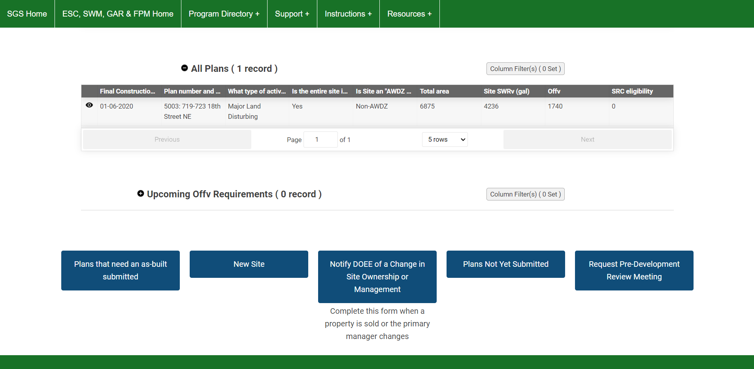
HOW TO REQUEST A PDRM
4. At the bottom of the page, go to “Request Pre-Development Review Meeting”
5. Enter the site information and save the form. DOEE will reach out to you.
@DOEE_DC
Notes:
Then scroll down again and click the “Request Pre-Development Review Meeting”. Fill out and save the form the button takes you to, and DOEE will reach out shortly to schedule a meeting with you and whichever parties you’d like to be present. We’ll ask you to fill out meeting minutes, which you will then upload to the project record you create in our system so any other reviewer that picks up the project will understand what we previously established.

Slide 8
2a. COMPILE PLAN DOCUMENTS
In a SWM submission set, we expect:
Cover Sheet and General Notes
Existing Conditions plan
Demolition plan
Site Design plan
Utility plan
Grading plan
Erosion and Sediment Control (ESC) plan (broken into phases if needed)
Stormwater Management Plan
Plan view showing site drainage area and contributing drainage area delineation
BMP design Calculations: storage volume, overflow capacity, drawdown time, etc
SGS compliance data sheets
Material specifications, stormwater BMP section details
Landscaping plan
Other documents: Geotechnical report with infiltration tests, meeting minutes from a PDRM, supplemental architectural or MEP sheets
@DOEE_DC
Notes:
Now that you’ve got your design established and initial regulatory questions answered, it’s time to prepare to submit to DOEE. On one track, you need to compile your plan documents. ** We expect in the SWM submission set all of these plans, some of which may be combined into the same plan if it’s a simple project. You’ll need ** [list #1 – 6]. ** If you’ve got multiple phases in your construction sequence, we ask you to break apart your ESC plan to reflect those phases. ** ** For SWM, we’ve got a plan view along with several other components supporting the plan: ** BMP design calculations, ** compliance data sheets from the SGS, ** and any stormwater BMP details. I’ve got site drainage areas and contributing drainage area delineation bolded and underlined because of how important it is and central to our review, we really can’t say a whole lot if those aren’t properly shown. ** Finally, since many of our sites have specific landscape requirements (such as a bioretention), if your landscape architect is taking care of plantings we need to see those sheets as well. ** There are some other documents we might need, such as a geotechnical report and infiltration test results, meeting minutes from a PDRM you previously held about the project, or if your SWM design relies on architectural or MEP sheets to support drainage area delineation, such as showing roof drains if parts of the roof downspout to a bioretention or green roof on a lower level.

Slide 9
2b. INPUT COMPLIANCE DATA INTO SGS
Note: See dedicated training on using the SGS
Go to http://doee.dc.gov/sgs
Request an account. NOTE: Site owner must have an account
Enter plan information
Site location (address)
Site Drainage Area information
Contributing Drainage Areas to each BMP
Generate the compliance data sheets, paste into the plan set
Upload all documents you want a plan reviewer to review
Upload plan sets as a single PDF (e.g. civil set, landscape set), not as individual sheets
@DOEE_DC
Notes:
On a different track, at the same time, you can create your project record in DOEE’s Surface and Groundwater System and input your compliance data.** Please note there is an entire training dedicated to how to use the SGS – this will be an extremely brief overview of steps you take. ** First, go to the website and either log in or create an account. ** The actual site owner must have an account and be listed as the site owner in the system, it cannot be the designer as a placeholder. ** Enter in your plan information, ** including your address, ** site drainage area, ** and contributing drainage area information. ** Once all the data is input to the system, there’s a big button you press that will generate a PDF summarizing the site’s compliance data. You need to paste this PDF into the plan set for DOEE to review. ** Finally, you upload any documents you want your plan reviewer to look at, ** and please upload the entire plan set as a single PDF and not as individual sheets like what DCRA requires in ProjectDox.

Slide 10
3. PAY REVIEW FEES, SUBMIT PLAN
Apply for building permit through DCRA
Project will be routed to DOEE during DCRA intake process
Once routed to DOEE, will assign initial plan review fees
Pay review fees
Electronically through the SGS with credit card (faster, recommended)
In-person at DCRA permit center and pay at cashier's desk
Submit plan: Hit the submit button
DOEE only considers a project fully submitted if:
Fees are paid AND
Plans are uploaded AND
Submit button is pressed
Then the clock starts on your review period
@DOEE_DC
Notes:
Once your plan set is put together and your plan is uploaded, there’s a few more steps to take before you can submit your plan. ** First, you need to apply for a building permit through DCRA so you have a building permit number. ** The intake process with DCRA will route the project to DOEE, ** where we will assign your initial plan review fees. ** Pay the initial review fees. ** You can do this either online with a credit card ** or in person at the DCRA permit center, although paying online will be faster as it triggers some automatic processes in our system that gets the plan into a reviewer’s queue quicker. ** Lastly, hit the submit button, which looks like ** this. It’s big bright green and you can’t miss it. However, some folks forget and then their plan never goes into a reviewer’s queue. ** The clock starts on the plan reviewer to review your project once all three of these conditions are met: ** plan review fees are paid, ** plans are uploaded, ** and you push the submit button. ** Then the project goes into the reviewer’s queue and the clock starts on when we need to turn it around back to you.

Slide 11
4. REVIEW AND COMMENT CYCLE
Once submitted, plan reviewer(s) assigned
Begin Review once it gets to the top of the reviewer’s queue
Return to applicant with comments – Within 30 business days of submittal
Applicant revises and resubmits any changes in the SGS
Once all comments are resolved, reviewer releases maintenance responsibility statement and Offv statement for owner signature
Any change to plan data in SGS will erase the signature, so we wait until the end of the process to sign these statements
Are you submitting plans less than 90% Design Development?
>> Do a plan review meeting instead
Plans missing information take a long time to review, lots of feedback to give
Potentially many changes between early and later design >> long 2nd review
Meeting: based on reviewer’s calendar (sometimes scheduled same week)
Full plan review: based on reviewer’s queue and general workload
@DOEE_DC
Notes:
** Now that your plan is submitted, DOEE will assign a plan reviewer to your project. ** Plan reviewers have a lot of projects in their review queue, so we don’t review a project right away. ** DOEE can commit to turning around projects within 30 business days, however we typically turn them around faster than that (like around 20 business days). ** The plan reviewer will provide comments, and the designer will revise and resubmit for another review cycle. This process will be repeated until all comments are resolved. ** When it looks like we’re close to approval, the reviewer will release a couple of statements for the site owner to sign electronically in the SGS and include in the final plan set for DOEE’s approval stamps. We wait until the very end because any change to compliance data will erase the site owner’s signature. ** At this point, it’s worth talking about what level of design detail DOEE expects in a plan set when submitted. We provide comments such that if all of them were addressed perfectly, we could approve the plan on the next review. However, if a plan is submitted too early in the design process (which is often anything before 90% design development), then it’s almost guaranteed there will be additional comments on the next round. ** If for whatever reason you need to submit to DOEE in an earlier design phase, please schedule a plan review meeting with your reviewer instead. ** We’ve seen that plans submitted too early have a lot of comments and then the design changes, resulting in more comments later.
** If you schedule a meeting, you just need to get the next available time on a reviewer’s calendar, which can often be the same week. ** If you are waiting on a full plan review, that’s going to be another 20 – 30 business days.

Slide 12
5. APPROVAL
Needed for approval:
Declaration of Covenants
Signed and notarized by owner
Appendix A: signed by OAG for legal sufficiency
Appendix B and C: signed by DOEE reviewer for technical sufficiency
Upload to SGS for electronic approval
Plan Set: 1 PDF set submitted through the SGS, signed and sealed with maintenance responsibility and Offv signatures pasted into the set
DOEE will quickly check and stamp these documents, then assign….
Final review fees: paid online or at DCRA Permit Center
All reviews have final review fees
Any reviews conducted past the second receives supplemental review fees
Pay the final review fees and you can download your DOEE-approved plan set and record your covenant
@DOEE_DC
Notes:
** Once all comments are resolved, there are some final documents to prepare. ** The first is the Declaration of Covenants. This is a legal document that any purchaser of the property will receive in the package of buyer’s documents, and it notifies the new owner that there is a legal requirement to maintain stormwater facilities on this land. ** The document is signed and notarized by the site owner. ** Appendix A is a legal description of the land, ** Appendix B is a map of where the stormwater facilities are located, and Appendix C details the minimum maintenance activities for these facilities. ** You upload this document for DOEE and OAG approval. ** The second item we need is a final plan set, which should be in a single PDF uploaded to the SGS with electronic signatures for the maintenance responsibility statement and the Offv statement if your site is choosing the off-site option. ** We’ll quickly check these documents are in order and then process the approval, which includes stamping the plans and assigning the final review fees. ** Depending on which reviews we conducted, we may apply different final review fees, ** and if there were any additional reviews beyond the second review, there will be supplemental review fees. ** Pay these fees and you can download your plan set and go record your covenant.

Slide 13
6. ESC PRECONSTRUCTION MEETING
Erosion and Sediment Control (ESC) Preconstruction meeting
Request 72 hours prior to land-disturbing activity
Must take place prior to starting work
MUST have building permit fully approved to schedule meeting
Relevant parties: Owner/Agent, Project Manager, Civil Engineer, General Contractor, Sub-contractors
Must have approved plans on-site
Items for discussion:
Field modifications to ESC plan
Sequence of construction
Material verification requirements
@DOEE_DC
Notes:
** Once you’ve obtained your DOEE-approved plan set and have your DCRA permit in hand, it’s time to schedule a preconstruction meeting. ** Reach out to us and give us 72 hours to get back to you to put a preconstruction meeting on the books. ** Please know, you must have this meeting take place prior to the start of work, ** and you can’t even schedule this meeting until you have your DCRA building permit approved. ** Who comes to these meetings? Typically we like to have an agent for the owner, the project manager, the civil, any contractors and subs, you name it. ** Make sure you have the DOEE-approved plan on site. ** ** We usually discuss any changes the DOEE inspector might want to make to the ESC plan, which we call field modifications. ** We’ll also talk about the sequence of construction, including any phases in the sequence, ** and any material verification requirements, meaning any documentation the contractor should keep on hand to confirm materials they use meet our specifications.

Slide 14
7. CONSTRUCTION
ESC Inspections
Initial ESC control inspection
Routine ESC inspections
Final ESC inspection
Stormwater BMP Inspections
Preconstruction meeting for Stormwater BMPs
Critical Steps in construction sequence – see inspection checklists in Guidebook
Final stormwater inspection
Substantial Plan Changes result in revision resubmission – refer to Chapter 5 in the Guidebook
Meet Offv 4 weeks before the Final Construction Inspection (if applicable)
@DOEE_DC
Notes:
Now that you’ve had your preconstruction meeting, we’ve moved into the construction phase. ** DOEE inspectors will conduct an initial ESC inspection to make sure all the controls are properly put in place ** and then conduct periodic drop-in inspections throughout construction. ** Towards the end of construction the inspector will confirm the entire site is stabilized, and after then you are allowed to remove your ESC controls. ** There’s a second set of inspections for stormwater BMPs, ** including a separate preconstruction meeting. It’s bolded and underlined because sometimes contractors forget to schedule these. ** For these inspections, the inspectors will discuss at what steps they will want to be present for observation, such as seeing the gravel layer installed in a bioretention or something. Typically these critical steps align with the construction inspection checklists in our Guidebook, so please see the relevant appendices for each checklist. ** Each BMP will also receive a final stormwater inspection. ** Additionally, we recognize that no plan is ever constructed perfectly to the design documents – there’s always changes during construction. There is a threshold below which a project can just make the change in the field, but there are several items which could result in the plan needing to go back to the plan reviewer for an Approved Plan Revision. The list is pretty thorough, so I encourage you to look at the section in Chapter 5 on “Substantial Plan Changes” for more info there. ** Lastly, a frequent question is when a site owner needs to have SRCs in hand to meet an off-site requirement. The answer is, four weeks prior to the final Construction Inspection, which the inspector will conduct when all the BMPs on site are finished and is the go-ahead to begin putting together the as-built plans. It may be difficult to precisely identify exactly when this date is, but the SRC team will be in contact with the project owner to ensure Off-site compliance is achieved in time.

Slide 15
8. AS-BUILT AND FINAL APPROVAL
As-built review: conducted by DOEE Inspector
As-Built Package:
Due within 21 days of Final Construction Inspection
1 PDF copy submitted through the SGS
Supporting Documentation per Inspector request
Approval of as-built package → Final Approval Notice (FAN) → needed for Certificate of Occupancy
@DOEE_DC
Notes:
** Once the inspector conducts their final inspection, the applicant has the go-ahead to prepare an as-built package, which consists of redline revisions to plans showing the difference between the approved condition and the final condition. ** ** The as-built package is due within 21 days of the final construction inspection ** and is merely a PDF copy of the redlines submitted through the SGS ** along with any other documents the inspector might ask for, like pictures of the site. A common misconception, the as-built review is conducted by the inspector, not the DOEE reviewer. ** Approval of the as-built package is required to receive your Final Approval Notice, which you need for your certificate of occupancy

Slide 16
9. MAINTENANCE, OFFv, FINANCIAL INCENTIVES
Maintenance Inspections by DOEE. Expectation: conduct maintenance according to schedule in approved plan, or better
Within 1st year of construction
Every 3 years
DOEE currently developing process for inspections through Self-Inspection, Self-Reporting (SISR)
Meet Offv (if applicable)
Offv is applicable in perpetuity until site is redeveloped again
Meet Offv by purchasing Stormwater Retention Credits (SRCs) on the market
Can also pay In-Lieu Fee but this is much more expensive
Requirement can be met annually or for several years at a time
RiverSmart Rewards: Earn a modest discount on DC Water bill for stormwater charges. (Very simple for properties with SWM plans approved)
@DOEE_DC
Notes:
Now that your building is occupied and in operation, there are some ongoing activities, responsibilities, and programs to keep track of. ** DOEE periodically will come out to the site to inspect the stormwater BMPs to make sure they are being maintained according to the approved maintenance plan. ** We’ll visit the site within the first year after construction ** and then every three years thereafter. ** At some point, we will roll out a Self-Inspection, Self Reporting program where the site owner can submit pictures of the stormwater BMPs and the inspector reviews them remotely without having to travel out to the site. ** ** Each year, if your project chose the off-site option, your Offv will be due and you will need to use SRCs to meet your Offv. This obligation applies to the site in perpetuity until the site is redeveloped at some point in the future. You can also pay the In-Lieu Fee but generally this is much more expensive and is only there to act as a price ceiling for SRCs so they don’t ever get too expensive. You can, of course, buy a lot of SRCs and negotiate a discount so you can meet your Offv for multiple years and not need to think about it again for a long time. ** Finally, there’s a discount program called RiverSmart Rewards that is incredibly easy to enroll in for owners of an approved stormwater management plan. This program offers a modest discount on the stormwater charges on your DC Water water bill. You can import data from your stormwater management plan, making filling out this form very easy.

Slide 17
Got Questions?
James Dunbar
Senior Environmental Protection Specialist
James.Dunbar@dc.gov
@DOEE_DC
Notes:
If you’ve got any questions, please don’t hesitate to reach out at my email, I’m happy to talk about anything I discussed or related to items in this presentation. Thanks for listening!

