Slide 1
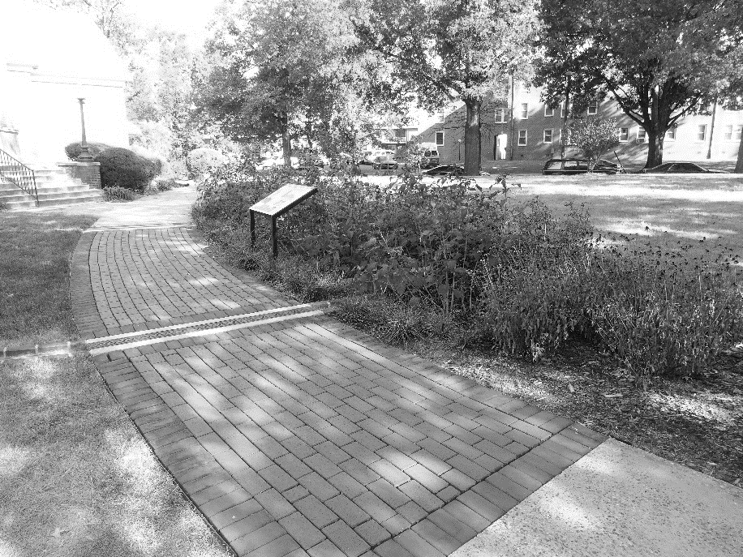
General Compliance Training
Stormwater Management
TAG THIS PRESENTATION @DOEE_DC

Slide 2
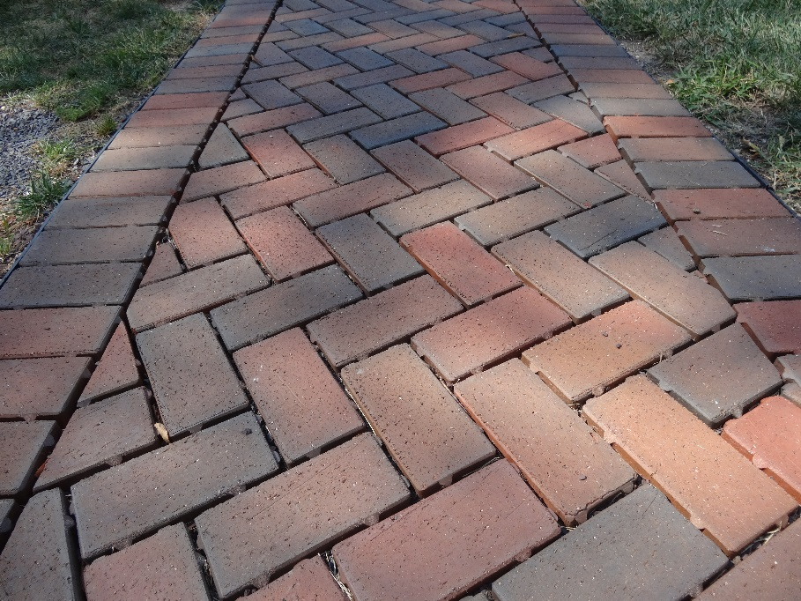
Objectives
Know when the stormwater rules apply
Calculate the SWRv for a site
Understand the difference between SDA and CDA
Understand the basic concepts of the BMPs in the Guidebook and the important design specifications
Understand PROW to the MEP
Know what Offv is and how to comply
Understand the overall process to have a plan approved
Know what the SGS is and how to access
Understand when detention is required
@DOEE_DC

Slide 3
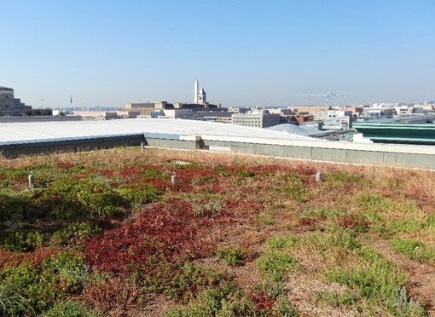
Stormwater Management Requirements
Chapter 2
TAG THIS PRESENTATION @DOEE_DC

Slide 4
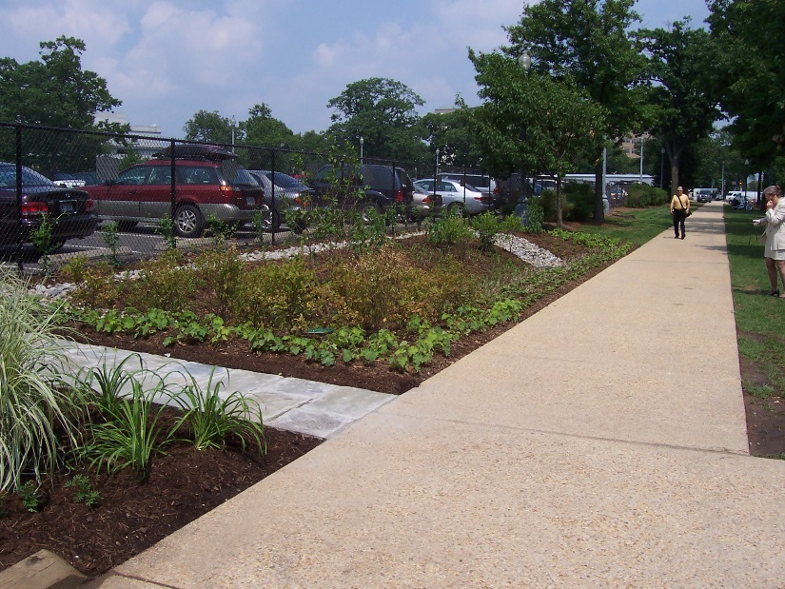
What is Retention and Why Do We Care?
@DOEE_DC
Notes:
Retention refers to ultimate fate of the runoff – runoff reduction.
Former approach treatment based. Shift to “runoff reduction.” The actual amount of water running off is as much a problem as the pollutants. If the runoff never runs off, neither do the pollutants.
Detention – slow down the runoff for a while.

Slide 5
Stormwater Retention Volume
SWRv = P/12 x (Rv_{I} x I + Rv_{C} x C + Rv_{N} x N) x 7.48
SWRv = Volume required to be retained on site (gal)
P = Precipitation (in)
Rv_{I} = 0.95 (runoff coefficient for impervious cover)
Rv_{C} = 0.25 (runoff coefficient for compacted cover)
Rv_{N} = 0.0 (runoff coefficient for natural cover)
I = impervious cover surface area (sf)
C = compacted cover surface area (sf)
N = natural cover surface area (sf)
@DOEE_DC
Notes:
Go through each term
P = 1.2 inches for most development projects
Natural cover = natural areas not regularly maintained (woods, meadows), some runoff would result from natural cover, but regs say you don’t need to manage
Compacted cover = everything else
Discuss bmp area during later example unless someone asks

Slide 6
When Stormwater Rules Apply
Major Land-Disturbing (MLD) Activity
Activity that disturbs, or is part of a common plan of development that disturbs, 5,000 square feet or greater of land area, and either or both:
Any portion of the pre-project land cover is natural; and/or
2,500 square feet or greater of the post-project land cover is impervious or BMP area.
@DOEE_DC

Slide 7
When Stormwater Rules are in Effect
Major Substantial Improvement (MSI) Activity
Construction costs for building renovation/addition are greater than or equal to 50% of the pre-project assessed value of the structure.
AND Combined footprint of structure(s) exceeding the cost threshold and any land disturbance are greater than or equal to 5,000 square feet, and either or both:
Any portion of the pre-project land cover is natural; and/or
2,500 square feet or greater of the post-project land cover is impervious or BMP area.
@DOEE_DC

Slide 8
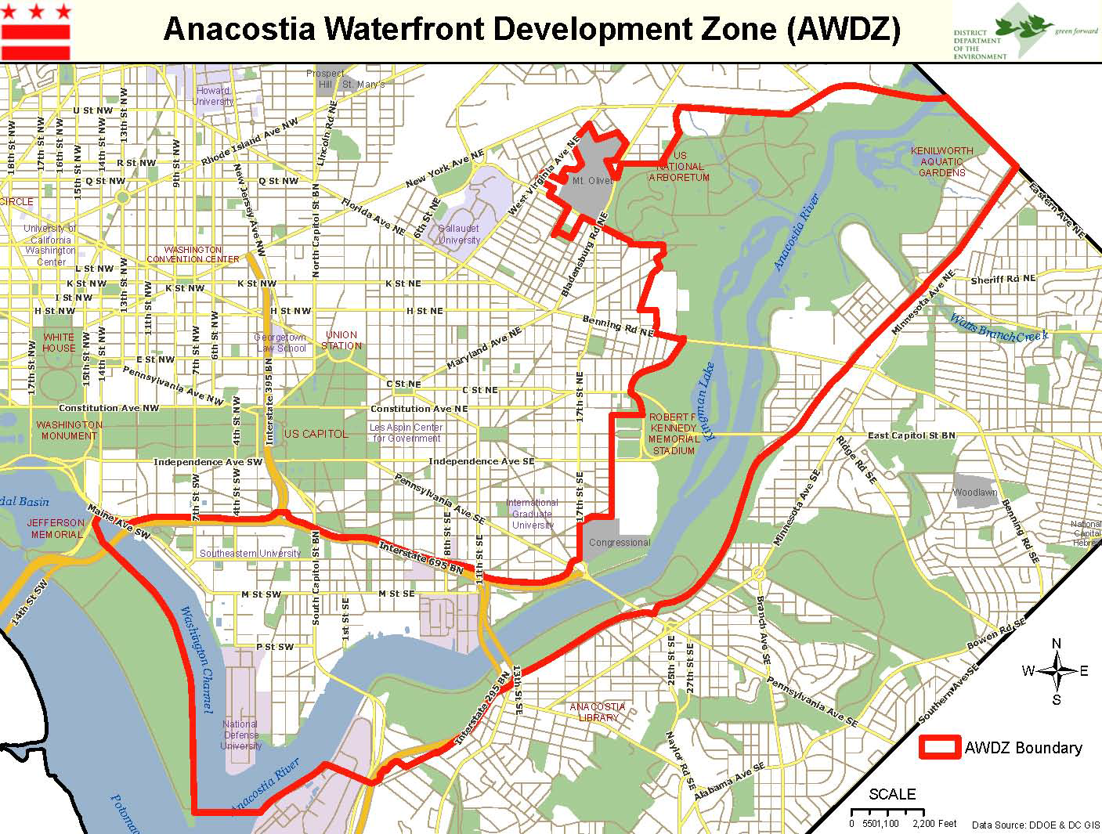
When Stormwater Rules are in Effect
@DOEE_DC
Notes:
Project in zone and city-funded
AWDZ projects have more stringent requirements: MSI P = 1.0 inch, MLD = 1.2
WQTv = volume from P = 1.7 after subtracting out SWRv

Slide 9
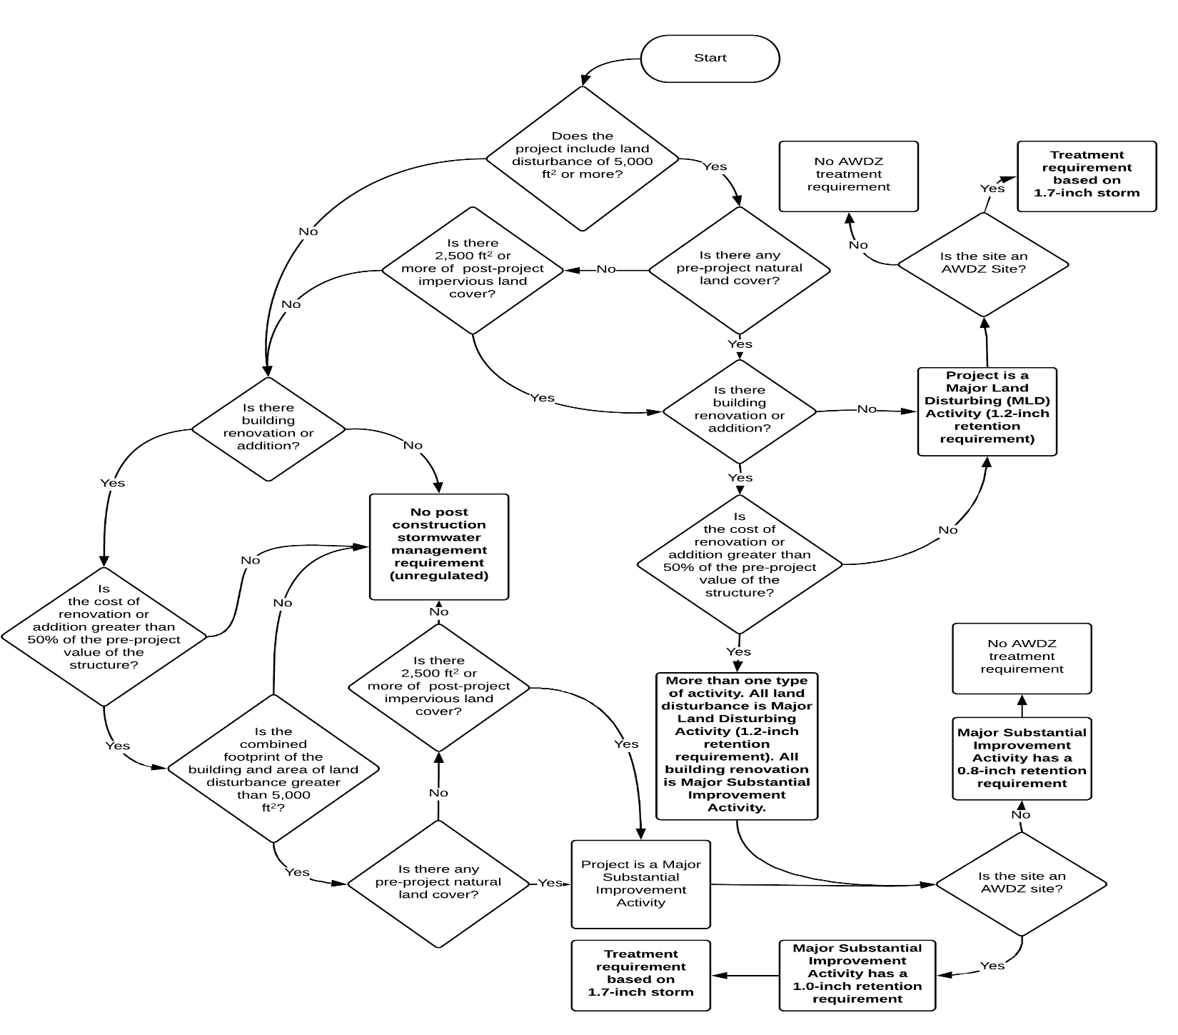
Determining the Regulatory Rain Event
@DOEE_DC
Notes:
Handout needed
Just mention briefly

Slide 10
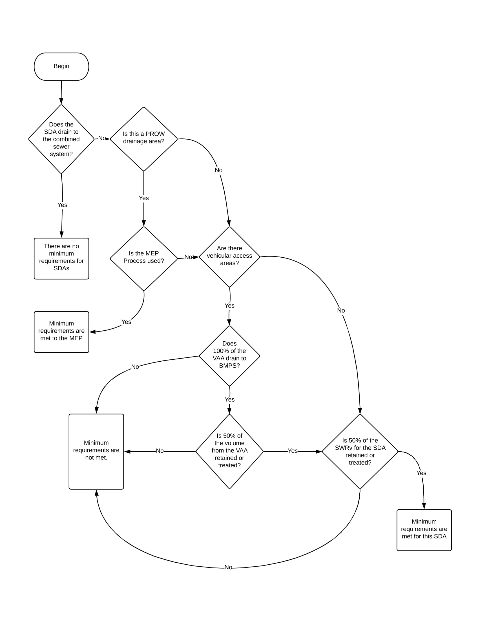
Determining if the Minimum SDA Requirements Are Met
@DOEE_DC
Notes:
SDA to be discussed in greater detail later.
Basically an SDA defined by where the runoff leaves the site (even if 2 pipes meet up in the street)
There are overall site requirements and Minimum SDA Requirements
Overcontrol to provide flexibility, but MS4 requires 50% because we want to improve water quality by treating before it gets to waterways

Slide 11
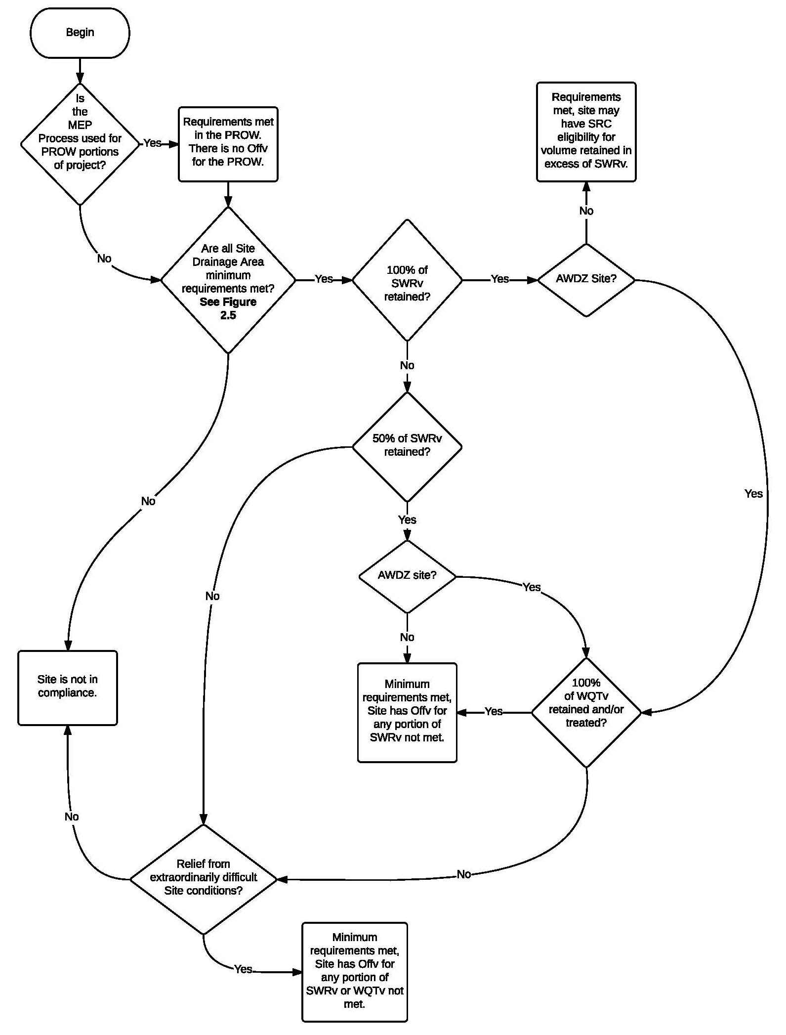
Determining if Minimum Retention and Water Quality Treatment Requirements Are Met
@DOEE_DC
Notes:
Minimum retention and water quality treatment requirements
Look into PROW requirements

Slide 12
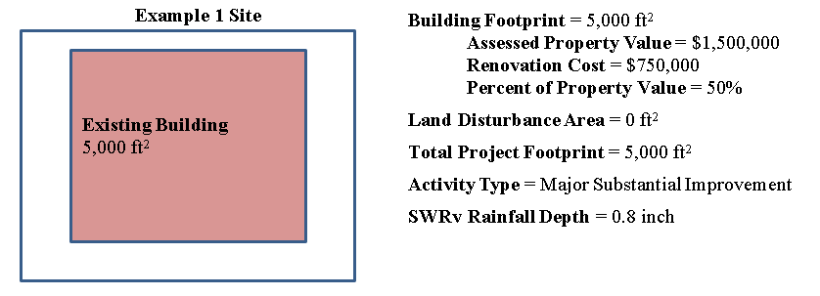
Examples of Major Substantial Improvement
@DOEE_DC
Notes:
Not property, structure value
Could alternate and have participants solve some

Slide 13
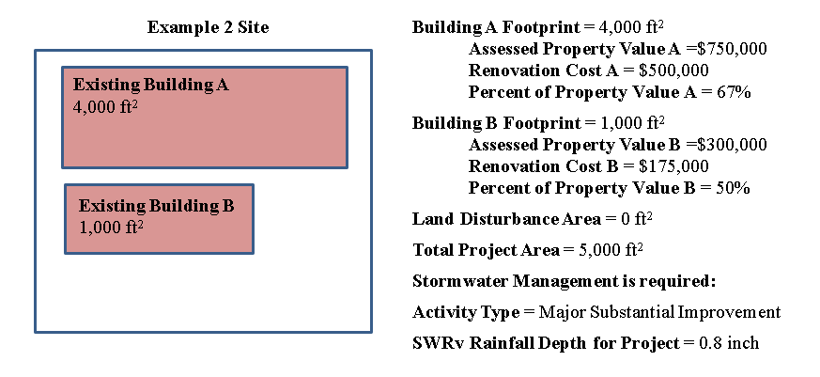
Examples of Major Substantial Improvement
@DOEE_DC

Slide 14
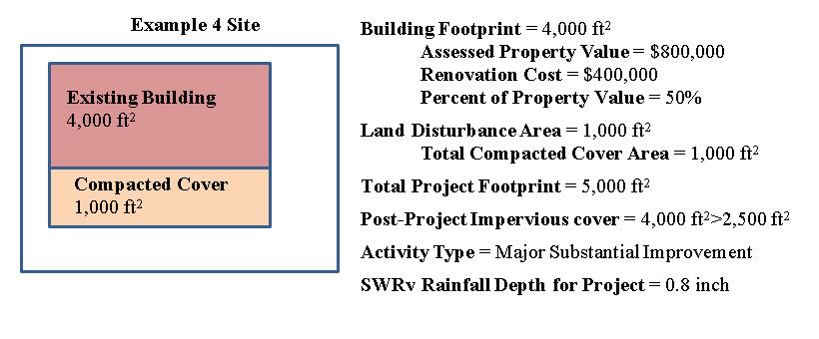
Examples of Major Substantial Improvement
@DOEE_DC

Slide 15
Examples of Major Substantial Improvement
@DOEE_DC

Slide 16
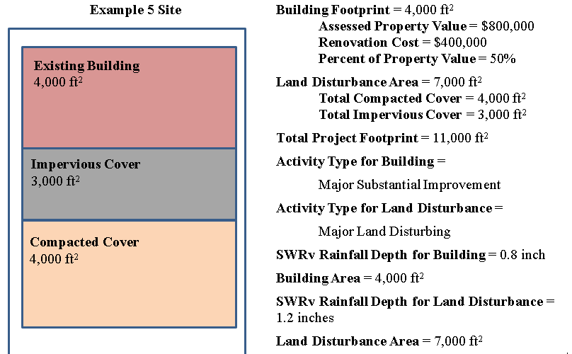
Examples of Major Substantial Improvement and Major Land Disturbance
@DOEE_DC
Notes:
Look at land disturbance first, then look at building.

Slide 17
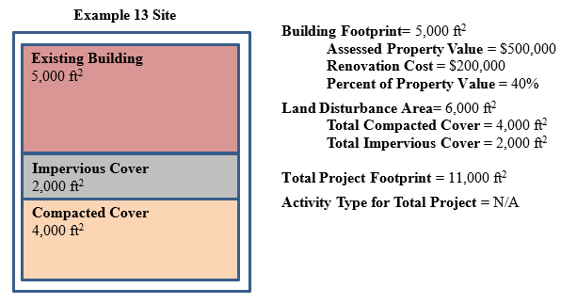
Examples of No Stormwater Regulated Activity
@DOEE_DC
Notes:
Look at land disturbance first, then building
Cost threshold not met for building
Post project impervious cover less than 2,500
More examples in Guidebook Appendix V

Slide 18
Quantity Control (Detention) Requirements
2-year storm: control peak discharge to pre-development conditions. (3.14 inches)
15-year storm: control peak discharge to pre-project conditions. (5.23 inches)
100-year storm: control peak discharge to pre-project conditions. (8.34 inches)
Applies only if the development increases the Special Flood Hazard Area (SFHA) or may cause flooding to a building.
@DOEE_DC
Notes:
Discuss difference in pre-project and pre-development

Slide 19
Exemptions and Practicability
Exempt from Retention
Athletic Playing Fields, Permeable Athletic Tracks, and Permeable Playground Surfaces
Exempt from Detention
Major Substantial Improvement
PROW
Exempt from Retention & Detention
Disturbance for BMP Installation
Utility Work
Practicable Process
Affordable Housing
Trails
Small Structures at Parks
@DOEE_DC
Notes:
Milling and overlay not disturbance, full depth is
Utility trench outside normal LOD not disturbance
Road projects, trenches more than half the width of the road are disturbance
Underpinning (foundation improvements on additional floors to rowhouse) and overhangs is disturbance if its open
Practicable process is similar to MEP

