Slide 1
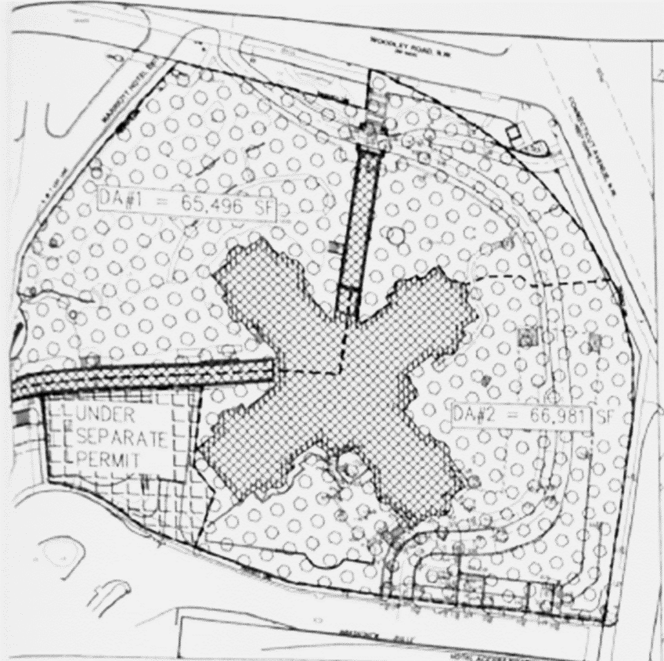



Site Drainage Areas (SDAs) vs.
Contributing Drainage Areas (CDAs)
TAG THIS PRESENTATION @DOEE_DC
Notes:
Site Drainage Area (SDA) – The area that drains stormwater from the site to a single discharge point or sheet flows from a single area off the site.
Contributing drainage area (CDA) – Area contributing runoff to a BMP.

Slide 2
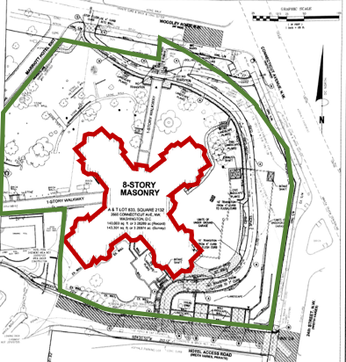
Building is undergoing a complete renovation.
Surrounding land is being regraded with new sidewalks and construction of an underground parking facility.
Building = Major Substantial Improvement (0.8”)
Land Area = Major Land Disturbing (1.2”)

Slide 3
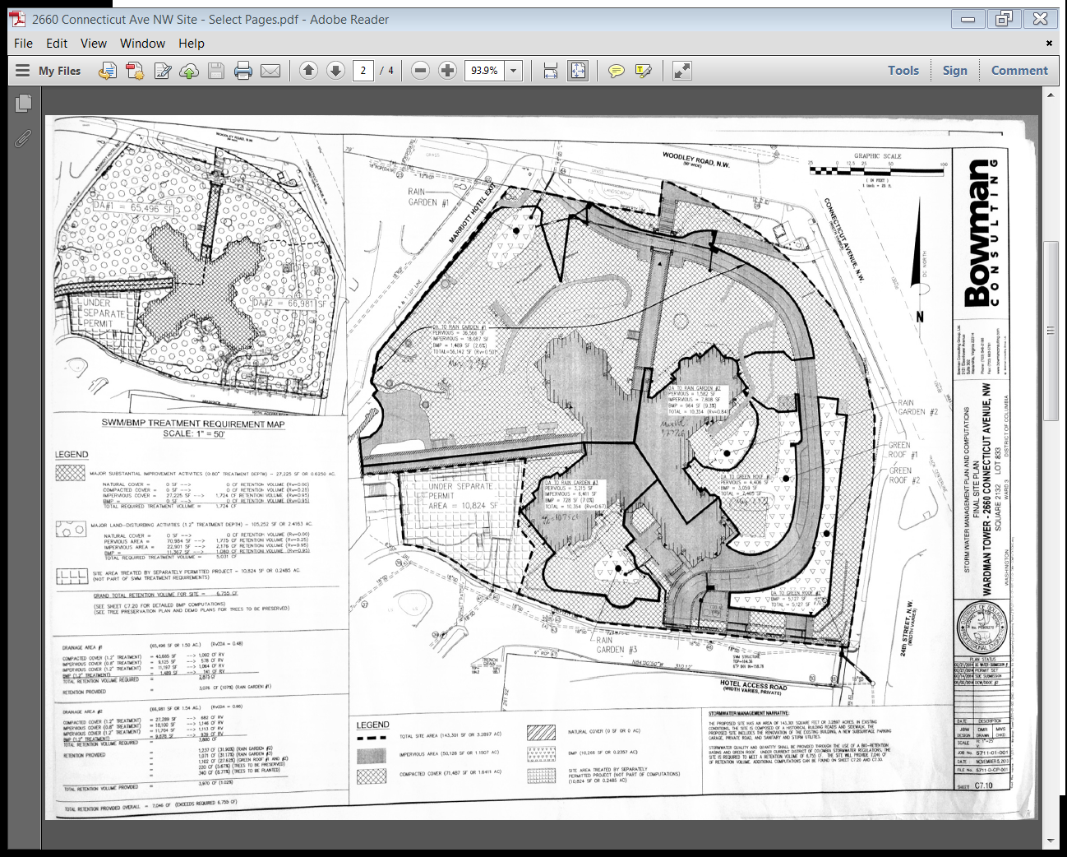
Site Drainage Areas
SDA#1 = 65,496 ft²
SDA#2 = 66,971 ft²

Slide 4

Site Drainage Area #1
Major Land Disturbing (1.2-inch) | Land Area (ft²⁾ | Rv | SWRv (ft³)
Impervious Cover (sidewalks, etc.) | 11,197 | 0.95 | 1,064
Compacted Cover (grass, landscaping) | 43,685 | 0.25 | 1,092
BMP (bioretention) | 1,489 | 0.95 | 141
MLD Total |  |  | 2,297
SDA#1 = 65,496 ft²
Major Substantial Improvement (0.8-inch) | Land Area (ft²⁾ | Rv | SWRv (ft³)
Impervious Cover (building) | 9,125 | 0.95 | 578
MSI Total |  |  | 578
Total | 65,496 |  | 2,875
@DOEE_DC

Slide 5
Site Drainage Area #2
Major Land Disturbing (1.2-inch) | Land Area (ft²⁾ | Rv | SWRv (ft³)
Impervious Cover (sidewalks, etc.) | 11,704 | 0.95 | 1,112
Compacted Cover (grass, landscaping) | 27,289 | 0.25 | 682
BMP (bioretention, green roof) | 9,878 | 0.95 | 938
MLD Total |  |  | 2,732
SDA#2 = 66,971 ft²
Major Substantial Improvement (0.8-inch) | Land Area (ft²⁾ | Rv | SWRv (ft³)
Impervious Cover (building) | 18,100 | 0.95 | 1,146
MSI Total |  |  | 1,146
Total | 66,971 |  | 3,878
@DOEE_DC

Slide 6
Total SWRv for Site
Site Drainage Area #1 | 2,875 ft³
Site Drainage Area #2 | 3,878 ft³
Total = 6,753
@DC
@DOEE_DC
Notes:
Similar model to DC Snow Teams

Slide 7
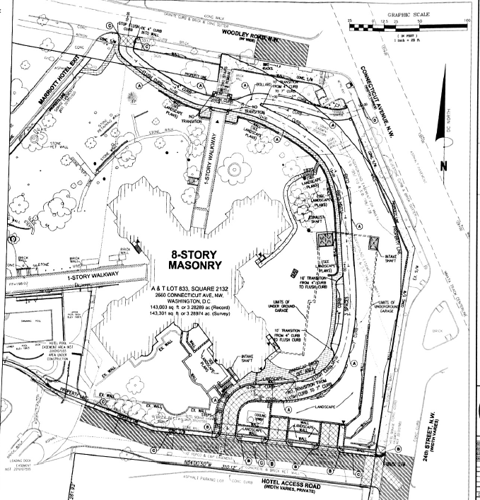
BMP Locations
Bioretention
Green Roof
@DC
@DOEE_DC
Notes:
Similar model to DC Snow Teams

Slide 8
A
C
Site Drainage Areas
D
B
E
Contributing Drainage Areas
@DC
@DOEE_DC
Notes:
SDAs based on proposed land cover. Must consider BMPs. If sheet flow is going to generally the same place as a sewer lateral as in the red/yellow area here, it can be considered the same SDA. The intent is to treat the site not just a tiny area.

Slide 9
Land Cover Type | CDA Area (ft²) | Rv | Max. Retention Vol. (ft³) (1.7-in)
Impervious Cover | 18,067 | 0.95 | 2,432
Compacted Cover | 36,566 | 0.25 | 1,295
BMP | 1,489 | 0.95 | 200
Total | 56,122 |  | 3,927
SDA#1 = 65,496 SF
A
SDA #1 SWRv (1.2-inch) = | 2,875 ft³
Retention Volume Bioretention | 2,576 ft³
Actual Retention Value | 2,576 ft³
@DC
@DOEE_DC
Notes:
Similar model to DC Snow Teams

Slide 10
Example #2
C
D
SDA#2 = 66,981 SF
B
E
BMP | Max. Retention Vol. (ft³) (1.7-inch) | BMP Retention Volume (ft³)
B | 997 | 1,047
C | 1,314 | 1,402
D | 923 | 859
E | 1,241 | 1,157
Total | 4,475 | 4,465
SDA #2 SWRv (1.2-inch) = | 3,878 ft³
Retention Value | 4,327 ft³
@DC
@DOEE_DC
Notes:
How do we deal with the bioretention area? Impervious because SWRv is a calculation of how much water will get to the bmp. (nearly) All the water that lands on a bmp gets to it.

Slide 11
Total SWRv for Site
Site Drainage Area #1 | 2,875 ft³
Site Drainage Area #2 | 3,878 ft³
Total = 6,753
Actual Retention Volume BMP A | 2,576 ft³
Actual Retention Volume BMPs B - E | 4,327 ft³
Total = 6,903
Met their stormwater obligation!
@DC
@DOEE_DC
Notes:
Met 50% min for SDA 1
Overcontrol on SDA results in greater than 100% total for the site. (assuming VAA met)

