Slide 1
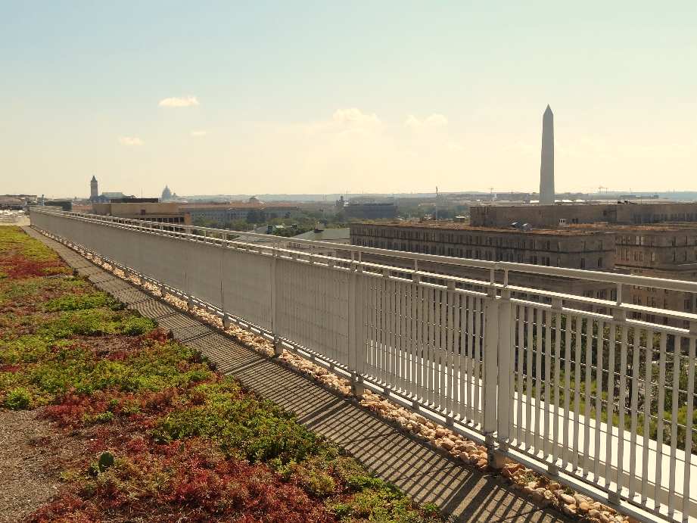



Stormwater BMP Specifications
Chapter 3
TAG THIS PRESENTATION @DOEE_DC
Notes:
Chapter 3 of the stormwater management guidebook covers the stormwater bmp specifications

Slide 2

Best Management Practices (BMPs)
3.2 Green Roofs | 3.9 Open Channel Systems
3.3 Rainwater Harvesting | 3.10 Ponds
3.4 Impervious Surface Disconnection | 3.11 Stormwater Wetlands
3.5 Permeable Pavement Systems | 3.12 Storage Practices
3.6 Bioretention | 3.13 Proprietary Practices
3.7 Filtering Systems | 3.14 Tree Planting and Preservation
3.8 Infiltration
@DOEE_DC
Notes:
In this video we’ll discuss green roofs

Slide 3
Specification Format
Feasibility Criteria
Conveyance Criteria
Pretreatment Criteria
Design Criteria
Landscaping Criteria
Construction Sequence
Maintenance Criteria
Retention Value Calculations
References
@DC
@DOEE_DC
Notes:
the guidebook is arranged such that the specifications for each bmp type are laid out in the same format and includes the following subsections

Slide 4
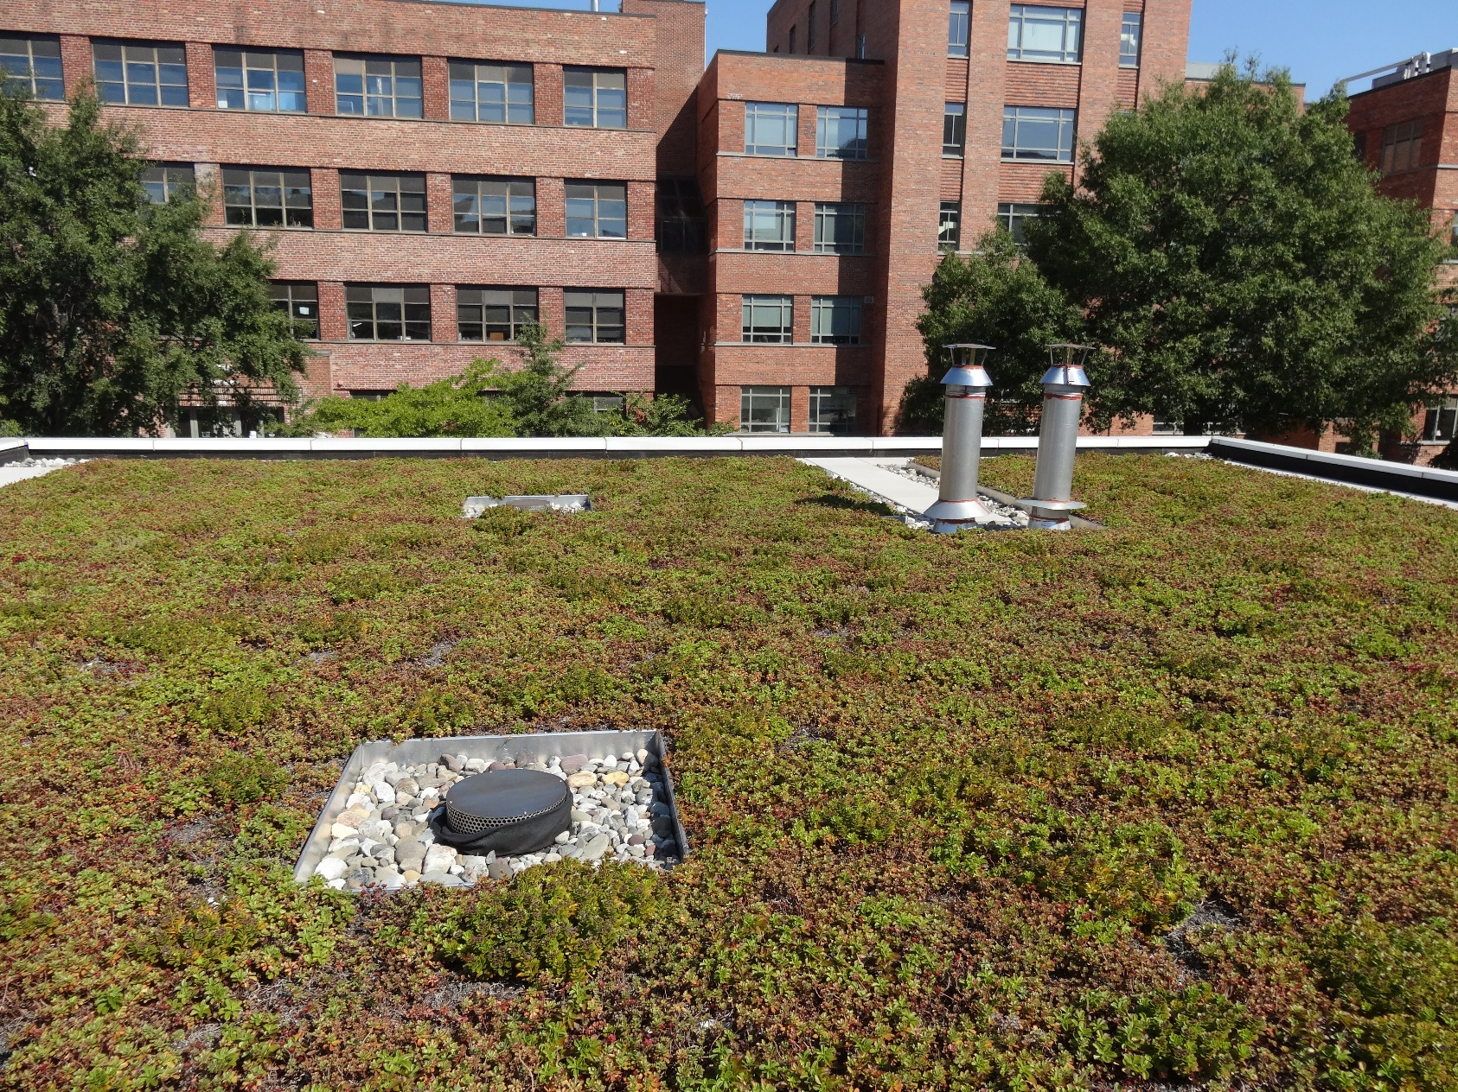
3.2 Green Roofs
Notes:
US Tax Court

Slide 5
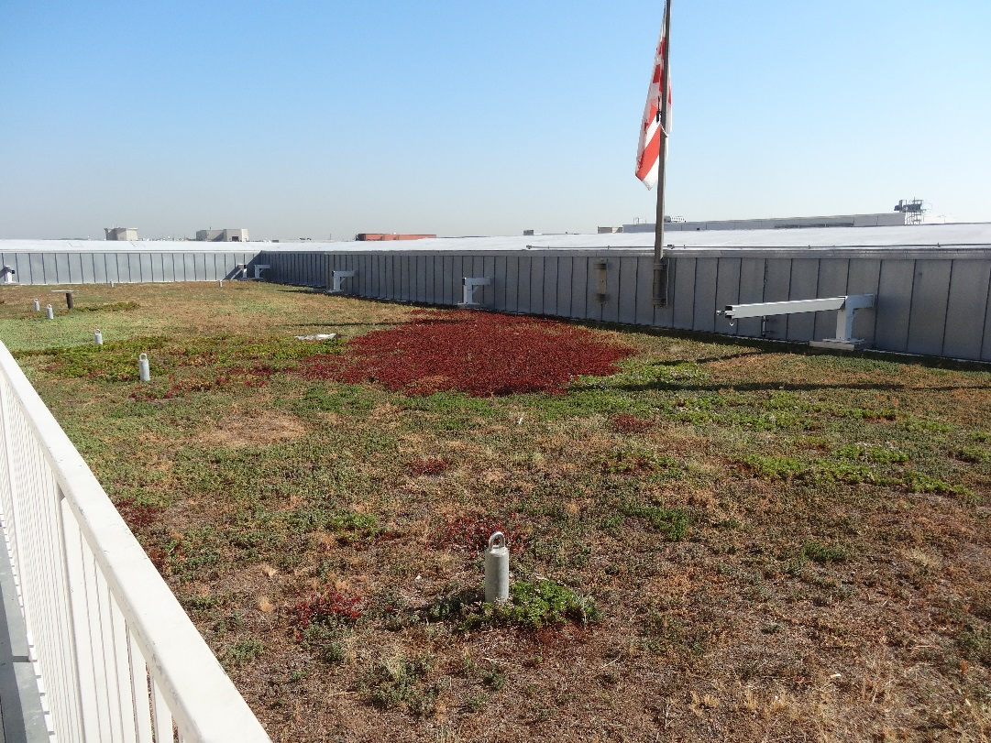
Green Roof Specification
Preferred practice in high intensity redevelopment areas
Allow for many different vendors and systems
Follow ASTM specifications
@DC
@DOEE_DC

Slide 6
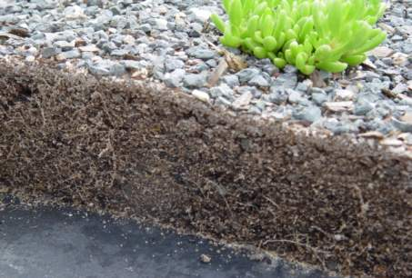
Green Roofs
Extensive or Intensive
Structural design considerations
High installation cost
Increased roof longevity
Additional urban environmental benefits
Major element of compliance at urban development sites
@DC
@DOEE_DC

Slide 7
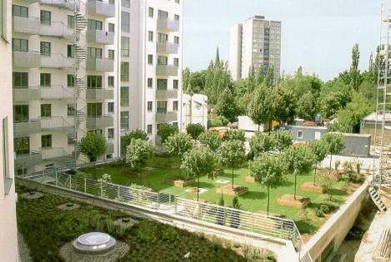
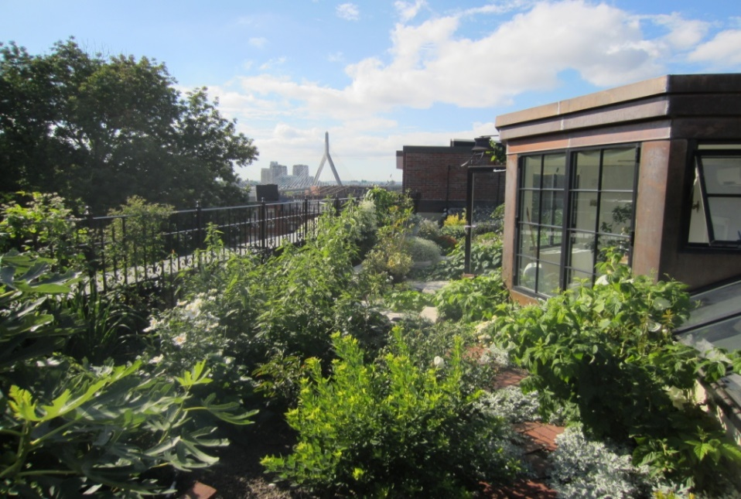
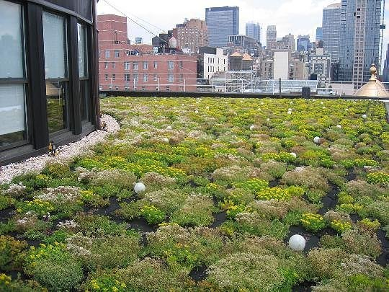
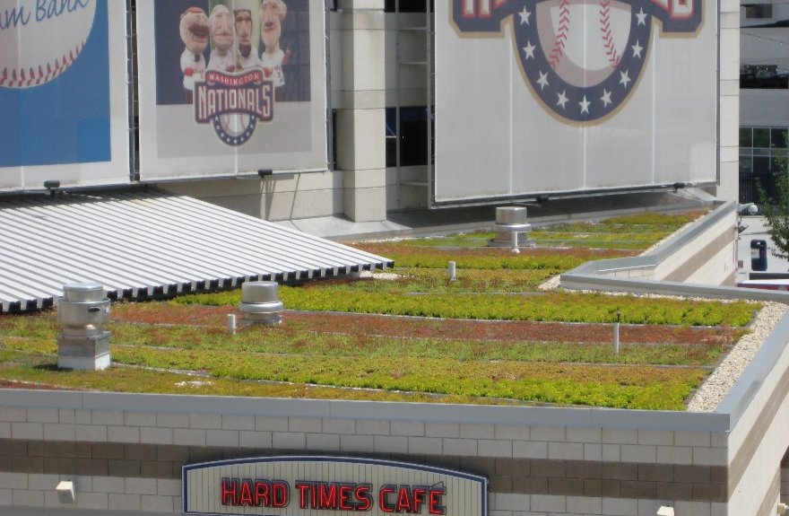
Intensive
Extensive
@DC
@DOEE_DC

Slide 8
Green Roof Feasibility Criteria
Structural capacity of roof
Roof pitch
Setbacks from HVAC, building edge
Compliance with building codes, fire code
Maximum contributing drainage area to the green roof is no more than 100% of the green roof area
Flow dissipation required to spread flow and prevent erosion
@DC
@DOEE_DC
Notes:
HVAC over green roof does not get credit unless it meets certain criteria
Very important to show reviewer how the CDA gets to the green roof.

Slide 9
Conveyance and Pretreatment
Drainage layer and roof drains must safely convey overflows
No requirements for pretreatment
@DC
@DOEE_DC

Slide 10
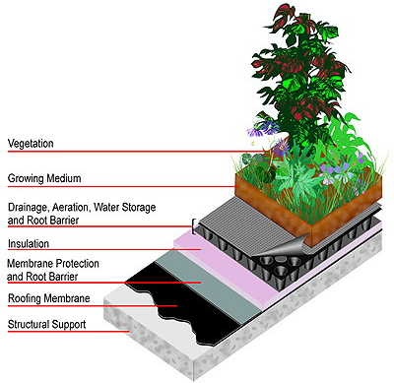
Green Roof Design Criteria
Material specifications for each layer
The drainage layer can be combined with the growing media layer
@DC
@DOEE_DC

Slide 11
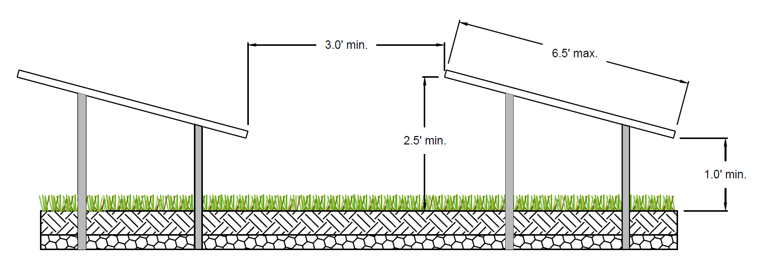
Green Roof Design Criteria
Solar panels, HVAC equipment, or other structures can be installed above a green roof as long as these minimum dimensions are met
@DC
@DOEE_DC
Notes:
Purpose of this is twofold:
1. space to walk in between for maintenance
2. Sun and rain contact with green roof
Flexible for different size solar panels but space between must be adjusted.
HVAC not sloped so it must be 2.5 above

Slide 12
Green Roof Design Criteria
Sizing Equation
Sv = storage volume (ft³)
SA = green roof area (ft²)
d = media depth (in) (minimum 3 in.)
η₁ = verified media maximum water retention (use 0.10 as a baseline default in the absence of verification data)
DL = drainage layer depth (in.) (if the drainage layer is combined with the media layer, then this value is 0)
η₂ = verified drainage layer maximum water retention (use 0.00 as a baseline default in the absence of verification data)
@DC
@DOEE_DC
Notes:
ASTM standard test for max water retention.

Slide 13
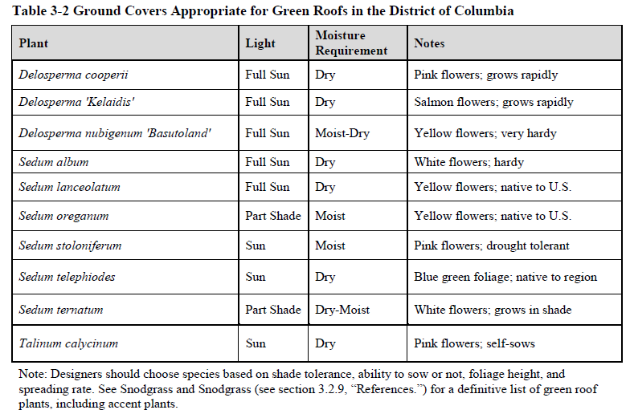
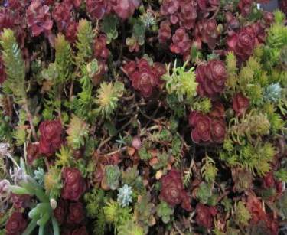
Green Roof Landscaping Criteria
Plants need to resist and withstand:
Drought
Fire
Wind
Snow-loading
Heat-stress
@DC
@DOEE_DC

Slide 14
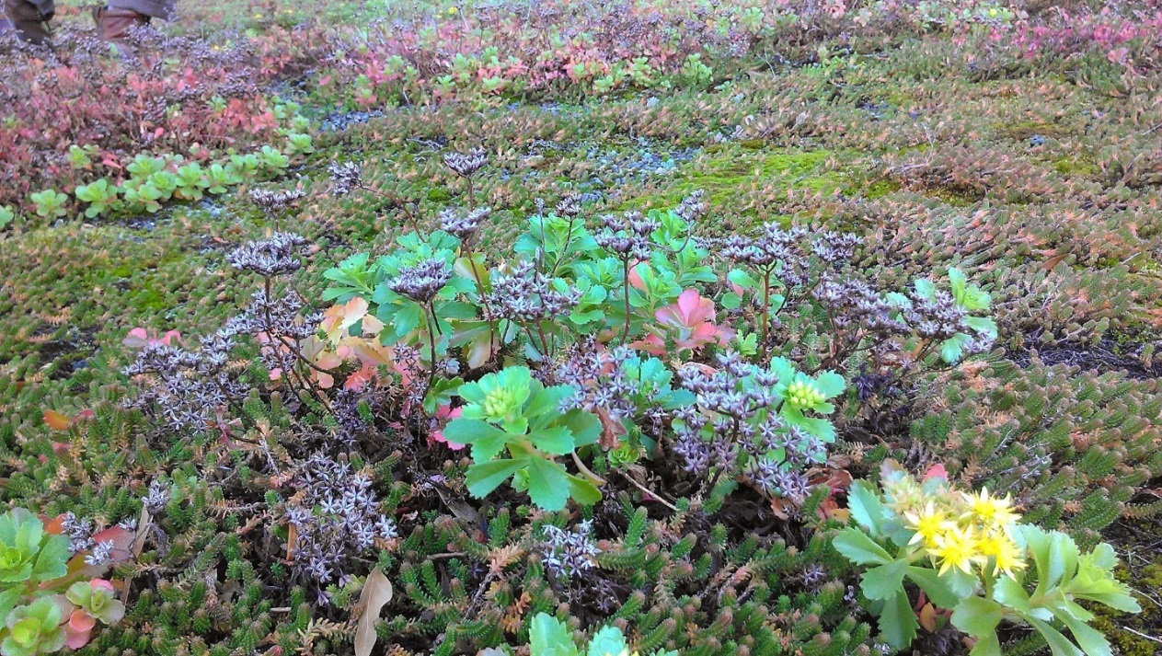
Green Roof Landscaping Criteria
Temporary irrigation is recommended for establishment or drought
Permanent irrigation is prohibited for extensive green roofs
Intensive green roofs with irrigation have a reduced retention value
@DC
@DOEE_DC
Notes:
Stormwater needs a roof not filled with irrigation water
Key is permanent irrigation

Slide 15
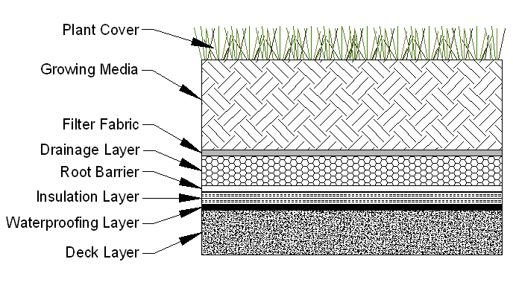
Green Roof Retention Value Calculations
Unirrigated Retention Value = Sv = 100% of Storage Volume in Media and Drainage Layer
Irrigated Retention Value = 50% of Storage Volume in Media and Drainage Layer
@DC
@DOEE_DC
Notes:
Admittedly not scientific enough 50% retention value for intensive GR w/ permanent irrigation

