Slide 1
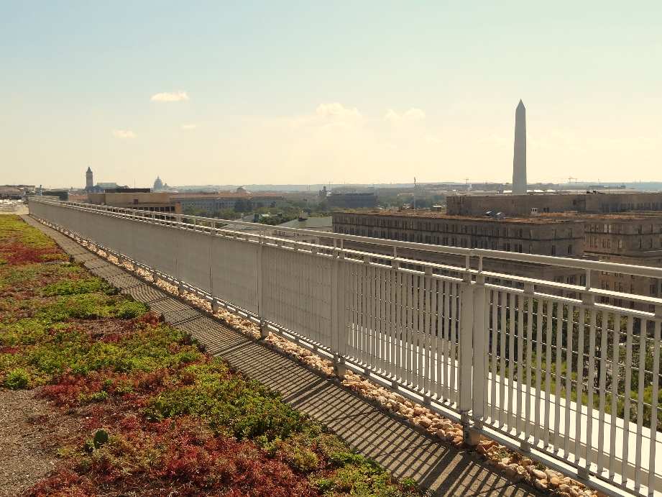



Stormwater BMP Specifications
Chapter 3
TAG THIS PRESENTATION @DOEE_DC
Notes:
Chapter 3 of the stormwater management guidebook covers the stormwater bmp specifications

Slide 2

Best Management Practices (BMPs)
3.2 Green Roofs | 3.9 Open Channel Systems
3.3 Rainwater Harvesting | 3.10 Ponds
3.4 Impervious Surface Disconnection | 3.11 Stormwater Wetlands
3.5 Permeable Pavement Systems | 3.12 Storage Practices
3.6 Bioretention | 3.13 Proprietary Practices
3.7 Filtering Systems | 3.14 Tree Planting and Preservation
3.8 Infiltration
@DOEE_DC

Slide 3
Specification Format
Feasibility Criteria
Conveyance Criteria
Pretreatment Criteria
Design Criteria
Landscaping Criteria
Construction Sequence
Maintenance Criteria
Retention Value Calculations
References
@DC
@DOEE_DC
Notes:
the guidebook is arranged such that the specifications for each bmp type are laid out in the same format and includes the following subsections

Slide 4
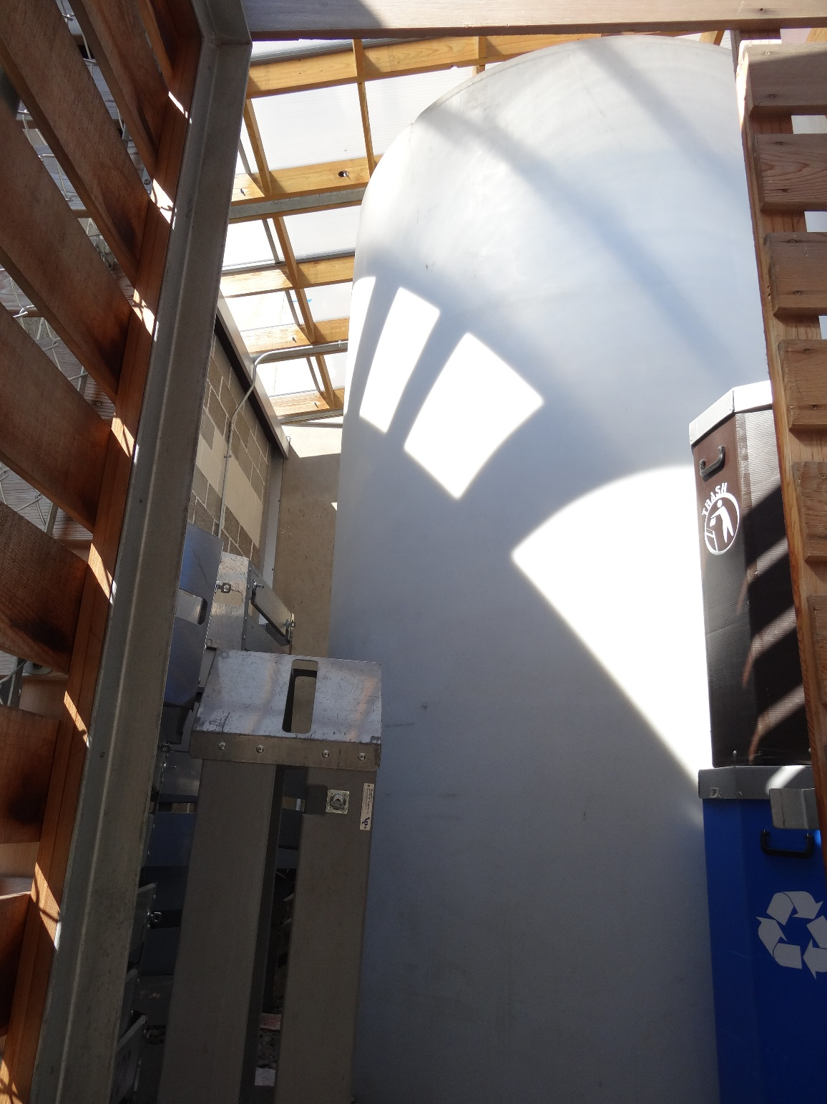
3.3 Rainwater Harvesting

Slide 5
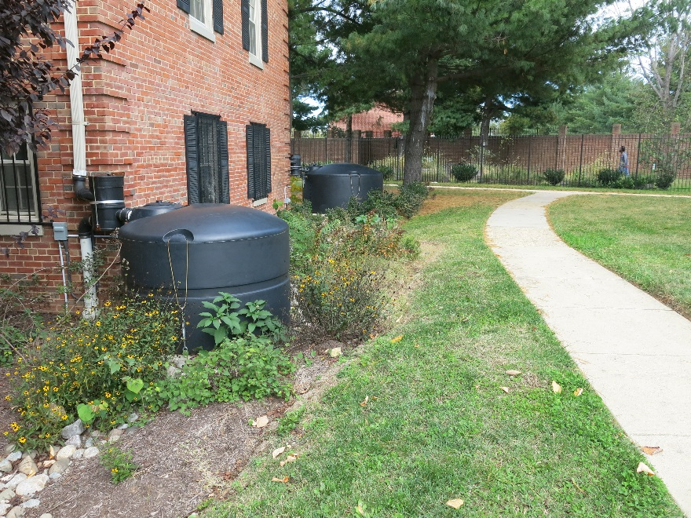
Rainwater Harvesting Feasibility Criteria
Effectiveness for retention requirements
  Tank size
  Dedicated demand
Minimal space or setback requirements
Risk-based framework for protecting public health
  Appendix N Rainwater Harvesting Treatment and Management Requirements
@DC
@DOEE_DC
Notes:
Demand important because the tank must have available storage
Appendix N
Treatment required based on source and use

Slide 6
Conveyance and Pretreatment
Inflow pipe higher than outlet pipe
Overflow mechanism
Pretreatment filters
Distribution system required
@DC
@DOEE_DC

Slide 7
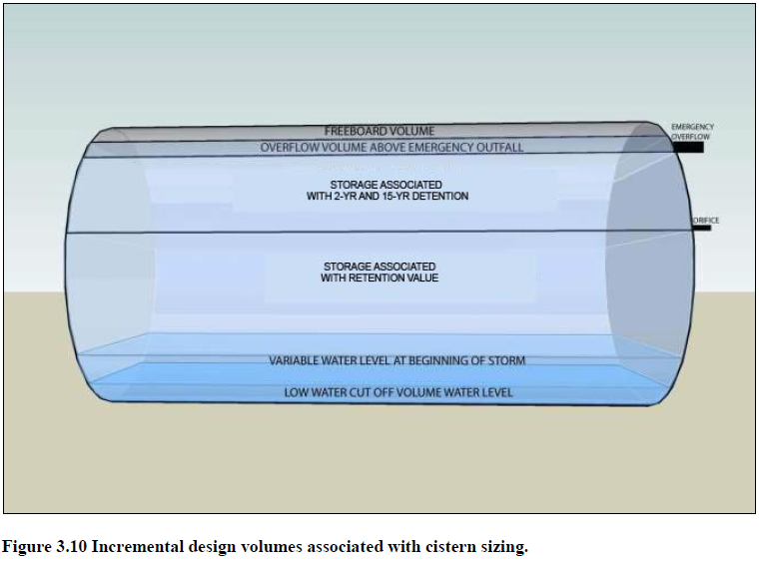
Design Criteria
Low water, detention, overflow, and freeboard volumes
@DC
@DOEE_DC

Slide 8
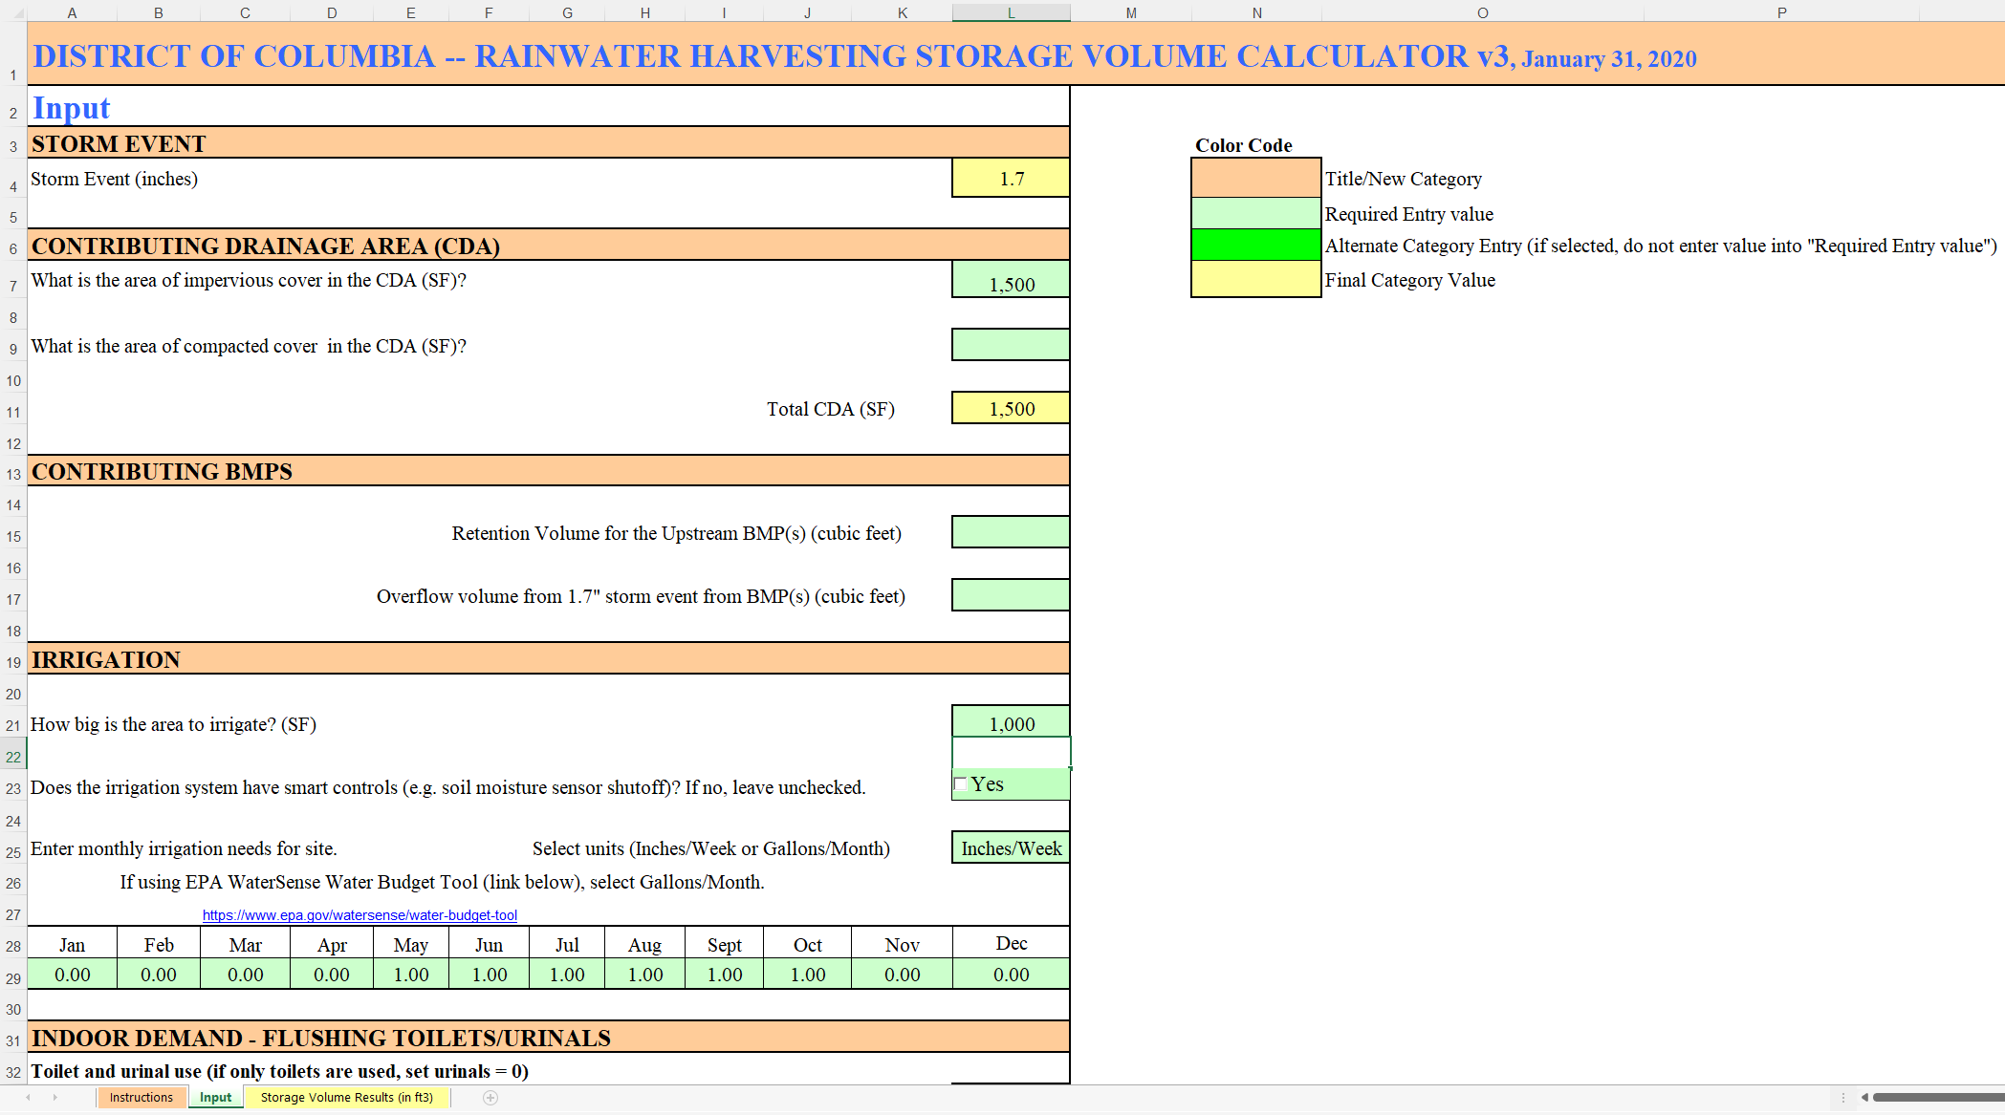
Design Criteria – System Sizing
Find at https://doee.dc.gov/swguidebook
@DC
@DOEE_DC
Notes:
Use historic rainfall data
Use average daily volume even though it’s likely to be empty in summer and full in winter

Slide 9
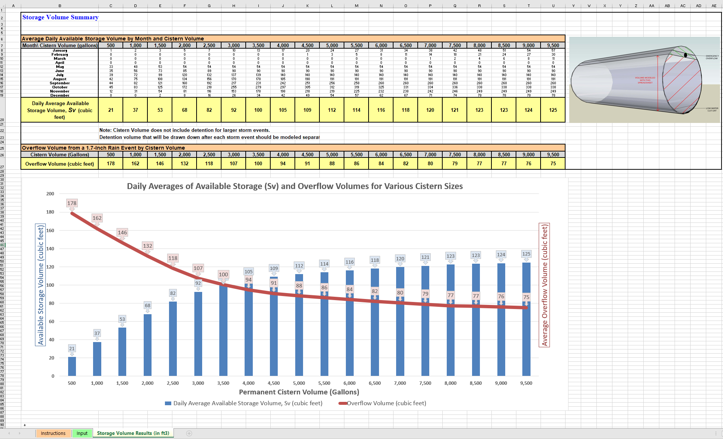
Design Criteria – System Sizing
@DC
@DOEE_DC
Notes:
Use historic rainfall data
Use average daily volume even though it’s likely to be empty in summer and full in winter

Slide 10
Landscaping Criteria
Delineate area to be irrigated
Default demand of 1 inch/week between May and October
Certified Landscaped Expert must sign for additional demand
@DC
@DOEE_DC
Notes:
If the stored rainwater is to be used for irrigation, you must indicate the area that is to be irrigated. The default irrigation water demand is 1 inch per week between may and October. If you want to adjust that demand, a certified landscape expert must justify and sign for that additional demand.

