Slide 1
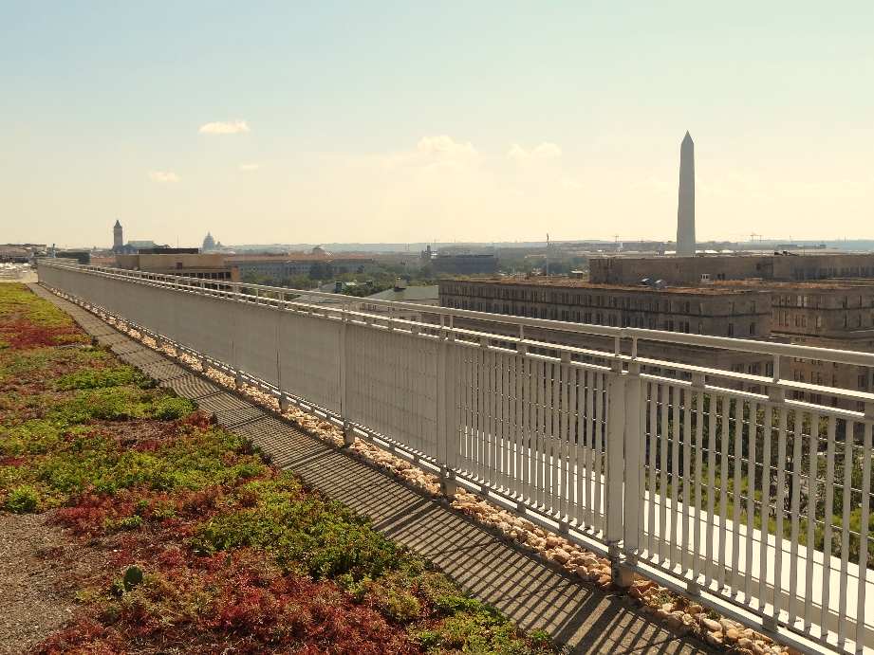



Stormwater BMP Specifications
Chapter 3
TAG THIS PRESENTATION @DOEE_DC
Notes:
Chapter 3 of the stormwater management guidebook covers the stormwater bmp specifications

Slide 2

Best Management Practices (BMPs)
3.2 Green Roofs | 3.9 Open Channel Systems
3.3 Rainwater Harvesting | 3.10 Ponds
3.4 Impervious Surface Disconnection | 3.11 Stormwater Wetlands
3.5 Permeable Pavement Systems | 3.12 Storage Practices
3.6 Bioretention | 3.13 Proprietary Practices
3.7 Filtering Systems | 3.14 Tree Planting and Preservation
3.8 Infiltration
@DOEE_DC

Slide 3
Specification Format
Feasibility Criteria
Conveyance Criteria
Pretreatment Criteria
Design Criteria
Landscaping Criteria
Construction Sequence
Maintenance Criteria
Retention Value Calculations
References
@DC
@DOEE_DC
Notes:
the guidebook is arranged such that the specifications for each bmp type are laid out in the same format and includes the following subsections

Slide 4
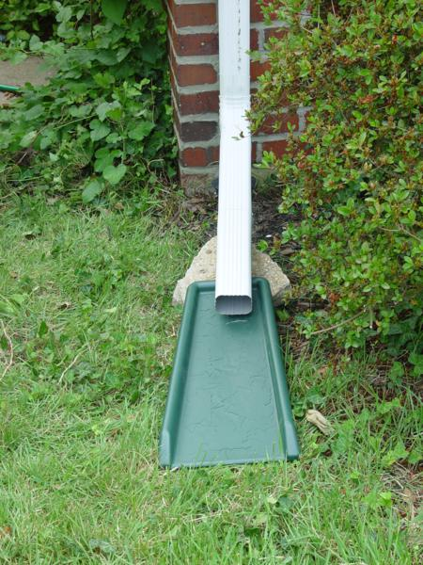
3.4 Impervious Surface Disconnection

Slide 5
Disconnection Specifications
Difficult in ultra-urban situations
Requires careful site planning
Uses green space efficiently
Turns runoff source into BMP
@DC
@DOEE_DC

Slide 6
Three Disconnection Options
D-1 Simple Disconnection to Pervious Area
D-2 Simple Disconnection to Conservation Area
D-3 Simple Disconnection to Compost Amended Filter Path
@DC
@DOEE_DC

Slide 7
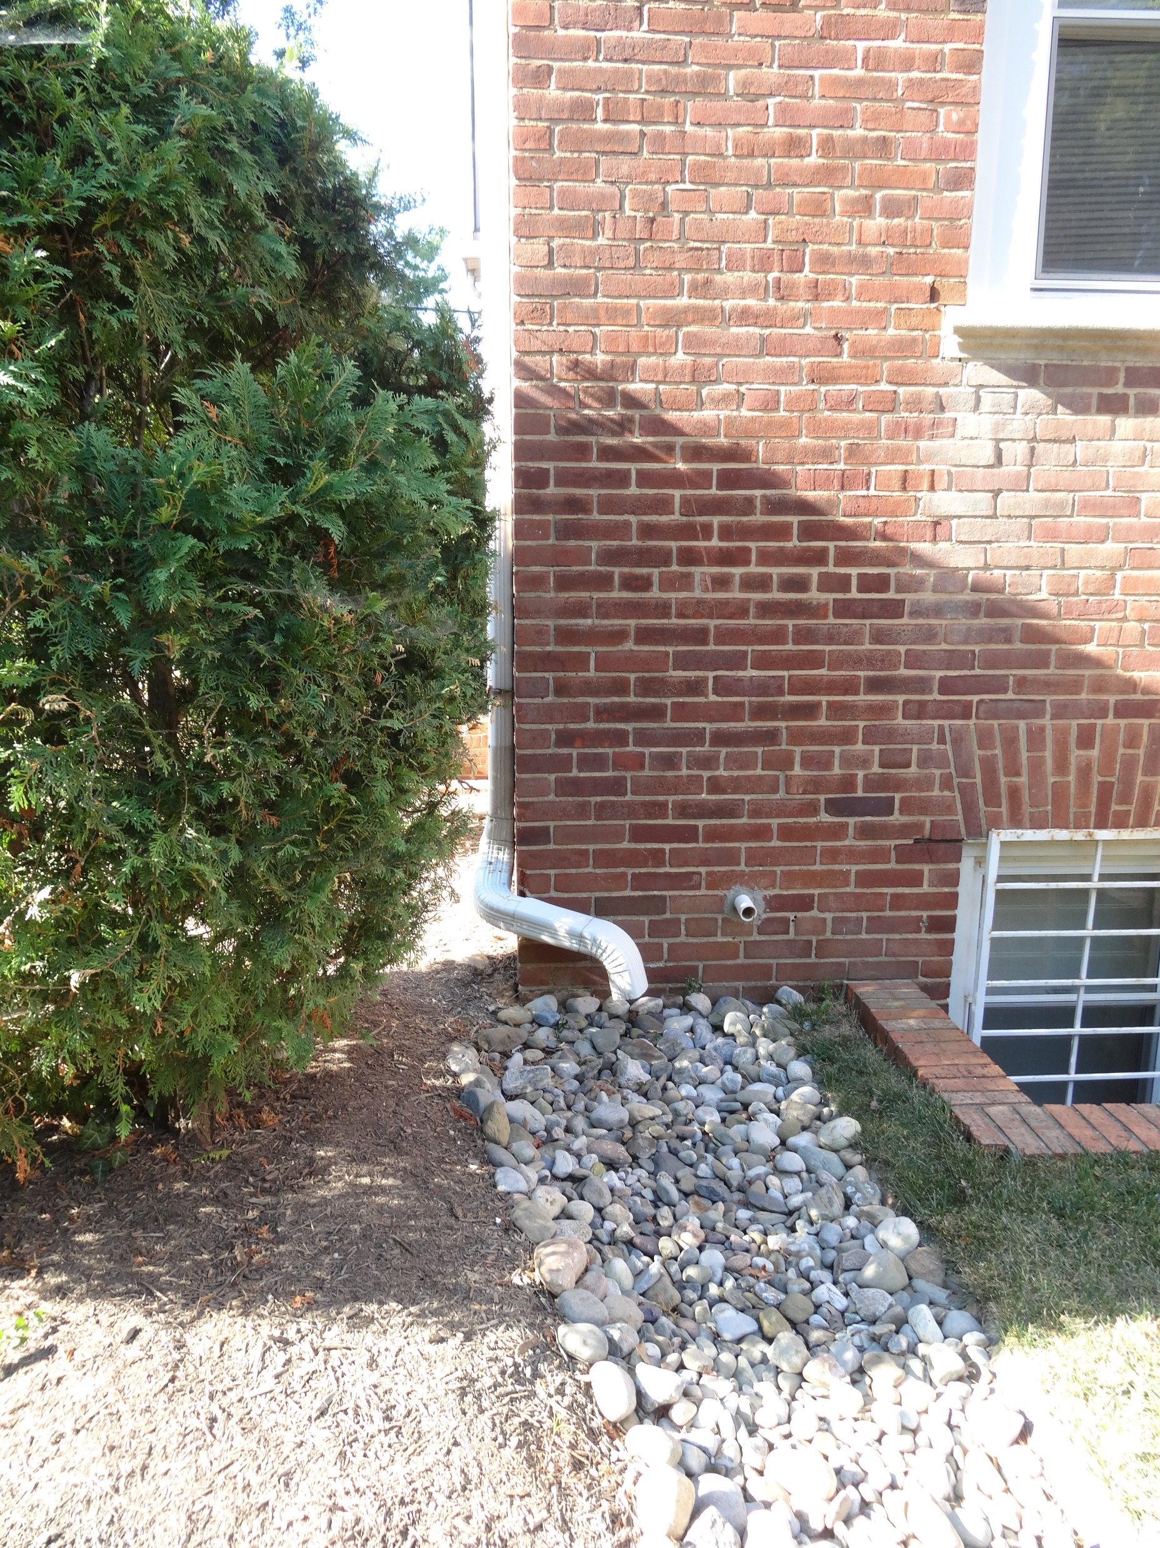
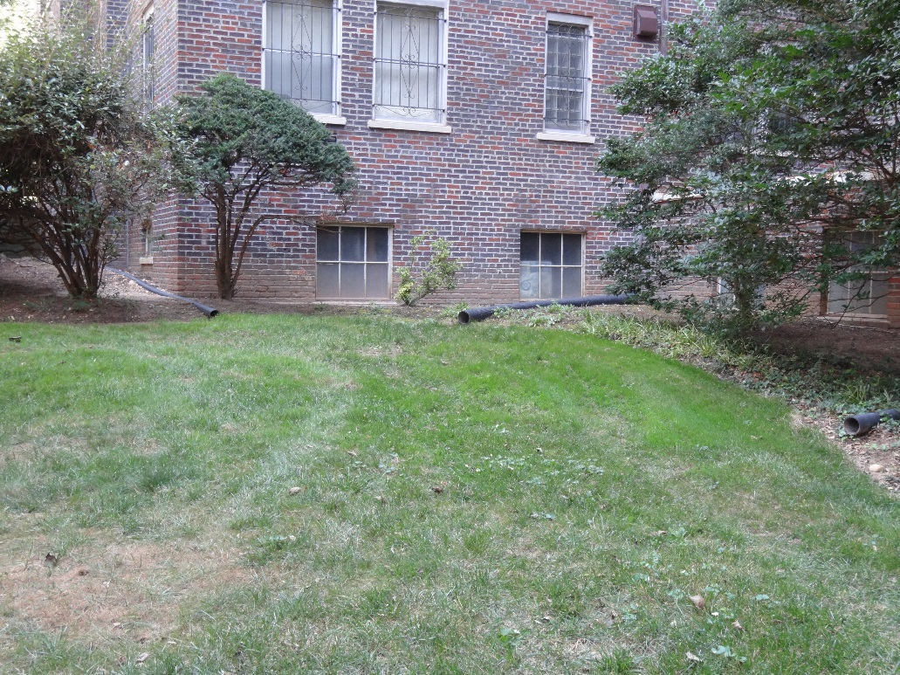
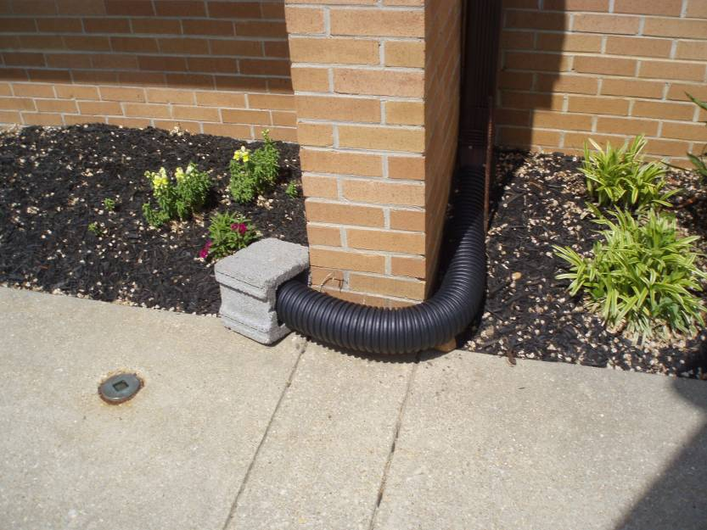
D-1 Disconnection to Pervious Area
@DC
@DOEE_DC
Notes:
Which one of these would not get credit? Bottom right – aimed at building, not enough area, sloped right to sidewalk

Slide 8
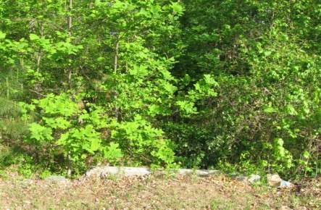
D-2 Disconnection to Conservation Area
Conservation area does not include regulated wetlands and buffer areas.
@DC
@DOEE_DC

Slide 9
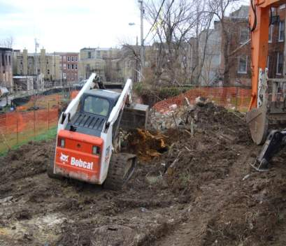
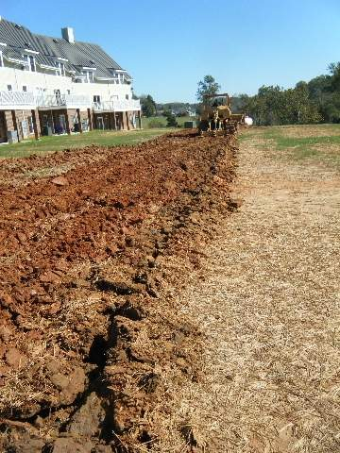
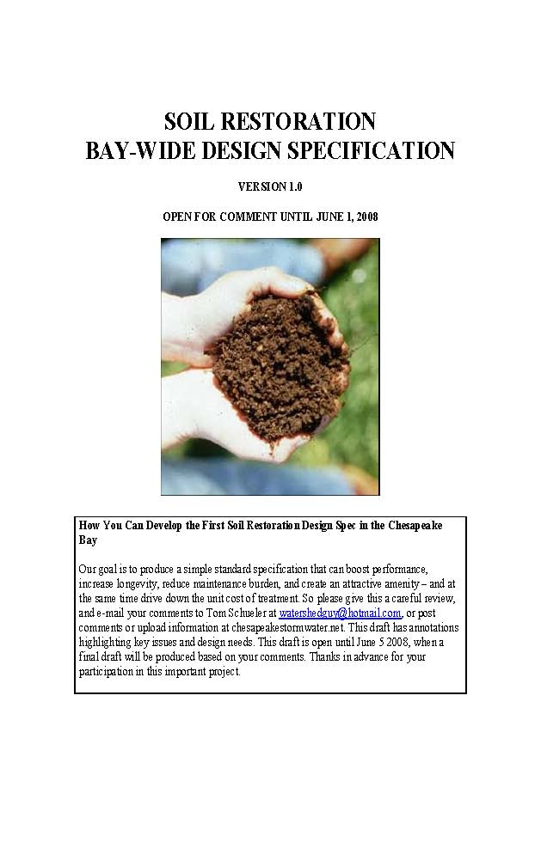
D-3 Disconnection to Compost Amended Filter Path
@DC
@DOEE_DC

Slide 10
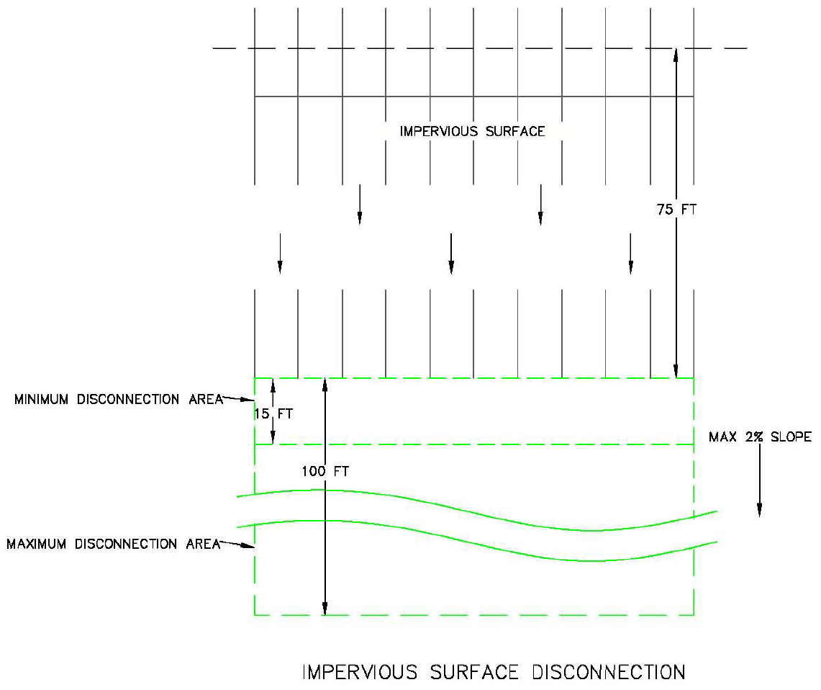
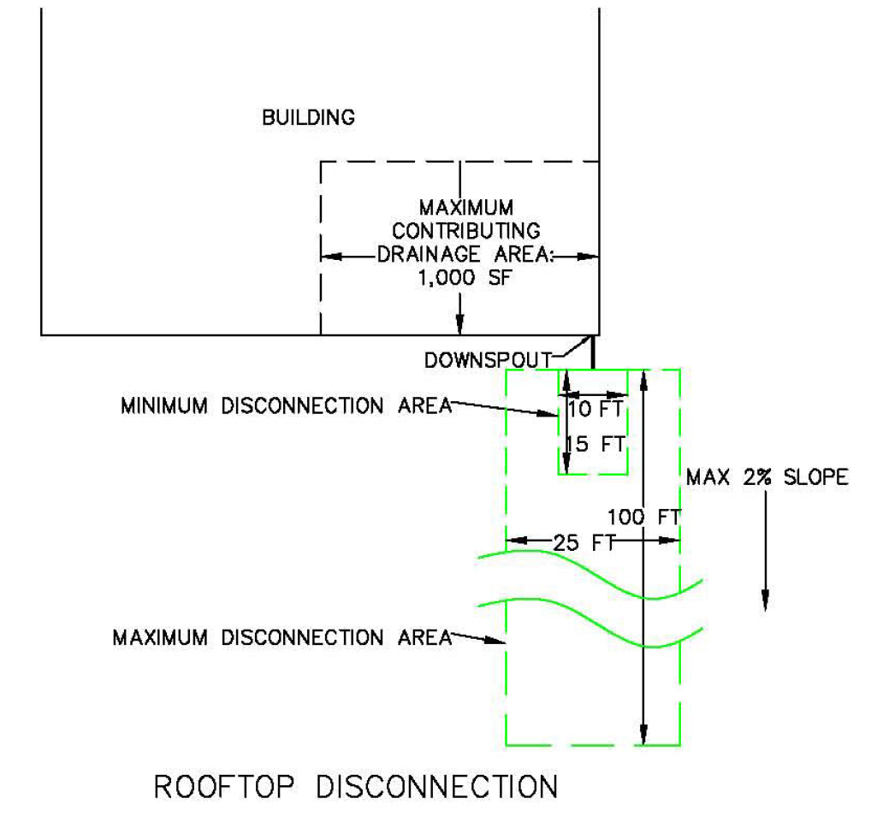
Design Criteria
For rooftops, CDA ≤ 1,000 ft² per disconnection
For non-rooftop, the longest contributing impervious area flow path ≤ 75 ft
Available receiving area:
  Minimum 10 ft wide and 15 ft long
  Maximum 25 ft wide and 100 ft long
    Wider with sheet flow or level spreader
@DC
@DOEE_DC

Slide 11
Retention Value Calculations
To a compacted cover area:
4.0 CF per 100 SF of receiving pervious area (A/B soils)
(42% volume reduction)
2.0 CF per 100 SF of receiving pervious area (C/D soils)
(21% volume reduction)
To a conservation area:
6.0 CF per 100 SF of receiving pervious conservation area
(63% volume reduction)
To a soil compost amended filter path:
4.0 CF per 100 SF of receiving pervious area
(42% volume reduction)
@DC
@DOEE_DC

