Slide 1
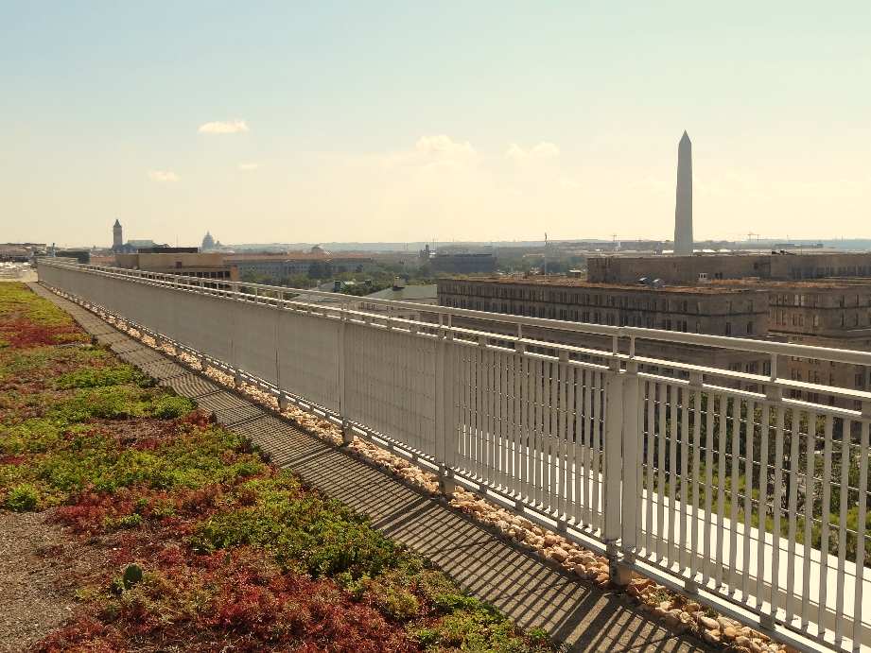



Stormwater BMP Specifications
Chapter 3
TAG THIS PRESENTATION @DOEE_DC
Notes:
Chapter 3 of the stormwater management guidebook covers the stormwater bmp specifications

Slide 2

Best Management Practices (BMPs)
3.2 Green Roofs | 3.9 Open Channel Systems
3.3 Rainwater Harvesting | 3.10 Ponds
3.4 Impervious Surface Disconnection | 3.11 Stormwater Wetlands
3.5 Permeable Pavement Systems | 3.12 Storage Practices
3.6 Bioretention | 3.13 Proprietary Practices
3.7 Filtering Systems | 3.14 Tree Planting and Preservation
3.8 Infiltration
@DOEE_DC

Slide 3
Specification Format
Feasibility Criteria
Conveyance Criteria
Pretreatment Criteria
Design Criteria
Landscaping Criteria
Construction Sequence
Maintenance Criteria
Retention Value Calculations
References
@DC
@DOEE_DC
Notes:
the guidebook is arranged such that the specifications for each bmp type are laid out in the same format and includes the following subsections

Slide 4
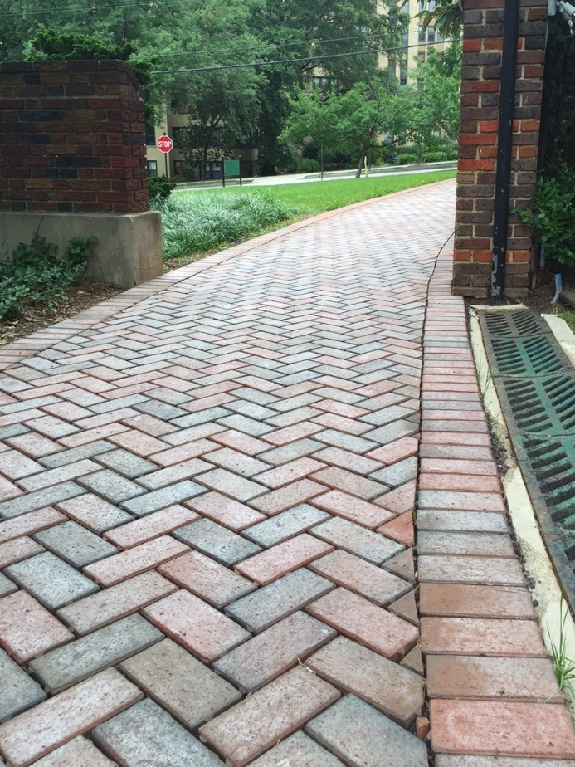
3.5 Permeable Pavement
Notes:
Ask if anyone has done a design

Slide 5
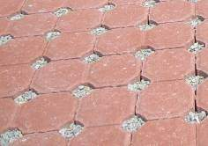
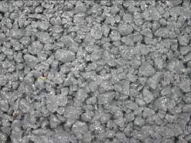
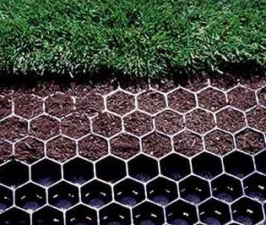
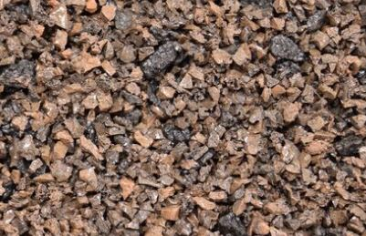
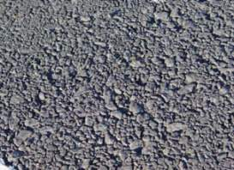
Permeable Pavement Surface Material
Permeable Pavers
Pervious Concrete
Plastic Grid Pavers
Porous Rubber
Porous Asphalt
@DC
@DOEE_DC
Notes:
Do you have a favorite? Guidebook doesn’t care

Slide 6
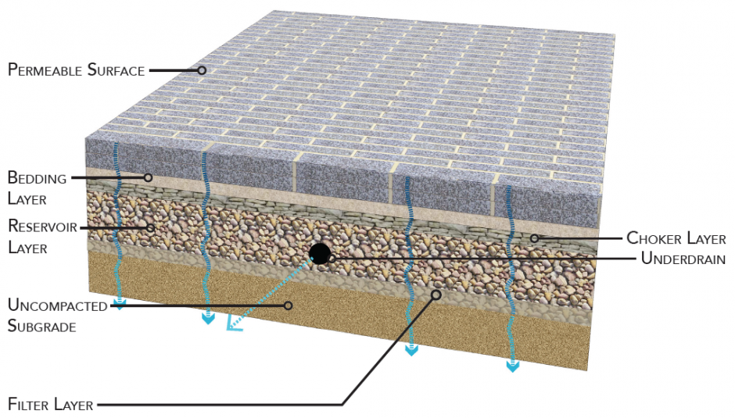
Typical Cross Section
Image credit: DDOT
@DC
@DOEE_DC

Slide 7
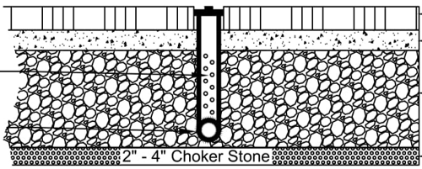
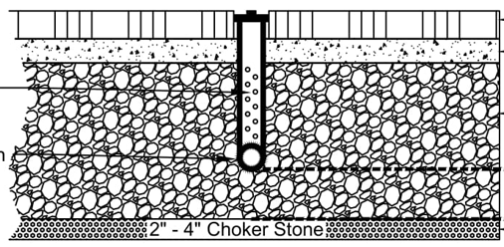
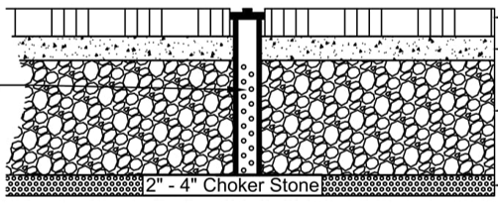
Permeable Pavement Versions
Standard
Enhanced with Underdrain
Enhanced without Underdrain
@DC
@DOEE_DC
Notes:
Which gets most retention? Enhanced w/o underdrain.
Much of the water that comes in goes out the underdrain. So only some credit for this.
100% of storage below underdrain.

Slide 8
Permeable Pavement Feasibility Criteria
Ratio of external contributing impervious surface to permeable pavement is 5:1 (2:1) is recommended
CDA should be impervious
Other requirements
  Water table depth
  Minimum head
  Setbacks
  Slopes
@DC
@DOEE_DC
Notes:
5:1 is a very high limit. Above some industry recommendations and Maryland does not allow any contributing drainage.
Why is there a limit? Clogging. Also why CDA should be impervious.
2’ above water table
10ft setback
Max 5% surface slope, bottom slop max 2% (check this)

Slide 9
Conveyance Criteria and Pretreatment
Large storm events must be managed
  Overdrains/overflow inlets
  Extra storage depth
  Underground detention
Pretreatment not required if CDA is 100% impervious
@DC
@DOEE_DC

Slide 10
Permeable Pavement Design Criteria
Specifications for each layer/element
  Reservoir Layer – No. 57 or No. 2 stone; sized for design storm
  Underdrains – PVC with 3/8-inch perforations; drain practice in 48 hours
  Infiltration Sump – No. 57 or No. 2 stone; must drain in 48 hours
  Filter Layer – No. 8 choker stone for optional separation
Must have an observation well
@DC
@DOEE_DC

Slide 11
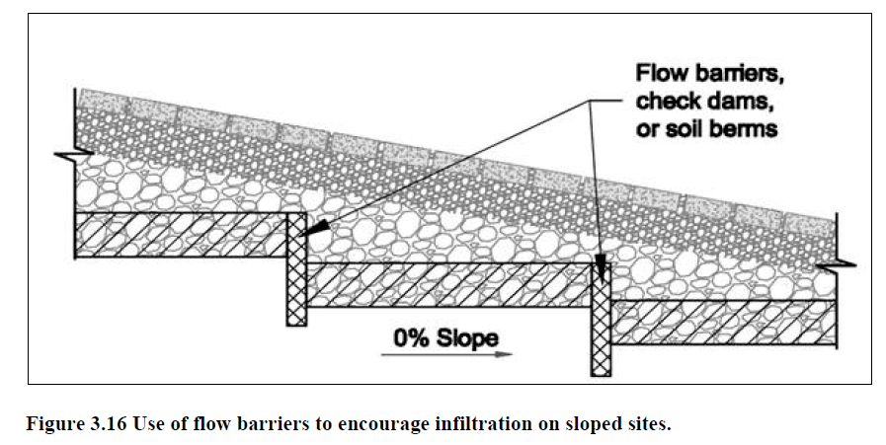
Permeable Pavement Design Criteria
Bottom slope must be as flat as possible (<2%)
Internal flow barriers may be used to create flat bottom slopes on sites with higher surface slopes
@DC
@DOEE_DC

Slide 12
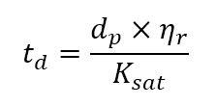

Permeable Pavement Design Criteria
Equation 3.3:
For enhanced design or enhanced designs with underdrains
t_{d} = Time to drain (days) (must be < 2.0)
d_{p} = Depth of the reservoir layer (ft)
η_{r} = The effective porosity for the reservoir layer (0.40)
K_{sat} = The field-verified saturated hydraulic conductivity for the subgrade soils (ft./day). If an impermeable liner is used in the design then K_{sat} = 0
Equation 3.4:
Sv = Storage Volume of Practice (ft³)
Ap = The permeable pavement surface area (ft²)
t_{f} = The time to fill the reservoir layer (day) – assume 2 hours or 0.083 day
@DC
@DOEE_DC
Notes:
3.3 is to make sure practice drains in 48hrs or less (only for enhanced).
3.4 only for enhanced (see next slide

Slide 13
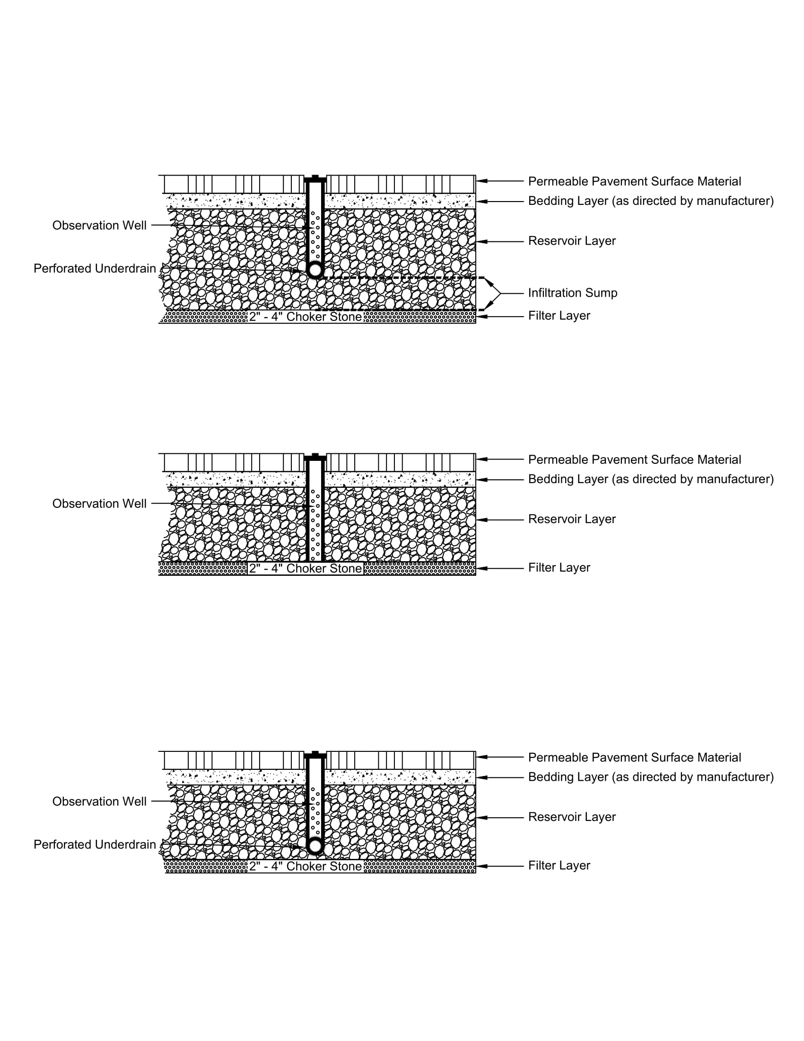
Permeable Pavement Retention Value Calculations
Standard Design
  Retention Value = 5.0 CF per 100 SF of practice area
  Accepted TSS removal practice
@DC
@DOEE_DC

Slide 14
Permeable Pavement Retention Value Calculations
Enhanced Design without Underdrain
  Retention Value = 100% of Storage Volume in Reservoir Layer
@DC
@DOEE_DC

Slide 15
Permeable Pavement Retention Value Calculations
Enhanced Design with Underdrain
  Retention Value = 100% of Storage Volume in Infiltration Sump Layer
  Additional 5.0 CF per 100 SF of practice area
@DC
@DOEE_DC

