Slide 1
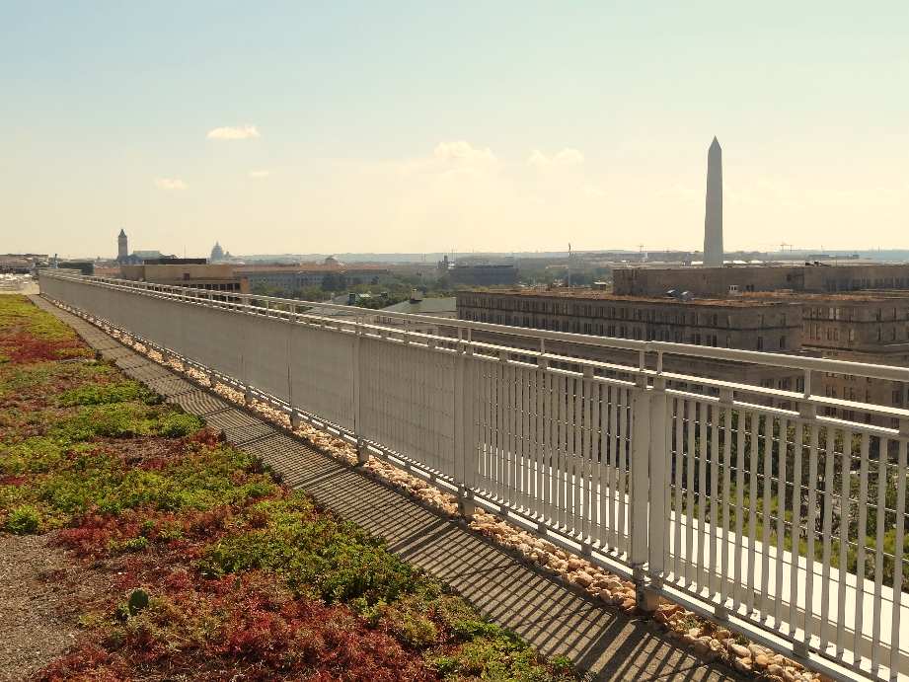



Stormwater BMP Specifications
Chapter 3
TAG THIS PRESENTATION @DOEE_DC
Notes:
Chapter 3 of the stormwater management guidebook covers the stormwater bmp specifications

Slide 2

Best Management Practices (BMPs)
3.2 Green Roofs | 3.9 Open Channel Systems
3.3 Rainwater Harvesting | 3.10 Ponds
3.4 Impervious Surface Disconnection | 3.11 Stormwater Wetlands
3.5 Permeable Pavement Systems | 3.12 Storage Practices
3.6 Bioretention | 3.13 Proprietary Practices
3.7 Filtering Systems | 3.14 Tree Planting and Preservation
3.8 Infiltration
@DOEE_DC

Slide 3
Specification Format
Feasibility Criteria
Conveyance Criteria
Pretreatment Criteria
Design Criteria
Landscaping Criteria
Construction Sequence
Maintenance Criteria
Retention Value Calculations
References
@DC
@DOEE_DC
Notes:
the guidebook is arranged such that the specifications for each bmp type are laid out in the same format and includes the following subsections

Slide 4
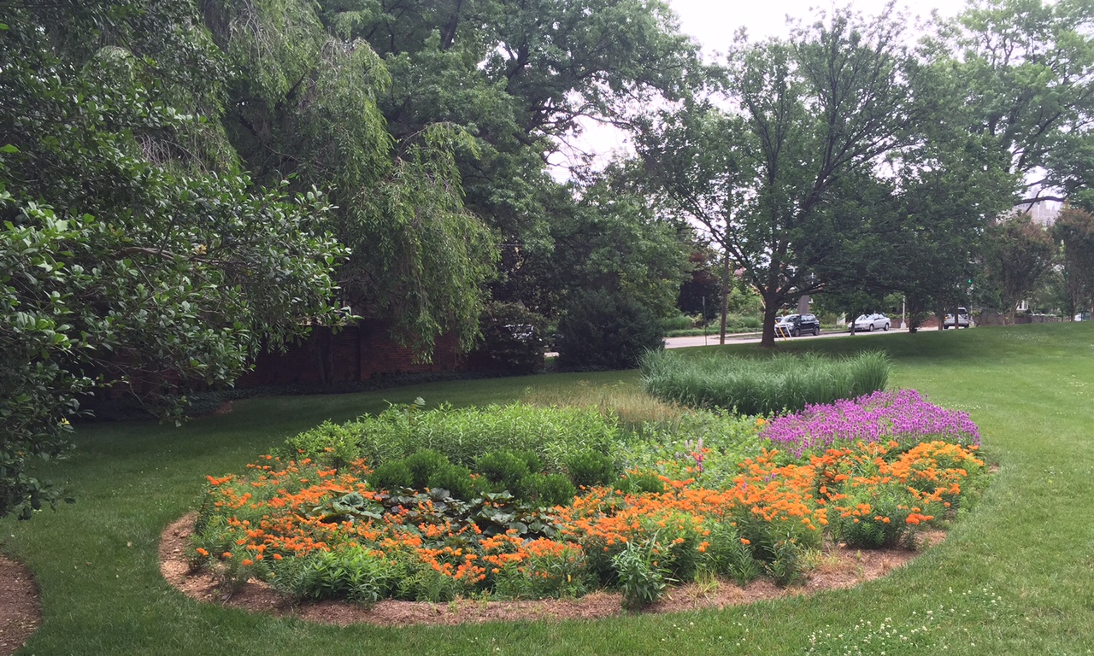
3.6 Bioretention

Slide 5
Bioretention Specification
Popular practice on sites with some surface land available
Multiple design options and sizes
@DC
@DOEE_DC

Slide 6
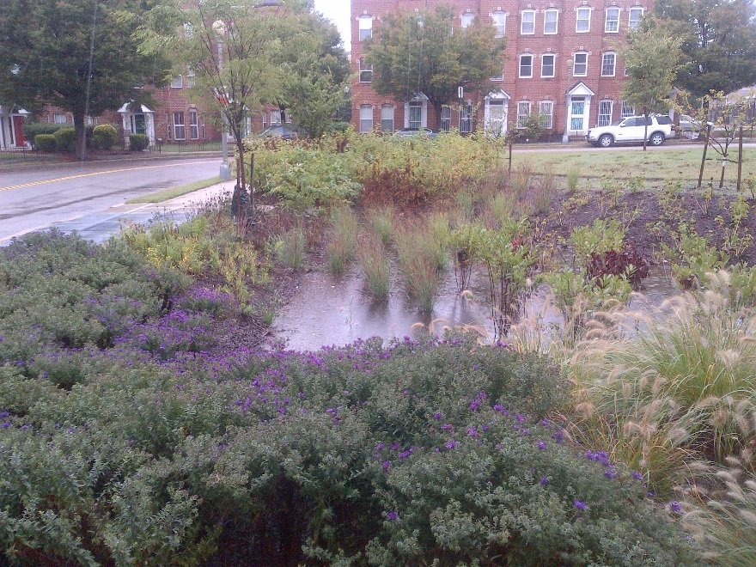
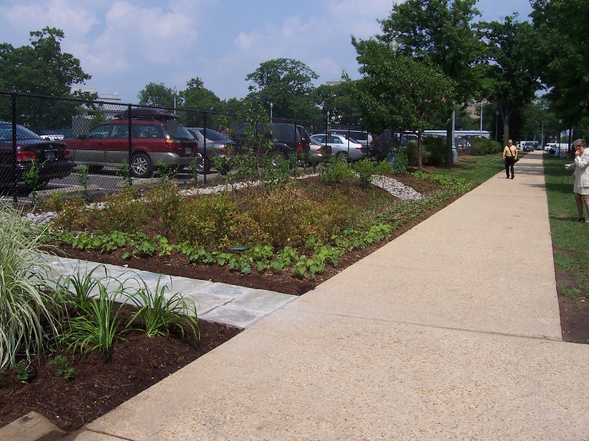
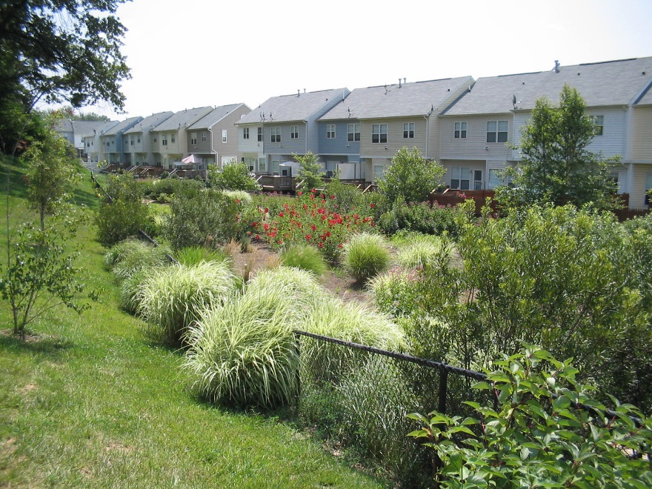
B-1 Traditional Bioretention
@DC
@DOEE_DC

Slide 7
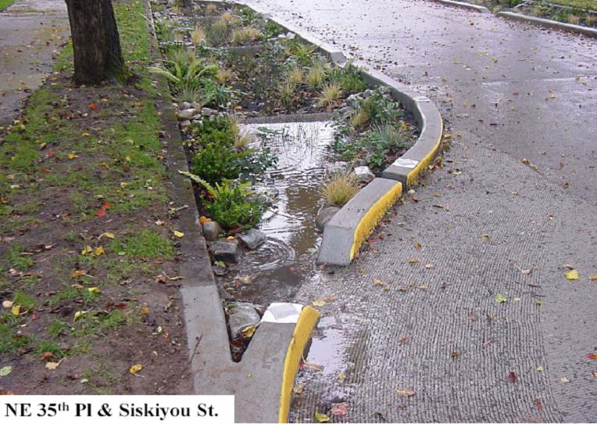
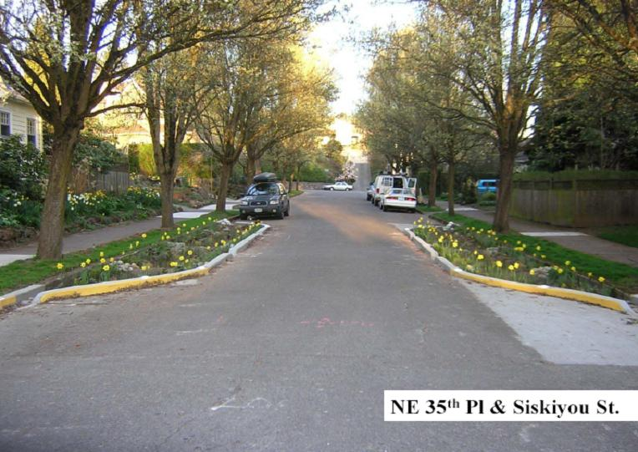
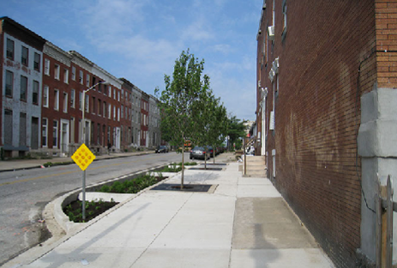
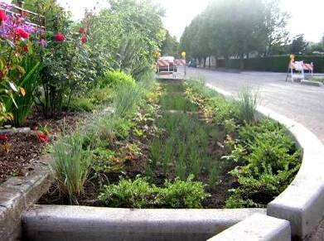
B-2 Streetscape Bioretention
@DC
@DOEE_DC
Notes:
Not common in DC because of parking

Slide 8
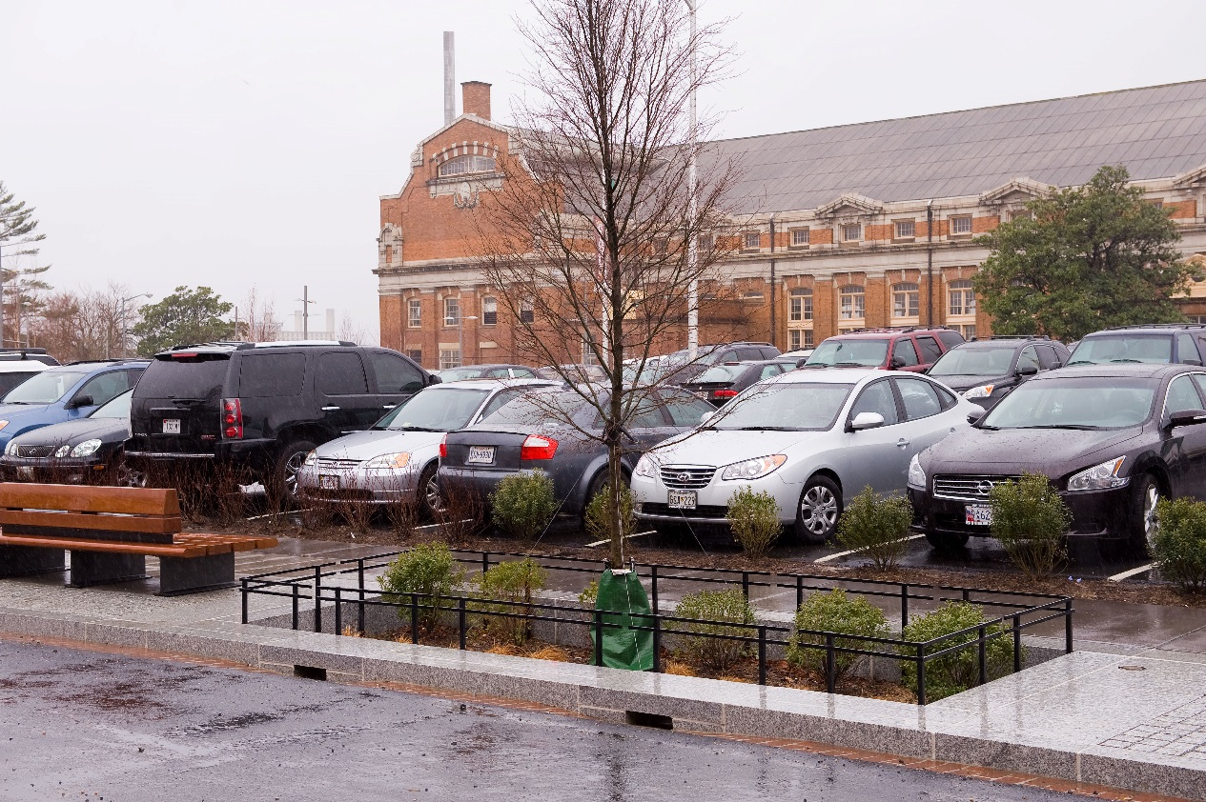
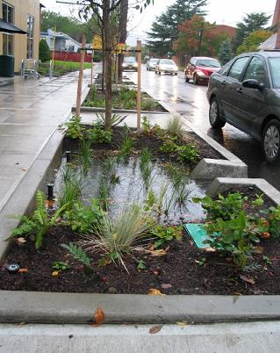
B-3 Engineered Tree Pits
@DC
@DOEE_DC
Notes:
More common due to wide sidewalks

Slide 9
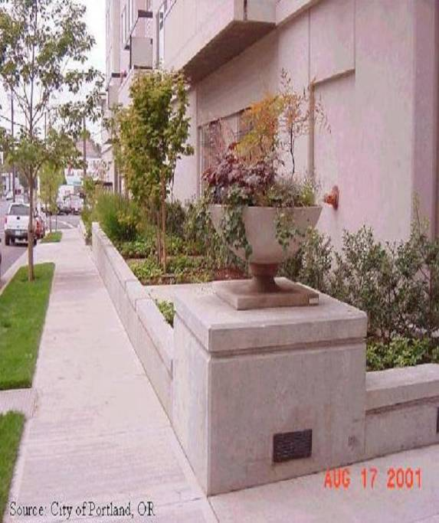
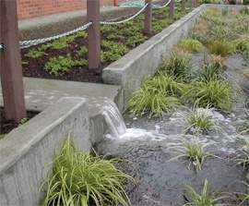
B-4 Foundation Planters
@DC
@DOEE_DC

Slide 10
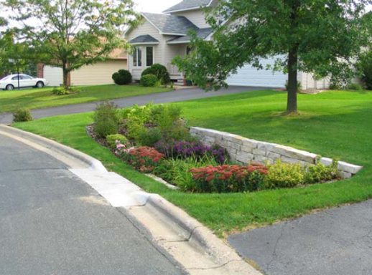
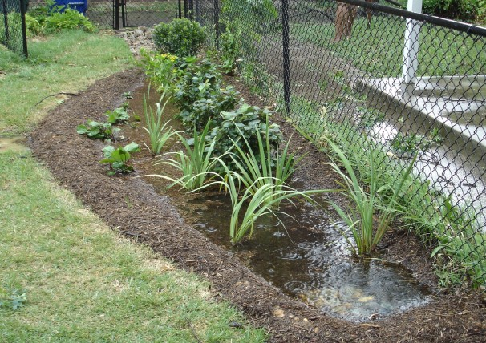
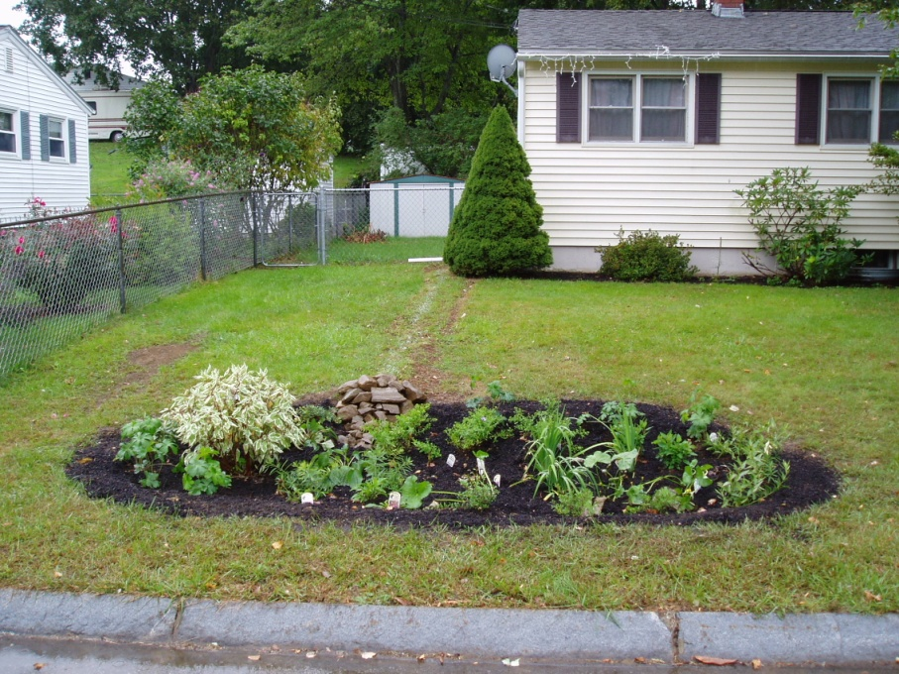
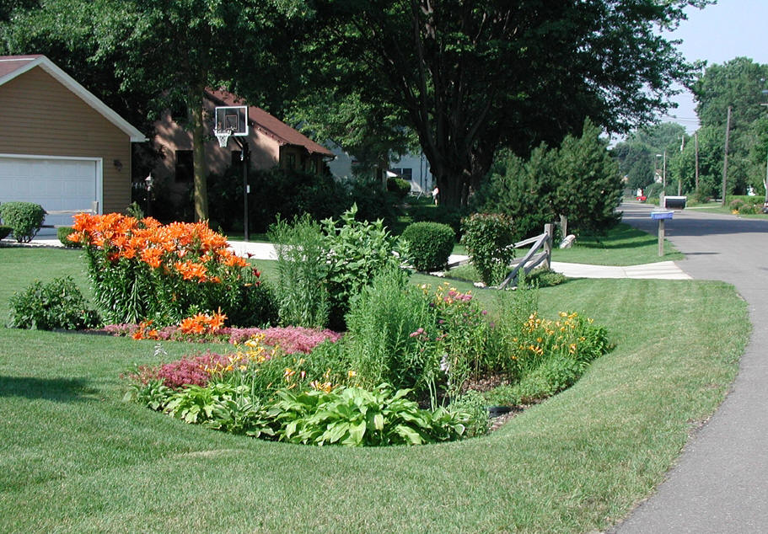
B-5 Residential Rain Gardens
@DC
@DOEE_DC

Slide 11
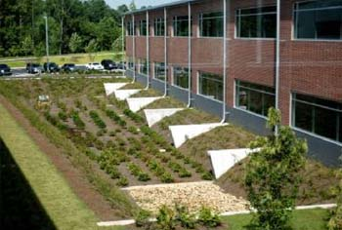
Bioretention Feasibility Criteria
Works for all soil types and most site conditions
4 to 5 feet of head
No irrigation or baseflow
Liner required for hotspots
@DC
@DOEE_DC

Slide 12
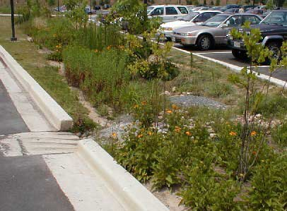
Conveyance Criteria and Pretreatment
Conveyance: Off-line vs. On-line
  On-line requires overflow device
Pretreatment Required
  Pretreatment Cell
  Grass Filter Strips
  Stone Diaphragm
@DC
@DOEE_DC
Notes:
Off-line shown here, can’t overflow because of bypass in large storms
In-line requires overflow to handle 15 yr storm w/ 3” freeboard.
Pretreatment helps with maintenance of a single point

Slide 13
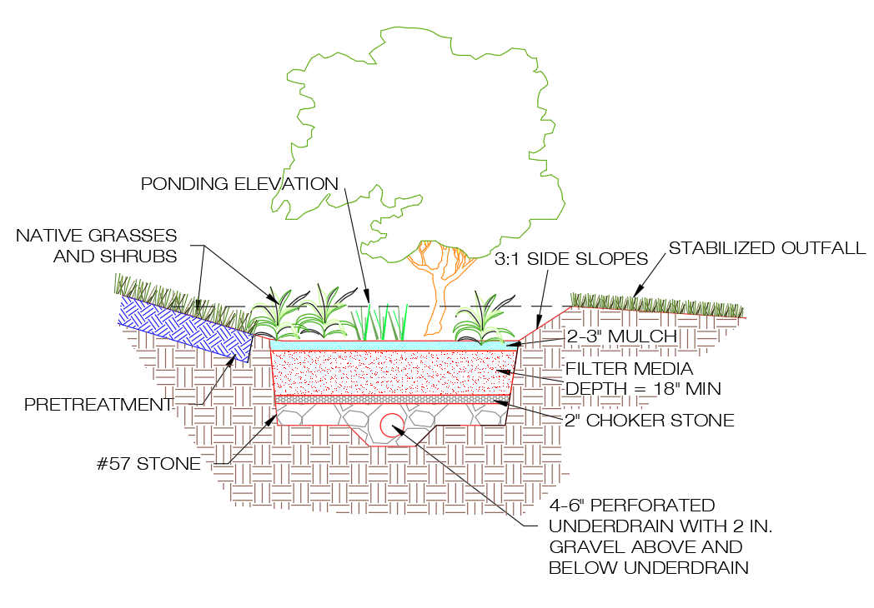
Standard Bioretention Design
  Underdrain designs without enhanced features
  At least 18” media
  60% retention value for the design storm captured
  Additional TSS removal
  Oversizing practice can result in meeting full criteria
@DC
@DOEE_DC

Slide 14
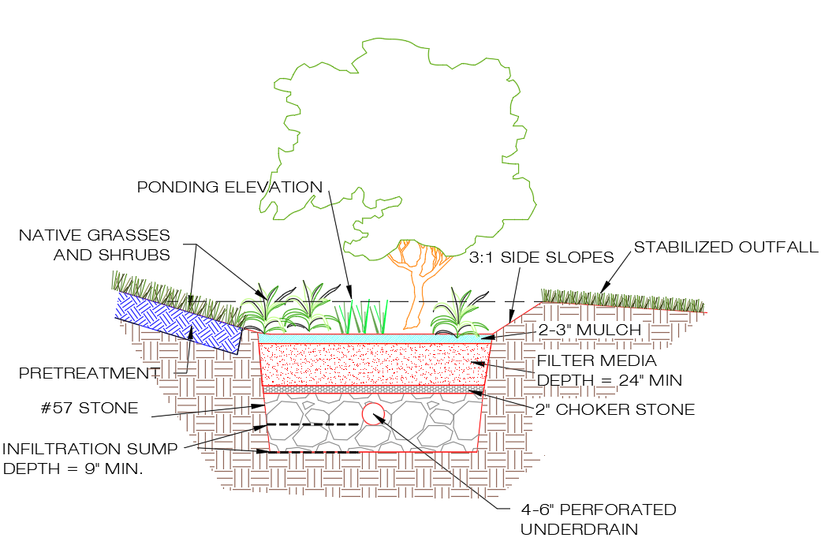
Enhanced Bioretention 1
(with Underdrain)
Underdrain designs with minimum 9” deep infiltration sump and at least 24” filter media
Sump storage volume must infiltrate within 72 hours (K_{sat} = 0.1 ft/day)
100% retention value for the design storm captured
@DC
@DOEE_DC

Slide 15
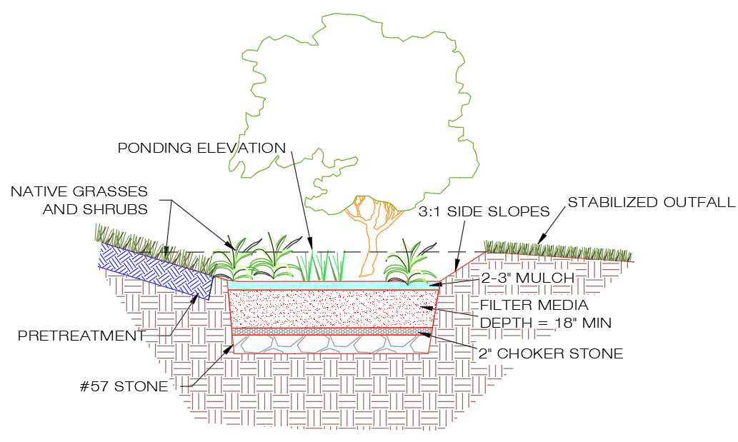
Enhanced Bioretention 2
(full Infiltration)
At least 18” filter media
Full storage volume must infiltrate within 72 hours
100% retention value for the design storm captured
@DC
@DOEE_DC

Slide 16
Bioretention Design Criteria
Ponding depth:
  Maximum 18”, Minimum 3”
3:1 side slopes or vertical drop
Must have an observation well
@DC
@DOEE_DC

Slide 17
Bioretention Design Criteria
Maximum filter media depth
  The runoff coefficient of the CDA to the BMP (RvCDA)
  The bioretention ratio of BMP surface area to the BMP CDA (SA:CDA) (in percent)
  See Table 3.20
@DC
@DOEE_DC
Notes:
Imagine a very deep small practice. Storm will be over before the water percolates down to the bottom.
Table based on modeling. Key factors on axes.

Slide 18
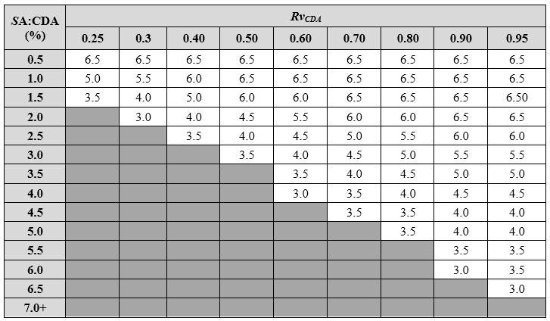
Table 3.20 Determining Maximum Filter Media Depth (feet)
@DC
@DOEE_DC
Notes:
During high intensity storm events, it is possible for the bioretention to fill up faster than the collected stormwater is able to filter through the soil media. This is dependent upon the surface area of the BMP (SA) relative to the contributing drainage area (CDA) and the runoff coefficient (Rv) from the CDA. To ensure that the design runoff volume is captured and filtered appropriately, a maximum filter media depth must not be exceeded (see Table 3.24). The maximum filter media depth is based on the runoff coefficient of the CDA to the BMP (RvCDA) and the bioretention ratio of BMP surface area to the BMP CDA (SA:CDA) (in percent). The applicable filter media depth from Table 3.21 should be used as dmedia in Equation 3.5.
Hardest part is the medium size practices. There may not be enough rain at the beginning and end of a storm to fill up the media.
Recommend maximizing ponding depth before maxing media depth.

Slide 19
Bioretention Design Criteria
Filter Media Specifications (based on weight)
  80%-90% sand
  10%-20% silt and clay
  Maximum 10% clay
3%-5% organic amendments
P concentrations between 5 and 15 mg/kg (Mehlich I) or 18 and 40 mg/kg (Mehlich III)
@DC
@DOEE_DC
Notes:
Because this is by weight and silt/clay much lighter than sand the media feels like a sandy topsoil from the organic ammendments.
Key to note on organic amendments is max P concentrations to prevent exporting P from the media itself.

Slide 20
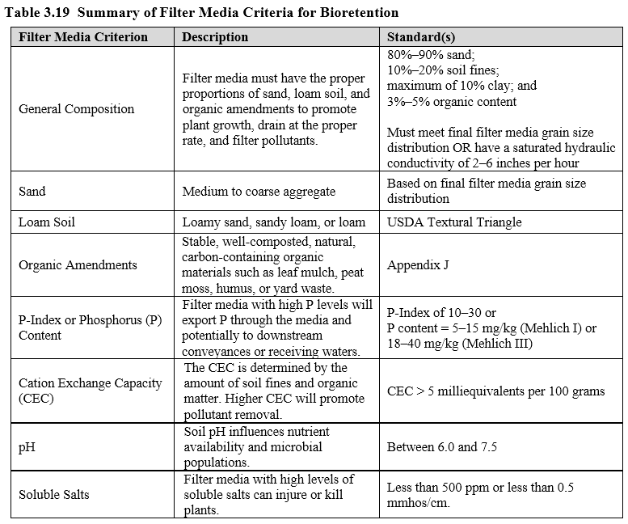
Table 3.19 Summary of Filter Media Criteria for Bioretention
@DC
@DOEE_DC

Slide 21
Bioretention Design Criteria
Sizing Equation
Where:
Sv = total storage volume of bioretention (ft³)
SA_{bottom} = bottom surface area of bioretention (ft²)
d_{media} = depth of the filter media, including mulch layer (ft)
η_{media} = effective porosity of the filter media (typically 0.25)
d_{gravel} = depth of the underdrain and underground storage gravel layer, including choker stone (ft)
η_{gravel} = effective porosity of the gravel layer (typically 0.4)
SA_{average} = the average surface area of the bioretention (ft²)
d_{ponding} = the maximum ponding depth of the bioretention (ft)
@DC
@DOEE_DC
Notes:
Long equation to say the volume of the water that fits in the pond, the gravel, and the media.
Diagram of top and bottom surface area to clarify. Top area is the bmp area.

Slide 22
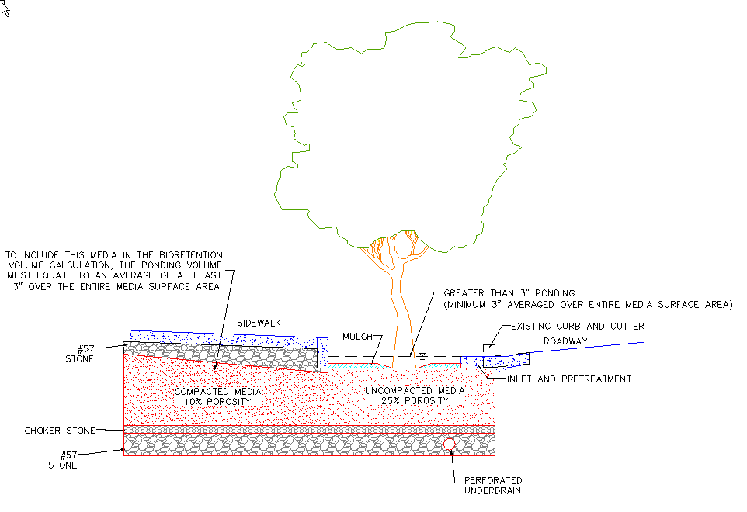
Bioretention Tree Pit Design Criteria
@DC
@DOEE_DC
Notes:
SBSS specs nearly the same as bioretention media. So it can be counted toward retention if it meets P requirements and overall average ponding depth is 3 in.

Slide 23
Bioretention Tree Pit Design Criteria
The filter media must be connected to media under the sidewalk
The average depth of ponding must be at least 3 inches
Sand based structural soil (SBSS) can be used as filter media with the following criteria:
  The SBSS must meet the same phosphorus content limits
  If the SBSS is to be compacted beyond the DDOT Green Infrastructure Standards maximum compaction for bioretention, it shall be assigned a porosity of 0.10
@DC
@DOEE_DC

Slide 24
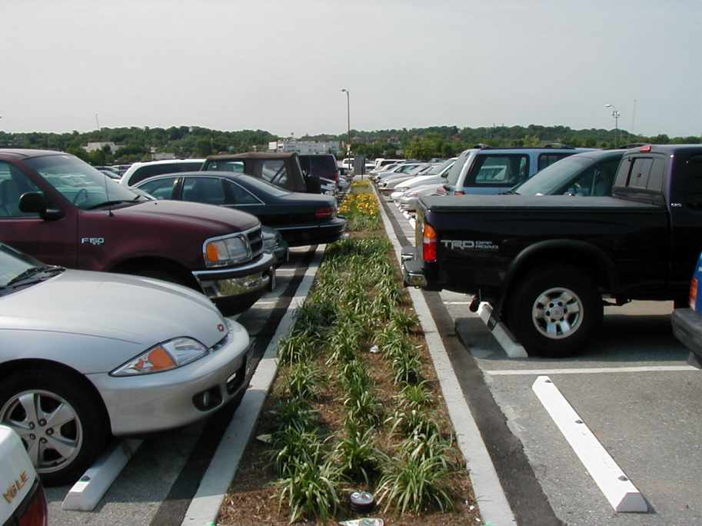
Bioretention Design Criteria
Surface Cover Options
  Mulch and perennial vegetation
  Turf
  Stone with perennial vegetation
@DC
@DOEE_DC
Notes:
Stone can be used instead of mulch (not a good idea at schools). Plants are important.

Slide 25
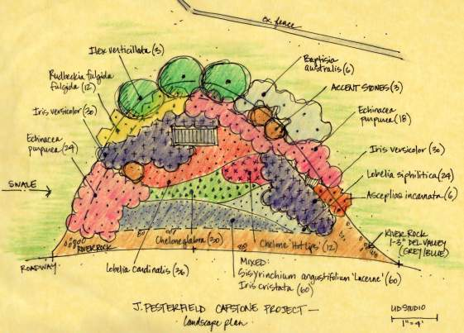
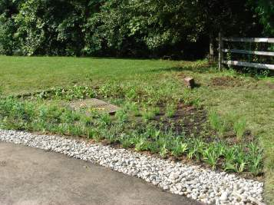
Bioretention Landscaping Criteria
Landscaping is critical to bioretention function
Planting plan must be submitted
Consider:
  Maintenance
  Plant suitability
  Native plants
@DC
@DOEE_DC
Notes:
Many options of cover available – plant lists included in spec.
Maintenance should inform landscape plan.

