Slide 1
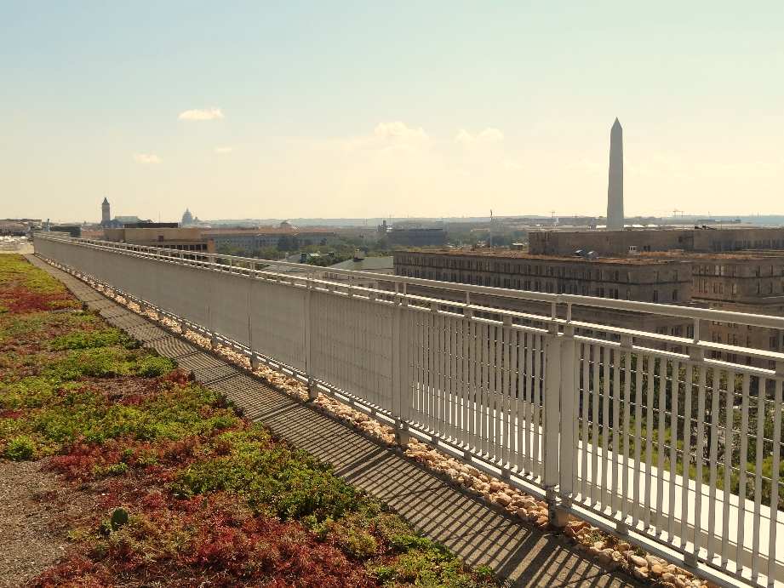
Stormwater BMP Specifications
Chapter 3
TAG THIS PRESENTATION @DOEE_DC
Notes:
Chapter 3 of the stormwater management guidebook covers the stormwater bmp specifications

Slide 2
Best Management Practices (BMPs)
3.2 Green Roofs | 3.9 Open Channel Systems
3.3 Rainwater Harvesting | 3.10 Ponds
3.4 Impervious Surface Disconnection | 3.11 Stormwater Wetlands
3.5 Permeable Pavement Systems | 3.12 Storage Practices
3.6 Bioretention | 3.13 Proprietary Practices
3.7 Filtering Systems | 3.14 Tree Planting and Preservation
3.8 Infiltration
@DOEE_DC

Slide 3
Specification Format
Feasibility Criteria
Conveyance Criteria
Pretreatment Criteria
Design Criteria
Landscaping Criteria
Construction Sequence
Maintenance Criteria
Retention Value Calculations
References
@DC
@DOEE_DC
Notes:
the guidebook is arranged such that the specifications for each bmp type are laid out in the same format and includes the following subsections

Slide 4
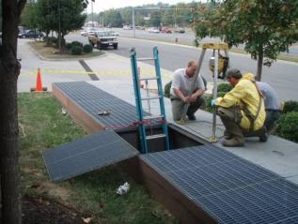
3.7 Filtering Systems
0% Retention Value
Accepted TSS removal practice
Usually installed to meet treatment requirements in vehicular access areas
@DC
@DOEE_DC
Notes:
Less often now because of retention approach.

Slide 5
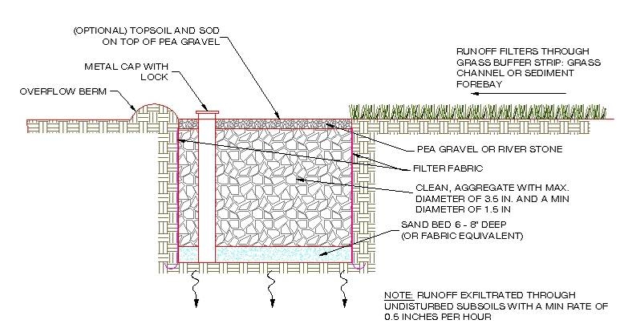
3.8 Infiltration
100% Retention Value for water that infiltrates in 72 hours
Requires field-verified saturated hydraulic conductivity
@DC
@DOEE_DC
Notes:
Simplified bioretention with just infiltration, no evapotranspiration

Slide 6
3.9 Open Channels
Dry swale, wet swale, and grass channel
Not high priority BMPs
Dry Swale = 60% Retention + accepted TSS removal practice
Wet Swale = 10% Retention + accepted TSS removal practice
Grass Channel = 10% - 30% Retention
@DC
@DOEE_DC
Notes:
Dry swale treated just like bioretention

Slide 7
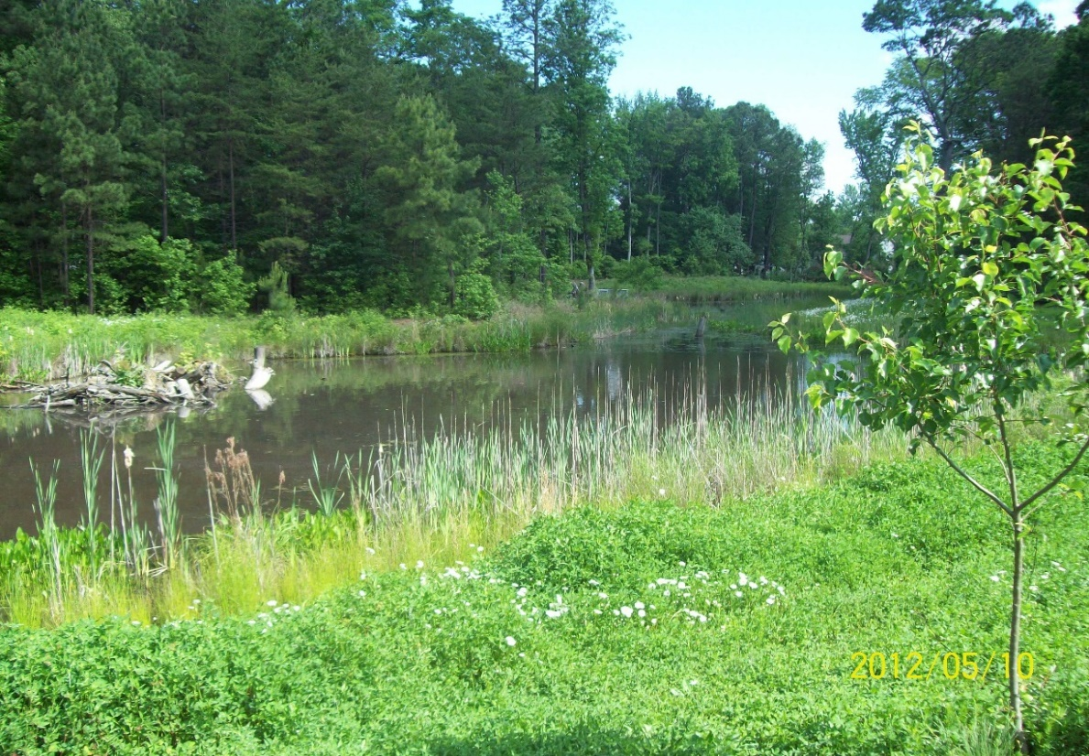
3.10 Stormwater Ponds &
3.11 Stormwater Wetlands
Rarely used
10% retention value
Accepted TSS removal practice
@DC
@DOEE_DC
Notes:
10% retention of permanent pool storage

Slide 8
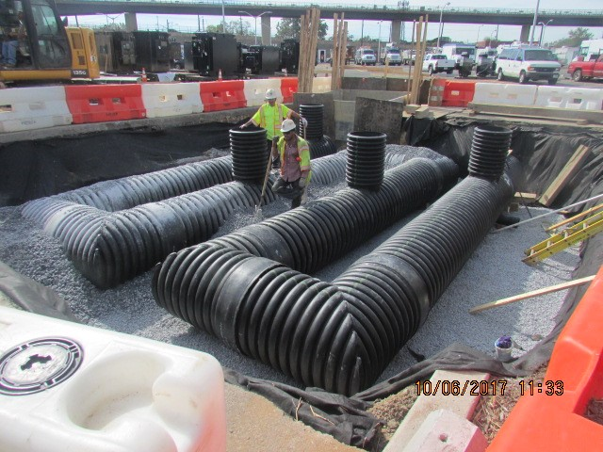
3.12 Storage Practices
No retention or TSS removal value
Intended only for detaining large storm events
Detention routing calculations required
@DC
@DOEE_DC

Slide 9
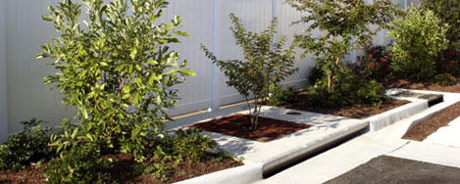
3.13 Proprietary Practices
Approval procedures involve field studies and/or lab tests
Variable retention and TSS removals
Generally low retention value and high TSS removal
Approval follows NJDEP Protocol
Appendix T
@DC
@DOEE_DC

Slide 10
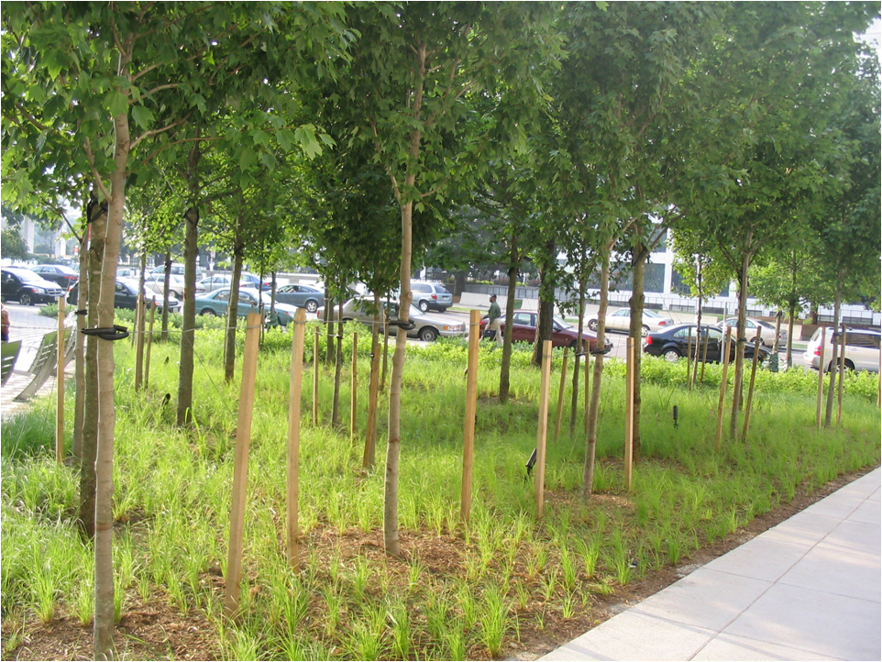
3.14 Tree Planting and Preservation
Gives Retention Value for individual trees
Landscape professional tree inventory for preservation
Planting plan for new tree planting
Proper planting and maintenance required
Trees must be within the LOD
@DC
@DOEE_DC
Notes:
1500 cf for a single tree, 1000 if shared

Slide 11
3.14 Tree Planting and Preservation
Minimum rootable soil volume requirements
Small trees
600 cf single planting
400 cf (each) shared space
Large trees
1500 cf single planting
1000 cf (each) shared space
Soil considered “rootable” to 3’ deep and 16’ (small) or 27’ (large) radius
Building
Adjacent Property
+
Standard Pavement
16’ – 27’
+
Rootable soil to max 3’ depth
New tree
@DC
@DOEE_DC
Notes:
1500 cf for a single tree, 1000 if shared

Slide 12
Tree Planting Preservation Retention Values
Preserved Trees
Small trees (< 40 ft avg. mature spread) = 10 ft³
Large trees (> 40 ft avg. mature spread) = 20 ft³
Special trees (> 44 in. circumference) = 30 ft³
Heritage trees (> 100 in. circumference) = 40 ft³
Planted Trees
Small trees (< 40 ft avg. mature spread) = 5 ft³
Large trees (> 40 ft avg. mature spread) = 10 ft³
@DC
@DOEE_DC
Notes:
Preserving an existing tree retains more water than a newly planted tree
Trees planted in bmps get credit for both the bmp and the tree
Green Area Ratio has resources on tree spread etc.

