Slide 1
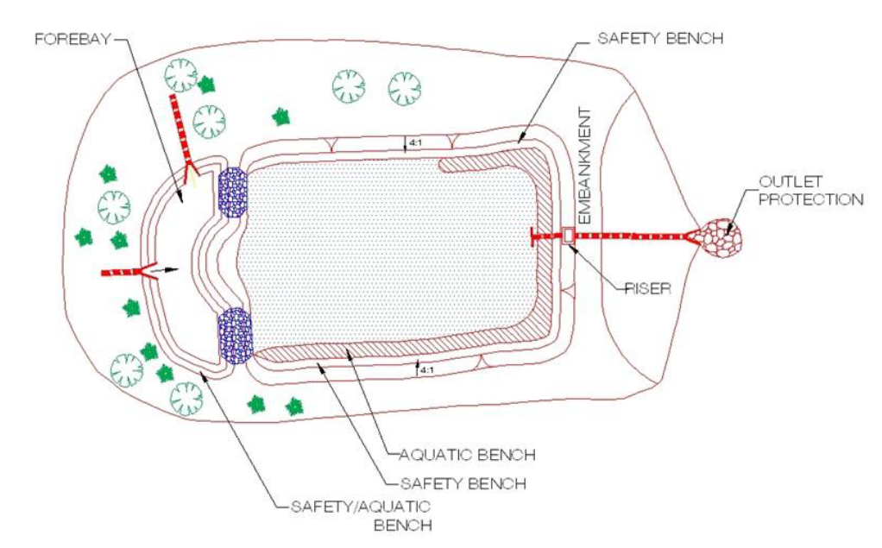
Detention Requirements
Chapter 2 and Appendix I
TAG THIS PRESENTATION @DOEE_DC
Notes:
In the other videos in this general compliance training for stormwater management we’ve focused on retention requirements. In this video we’ll cover the detention requirements in more detail.

Slide 2
Quantity Control Requirements
2-year storm: control peak discharge to pre-development conditions.
15-year storm: control peak discharge to pre-project conditions.
@DOEE_DC
Notes:
For WQTv, P = 3.2 inches

Slide 3
How to meet Detention Requirements
Underground storage
Above ground storage
Increasing size of BMPs
@DOEE_DC

Slide 4
Chapter 2 Note
Note: 2-year post-development peak discharge requirements do not apply to projects when three conditions can be established:
(1) site discharges flow directly to, or through the separate sewer system, into the main stem of the tidal Potomac or Anacostia Rivers, the Washington Channel, or the Chesapeake and Ohio Canal;
(2) site discharges do not flow into or through a tributary to those waterbodies that runs above ground or that the District Department of the Environment (DDOE) expects to be daylighted to run above ground; and
(3) site discharges will not cause erosion of land or transport of sediment.
@DOEE_DC

Slide 5
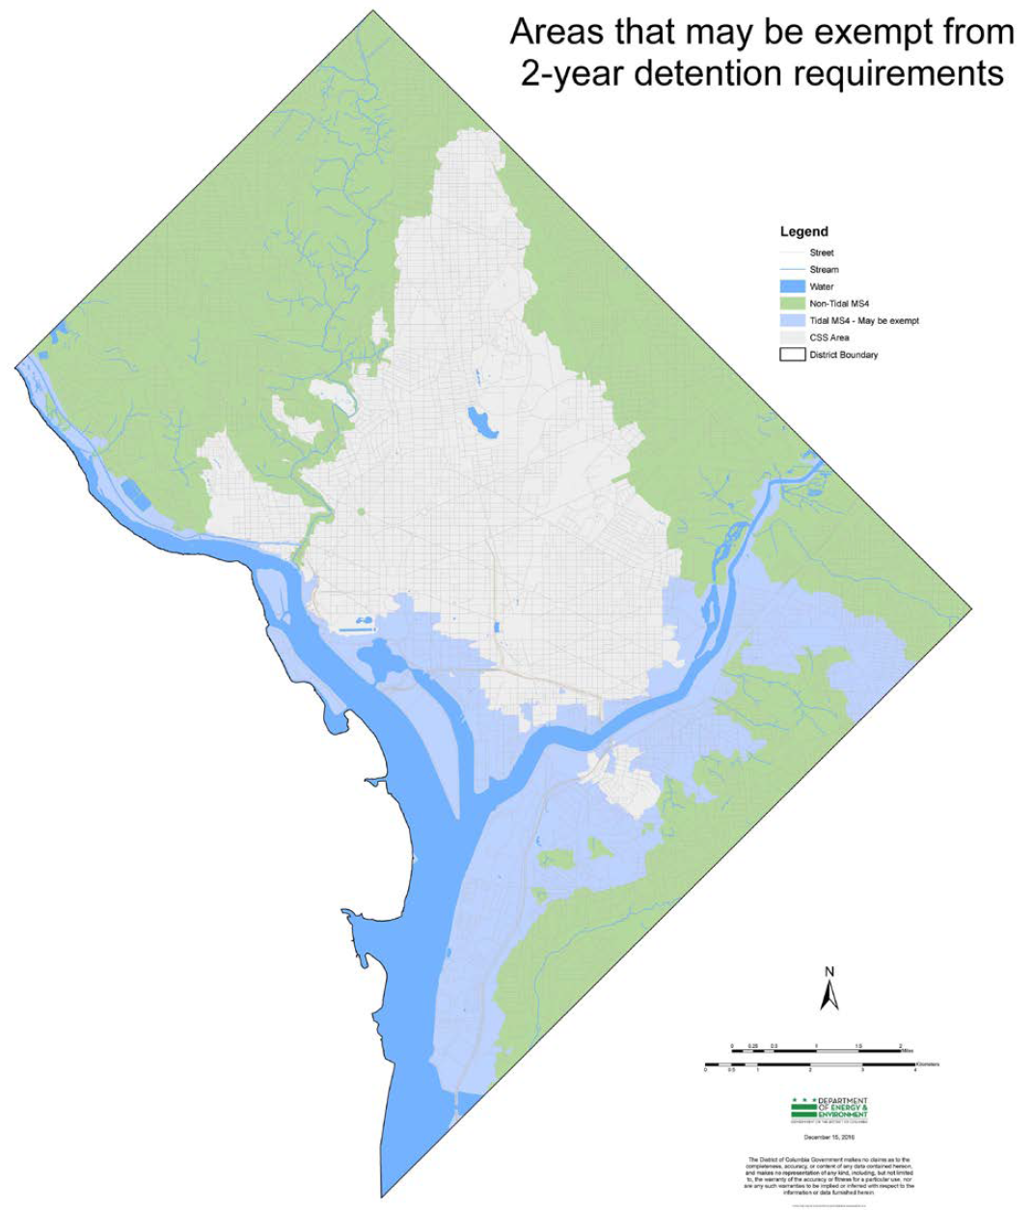
Tidal MS4 – May be exempt
@DOEE_DC

Slide 6
Curve Number Reduction
Calculate Curve Number and Site Runoff Volume
Subtract Storage Volume Achieved from Site Runoff Volume
Determine Reduced Curve Number based on Reduced Site Runoff Volume
@DOEE_DC
Notes:
The goal of stormwater detention is to reduce peak flow rates. As you can see in the chart, the dark green plot has a high peak flow rate which is a common impact of urbanization and that high flowrate carries with it a lot of energy that can degrade receiving streams. We want to lower this peak and delay it’s timing by adding detention storage. In DC, a reduced curve number method is used to check if the proposed conditions and BMP storage adequately reduce peak flow rates to the relevant, that is 2-yr or 15-yr peak discharge. The first step in this method is calculating the curve number based on proposed land covers. There is a site runoff volume associated with this curve number. There is also storage achieved from the BMPs that are being proposed. The BMP storage is subtracted from the site runoff volume to obtain a reduced site runoff volume. This reduced site runoff volume is associated with a reduced curve number which is then compared against the required curve numbers for the 2-yr pre development condition and the 15-yr pre-project condition.

Slide 7
Pre-Development and Pre-Project Conditions
S.D.A. 1
Pre-Development CN = 70
Pre-Project:
Imp. Cover= 16,187 sf
CN = 98
Comp. Cover= 5,914 sf
CN = 74
Pre-Project CN: 92
S.D.A. 2
Pre-Development CN: 70
Pre-Project:
Imp. Cover= 15,593 sf
CN = 98
Comp. Cover= 12,125 sf
CN = 74
Pre-Project CN: 88
@DOEE_DC

Slide 8
Post-Project Conditions (No BMPs)
S.D.A. 1
Post-Project:
Imp. Cover= 17,835 sf
CN = 98
Comp. Cover= 4,896 sf
CN = 74
Post-Project CN: 93
S.D.A. 2
Post-Project:
Imp. Cover= 17,468 sf
CN = 98
Comp. Cover= 10,250 sf
CN = 74
Post-Project CN: 89
@DOEE_DC

Slide 9
Post-Project Conditions (With BMPs)
S.D.A. 1
Post-Project:
Imp. Cover= 17,835 sf
CN = 98
Comp. Cover= 4,896 sf
CN = 74
Post-Project CN: 93
BMP: 1,800 cf
Reduced Post-Project CN: 76 & 80
S.D.A. 2
Post-Project:
Imp. Cover= 17,468 sf
CN = 98
Comp. Cover= 10,250 sf
CN = 74
Post-Project CN: 89
BMP: 2,200 cf
Reduced Post-Project CN: 68 & 75
@DOEE_DC
Notes:
Database calculates the runoff volume using the SCS method used in TR-55

Slide 10
Detention Calculations
 | Area | 2-Year Pre-Development Curve Number | 2-Year Post-Development Reduced Curve Number | 15-Year Pre-Project Curve Number | 15-Year Post-Development Reduced Curve Number
SDA 1 | 22,731 sf | 70 | 76 | 92 | 80
SDA 2 | 27,718 sf | 70 | 68 | 88 | 75
Total Site | 50,449 sf | 70 | 72 | 90 | 77
Detention Required? |  | Yes |  | No
<
>
Detention Required for 2-year storm only!
@DOEE_DC
Notes:
We care about the total site
Total site CN calculated by area-weighted average
But must calculate reduced curve numbers by SDA because we can only account for BMP storage in the SDA where it is located
To provide detention, designs must be submitted for the detention facility and show modeling results that demonstrate a lower peak flow – tie back to purpose of detention

Slide 11
Hydrologic Methods – Appendix I
The following methods are acceptable to demonstrate peak flow reductions
Urban Hydrology for Small Watersheds TR-55
Storage-Indication Routing
HEC-HMS, WinTR-55, TR-20, and SWMM Computer Models
Rational Method (limited to sites under 5 acres)
TR-55 and SWMM are preferred for ability to account for detention benefits of BMPs
Rational method not recommended for detention, cannot easily account for BMP benefits
@DOEE_DC

