Slide 1
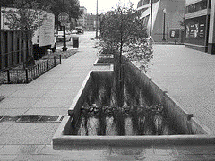
Reconstruction of Existing Public Right-of-Way
MEP tailored to the streetscape portion of a Major Regulated Project
TAG THIS PRESENTATION @DOEE_DC
Notes:
In this video we’ll cover reconstruction of existing public right of way. We’ll learn when stormwater regulations apply for work in the prow and how to meet stormwater requirements to the maximum extent practicable.

Slide 2
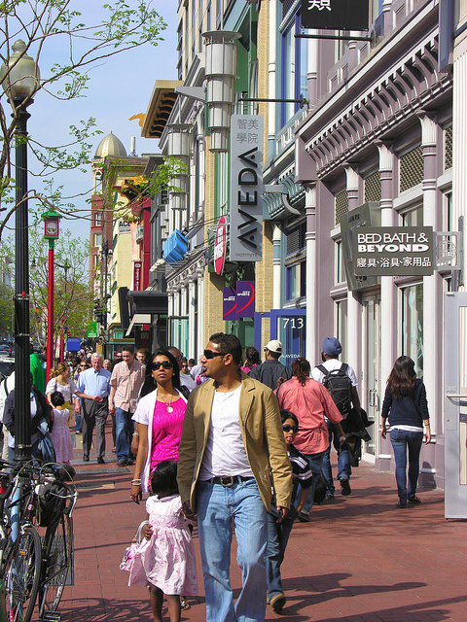
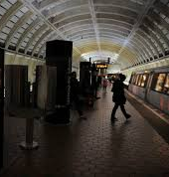
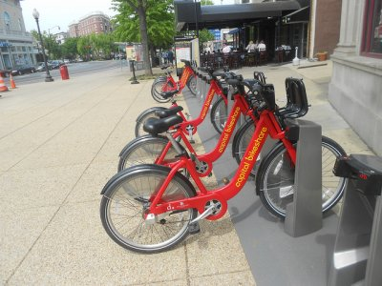
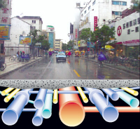
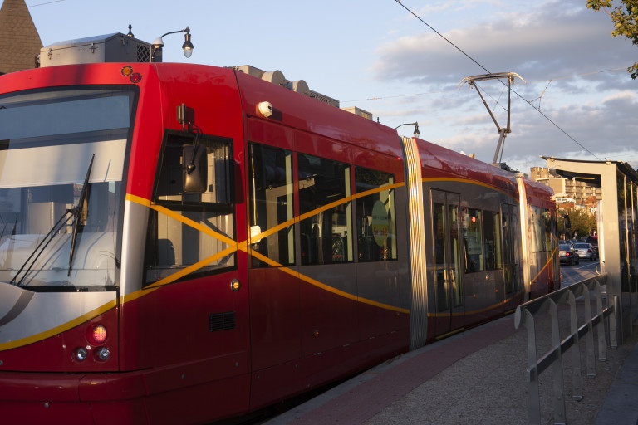
@DOEE_DC
Notes:
For WQTv, P = 3.2 inches

Slide 3
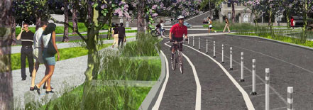
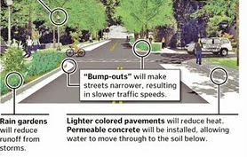
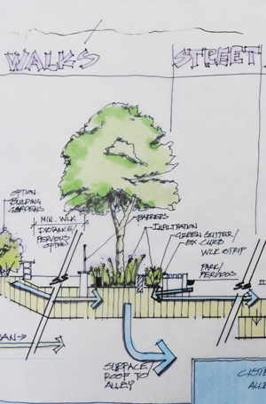
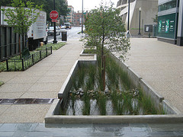
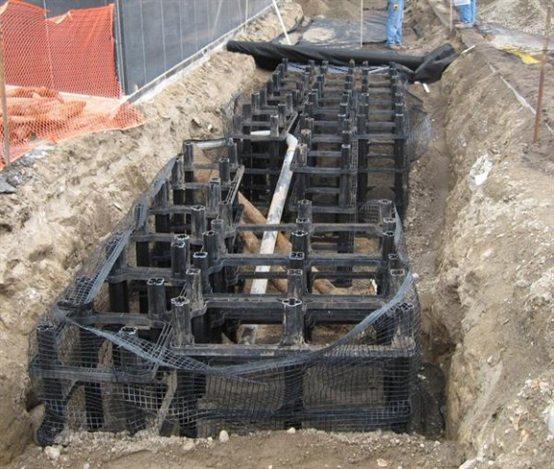
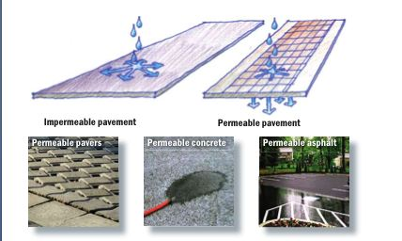
@DOEE_DC

Slide 4
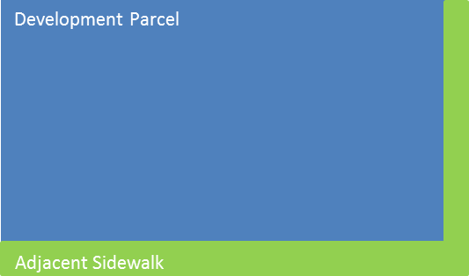
When PROW MEP applies…
Reconstruction of Existing Public right-of-way
Type 1: Federal or municipal
roads, alleys, sidewalks, trails, etc.
Type 2: Private development
adjacent sidewalks and alleys
@DOEE_DC

Slide 5
When PROW MEP does not apply…
A major regulated project that does not disturb the adjacent public right-of-way
Voluntary retrofits of existing PROW
PROW disturbance that is limited to
Trenches
Driveways
Utilities
Aprons
Minor disturbance
Disturbance of new PROW that was not previously PROW
@DOEE_DC

Slide 6
Principles of PROW MEP include…
Maximize BMP placement
Maximize BMP sizing
Innovate--integrate “green” with “grey” infrastructure
Minimize impervious widths
Maximize land cover types with little stormwater runoff
Maximize tree canopy
planting or preserving trees, amending soils, increasing soil volumes and connecting tree roots with stormwater runoff
Use impervious surface disconnection strategies
e.g., draining sidewalk area to continuous tree planting strip
Manage comingled stormwater runoff
prioritize the conveyance and control of roadway runoff
Over-control the roadway runoff beyond LOD to compensate for less retention elsewhere
Use porous pavement or pavers for low traffic roadways, on-street parking, shoulders or sidewalks
Integrate BMPs into traffic calming measures
@DOEE_DC
Notes:
Database calculates the runoff volume using the SCS method used in TR-55

Slide 7
Parcel PROW MEP steps include…
Calculate SWRv
Prioritize managing roadway runoff inside the curb line
Place, size and design PROW BMPs to maximize retention
Stormwater Management Guidebook Chapter 3 BMP specifications
Stormwater Management Guidebook Appendix B BMP priorities and limitations
DDOT LID Standards and Specifications
dc.gov/DC/DDOT/Projects+and+Planning/Environment/Low+Impact+Development
@DOEE_DC

Slide 8
Design Example: Scenario
Corner property includes 200 ft x 10 ft adjacent PROW disturbance (sidewalk)
SWRv = 1.2 in x (0.95x100%) x 2000 ft² x 7.48/12
SWRv = 1,421 gallons
Poor infiltration rate on site
Sufficient head available for underdrain connections.
@DOEE_DC

Slide 9
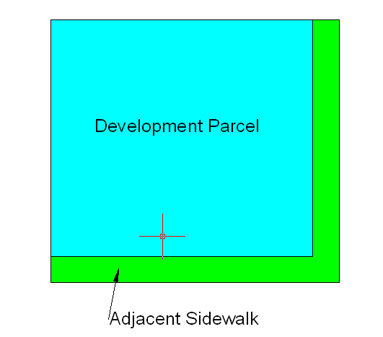
Design Example: Site Plan
@DOEE_DC

Slide 10
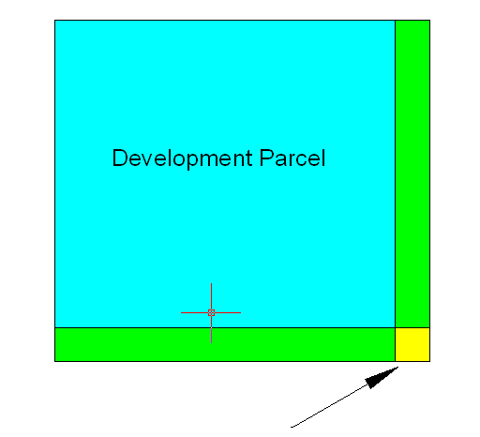
Design Example: Limitations
ADA Crossing Requirements
@DOEE_DC

Slide 11
Design Example: Limitations
Driveways
@DOEE_DC

Slide 12
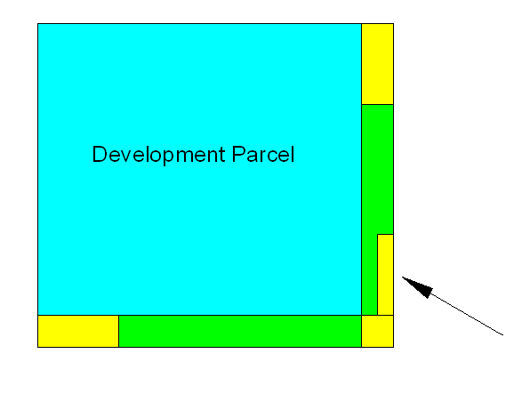
Design Example: Limitations
Bus Stop
@DOEE_DC

Slide 13
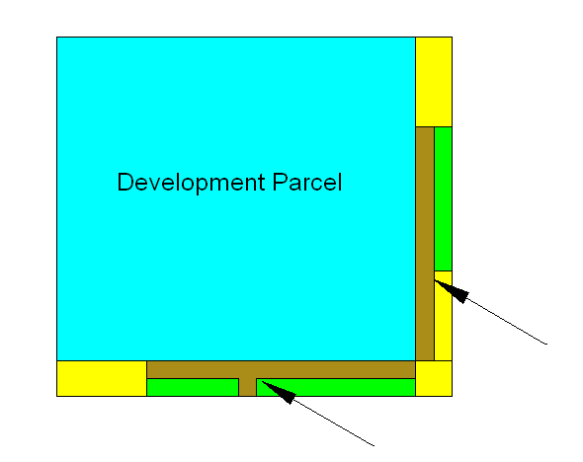
Design Example: Limitations
Building Exist and 5’ – Wide Sidewalk
@DOEE_DC

Slide 14
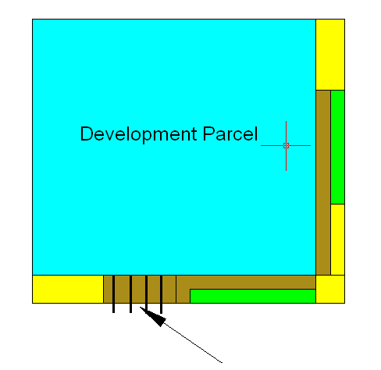
Design Example: Limitations
Utilities
@DOEE_DC

Slide 15
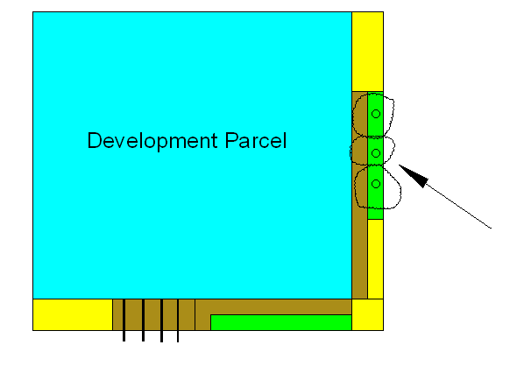
Design Example: Limitations
Existing Trees
@DOEE_DC

Slide 16
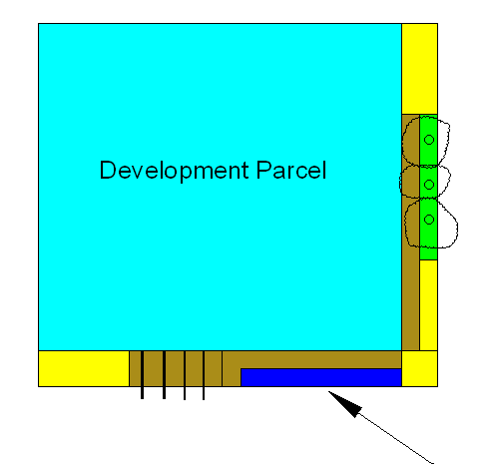
Design Example: Limitations
Bioretention
@DOEE_DC

Slide 17
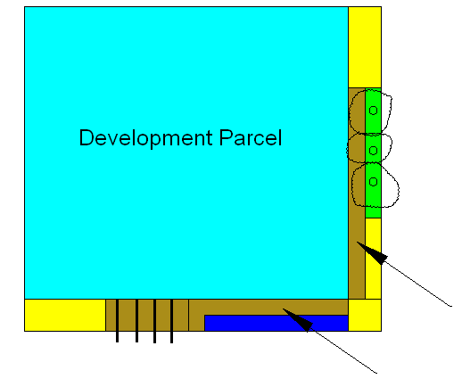
Design Example: Limitations
Permeable Pavement considered, but trees and utilities limit space available, and much of remaining sidewalk drains to bioretention area.
@DOEE_DC

Slide 18
Design Example: Results
SWRv Achieved:
3 existing trees x 20 ft³ x 7.48 = 449 gallons
220 ft² bioretention area (with shallow ponding) provides 823 gallons of storage
823 gallons x 0.6 = 494 gallons
SWRv Achieved = 943 gallons
Required SWRv not met, but MEP process followed.
@DOEE_DC

Slide 19
Design Example: Results
Recalculate SWRv for Reduced Impervious Cover:
SWRv = 1.2 in x (0.95 x 84% + 0.25 x 16%) x 2000 ft² x 7.48/12
SWRv = 1,254 gallons
Poor infiltration rate on site
Sufficient head available for underdrain connections.
@DOEE_DC

