Slide 1




Best Practices for
Plan Submissions
Stormwater Management Plans
Notes:
Thank you for joining the Best Practices for Plan Submissions. We hope that this training will guide designers to include pertinent information in the stormwater, ESC, and GAR plan submissions so plan reviewers can efficiently review plans and reduce the amount of comments necessary. This training was developed because plan reviewers found that submittals had similar errors and misunderstanding. This training assumes some basic understand of stormwater, ESC, and GAR regulations and guidebooks. I recommend watching or attending the other overview trainings prior to this one if you are not familiar with these.

Slide 2
BACKGROUND, PURPOSE, and GENERAL PLAN COMMENTS
TAG THIS PRESENTATION @DOEE_DC

Slide 3
OBJECTIVES
Know what information plan reviewers are checking
Know the most common comments and errors and how to avoid them
Review commonly misunderstood parts of the guidebook/submission
Provide resources
Provide examples of good plan submissions
https://doee.dc.gov/swtraining
Notes:
The objectives for this training are to learn what specific information plan reviewers are checking, learn the most common plan reviewer comments and the most common errors and how to avoid them, review commonly misunderstood parts of the guidebook and the submission process, provide resources, and provide examples of good plan submissions. Overall, the goal of this training is to improve plan submittals to create a more efficient review process. Not everything in this training will be required, it may just be helpful for a plan reviewer to clearly understand the plans.
We are not going over the guidebooks or the SGS in detail. We are simply addressing common mistakes the plan reviewers see
Not everything shown is required, but some of the items shown will help plan reviewers quickly understand the project
Additional training can be found at the website at the bottom of the slide

Slide 4
BASIC PLAN REVIEW METHODOLOGY
Review plans to understand project
  Drawings should be clear, easy to understand
  All basic necessary components are shown on plans
Verify data in the General Compliance Data and/or GAR Scoresheet sheets is supported by plans
  SDA and CDA land cover
  Storage volume calculations
  Drainage area delineation
  Detention requirements
  Sewershed, compared to on-site retention achieved
Check BMPs meet design requirements
  Section details
  Material specifications
  Drawdown time achievement
Notes:
For a plan reviewer, they will typically first go through and review the plans to understand the overall project. The drawings should be clear and easy to understand and all required pieces should be included. The plan reviewer will verify that the data in the General Compliance Data or the GAR Scoresheet match the information on the plans and calculations were done correctly. Some items that are checked include SDA and CDA area and land cover, storage volume calculations, drainage area delineation, and detention requirements. The plan reviewer will also check that each BMP or GAR element meets the design requirements as stated in the guidebook.

Slide 5
GENERAL PLAN COMMENTS
Plans should be at least 90% design when submitted
If there is land disturbance in the PROW, use Appendix B (MEP)
BMPs typically cannot straddle property lines
All SWM sheets should be in one PDF
Notes:
Here are some common general plan comments plan reviewers have provided. The plans submitted should be at least 90% design, unless it is an MEP project in the PROW. If there is land disturbance in the PROW that is not exempt, it must use the MEP process as show in appendix B. BMPs typically cannot straddle property lines, for example over public and private property. All SWM sheets should be in one PDF set.

Slide 6
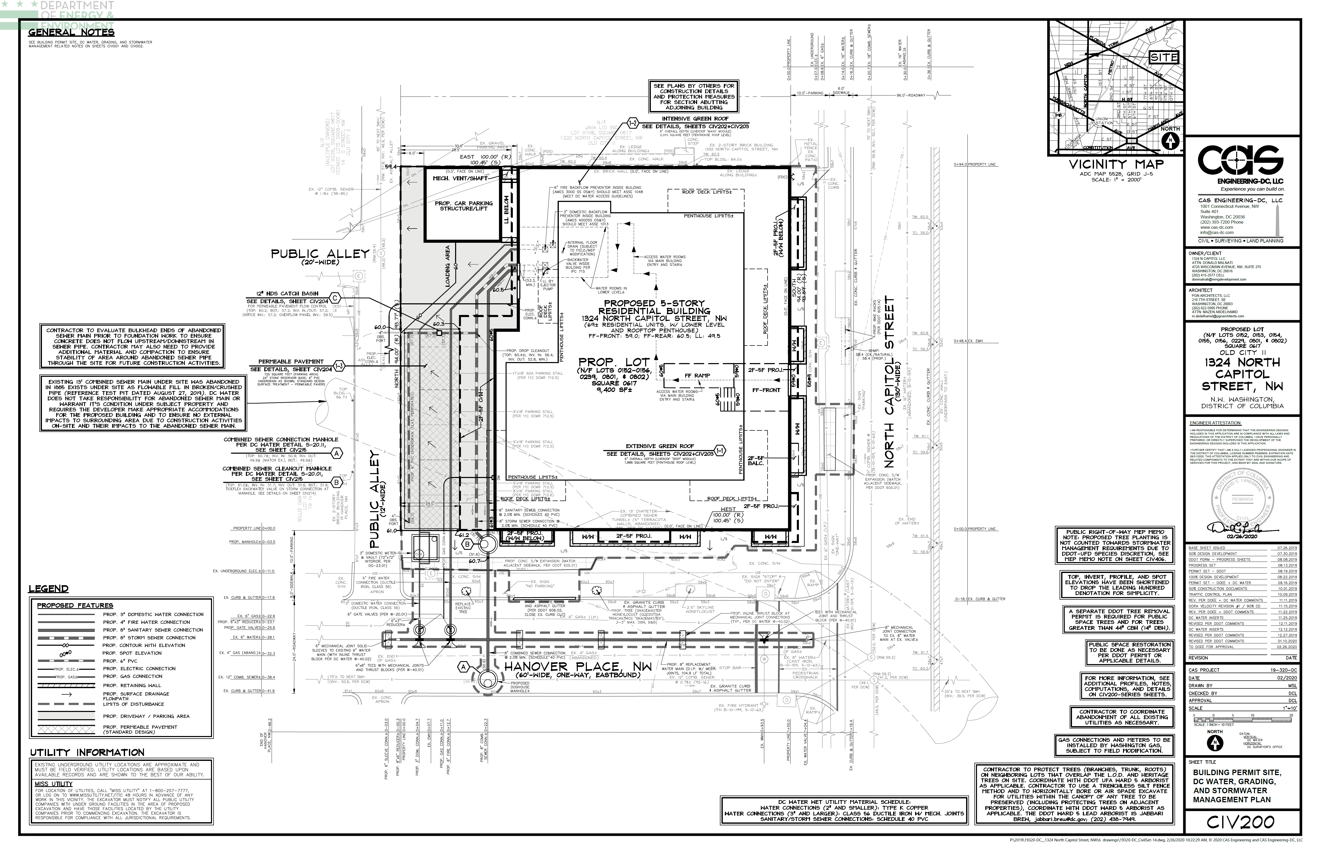
EXAMPLE - GOOD
Lines are different weight and type to distinguish layer
Notes:
Here is an example plan sheet that is very easy for a plan reviewer to read. Everything is clearly marked with differing line type of hatching and a legend.

Slide 7
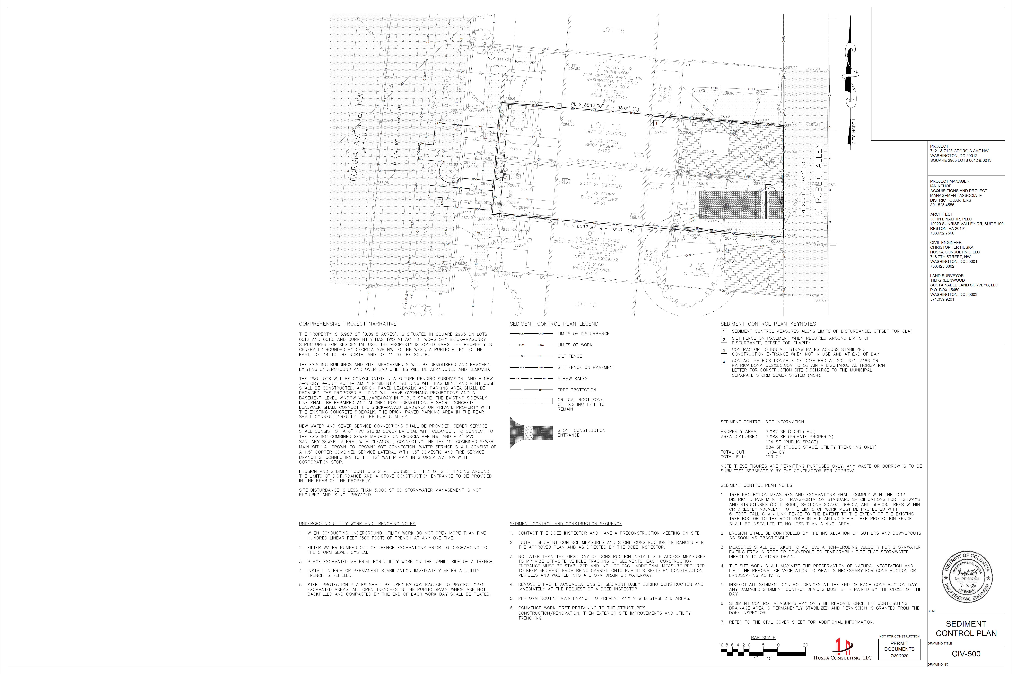
EXAMPLE - BAD
Lines look too similar to distinguish
Notes:
Here are examples of plans that are difficult to read and difficult for the plan reviewer to understand what the lines are representing. Both plans have lines that are the same thickness and type, making it very difficult to know what the lines are representing.

Slide 8
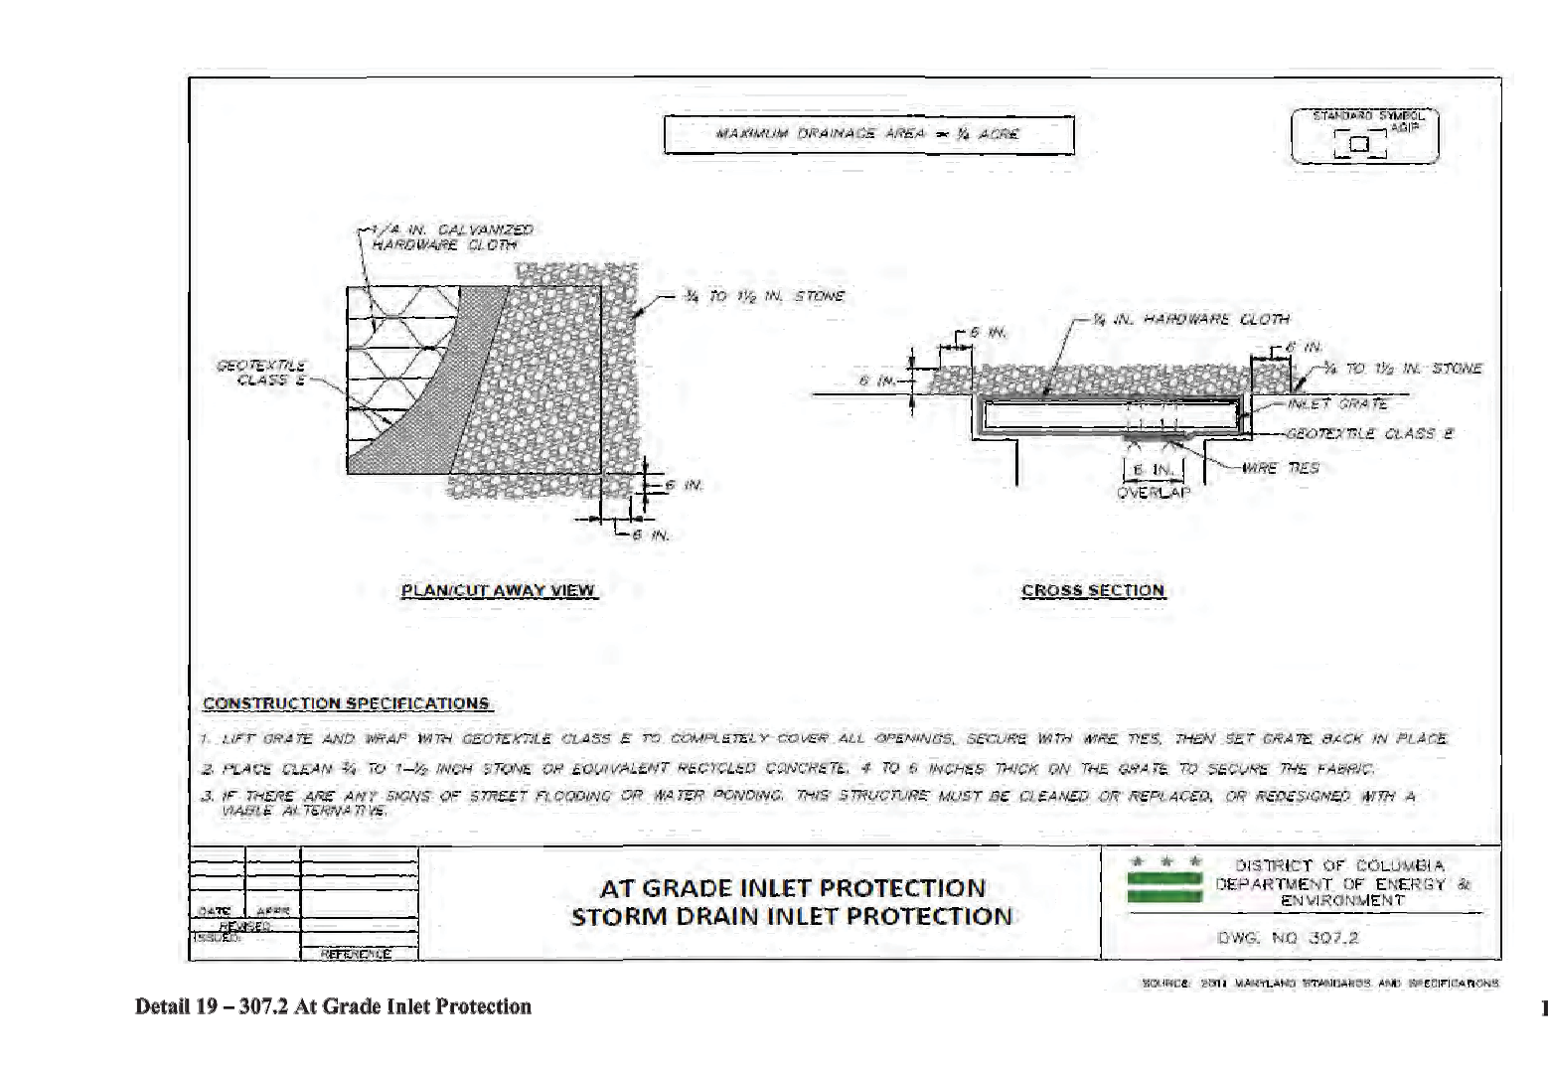
EXAMPLE - BAD
Overlapping layers obscures information
Illegible references
Notes:
One common issue on plan set is to have overlapping layers that obscure the information below, such as spot elevations. Illegible references are also not allowed on plans.

Slide 9

UTILITY TRENCHING EXEMPTION
Notes:
A common misunderstand is when utility trenches are exempt from stormwater management. This slide shows images from the stormwater guidebook about utility exemptions. For the one on the top, the building in green and the entire trench are included in the LOD. This trench is only necessary for utility connections. The remainder of the ROW is not included in the LOD. Because the ROW is only disturbed for the utility, it can be exempt from SWM. Now the piece of the trench inside the building is NOT exempt, as that blue portion would have like been within the LOD regardless of the utility.
The next image shows a example with construction occurring at the building and the sidewalk. For this example, the PROW is disturbed for the project, so the sidewalk would need to meet MEP. The little portion that WAS exempt in the previous example is no longer exempt, since the portion would have been disturbed regardless of the utility trench.

Slide 10
COMMON ITEMS IN PLANS OR SGS
Signed and sealed statement by Professional Engineer
As-Built Certification by Professional Engineer
Environmental Intake Form, signed by DCRA
Complete EISF report, if required
Geotechnical report, if required (Appendix P)
Pollution Prevention Good Housekeeping Stamp Note
  >5000SF, <1acre
DC Water Storm Sewer Verification Form, signed by DC Water
Complete AWDZ Site Claim form, if required
Hotspot Cover Sheet and Checklist, if required
Found on DOEE or DCRA website
Notes:
Here are so common items that should be required in the plan set. They can be found on the DOEE or DCRA website
https://doee.dc.gov/node/610622

Slide 11
SHEET SPECIFIC COMMENTS
General and SWM
TAG THIS PRESENTATION @DOEE_DC

Slide 12
COMMON PLAN SHEETS
Not all are required- project dependent
Cover Sheet
Existing Conditions
Demolition
Site Plan
Utilities
Utilities Profile
Grading
Stormwater Management
Stormwater Management Details
Stormwater Management CDA
ESC Plans, Details, Notes
Notes:
Will go through each sheet and what should be on there.
ESC is typically in the plans, but those are covered in the ESC training

Slide 13
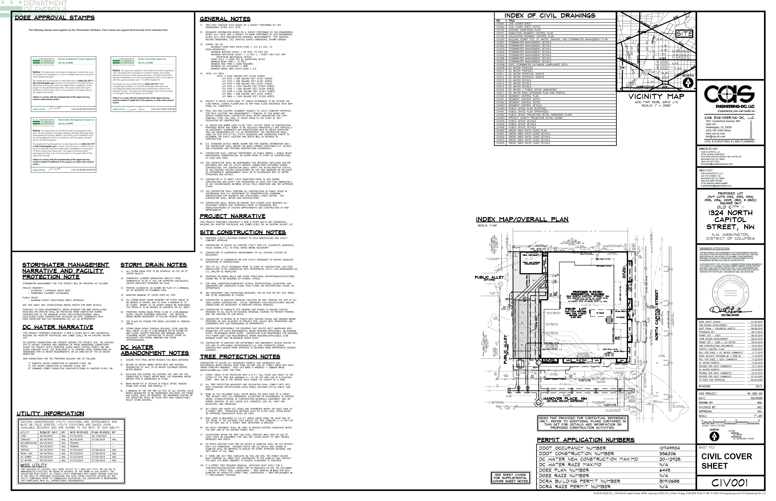
EXAMPLE COVERSHEET
Blank area- 7″ wide by 9.5″ tall and have a 1″ margin
Index of Sheets
Vicinity map
Lot and square
PE Signature and Stamp
Narrative
Building permit number
Notes:
Index not required, but helpful
5907

Slide 14
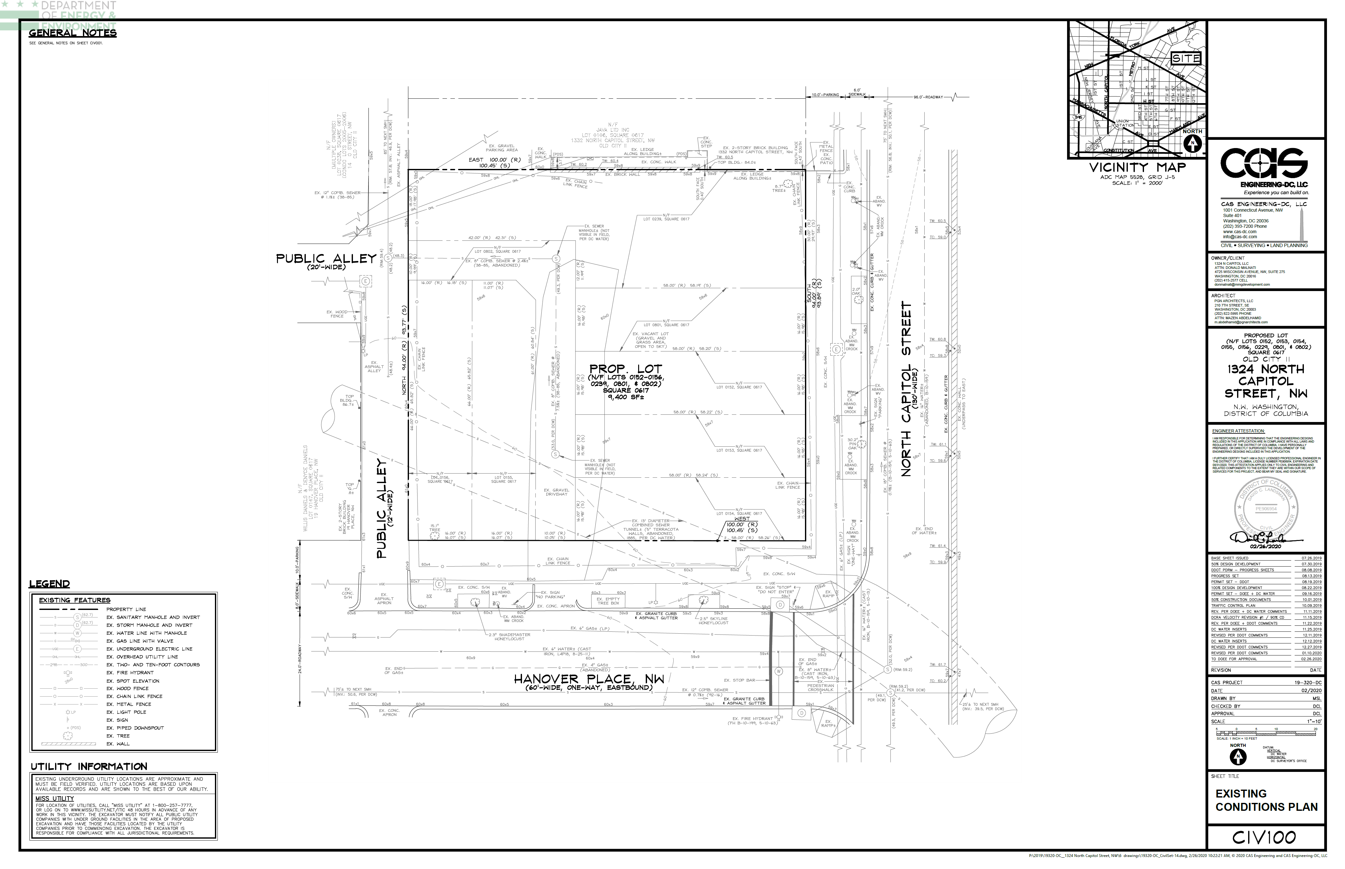
EXAMPLE- EXISTING CONDITIONS
Property Line
Special and heritage trees- show critical root zone if in or near LOD (CRZ: 1.5’ radius per inch DBH)
Legend, include all line types and hatching
North arrow and scale
Include existing buildings, trees, utilities, etc.
Notes:
5907
Size and CRZ

Slide 15
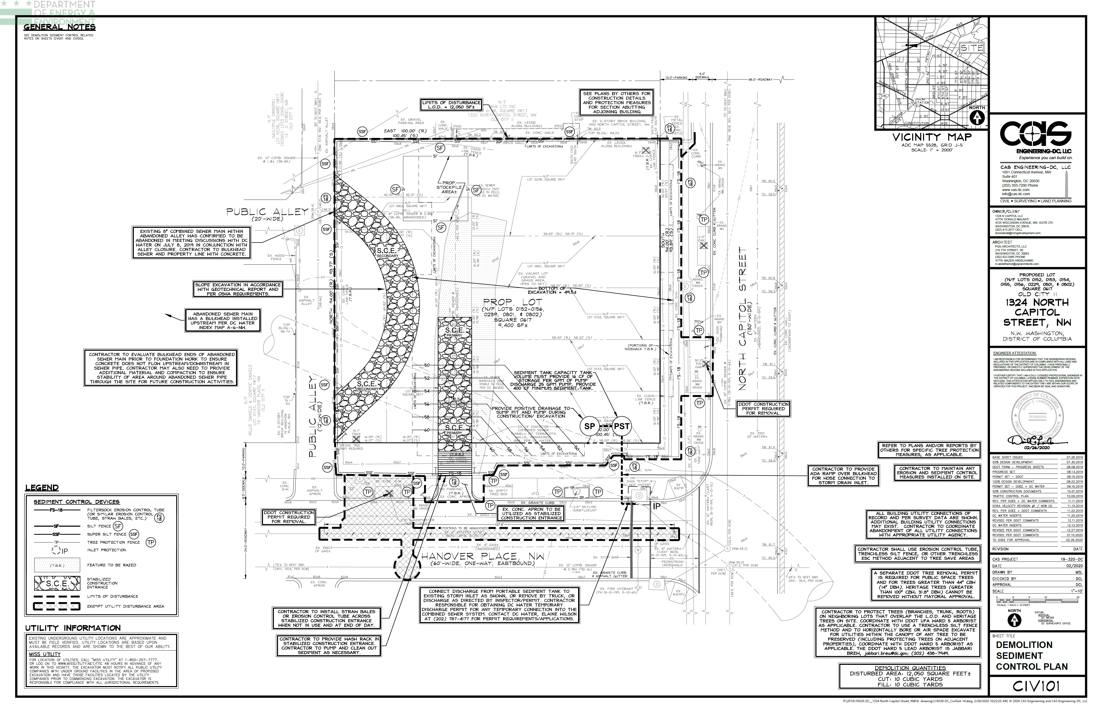
EXAMPLE- DEMOLITION
Include LOD and property lines on stormwater/ESC sheets
If demolition is on a different SWMP, include plan number
Is there ESC for demolition?
Special and heritage trees- coordinate with UFD

Slide 16
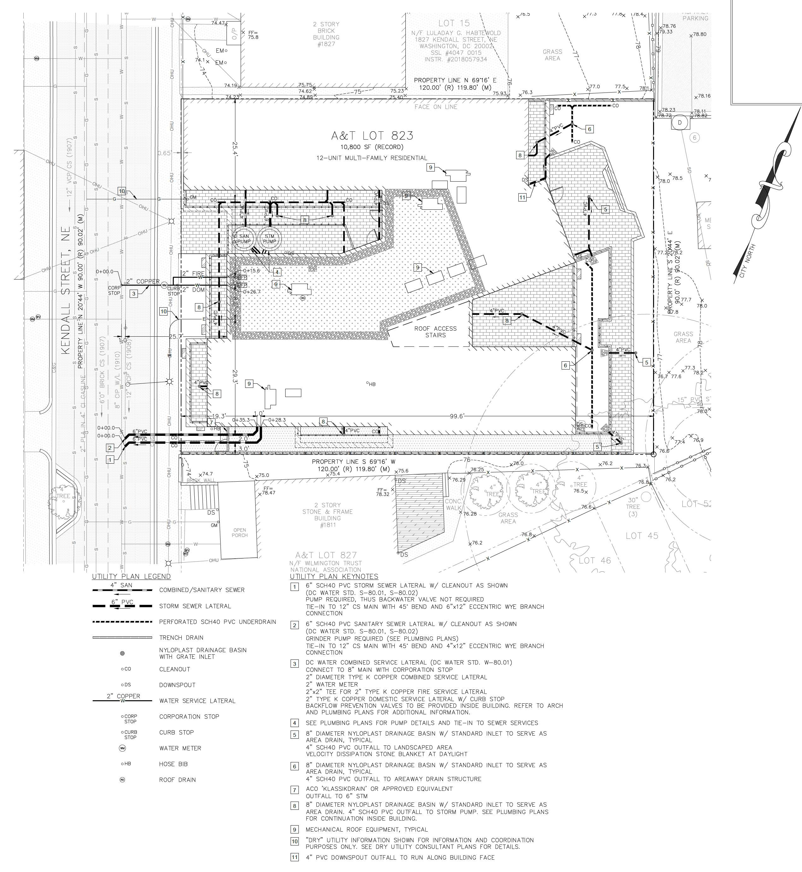
EXAMPLE- UTILITY AND UTILITY PROFILE
Can include BMP utilities
Utility type and location
15-yr HGL
Notes:
6530, Huska
Note- these can be on separate sheets
15-yr HGL should not be above pipe

Slide 17
EXAMPLE- GRADING
✓
Provide enough information to verify SDA, CDA, placement of ESC, no downstream flooding
  Contour lines
  Spot elevation
Notes:
6452

Slide 18
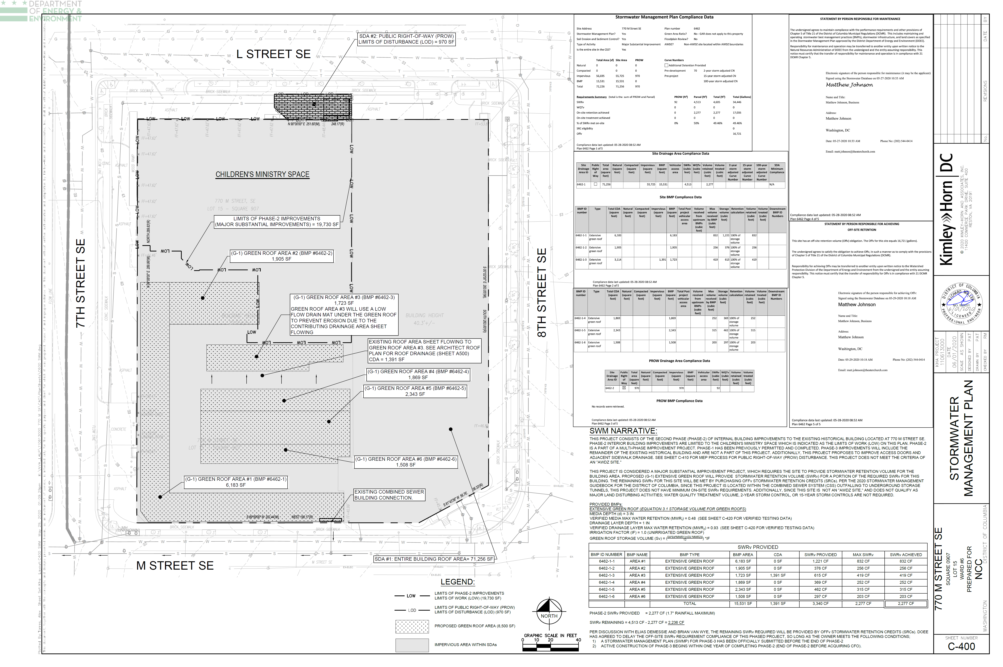
EXAMPLE – STORMWATER MANAGEMENT
Compliance Sheets (Check Timestamp)
Correct BMP ID and info
Stormwater Management Narrative
Storage Volume Calcs
Labeled SDA
Notes:
Important to note that information in each sheet depends on size of project, this information can be split onto various sheets if needed.
Include stormwater management narrative, storage volume calcs
Compliance data sheets from SGS. Plan reviewers will check the timesheet on the sheet on the plans to the latest Compliance data sheet on SGS. So it is best to make sure SGS is correct before pasting these sheets onto the plans.
Labeling and delineating the SDA is very helpful for the plan reviewer
Labeling the BMPs on your plans with the BMP ID given in SGS is very helpful for a plan reviewer to check that the data is correct.

Slide 19
SUMMARY: ITEMS TO INCLUDE
Existing Conditions
  Property line
  Existing buildings, trees
Demolition
  LOD
  If demolition is on a different submitted plan, provide plan number
  Is demolition included in ESC?
Utilities
  BMP utilities
Utility Profile: Items to Include
  15-yr HGL on storm sewer profiles- should not be above pipe
Grading Plan
  Detail to verify SDA, CDA, and placement of ESC
  Detail to verify that grade changes will not cause flooding in neighboring lots
Site Plan
  Detail to understand what is being proposed
Notes:
Didn’t include site plan example because those can vary so much
Depending on project, some information can be on the same sheet. Some information can span multiple sheets. Project specific.

Slide 20
STORMWATER MANAGEMENT PLAN SHEET(S)
Stormwater narrative
Label BMPs with ID in SGS (e.g. Permeable Pavement 1-1, Bioretention 2-3, etc.)
Detention requirements (typically on Compliance Sheet)
  If detention not met on compliance sheet, provide narrative
    Mainly look at CN in the SGS
    Can submit own calculations (Appendix I)
Storage volume calculations
Compliance Data Sheet
  Timestamp should match date sheet in SGS
Delineations
Notes:
Next will go into detail about delineations

