Slide 1
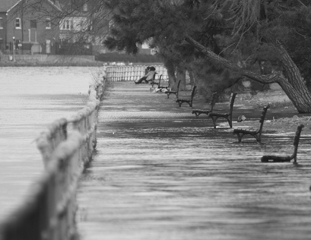

STORMWATER MANAGEMENT PLAN- DELINEATION
TAG THIS PRESENTATION @DOEE_DC
Notes:
In this section, we will go over various delineations for stormwater management.

Slide 2
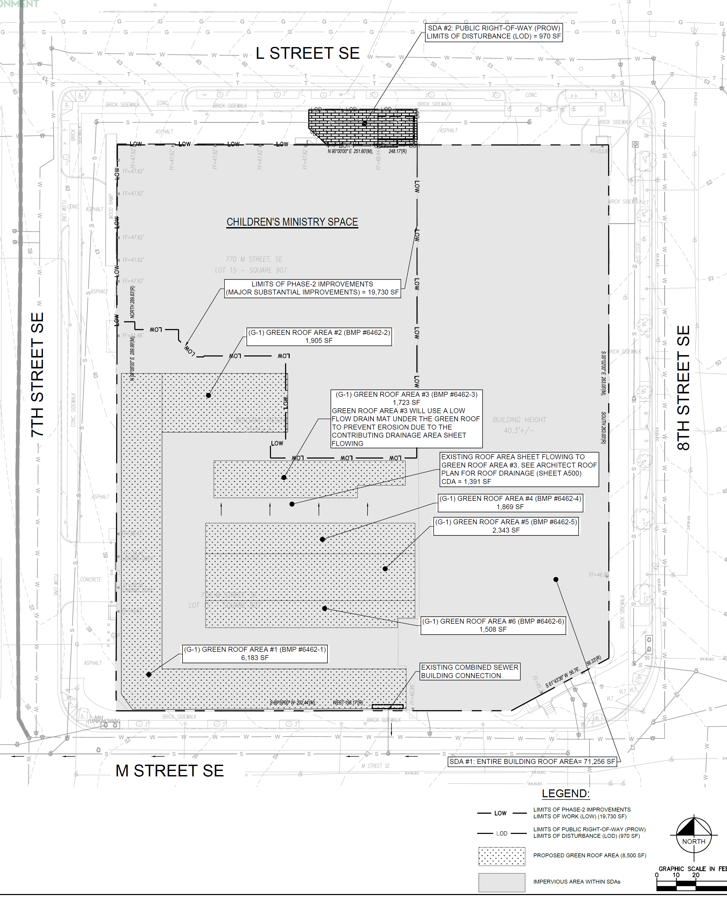
DELINEATION EXAMPLE- MSI
MSI based on whole building footprint even if only a portion of the building is being renovated
Example:
  LOW- building renovation
  SDA- entire building
  Retention volume based on SDA- entire building
Notes:
Our first example is how to delineate major substantial improvement. As a reminder, MSI is based on the whole building footprint, even if only a portion of the building is being renovated. [Grab laser] In the example on the right, only what is labeled LOW [follow LOW with laser] is being renovated. But if stormwater management is triggered for the building, the whole building footprint is used to calculate the stormwater retention volume. In this plan, they shown the whole building footprint and property line and differentiate where they are working with an LOW line.

Slide 3
DELINEATION EXAMPLE- MSI & MLD
Show delineation b/t MSI and MLD
Include area of each type
Notes:
This next example shows the delineation when there is Major sub improvement and major land disturbing activities. We are looking at an existing building that is being renovated with an internal courtyard that will be disturbed land. This designer chose to show MSI was a dark grey and MLD as white. Also included on here is land cover type, which really only applies to MLD. They show the 825SF of compacted cover and 2167SF of bioretention. Everything else is impervious. The plan review will check these numbers of the plans with the information in the data compliance sheets, as shown on the bottom right.
Vika- 6288
Missing area of LOD

Slide 4
DELINEATION EXAMPLE- CDA, LAND TYPE, VAA
CDA is to a BMP
Pre and post land cover area
Don’t forget VAA!
Notes:
For this next example, we are looking at delineations for contributing drainage area, land cover type, and vehicle access acrea. Now, CDA is the area that goes into a BMP. This designer chose to show a view that only includes the CDA, land type, and VAA, which is very helpful for a plan reviewer. The CDA is the subdrainage area for this example. The legend shows how each thing is represented, and a chart below shows the actual area of each delineation- natural cover, compacted cover, impervious surface, VVA, BMP. The chart also shows the pre and post land cover areas. For very complicated plans, this view might be difficult to understand. Works better for simple plans.
CAS 6614

Slide 5
HOW TO DELINEATE SDAS
SINGLE LOT
“Site” = the single lot
Notes:
Next we pulled out some examples from the stormwater guidebook. This is in appendix W if you want more examples. Site drainage areas tend to be commonly misunderstood, so we wanted to review this topic. What is shown here is a project outlined with the LOD. Everything within the LOD is part of a site. This site happens to have 4 SDAs. So lets look at SDA 1. There are two pipes coming out from the site, crosses over the LOD, but them comes together and becomes one single pipe. This single pipe then leaves the lot boundary into another lot or the PROW. There is a distinct point [point to it] at which the pipe leaves the property. Because the pipes combine before leaving the property, it can be considered on site drainage area. Lets look at SDA2. Here we have sheet flow coming off of the property towards the same direction. This one would considered one separate SDA. If there is another area of the lot that is sheet flow in a completely different direction, then it also be a different SDA. Now lets look at SDA 3 and 4. At SDA 3, two pipes combine and leave the SDA aka LOD as one pipe, then this one pipe leaves the property, then connects to a common pipe outside the lot. For SDA, a pipe leaves the LOD, leaves the property, and connects to the same common pipe outside. While ultimately they connect to the same pipe, because they leave the property as separate pipes, they are separate SDA.So in total, this site has 4 sda.

Slide 6
HOW TO DELINEATE SDAS
MULTIPLE LOTS
“Site” = external boundary of lots
Notes:
If you are working on multiple lots at once, the idea is the same, except your site is the external boundary of the lots you are working on.

Slide 7
HOW TO DELINEATE SDAS
CAMPUSES
“Site” = extent of LOD
Notes:
If you are working on campuses, the site drainage area changes a bit. The extent of your site is now the LOD, not the lot boundary. So you determine the SDA based on each pipe leaving the LOD, not the property. So compared to the previous examples, this campus example as one more SDA due to the area in the upper left becoming two SDAs.

Slide 8
DELINEATION EXAMPLE – SITE DRAINAGE AREAS
✓
SDA’s go to distinctly different areas within LOD
  PROW is a separate SDA
Notes:
Next I will go over some real examples of how designers depicted different delienations. In the example on this slide, we see three different site drainage areas with different hatching and color. You can also so the information on the legend to the right. So the things to check are, that the entire LOD is delineated into site drainage areas. Next would be to make sure that each SDA either rsheet flow to the same direction or flow out of the site through the same pipe. In this example, all of the blue area drains to west and out one stormdrain pipe, leaving the property. The SDA 2 is the PROW draining south and SDA 3 is te PROW draining east. The BMPS are shown in a grey shading.
6565

Slide 9
DELINEATION EXAMPLE –
CONTRIBUTING DRAINAGE AREAS
✓
✓
Notes:
This is the same project, but showing the contributing drainage areas to the BMPs. We have two BMPs one a retangle, one L shaped. The color and hatching is showing all of the area that will drain to the BMP. The plan reviewer will check to make sure that all of that water will infact flow into the bioretention, so if there are any storm drains or grading that may be needed, make sure that information can be found on the plans.
Additionally, you may notice that the blue rectangle on the topleft was not part of a SDA in the previous slide. This is because you can have drainage outside of your SDA IF it is from the same property. See appendix W for more detail on this.
6565

Slide 10
DELINEATION EXAMPLE –SDA vs. CDA
✗
SDA should be within LOD
Everything within the LOD should be part of an SDA
LIMITS OF DISTURBANCE
Notes:
This next sample shows the common misunderstanding of SDA and CDA. The dotted line is showing the limits of the CDA, so what drains to the BMP. The thick grey dotted line is showing the site drainage area. The purple line is showing the LOD. There are two things wrong with this example. 1. part of the SDA is outside LOD and 2. Part of LOD is not in any SDA. All site drainage areas should be within an LOD and everything within the LOD should be part of a SDA.
Note that everything is in the PROW, so no “property line” issue. There is a property line drawn in there, but it’s because it’s a private property that will be turned into the PROW, so in the end, it’s all PROW.
Plan 6535- it’s wrong

Slide 11
DELINEATION EXAMPLE – SDA vs. CDA
✓
SDA should be within LOD
CDA is what enters the BMP- can be outside the SDA if it is the same property
LIMITS OF DISTURBANCE
Notes:
Here is the corrected version of the plans. The LOD got moved to delinate the same outline as the site drainage areas. Another thing to note is that for this example, the CDA is outside of the site because it is the same property draining to a BMP within the site.

Slide 12
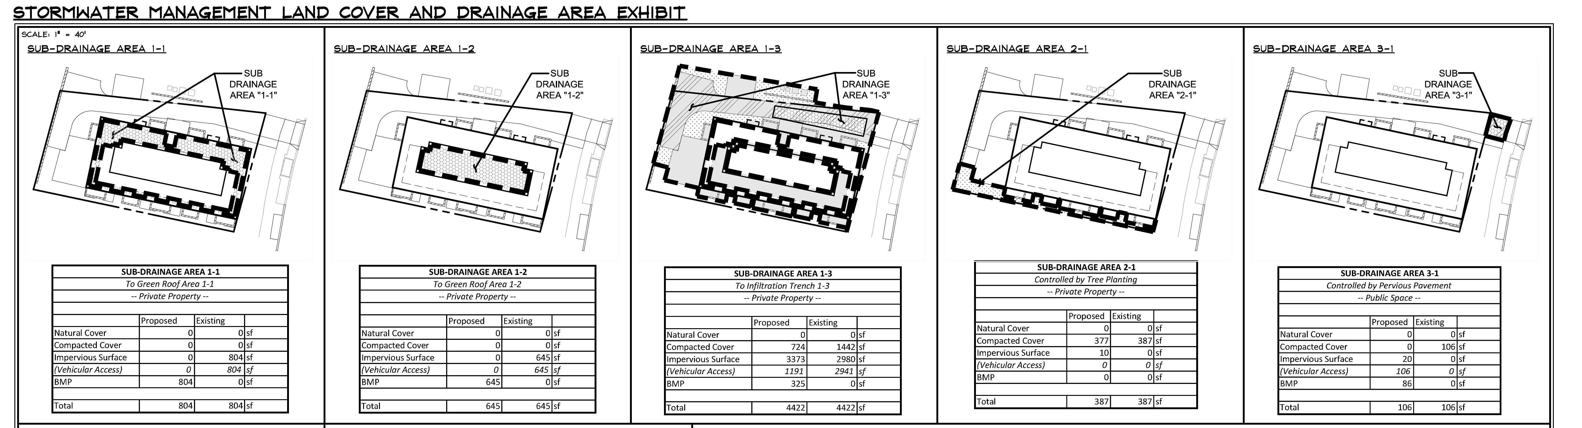
DELINEATION EXAMPLE – SDA and CDA
✓
Format Benefits
Easy to match CDA and land cover with compliance data sheet
Can show exempt areas
Format Limitations
Hard to confirm actual CDA without grading/plan details
Cannot accurately measure CDA on PDF
Notes:
Here is another example of delineating the SDA and contributing drainage area together. Lets look at the first three boxes. Here we see one site drainage area, that has been divided into three sub-drainage areas, which are actually contributing drainage areas in this situation. So we can see the CDA to each BMP within a SDA. So let’s look at the next box. Here we see a separate SDA 2. This is separate from the other 3 because it sheet flows off the property, therefore is a different SDA. The last box shows the 3rd SDA, which is the PROW.
This way of showing SDA and CDA can be very easy for the reviewer to understand and see. It is easy to match CDA and land cover with the compliance data sheets and can easily show exempt areas. The limitations with this example is that it is difficult to confirm the actual CDA without flipping to the grading sheet or the other plan sheets. It is also difficult to accurately measure the CDA on the pdf because the scale is so small. This worsk well for simple projects, where drainage is
5907- CAS

Slide 13
DELINEATION EXAMPLE –BMP vs. CDA
Format Benefits
Good for small projects
Easy to match CDA and land cover with compliance data sheet
Easy to confirm actual CDA with grading/plan details
Can accurately measure CDA on PDF
Format Limitations
Complicated for larger projects
Notes:
Uses color and hatching
5932

Slide 14
DELINEATION SUMMARY
Delineations to include
  Major substantial improvement (MSI) and/or major land disturbing (MLD)
  Contributing Drainage Area (CDA)
  Site Drainage Area (SDA)
  Land cover type pre and post construction for all SDA and CDA
MSI/MLD
  MLD based on LOD
  MSI based on whole building footprint, even if only a portion of the building is being renovated
  Show delineation between the two (if applicable) and the total area of each
Contributing Drainage Area (CDA)
  Area discharging into BMP
  Area discharging from outside property line may be certified for SRCs, can’t count for on-site req.

Slide 15
DELINEATION SUMMARY
Site Drainage Area (SDA)
  Within LOD (MLD) and/or building (MSI) are the SDAs
  In MS4
    50% of SWRv for each SDA must be retained or treated
    50% of SWRv from entire Vehicular Access Area (VAA) must be treated
  If LOD includes PROW, must achieve SWRv to the Maximum Extent Practicable (MEP)- Appendix B
Land cover type pre and post construction for all SDA and CDA
  Natural, compacted, impervious, BMP

Slide 16
Compliance Data Sheets AND STORAGE VOLUME CALCS

Slide 17
Check that data is correct and matches plan sheets
If detention not met, provide narrative or calculations (Appendix I)
If 100% PROW SWRv not met, MEP memo required
Notes:
Make sure data are correct
Check that data match plans
SDA, CDA, VAA, PROW area
BMP type and area
Land cover type and area
If detention has not been met or exempt, plans need to provide narrative or calculations (Appendix I)
If 100% PROW SWRv is not met, MEP memo required
Downstream BMPs

Slide 18
Check that data is correct and matches plan sheets

Slide 19
Include downstream BMPs if applicable
Check that data is correct and matches plan sheets

Slide 20
STORAGE VOLUME CALCULATIONS
BMP storage volume calculator spreadsheet
Found on DOEE Stormwater Management Guidebook page, under Calculators and Spreadsheets
https://doee.dc.gov/node/610622
Example: bioretention and permeable pavement entry into spreadsheet

Slide 21
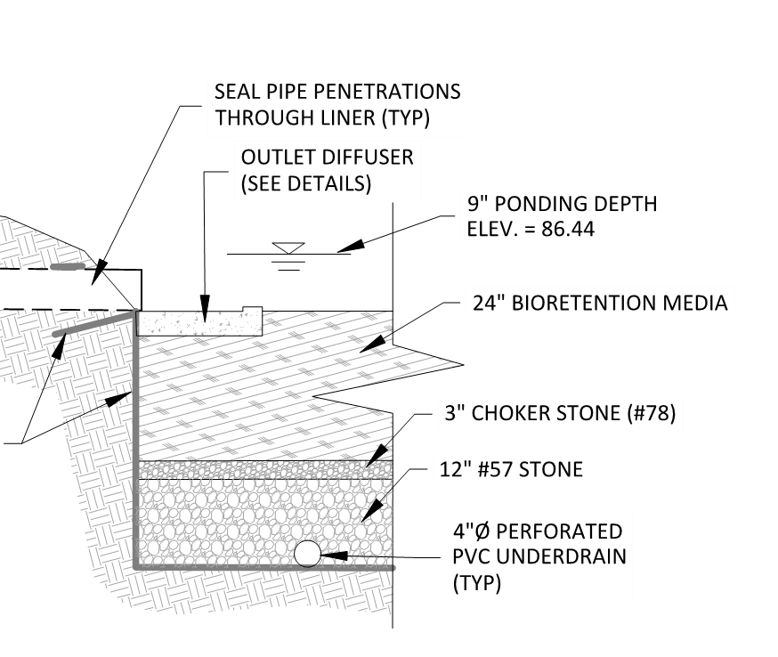
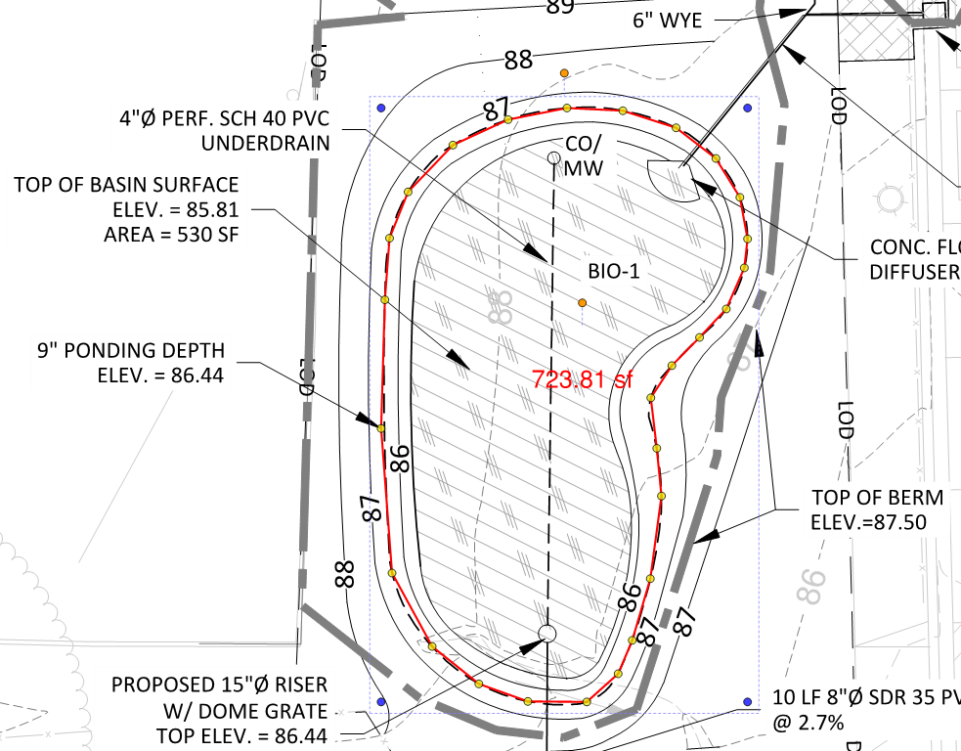
Sv/Rv CALCULATOR EXAMPLE- BIORETENTION
Parameters in calculator:
SA_{top} = 724 sf
SA_{bottom} = 530 sf
Standard
Ksat=0
Notes:
6382: 2959 Carlton Avenue NE

Slide 22
Sv/Rv Calculator Example- Permeable Pavement
Parameters in calculator:
A_{p} = 1589 sf
d_{p} = 2 ft
Standard
Ksat=0
Notes:
CAS 6614

Slide 23
BMP Design and details - BIORETENTION

Slide 24
Example Profile/Cross Section
Show:
All layers
All depths
Elevations
Overflow
Underdrain (no UD in example)
Notes:
6494

Slide 25
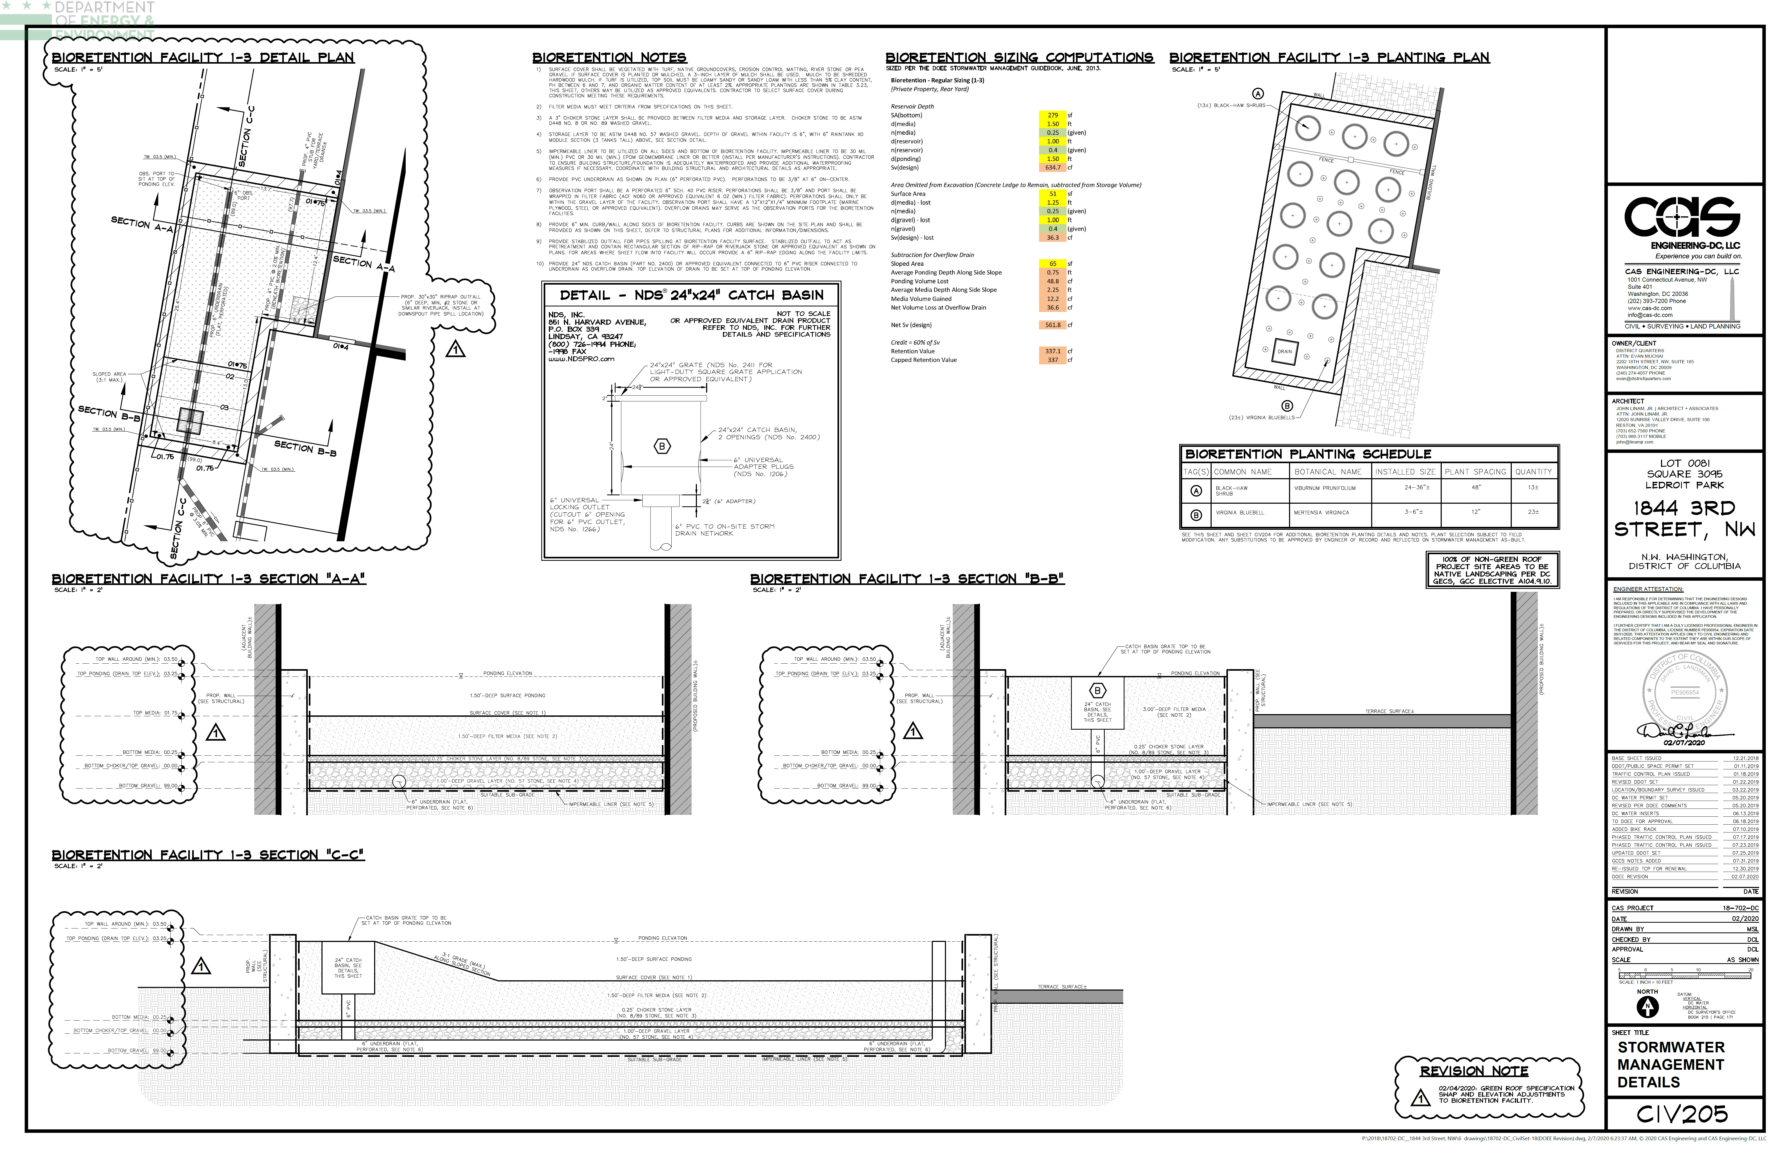
EXAMPLE: BIORETENTION
Notes:
6267

Slide 26
EXAMPLE: BIORETENTION
Details to include:
Location
Size
Material
Slope
Perforated (UD)
Elevation
Details
Other specs
Observation Well
Underdrain
Overflow
Notes:
6267

Slide 27
EXAMPLE: BIORETENTION
Depth of every layer
Material Spec
Included additional information
Notes:
6267

Slide 28
BIORETENTION: ITEMS TO INCLUDE
Calculations that sump will drain in 72 hours
Overflow must be sized to convey the 15-year storm with 3” additional freeboard
Cleanouts must extend above top of ponding
Enhanced Bioretention
  Geotechnical Report showing infiltration rate (Appendix P)
Underground- Geotechnical Report showing no bedrock and groundwater at least 2’ away from bottom of practice
Notes:
I think these slides might just be better for people reading the slides. During the training, I would just talk about each one of these points on the plans in the next pages

Slide 29
REVIEW- INFORMATION TO INCLUDE
Plan view
  Underdrain, observation well, cleanout, overflow, inlet, outlet location
  Pretreatment w/ detail (if applicable)
  Landscape Plan (if applicable)
Profile/cross section of practice
  Has to match plan view
  Show detail of inlet, outlet, overflow, cleanout, observation well
  Depth of every layer
Material specification for all layers
Impermeable liner, required when within 10 feet of a building
How stormwater enters and leaves a BMP
When stormwater leaves a site, non-erosive forces and no flooding for 15-year storm
Check that CDA does not exceed max allowable

Slide 30
BMP Design and details – PERMEABLE PAVEMENT

Slide 31
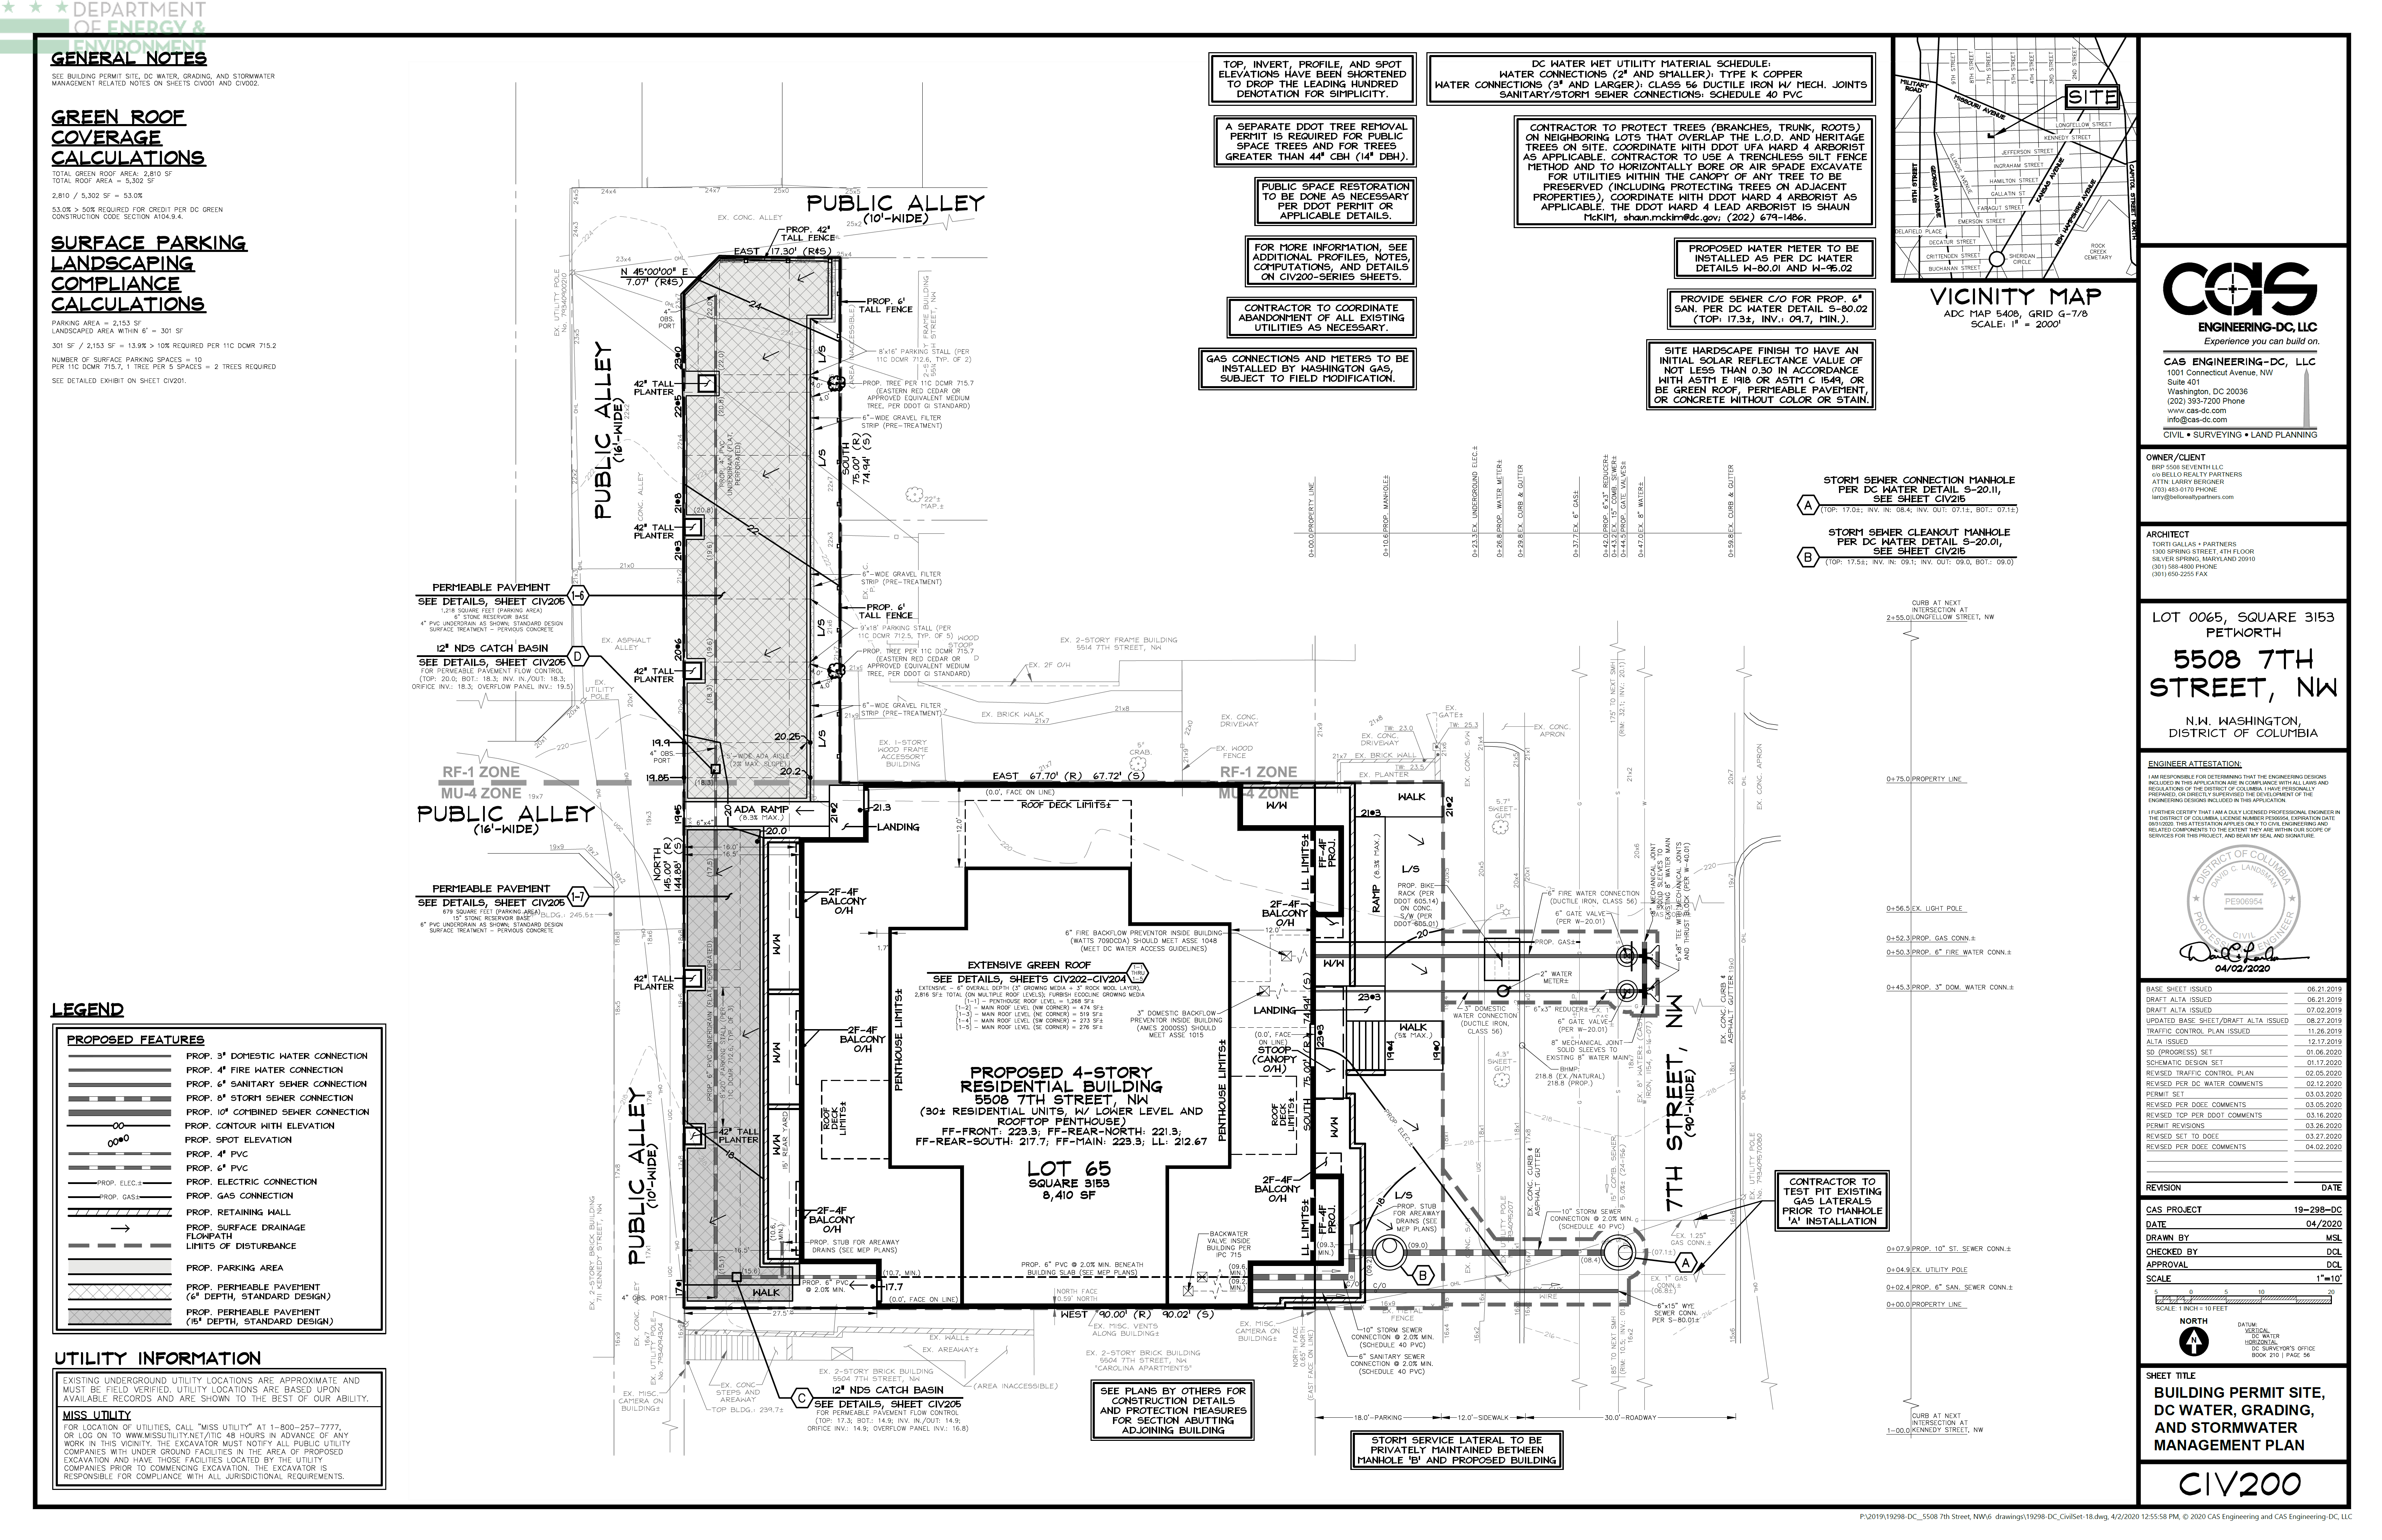
EXAMPLE: PERMEABLE PAVEMENT
Contours
Can calculate slope
Can confirm CDA
Connects to existing
Observation Well
Details to include:
Location
Size
Material
Type
Slope
Perforated (UD)
Elevation
Details
Pretreatment
Underdrain
Overflow
Notes:
6604

Slide 32
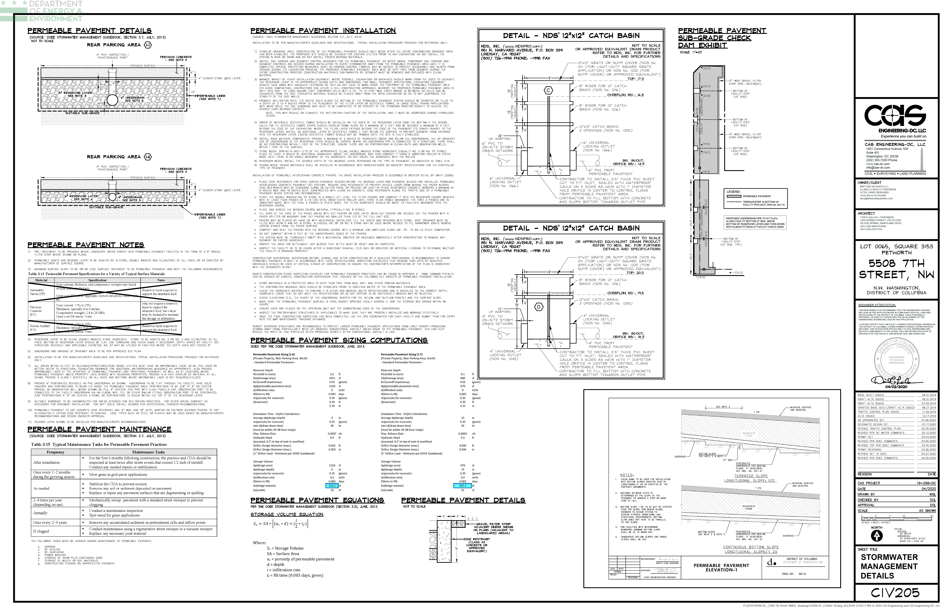
EXAMPLE: PERMEABLE PAVEMENT
Depth of every layer

Slide 33
EXAMPLE: PERMEABLE PAVEMENT
Depth
Check dam information
Calculations
Notes:
6604

Slide 34
PERMEABLE PAVEMENT: ITEMS TO INCLUDE
Type of PP must be selected (Permeable pavers, asphalt, or concrete) and consistent on all sheets
Additional CDA should be 100% impervious, if not, show pretreatment
Edging detail
Calculations that PP will drain between 36-48 hours
Orifice calculations
Slope of top of permeable pavement (maximum 5%) and bottom of permeable pavement (maximum 0% unless have check dams)
Geotechnical Report showing no bedrock and groundwater at least 2’ away from bottom of practice
Enhanced PP
  Geotechnical Report showing infiltration rate (Appendix P)
Notes:
I think these slides might just be better for people reading the slides. During the training, I would just talk about each one of these points on the plans in the next pages

Slide 35
REVIEW- INFORMATION TO INCLUDE
Plan view
  Underdrain, observation well, cleanout, overflow, inlet, outlet location
  Pretreatment w/ detail (if applicable)
Profile/cross section of practice
  Has to match plan view
  Show detail of inlet, outlet, overflow, cleanout, observation well
  Depth of every layer
Material specification for all layers
Impermeable liner, required when within 10 feet of a building
How stormwater enters and leaves a BMP
When stormwater leaves a site, non-erosive forces and no flooding for 15-year storm
Check that CDA does not exceed max allowable

Slide 36
BMP Design and details – GREEN ROOF

Slide 37
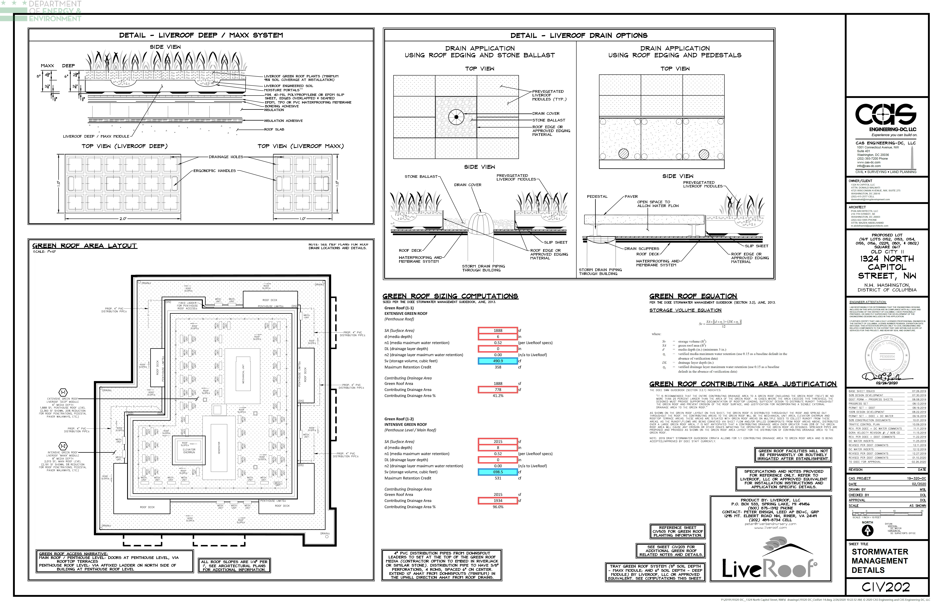
EXAMPLE: GREEN ROOF
Green roof detail with depths and all layers
Roof drain detail
Calculations
GR Layout Details (next slide)
Note on additional CDA
Note on irrigation
Notes:
6445

Slide 38
EXAMPLE: GREEN ROOF
Roof access
Mechanical Equipment
Roof slope
Roof drain
Note floor of GR
Notes:
6445

Slide 39
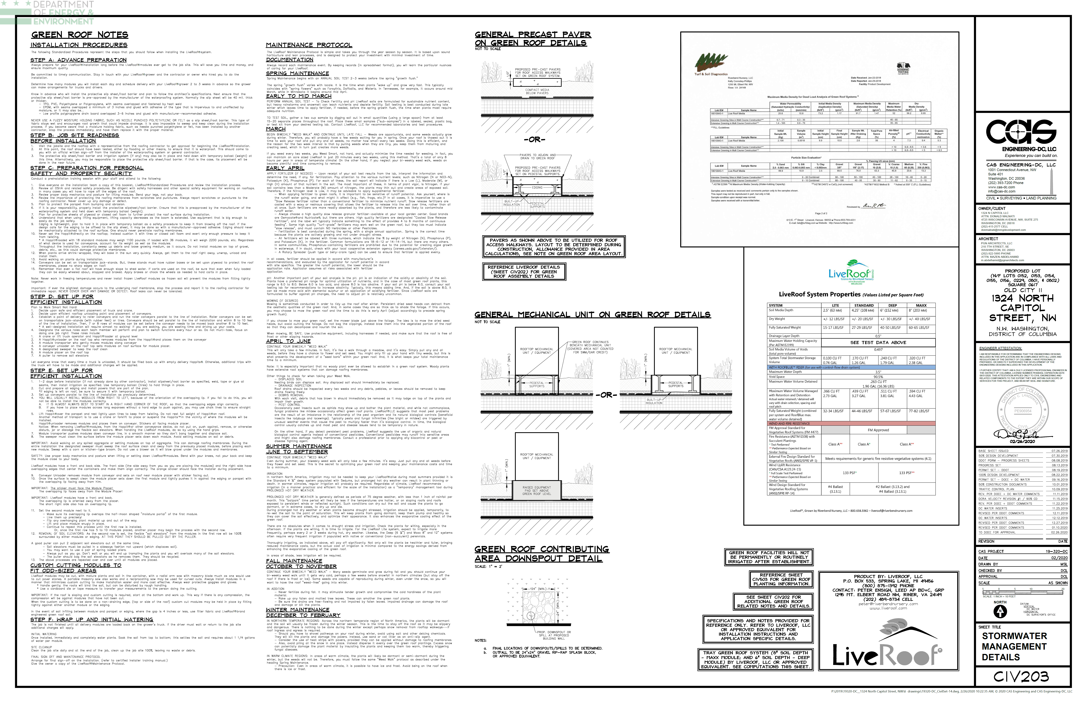
EXAMPLE: GREEN ROOF
Lab result of media retention
Notes:
6445

Slide 40
GREEN ROOF: ITEMS TO INCLUDE
Overflow drains, roof drains, roof slope
2’ minimum distance between HVAC equipment and green roof
Roof top equipment on plans
How green roofs are accessed
Which floor the green roof is on (usually if on multiple floors)
Manufacturer’s specification detailing maximum water retention value for green roof media and drainage layer
PV panels, must meet design requirements
Provide Riser Diagram if overflow drains to another BMP
If have run-on CDA, show how it enters the green roof and how it is designed to not cause erosion
Only intensive green roofs can be irrigated, and if so, they receive 50% of the retention volume
Each distinct green roof should be entered into the SGS separately (within reason)
Notes:
I think these slides might just be better for people reading the slides. During the training, I would just talk about each one of these points on the plans in the next pages

Slide 41
REVIEW- INFORMATION TO INCLUDE
Plan view
  Underdrain, observation well, cleanout, overflow, inlet, outlet location
  Pretreatment w/ detail (if applicable)
  Landscape Plan (if applicable)
Profile/cross section of practice
  Has to match plan view
  Show detail of inlet, outlet, overflow, cleanout, observation well
  Depth of every layer
Material specification for all layers
How stormwater enters and leaves a BMP
Check that CDA does not exceed max allowable

Slide 42
BMP Design and details – TREES

Slide 43
TREE PLANTING/PRESERVATION: ITEMS TO INCLUDE
Tree Planting
  Show that the rootable soil volume is met and delineate the area used
  Proposed tree size and location
Tree Preservation
  Must have tree inventory from professional, detailing tree species, size, condition, and ecological value
  Show critical root zone (CRZ)
  Not that if a tree dies it must be replaced by a tree of similar mature spread no longer than 6 months from time of depth in an appropriate location
Notes:
5880

Slide 44
EXAMPLE- TREE PLANTING
Credit calculations
Note
Delineate rootable soil volume
Proposed tree species and size
Notes:
5880

Slide 45
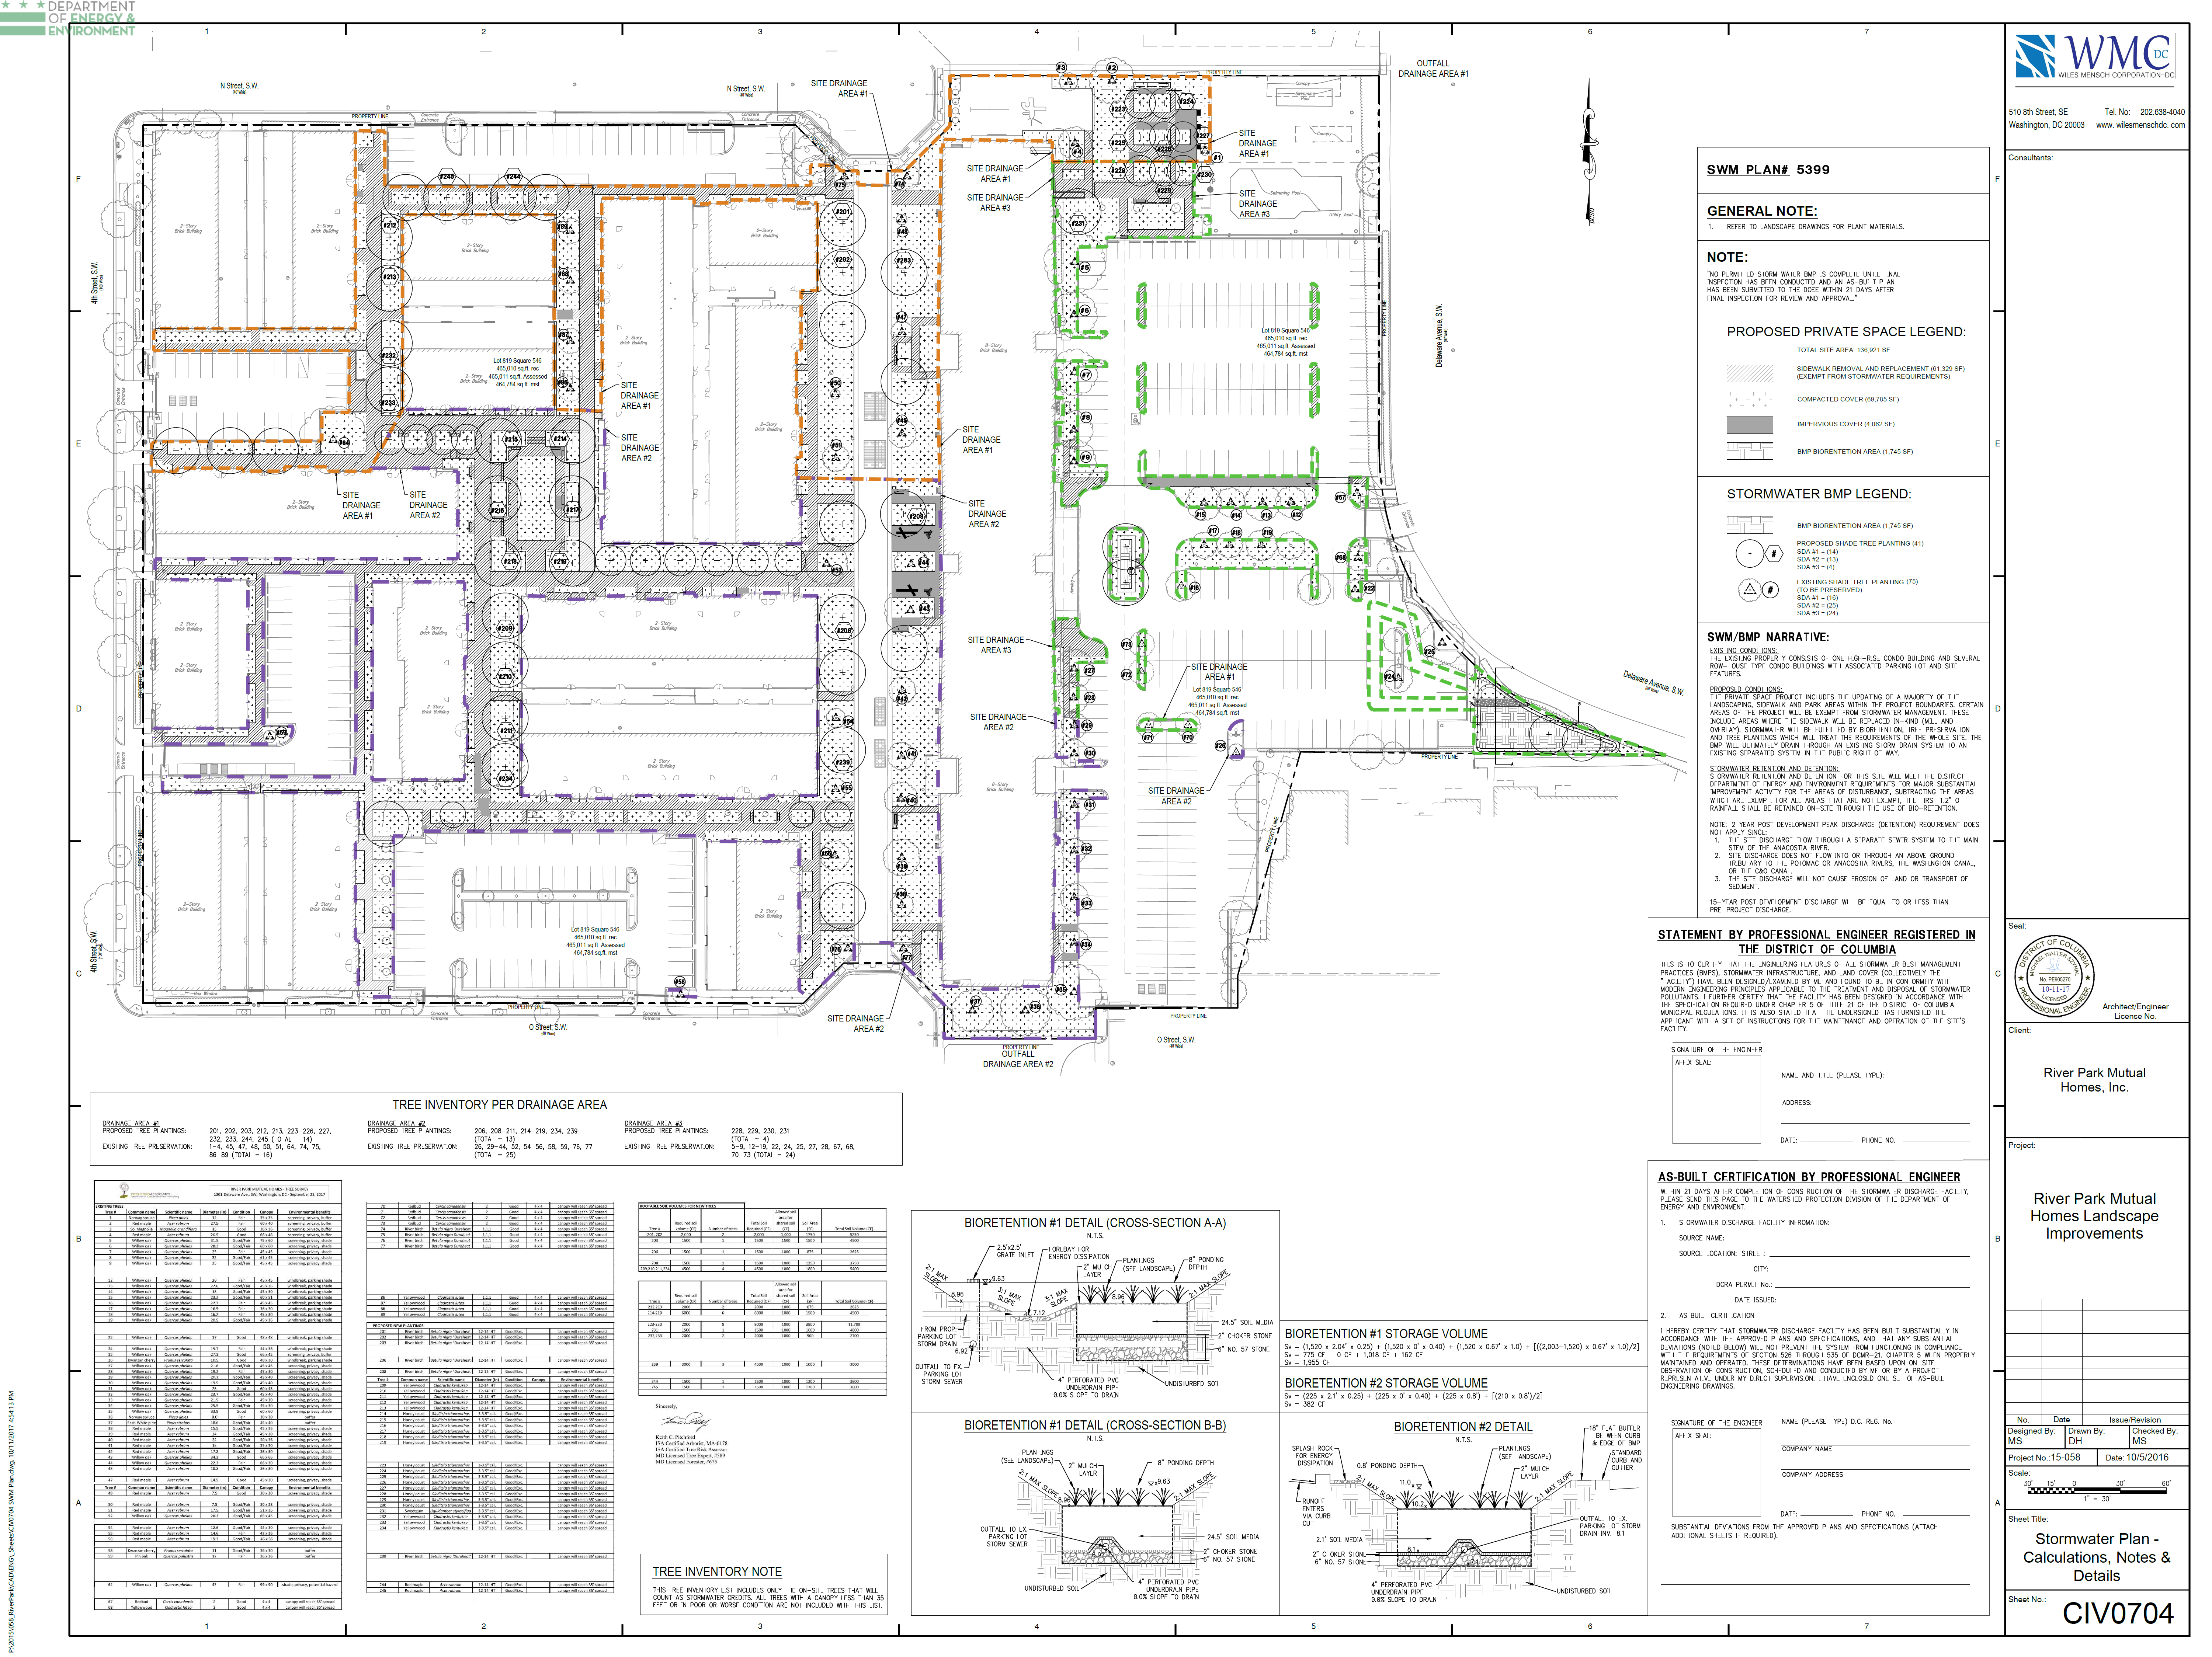
EXAMPLE- TREE PLANTING/PRES.
Proposed trees with species, soil requirement, size
Existing tree inventory with species, size, condition, value
Show where proposed/preserved trees are located
Notes:
Preseration plan certified by landscape professional
5399
This example uses tree ID numbers

Slide 46
EXAMPLE- TREE INVENTORY
Tree # | Common Name | Scientific name | Diameter (in) | Condition | Canopy | Ecological Benefits
1 | Norway spruce | Picea abies | 12 | Fair | 35 x 35 | Screening, privacy, buffer
2 | Red maple | Acer rubrum | 27.5 | Fair | 60 x 40 | Screening, privacy, buffer
3 | Pin Oak | Quercus palutris | 11.1 | Good-Fair |  | Species notable for: wildlife forage, native insect habitat, large mature canopy
Notes:
5399
What is included in tree inventory

