Slide 1
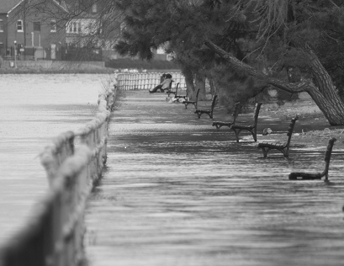

Compliance Data Sheets AND STORAGE VOLUME CALCS

Slide 2
Check that data is correct and matches plan sheets
If detention not met, provide narrative or calculations (Appendix I)
If 100% PROW SWRv not met, MEP memo required
Notes:
Make sure data are correct
Check that data match plans
SDA, CDA, VAA, PROW area
BMP type and area
Land cover type and area
If detention has not been met or exempt, plans need to provide narrative or calculations (Appendix I)
If 100% PROW SWRv is not met, MEP memo required
Downstream BMPs

Slide 3
Check that data is correct and matches plan sheets

Slide 4
Include downstream BMPs if applicable
Check that data is correct and matches plan sheets

Slide 5
Stormwater volume calculations

Slide 6
STORAGE VOLUME CALCULATIONS
BMP storage volume calculator spreadsheet
Found on DOEE Stormwater Management Guidebook page, under Calculators and Spreadsheets
https://doee.dc.gov/node/610622
Example: bioretention and permeable pavement

Slide 7
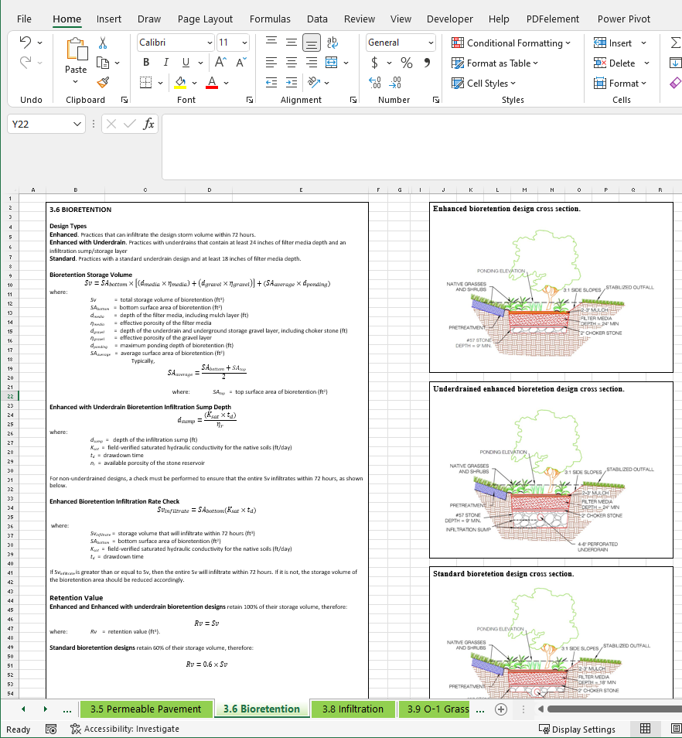
STORAGE VOLUME CALCULATOR

Slide 8
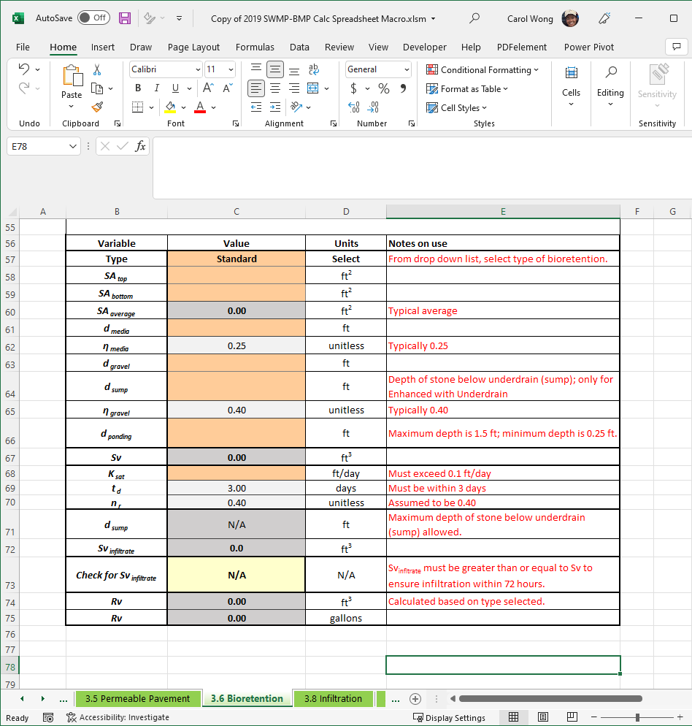
STORAGE VOLUME CALCULATOR

Slide 9
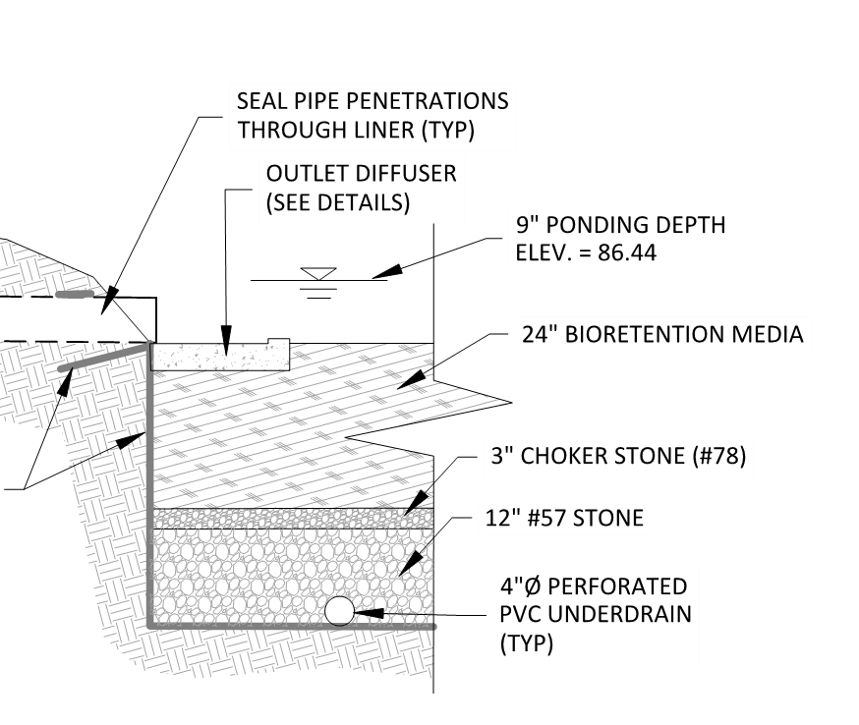
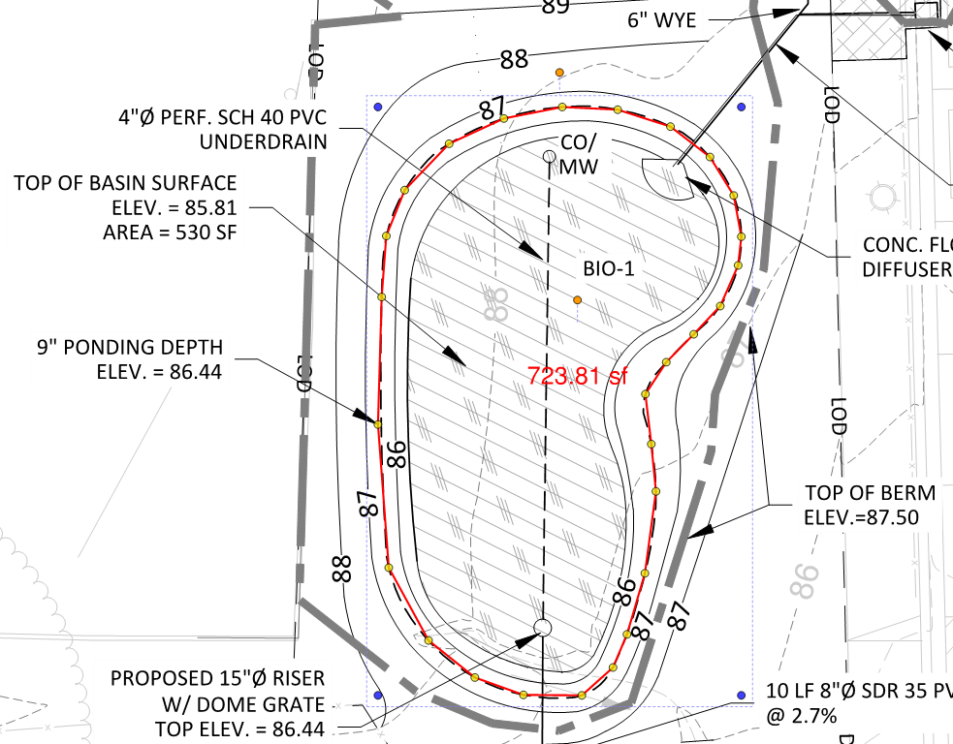
Sv/Rv CALCULATOR EXAMPLE- BIORETENTION
Parameters in calculator:
SA_{top} = 724 sf
SA_{bottom} = 530 sf
Standard
Ksat=0
Notes:
6382: 2959 Carlton Avenue NE

Slide 10
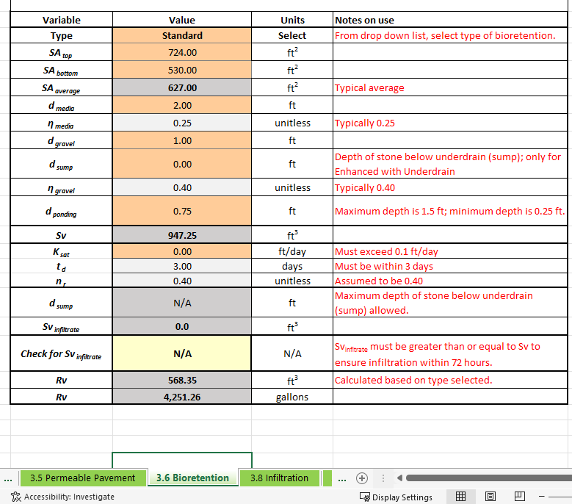

Slide 11
Sv/Rv Calculator Example- Permeable Pavement
Parameters in calculator:
A_{p} = 1589 sf
d_{p} = 2 ft
Standard
Ksat=0
Notes:
CAS 6614

Slide 12
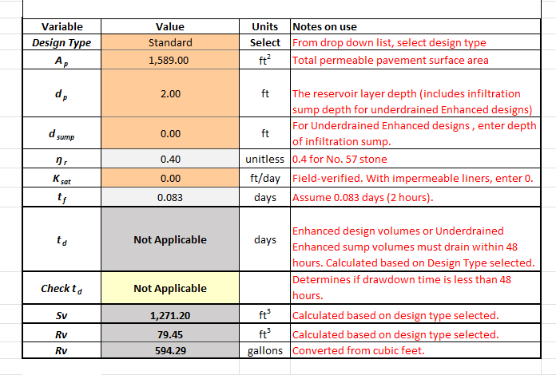

Slide 13
BMP Design and details - BIORETENTION

Slide 14
Example Profile/Cross Section
Show:
All layers
All depths
Elevations
Overflow
Underdrain (no UD in example)
Notes:
6494

Slide 15
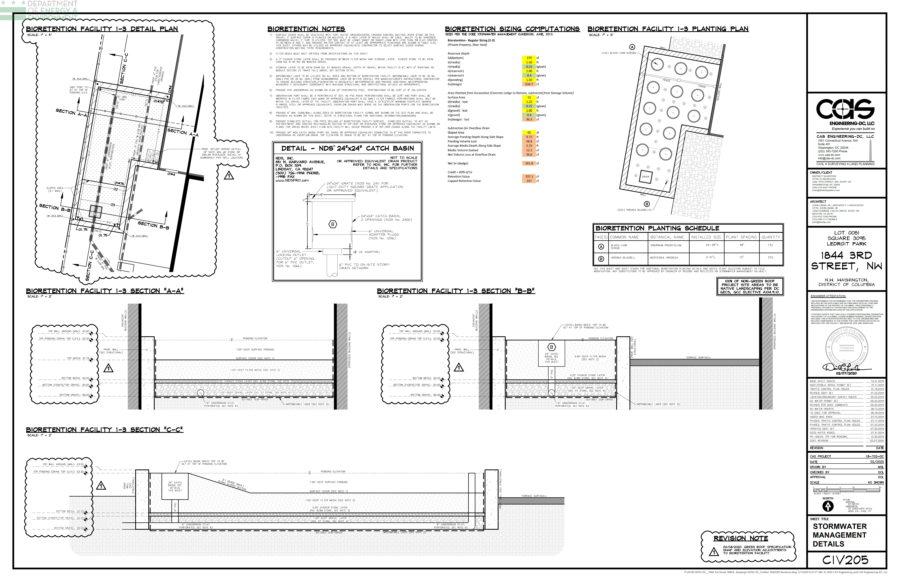
EXAMPLE: BIORETENTION
Notes:
6267

Slide 16
EXAMPLE: BIORETENTION
Details to include:
Location
Size
Material
Slope
Perforated (UD)
Elevation
Details
Other specs
Observation Well
Underdrain
Overflow
Notes:
6267

Slide 17
EXAMPLE: BIORETENTION
Depth of every layer
Material Spec
Included additional information
Notes:
6267

Slide 18
BIORETENTION: ITEMS TO INCLUDE
Calculations that sump will drain in 72 hours
Overflow must be sized to convey the 15-year storm with 3” additional freeboard
Cleanouts must extend above top of ponding
Enhanced Bioretention
  Geotechnical Report showing infiltration rate (Appendix P)
Underground- Geotechnical Report showing no bedrock and groundwater at least 2’ away from bottom of practice
Notes:
I think these slides might just be better for people reading the slides. During the training, I would just talk about each one of these points on the plans in the next pages

Slide 19
BMP Design and details – PERMEABLE PAVEMENT

Slide 20
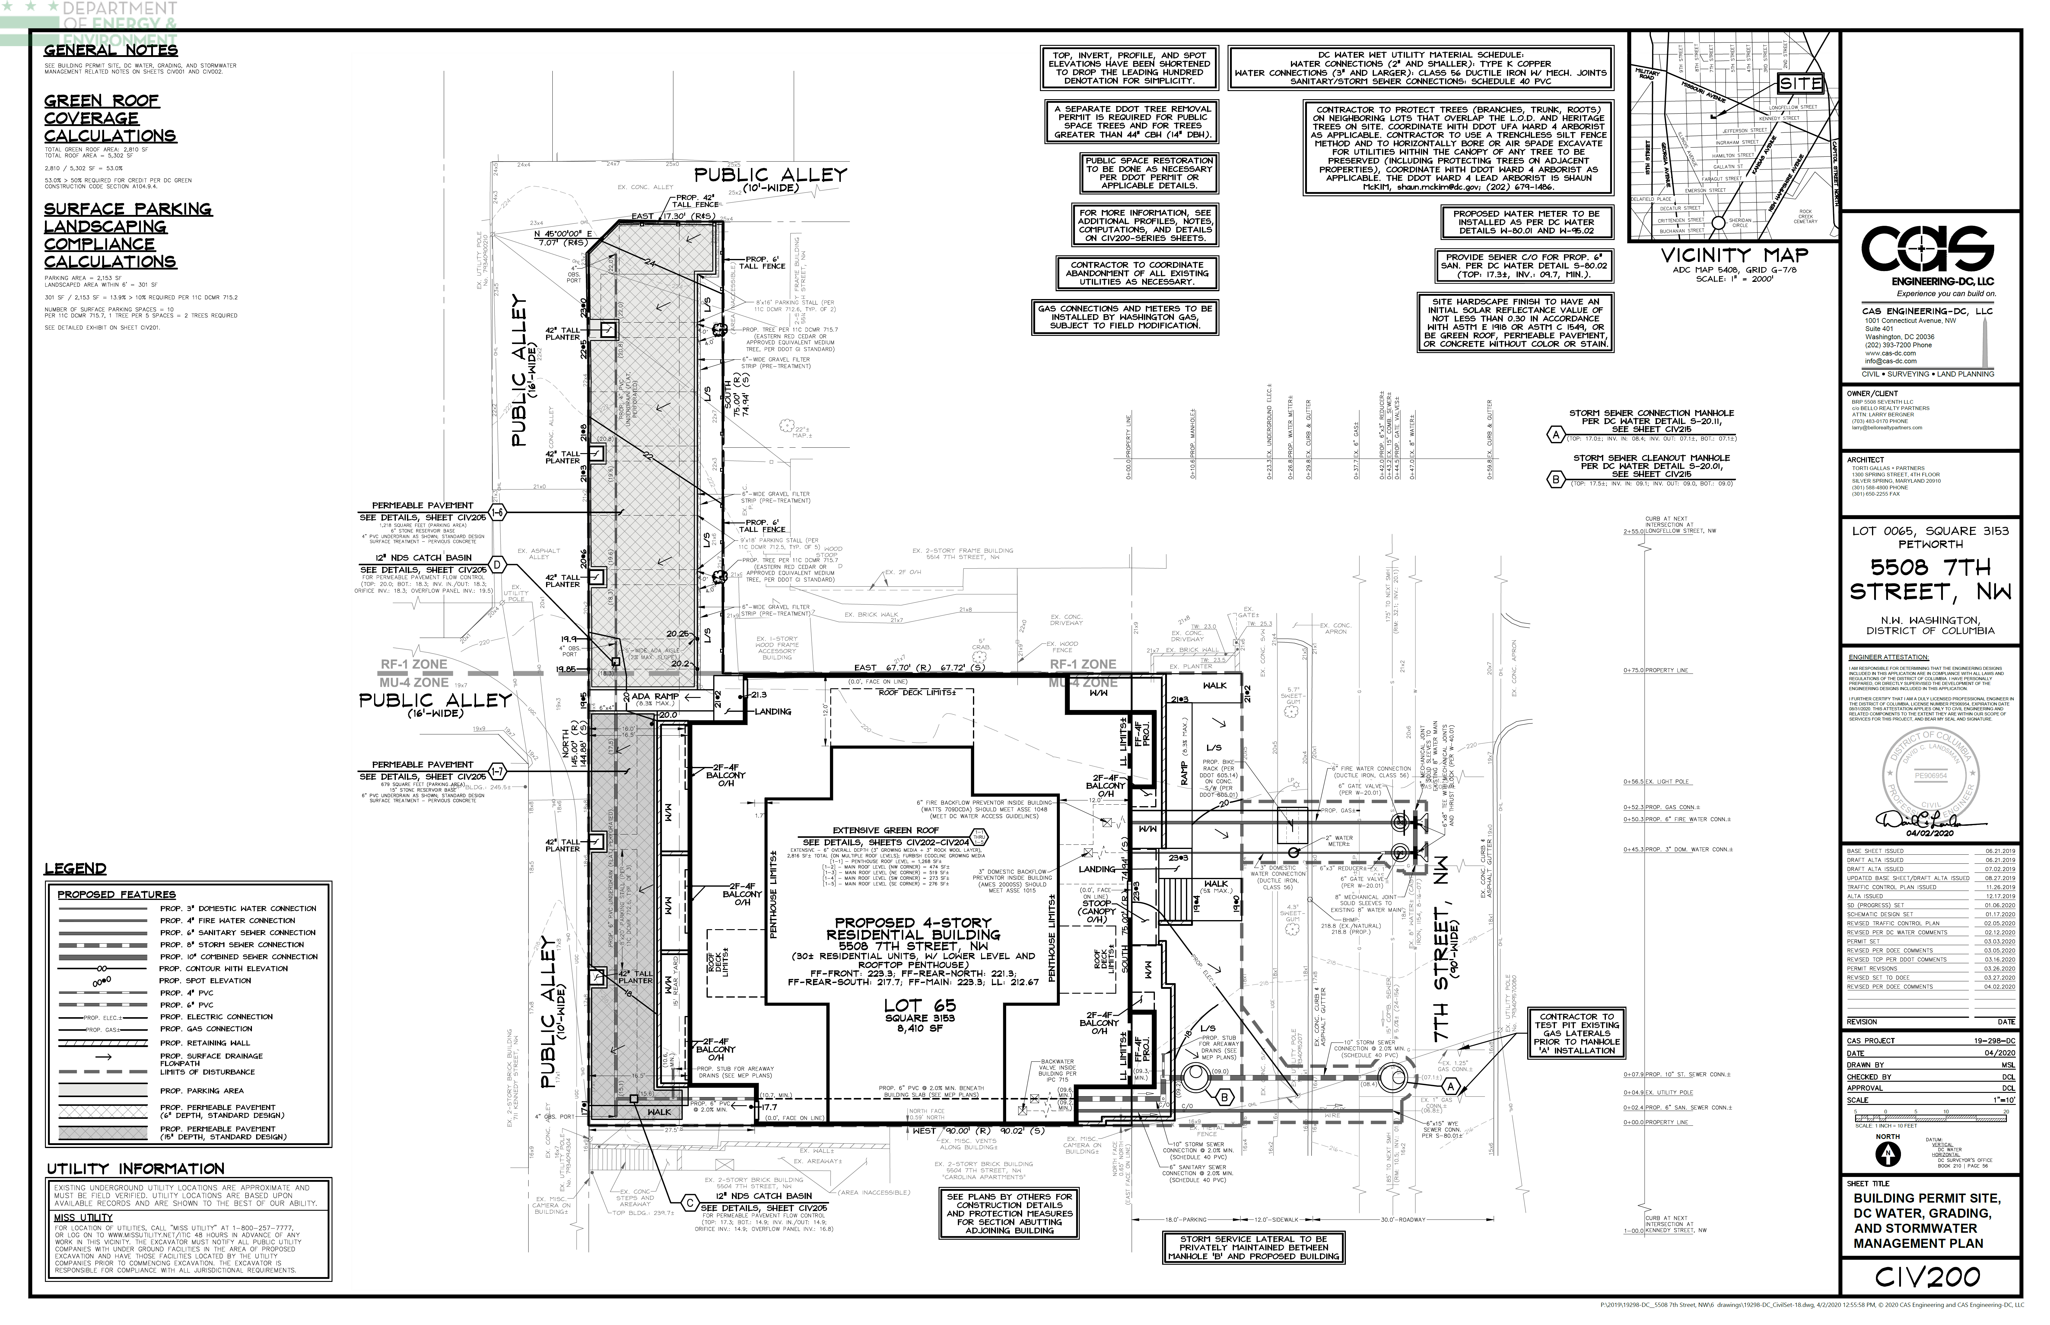
EXAMPLE: PERMEABLE PAVEMENT
Contours
Can calculate slope
Can confirm CDA
Connects to existing
Observation Well
Details to include:
Location
Size
Material
Type
Slope
Perforated (UD)
Elevation
Details
Pretreatment
Underdrain
Overflow
Notes:
6604

Slide 21
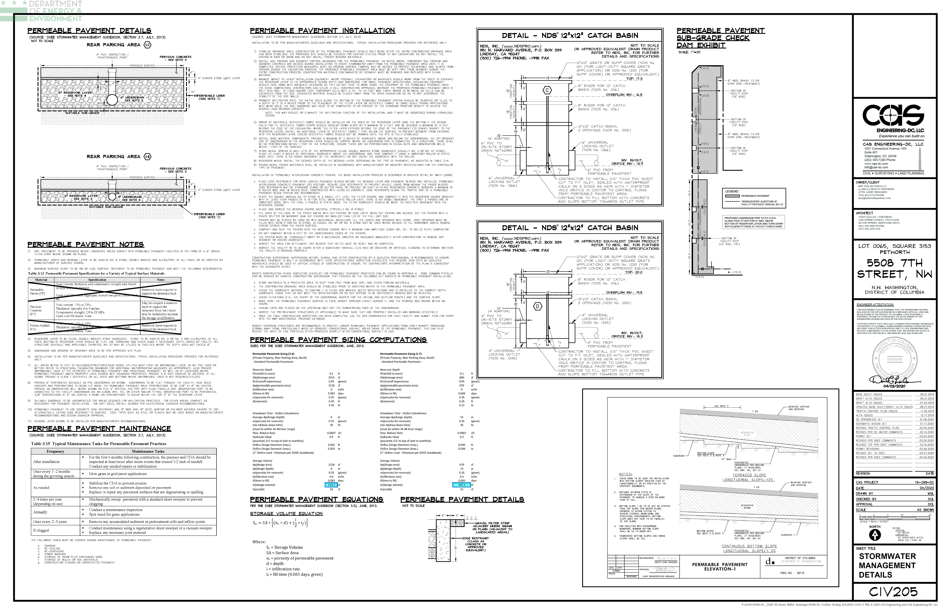
EXAMPLE: PERMEABLE PAVEMENT
Depth
Check dam information
Calculations
Notes:
6604

Slide 22
PERMEABLE PAVEMENT: ITEMS TO INCLUDE
Type of PP must be selected (Permeable pavers, asphalt, or concrete) and consistent on all sheets
Additional CDA should be 100% impervious, if not, show pretreatment
Edging detail
Calculations that PP will drain between 36-48 hours
Orifice calculations
Slope of top of permeable pavement (maximum 5%) and bottom of permeable pavement (maximum 0% unless have check dams)
Geotechnical Report showing no bedrock and groundwater at least 2’ away from bottom of practice
Enhanced PP
  Geotechnical Report showing infiltration rate (Appendix P)
Notes:
I think these slides might just be better for people reading the slides. During the training, I would just talk about each one of these points on the plans in the next pages

Slide 23
REVIEW- INFORMATION TO INCLUDE
Plan view
  Underdrain, observation well, cleanout, overflow, inlet, outlet location
  Pretreatment w/ detail (if applicable)
Profile/cross section of practice
  Has to match plan view
  Show detail of inlet, outlet, overflow, cleanout, observation well
  Depth of every layer
Material specification for all layers
Impermeable liner, required when within 10 feet of a building
How stormwater enters and leaves a BMP
When stormwater leaves a site, non-erosive forces and no flooding for 15-year storm
Check that CDA does not exceed max allowable

Slide 24
BMP Design and details – GREEN ROOF

Slide 25
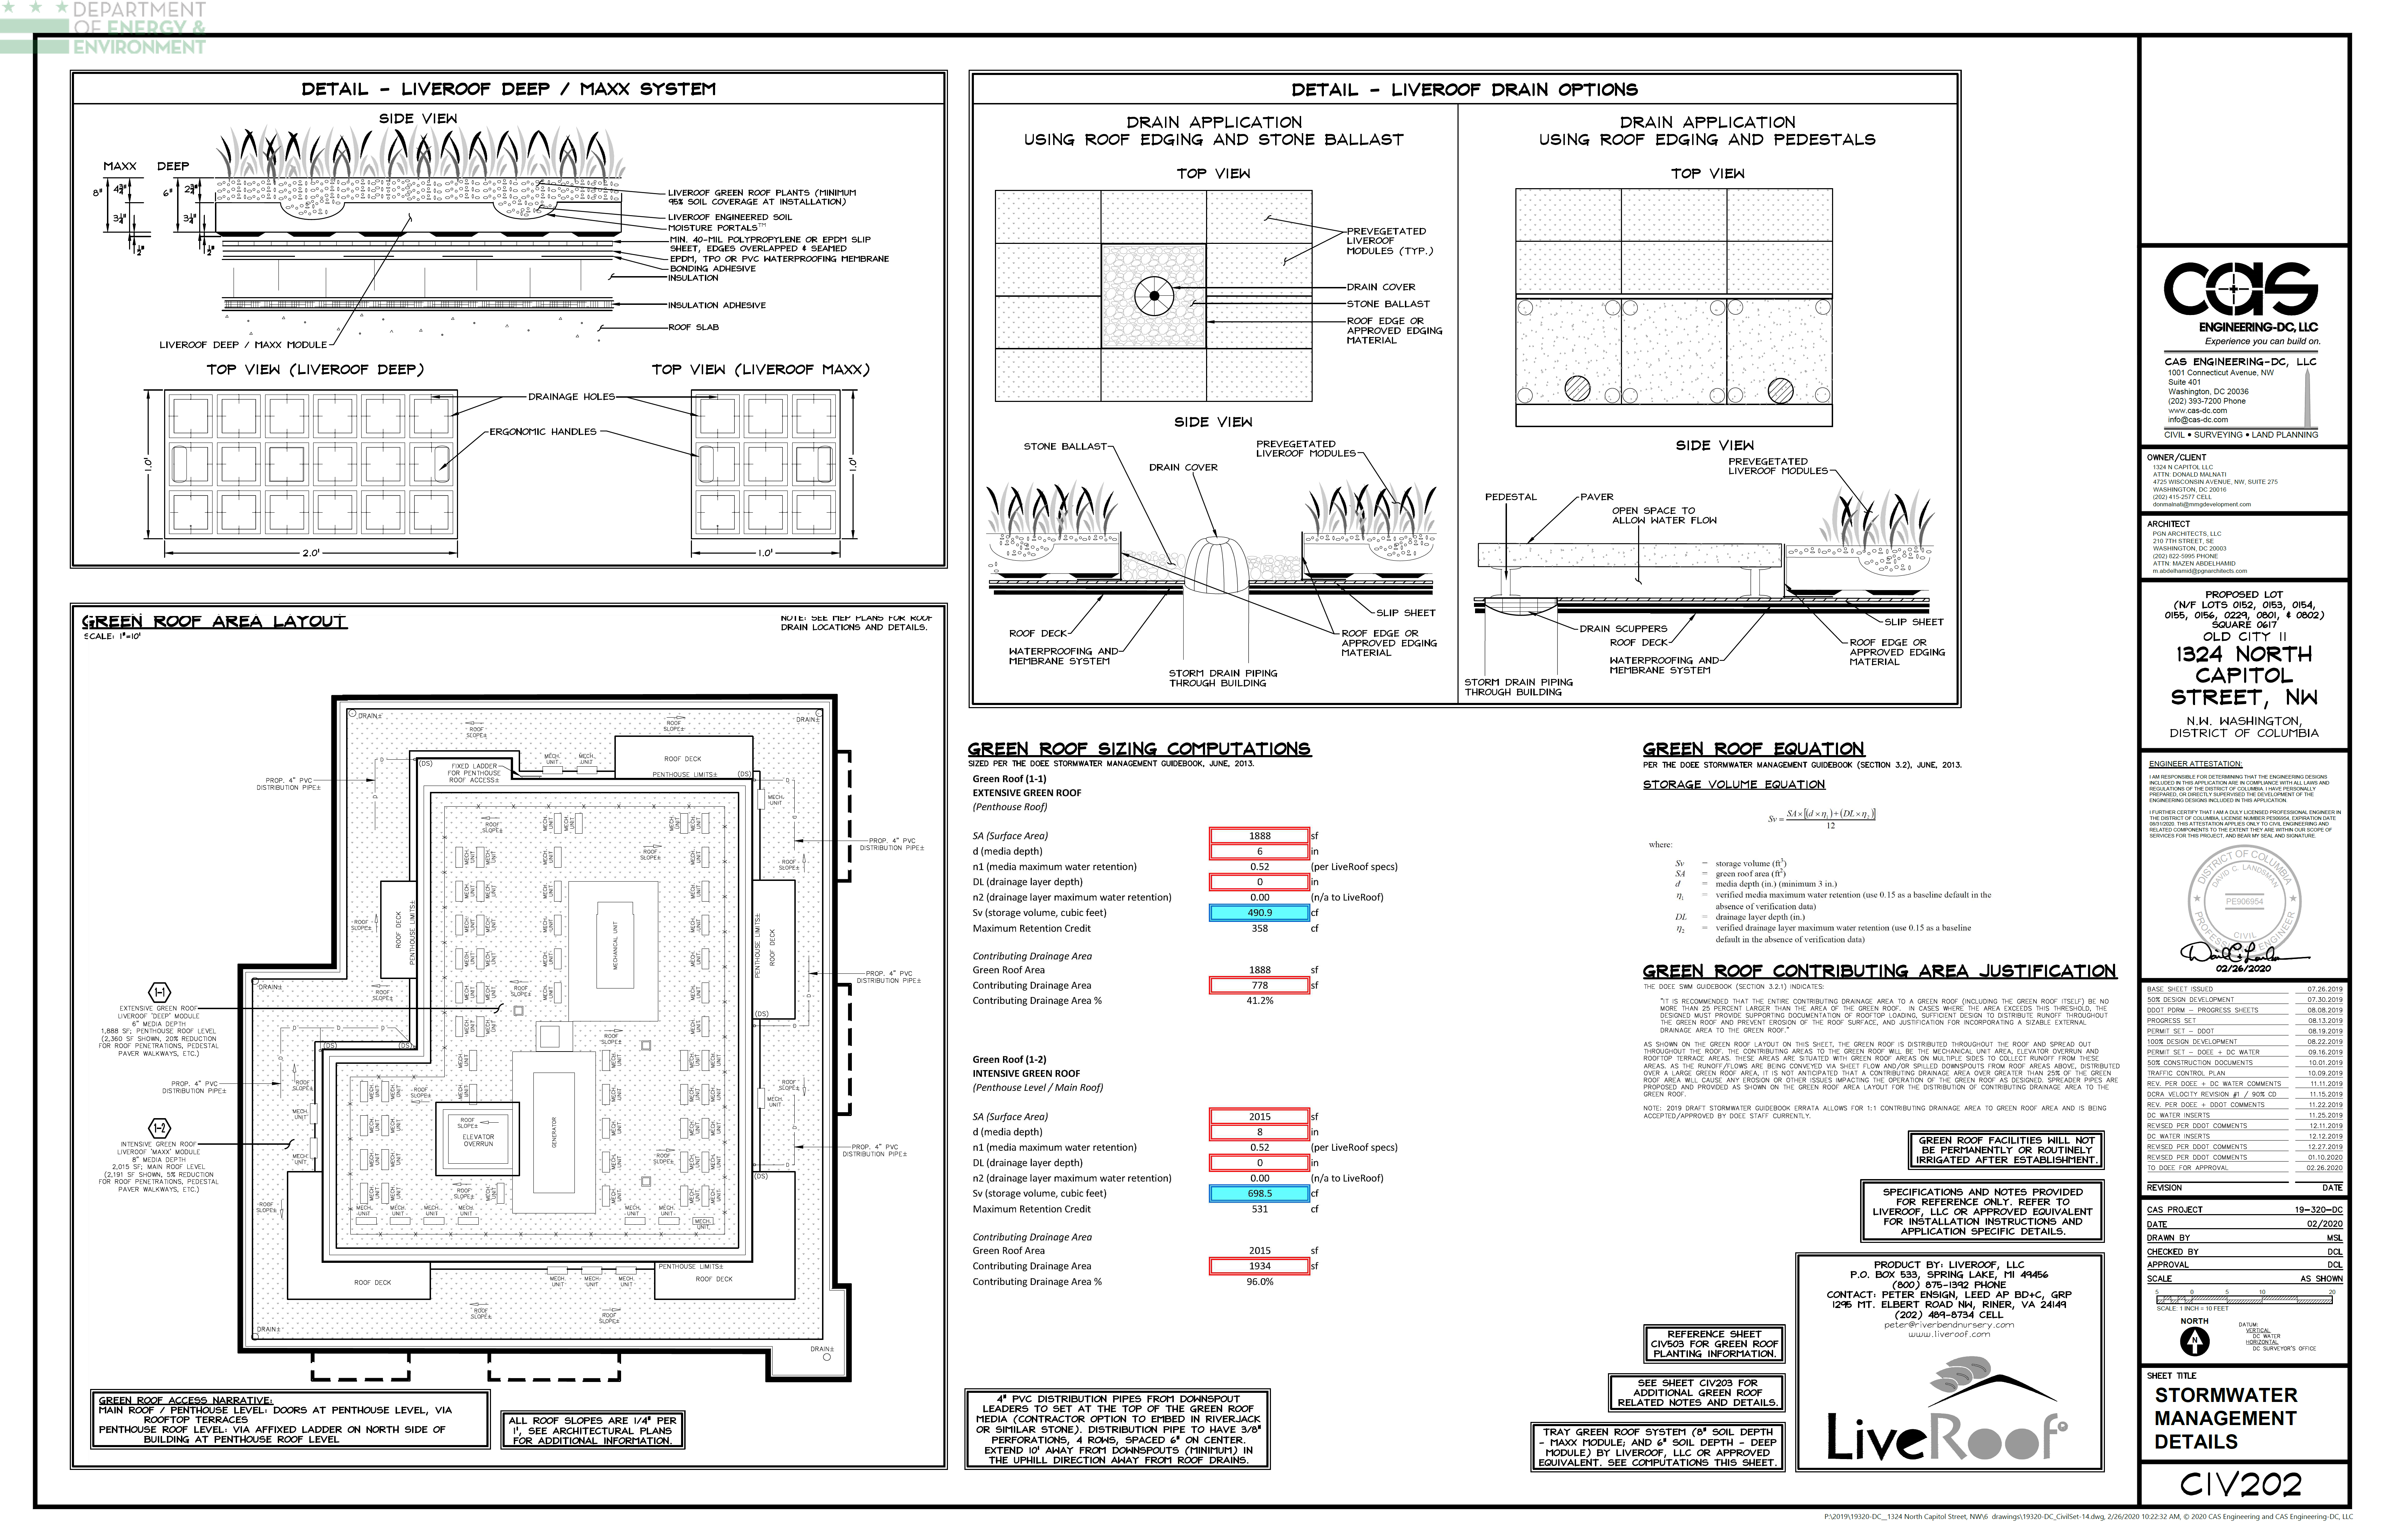
EXAMPLE: GREEN ROOF
Green roof detail with depths and all layers
Roof drain detail
Calculations
GR Layout Details (next slide)
Note on additional CDA
Note on irrigation
Notes:
GR layour details last thing
6445

Slide 26
EXAMPLE: GREEN ROOF
Roof access
Mechanical Equipment
Roof slope
Roof drain
Note floor of GR
Notes:
Note floor of GR last
6445

Slide 27
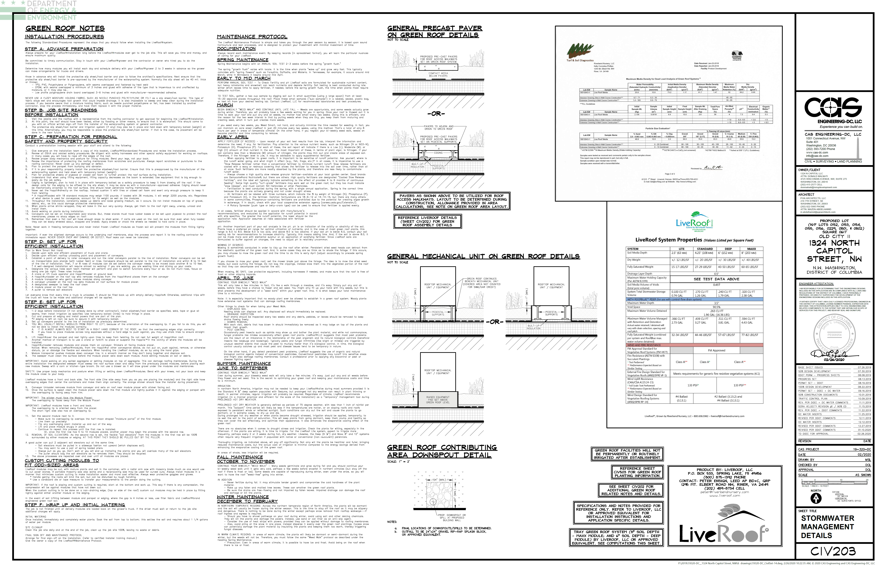
EXAMPLE: GREEN ROOF
Lab result of media retention
Notes:
6445

Slide 28
GREEN ROOF: ITEMS TO INCLUDE
Overflow drains, roof drains, roof slope
2’ minimum distance between HVAC equipment and green roof
Roof top equipment on plans
How green roofs are accessed
Which floor the green roof is on (usually if on multiple floors)
Manufacturer’s specification detailing maximum water retention value for green roof media and drainage layer
PV panels, must meet design requirements
Provide Riser Diagram if overflow drains to another BMP
If have run-on CDA, show how it enters the green roof and how it is designed to not cause erosion
Only intensive green roofs can be irrigated, and if so, they receive 50% of the retention volume
Each distinct green roof should be entered into the SGS separately (within reason)
Notes:
I think these slides might just be better for people reading the slides. During the training, I would just talk about each one of these points on the plans in the next pages

Slide 29
BMP Design and details – TREES

Slide 30
TREE PLANTING/PRESERVATION: ITEMS TO INCLUDE
Tree Planting
  Show that the rootable soil volume is met and delineate the area used
  Proposed tree size and location
Tree Preservation
  Must have tree inventory from professional, detailing tree species, size, condition, and ecological value
  Show critical root zone (CRZ)
  Not that if a tree dies it must be replaced by a tree of similar mature spread no longer than 6 months from time of death in an appropriate location
Notes:
5880

Slide 31
EXAMPLE- TREE PLANTING
Credit calculations
Note
Delineate rootable soil volume
Proposed tree species and size
Notes:
5880

Slide 32
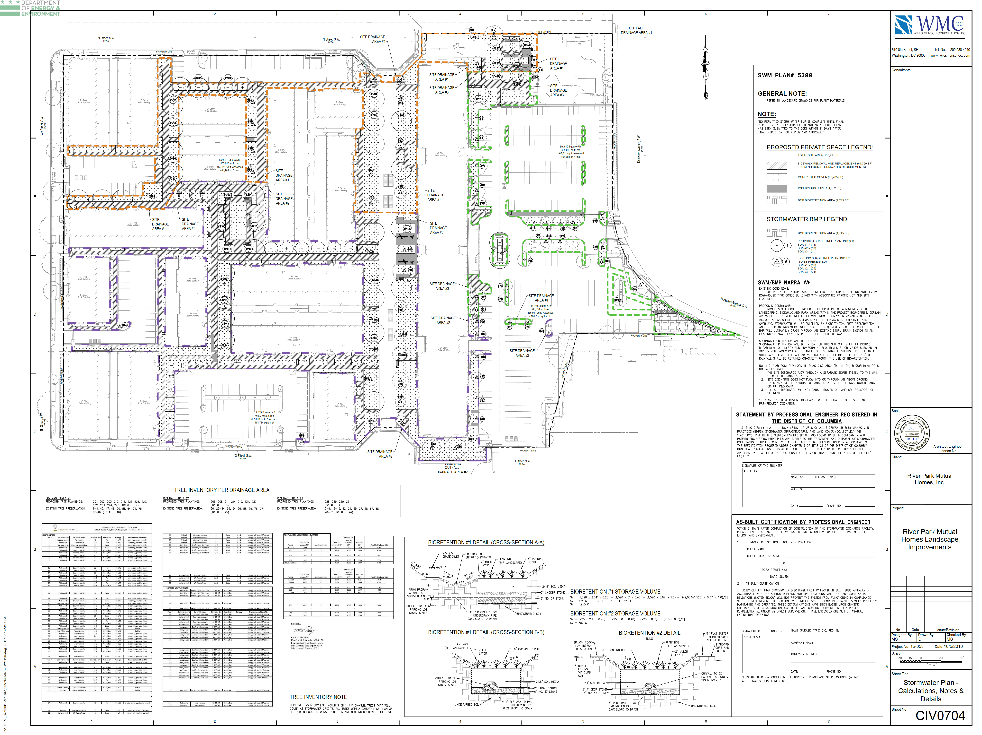
EXAMPLE- TREE PLANTING/PRES.
Proposed trees with species, soil requirement, size
Existing tree inventory with species, size, condition, value
Show where proposed/preserved trees are located
Notes:
Preseration plan certified by landscape professional
5399
This example uses tree ID numbers

Slide 33
EXAMPLE- TREE INVENTORY
Tree # | Common Name | Scientific name | Diameter (in) | Condition | Canopy | Ecological Benefits
1 | Norway spruce | Picea abies | 12 | Fair | 35 x 35 | Screening, privacy, buffer
2 | Red maple | Acer rubrum | 27.5 | Fair | 60 x 40 | Screening, privacy, buffer
3 | Pin Oak | Quercus palutris | 11.1 | Good-Fair |  | Species notable for: wildlife forage, native insect habitat, large mature canopy
Notes:
5399
What is included in tree inventory

