Slide 1


GAR PLAN REVIEW and Score sheet

Slide 2
GAR Training Summary
You are here
GAR Training
Best Plan Submittal Practices
Overview of GAR
Plan Submittal Process
Guidebook
Role of CLE
Most common errors
Provide resources
Examples of good and bad plans
Notes:
There are no scheduled GAR training right now, but check back in and they may be posted

Slide 3
GAR Project Types
GAR Major
Erosion and Sediment Control
GAR
Erosion and Sediment Control
GAR Minor
GAR
Stormwater Management
Notes:
definitions

Slide 4
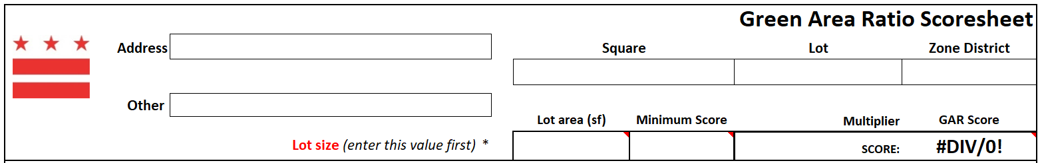
GAR SCORESHEET
Include Scoresheet in plans
Each lot and each zone needs a separate scoresheet
Property Quest
Total record lot area in Property Quest
No PROW
≥ min. score
Score based on Zone
Notes:
Here is what the GAR scoresheet looks like. Th einformation on the scoresheet should be the same information on the plans. The scoresheet itself should be inserted into the plans. If you have different lots or zones on your plans, each lot or zone needs a sparate scoresheet. If you want more information on that, please go review the GAR training.
Here I have zoomed in on the top of the scoresheet. All of the information should be filled out. (click)The zone district of your lot can be found in property quest as* your total record lot area. The PROW should not be included in this area. Next enter in the minimum score required, also found on PQ. The GARscore will automatically be calculated as you fill in the rest of the form. This value should be equal to or greater than the mn score/
Sheet needs to be in plans
All of top section needs to be filled out
Lot area- if your plan doesn’t fit the normal methods of GAR, ask your reviewer or include a narrative explaining why things are different
Min score found on property quest
PROW cannot be used for GAR
Include the GAR Scoresheet and Worksheet (if applicable) in the plans
If multiple zones, each zone needs it’s own scoresheet
Just note that they need separate score sheets, if need more information, go to other GAR training

Slide 5
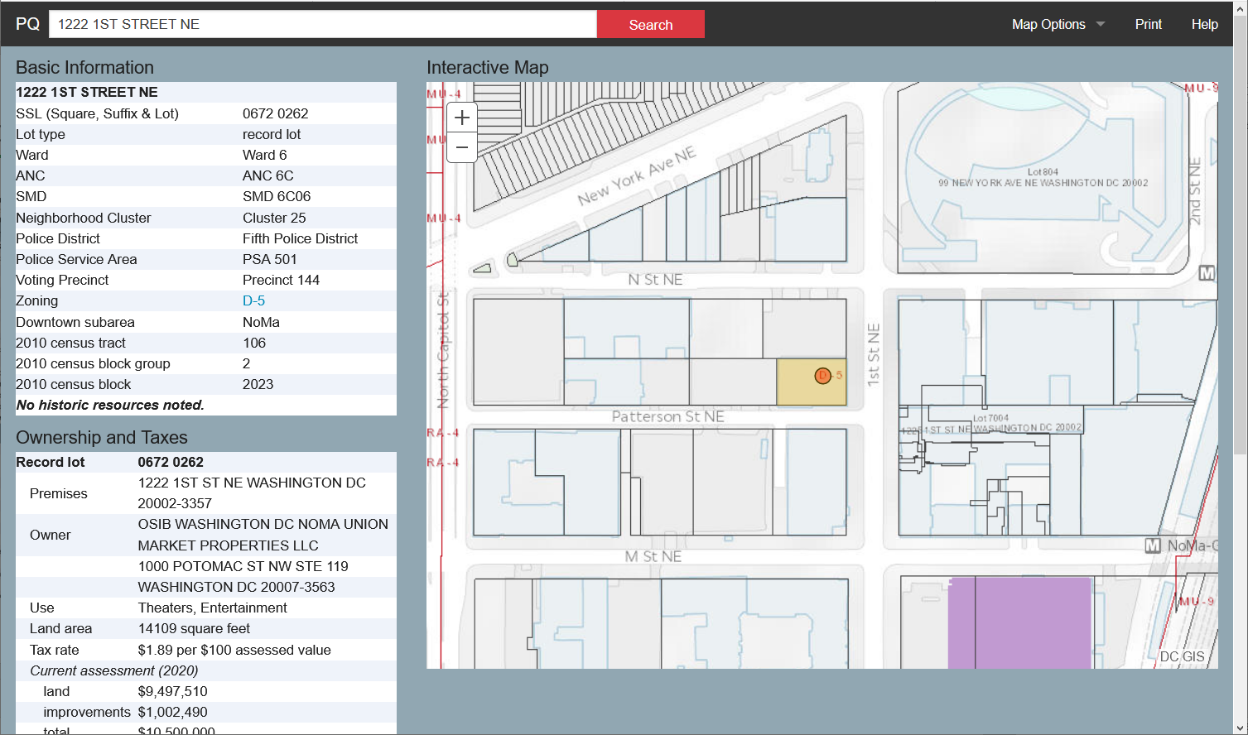
PROPERTY QUEST - PROPERTYQUEST.DC.GOV
Notes:
On this slide are screen shots of property quest. Here you can see your lot type, zone, and lot area. If you click on the zoning link, it will bring yout o

Slide 6
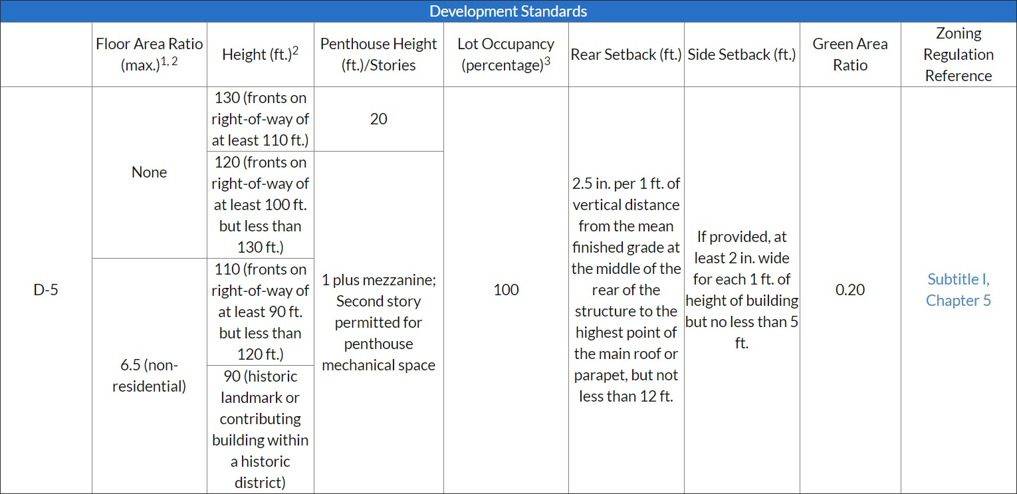
GAR – MINIMUM SCORE
Notes:
This site. And on here you will see the GAR for tha tzone.

Slide 7
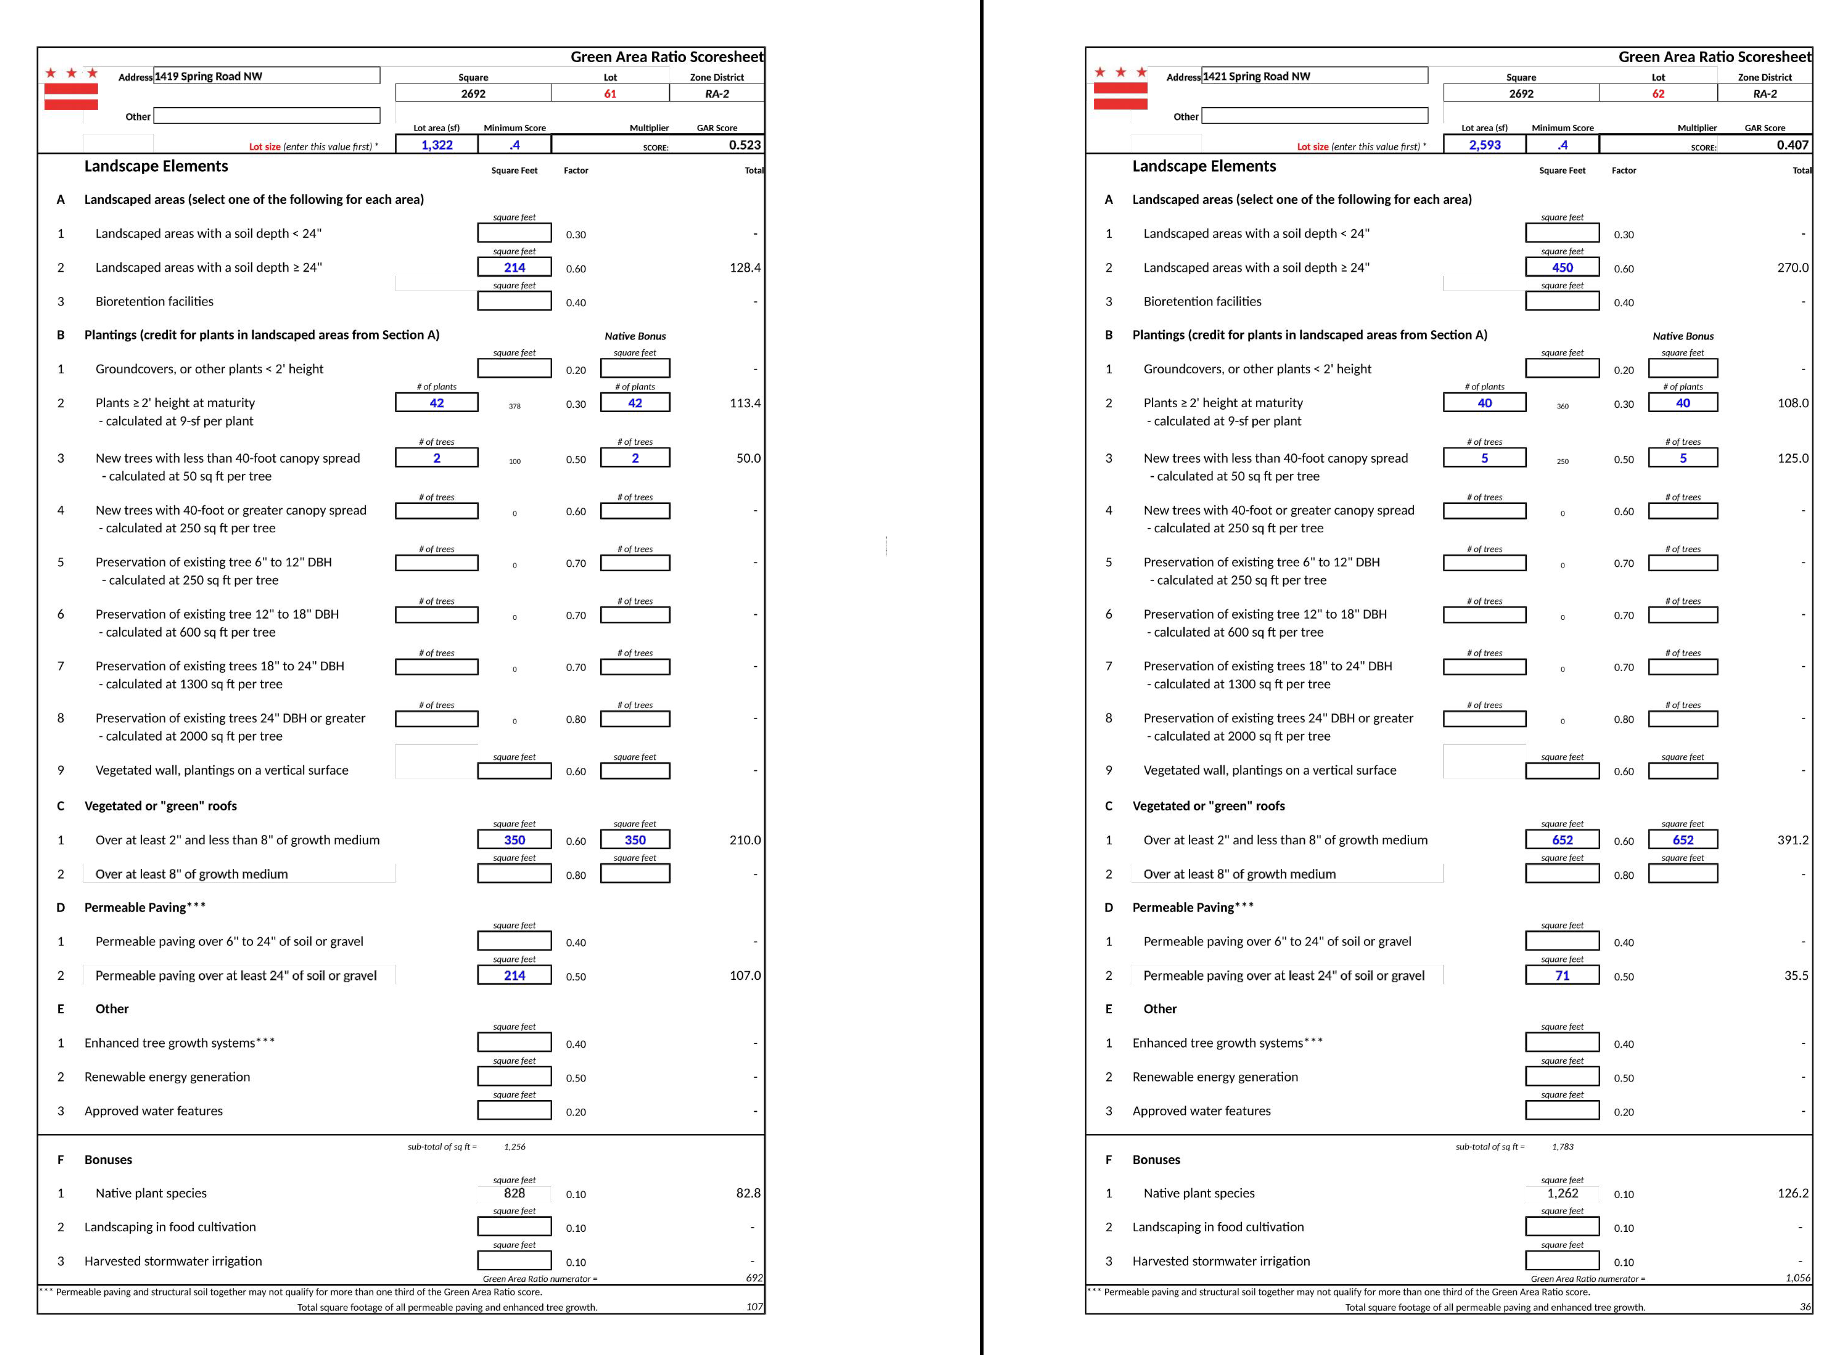
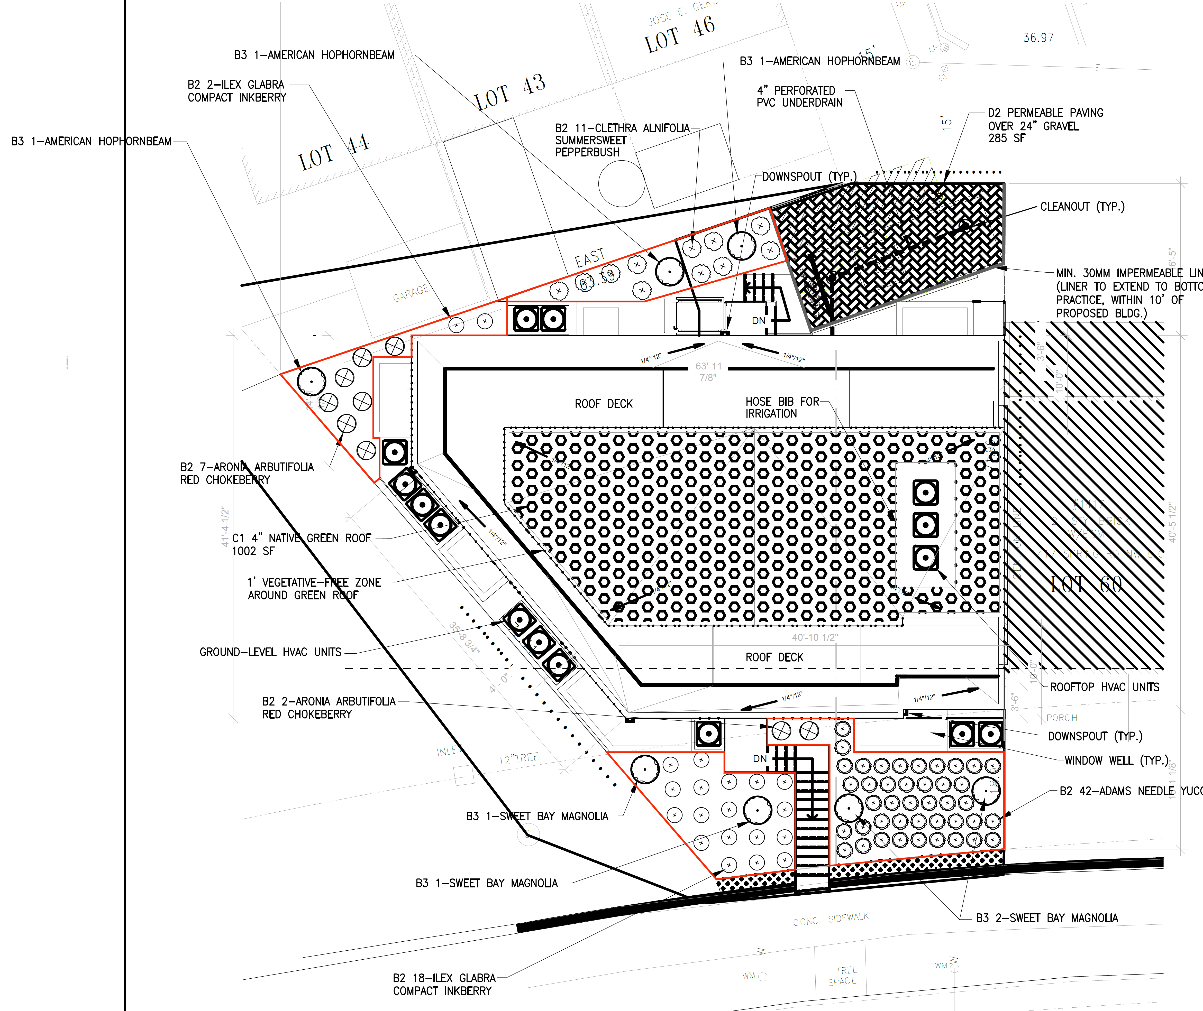
GAR SCORESHEET- MULTIPLE LOTS
Each lot has a scoresheet
Lot Division Line
Also for multiple zones
Notes:
If you have multiple lots within one permit, each lot must meet it’s GAR score. So in this example, the dotted line shows the lot division line. And each lot has their own scoresheet.
If you have multiple zones on a lot, you also must have separate score sheets.
15053
Multiple/phased lots within one permit–Each lot must meet its GAR score
Multiple zones in one lot–Each zone must meet score, but whole lot may be used

Slide 8
GAR EXAMPLE – SITE PLAN overview
Notes:
In this next section I will review an example GAR plan with all of the different components include on that plan.

Slide 9
EXAMPLE PLAN 1- CATEGORIES
Has GAR and SWM
A1: Landscape area <24”
A2: Landscape area ≥24”
A3: Bioretention
B1, B2, B3: Plantings
C1: Vegetated roof
F1: Bonus- Native species
Notes:
To begin, this example plan has both GAR and SWM. It also has elements A1, landscape area…
B1, b2, b3 which are different plantings, C1 green roof, and a f1 bonus.
Plan details to set up b/g and remind audience of what each element is

Slide 10
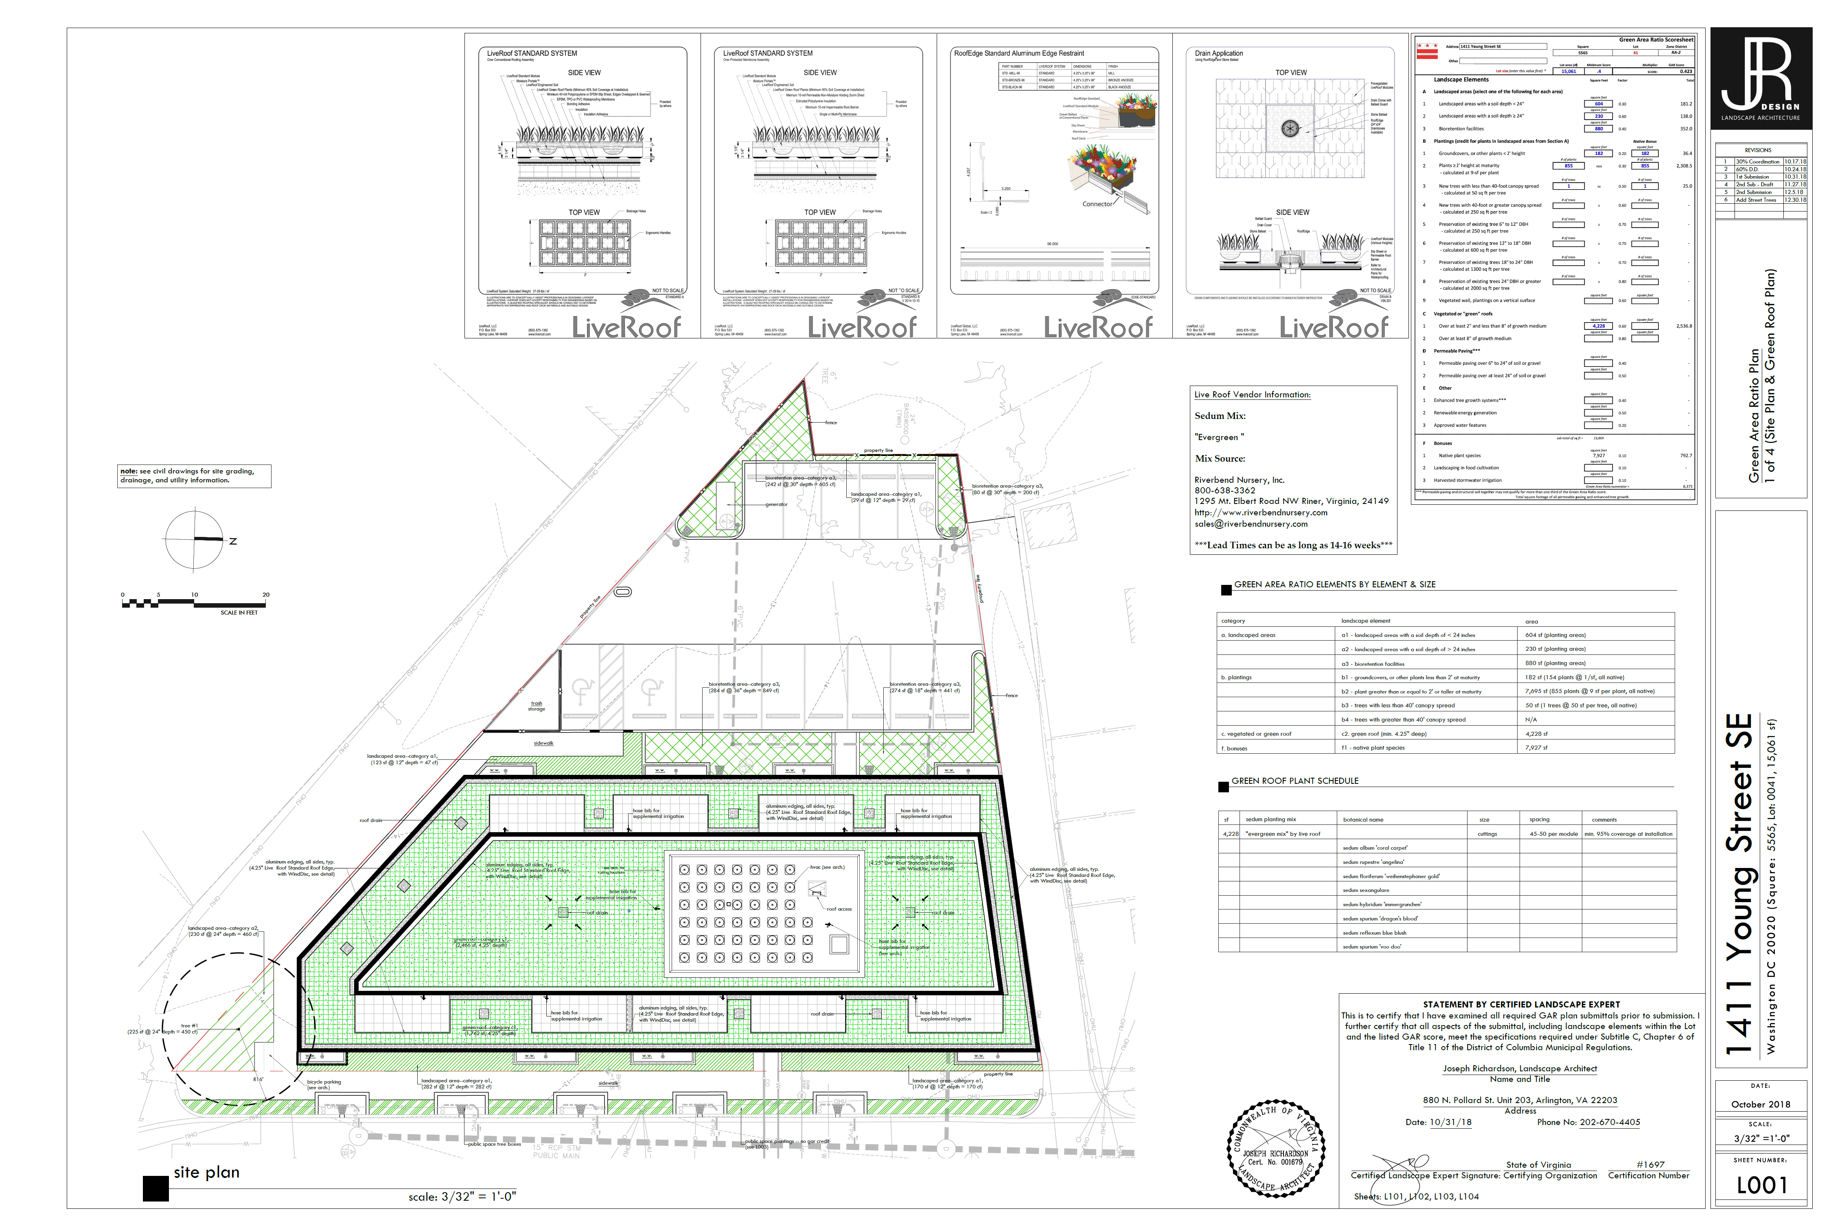
EXAMPLE PLAN 1: PAGE 1- SITE PLAN AND GREEN ROOF
Scoresheet
Green Roof Details
Arrow, Scale
Property Line
GR Plant Schedule
(non-invasive)
Legend
CLE Signature Block
Stamp
Notes:
Here is the first sheet of the example plan 1. There is a lot of information on here but we will break down each section. You should include a north arrow and scale, include the property line, as PROW can not be used ot meet GAR, CLE signature block, include a legend- this plan actually didn’t have one. Green roof details- include the manufacturer, green rood plant schedule- will go over in detail later. Gar score sheet. So lets take a look at the scoresheet (done)
Property line- important because can’t use PROW
CLE must match SGS
Next we zoom into the plan and review the scoresheet
Legends are helpful, not required
Stamp not required
Now to look at the scoresheet

Slide 11
EXAMPLE PLAN 1: SCORESHEET
Notes:
Ive zoomed on the top section. We see here the A, B and C elements. As a plan reviewer, they will use this scoresheet to check to make sure it matches what is shown on the plans.

Slide 12
EXAMPLE PLAN 1: CHECK AREAS
Check: Do areas and descriptions match plans?
Notes:
So here is the plan again, zoomed in. A plan reviewer will look to see if the areas in the scoresheet match what is shown on the plans. So if we look at the score sheet, we see landscaped areas with soil depth <24” is 604. We go to the plans a find the areas that are claiming A1 credit, they all add up to 604. And same for A2 and A3.

Slide 13
EXAMPLE PLAN 1: CHECK AREAS- A1, A3
Check SWMP
Each element is clearly hatched
Category
Area
Category
Area
Soil Depth
Notes:
Here I’m going to zoom in some more to see the details they’ve included on their plans. Each element is clearly hatched and diffierentialed. I know the diagonal lines are A1 and diamonds are bioretention A3. For the A1 credit, it lists the area, category and depth. Same for bioretention. The plan reviewer will go back and check that these areas are shown on the SWMP and that the information match.

Slide 14
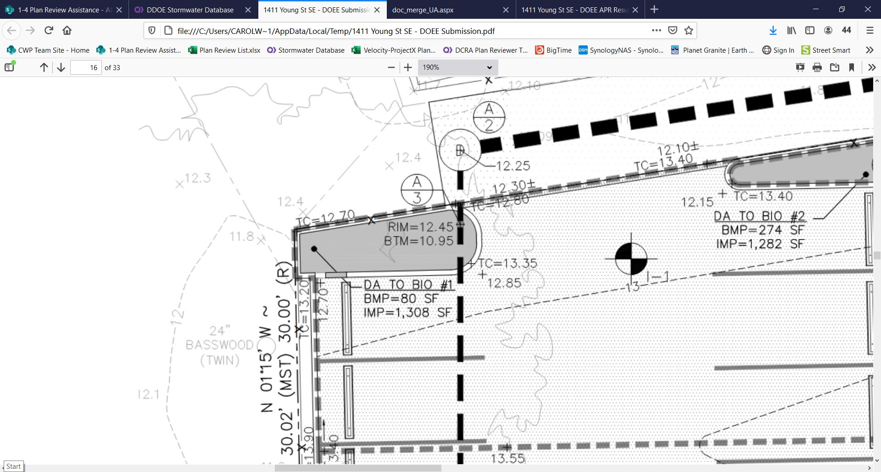
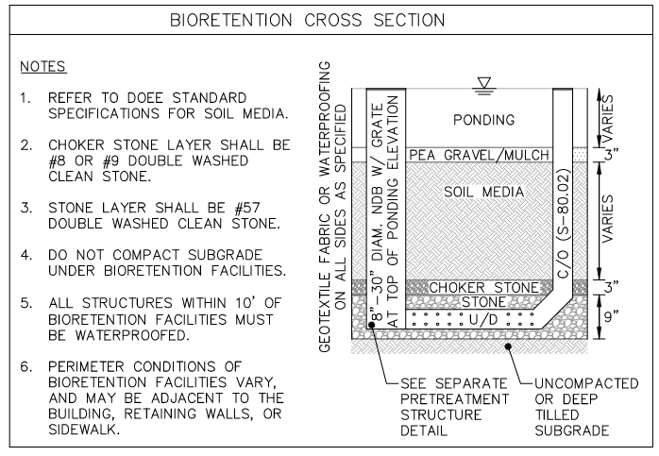
GAR AND SWMP- BIORETENTION DIFFERENCES
Bioretention area does not include side slopes (if applicable)
  If the side slope is vertical, GAR area should match SWM
  If side slopes are not vertical, only include surface of bioretention in GAR area (I.e. area of bioretention soil)
Side slopes can get A1 or A2 credit
GAR
SWM
Notes:
For bioretentions in GAR and SWMP, there are some differences in how they are measured. For SWMP, the area of bioretention is at the top of ponding. For GAR, it is at the surface of the bioretention gets A3 credit. In other words, only the area with bioretention media gets the A3 credit. If there is a side slope, that can get A1 od A2 credit. If you have vertical side slopes, say it has concrete walls, then GAR and SWM has the same area. *
So for the example plan, wehad a bioretention with 80sf. In the SWM plan, we can see that it matches with 80sf and the profile shows vertical side slopes.

Slide 15
EXAMPLE PLAN 1: CHECK AREAS A2 & B3 (TREES)
Category
Area
Soil Depth
Soil Volume
B3: Mature canopy <40’
  Min Soil Volume: 400 cf w/in 16’ radius
  If min soil volume not met, B2
B4: Mature canopy ≥ 40’
  Min Soil Volume: 1,000 cf w/in 27’ radius
  If min soil volume not met, B3
Can only get A2 credit if:
  Beneath vegetated walls
  Within rootable soil radius of trees
  Preserved soils
2’ min soil depth for new trees
Max depth for soil volume calculation is 3’
Notes:
Moving on, we zone into the A2 area, where we also see a B3 credit as well. The A2 area is labeled with category area, and soil depth. The B3 credit is shown as tree #1. They show the rootable soil area as 225 sf, with a depth of 24” which gives RSV as 450 CF. They also shown the 16’ radius where the RSV must be within.
*Some notes on trees. A tree with mature canopy <40’ is a minimum soil volume of 400cf within a 16’ radius. If the RSV is not met, it can qualify for B2 credit. Now for a larger tree, B4 mature canopt >40, the min soil volume is 1000 cf within 27’ radius.
For A2 credit, you can only claim it if it is beneath vegetated wall, within RSR of a tree, or is preserved soils. There is a minimum of 2’ of soil depth and maximum of 3’ for calculations.
Note to presenter- not sure why tree area and A2 area are different in the plans.
Tree type can be found in GAR plant list, which we will go over later

Slide 16
GAR EXAMPLE – GREEN ROOF
Notes:
In this section we will cover green roofs in GAR.

Slide 17
EXAMPLE PLAN 1: C1 GREEN ROOF

Slide 18
EXAMPLE PLAN 1: CHECK DETAILS C1, GREEN ROOF
Suppl. Water
Mechanical Equipment
Roof drain and slope
Roof access
Category
Area
Depth
Notes:
All information must match stormwater plans
4.25” extensive roof

Slide 19
Example Plan 1: Roof Slope
Roof slope and drain required
Notes:
This very detailed, simpler is okay

Slide 20
EXAMPLE PLAN 1: CHECK GR PLANTING PLAN
Vegetated Roof
Media depth
Planting mix 60% max native species
At least 5 species evenly mixed
No stacking
Notes:
Can not stack <8” vegetated roof with B2 credit. >8” you can stack with B2
Cannot stack any vegetated roof with B1
Can stack C2 vegetated roof with B2
Check max native species %

Slide 21
EXAMPLE PLAN 1: CHECK PLANTING PLAN
Vegetated Roof
4.25” media depth
Planting mix 60% max native species
At least 5 species evenly mixed
No stacking
Notes:
Can not stack <8” vegetated roof with B2 credit. >8” you can stack with B2
Cannot stack any vegetated roof with B1
Can stack C2 vegetated roof with B2
Check max native species %

Slide 22
CLARIFICATION ON TABLE 7
Cannot stack A1-A3
Cannot stack any vegetated roof with B1
Can only stack B2 with C2 vegetated roof (>8”)
Check species and max native %
If GR used for SWM, <8” cannot have permanent irrigation

Slide 23
GAR EXAMPLE – PLANTING PLAN

Slide 24
EXAMPLE PLAN 1: PAGE 2- PLANTING PLAN- B1-B3
Planting Details
GAR and PROW planting plan on separate sheets/tables or clearly labeled
Stamp
Notes:
Next page- planting plan
*Private and PROW planting plan on different sheets- not required, easier for reviewers to see. Minimum planting schedule needs to be separated out

Slide 25
EXAMPLE PLAN 1: CHECK PLANTINGS- B1-B3
Stamp
Notes:
Check that scoresheet matches planting schedule
Would have been better if the category was labeled on this
- List is of things reviewers will check for. Single trunk trees min 1.5” caliper take 6” above ground

Slide 26
EXAMPLE PLAN 1: CHECK PLANTINGS- B1-B3
Check that info matches
GAR Plant List
Qty, common name, native, botanical name, installed size, spacing, other details
Missing GAR category (ex. B1, B2, or B3)
Stamp
Notes:
Check that scoresheet matches planting schedule and plan
Would have been better if the category was labeled on this
- List is of things reviewers will check for. Single trunk trees min 1.5” caliper take 6” above ground

Slide 27
GAR PLANT LIST
Native vegetation not on GAR plant list or nativeplantcenter.net, require two references in current publication to support designation.
No proposed invasive plant species permitted, no credit for invasives
Notes:
No credit for invasive species, species specified in GAR guidebook and plantlist
Invasives don’t have to be removed, but can’ t be proposed and can’t receive preservation credit (B5-8)
nativeplantcenter.net

Slide 28
EXAMPLE PLAN 1- PLANTING PLAN (B1-B3)
Stamp
Notes:
Check that scoresheet and schdule match the plans
Check that the planting area will be large enough for the spacing of the plants

Slide 29
EXAMPLE PLAN 1- PLANTING PLAN (B1-B3)
Hatching for perennials/groundcover okay
Check plant spacing and plant area match
Ex. 137 carex @12” OC needs ≈137 sf
Category
Quantity
Name
Size
Notes:
Check that scoresheet and schedule match the plans
Check that the planting area will be large enough for the spacing of the plants, multiple plant spacing calculators available
B2 credited by # of plants, so area not needed, but helpful

Slide 30
EXAMPLE PLAN 1: SHEET 3- SPECIFICATIONS
Planting Installation/ Construction Notes
(Page 48-50 in Guidebook)
Landscape Maintenance Plan
(Chapter 6)
Soil and Amendment Specifications
(Page 32-36 as needed)
Plant materials must meet the standards in the ANLA American Standards for Nursery Stock (ANSI Z60.1-2014).
Stamp
Notes:
Landscapa maintenance plan required for all elements

Slide 31
EXAMPLE PLAN 1: GREEN ROOF SPECS
Okay if Bioretention Specs in SWM section
Stamp

Slide 32
OTHER GAR ELEMENTS

Slide 33
PERMEABLE PAVEMENT COMMENTS
Check that it meets SWM Guidebook design requirements
Check it matches SWM Plan, if applicable
Check area and depth
Include Geotech report and infiltration test/underdrain
Show the underdrain connection to sewer
Notes:
5850
Depth is between pavement layer and sub-grade
Can refer to SWM plan, not necessary to copy

Slide 34
RENEWABLE ENERGY COMMENTS
Provide solar plans – solar permit number
Include maintenance items for renewable energy
Provide a shading analysis if more than 20% of shading exists on the solar array location
Actual layout of solar panels required
Schematic diagram showing wiring, inverters, etc.
Notes:
6771

Slide 35
VEGETATED WALL COMMENTS
Supplemental irrigation required and source must be shown
Irrigation specification should also include a recommended initial irrigation frequency and time, based upon the season and plant requirements
Provide vertical and cross-sectional details for the vegetated wall

Slide 36
VEGETATED WALL/SCREEN
5’ offset:
Adjacent, facing lot lines with zero lot-line development potential
Adjacent, facing structure or wall (does not apply to lot lines abutting streets or alleys)
Notes:
6611
Offset is for light
Vegetated walls facing adjacent lots with zero lot-line development potential shall be at least 5 feet from a side or rear lot line.
•Vegetated walls shall be at least 5 or more feet from adjacent, facing structures to allow adequate light penetration.
The vegetated wall setback does not apply to lot lines abutting streets or alleys. •Vegetated walls should have a 5-foot clearance from all facing walls to allow adequate light penetration.
Can not double count plants, already included

Slide 37
MINOR GAR PROJECTS
Construction sequence
SWM BMP specifications
Notes:
Still need this information even when minor (no SWM)

Slide 38
COMMON COMMENTS
Include the CLE and GAR info in SGS
Enter all applicable DCRA building permit numbers associated with this project in the SGS
Include note: “The property owner is required to maintain the lot’s minimum GAR score through appropriate stewardship and maintenance of landscape elements after the property is granted its Certificate of Occupancy.”
Include construction sequence for each landscape element
  Can be in ESC and/or SWM sheets
  Soil amendments should be included in ESC
On multiple lots- uploaded proposed plat showing how they are to be combined
GAR information should match SWM and ESC plans
How are planting areas protected from vehicular traffic (wheel stops, curbs, bollards, fencing, etc)? Show on plans and provide details.
Rootable soil volume not met
Number of plants in plant schedule do not match the plans
The areas in the labels/GAR scoresheet do not match plans
Include schematic irrigation and drainage plan for rooftop and container landscaping or areas requiring harvested rainwater irrigation
Notes:
Big one people miss is soil amendments

Slide 39
HELPFUL INFORMATION TO INCLUDE IN PLANS
Narrative of project, especially in terms of record lots, zoning, zoning changes, etc.
Zoning Commission (ZC), Board of Zoning Adjustment (BZA), or Planned Unit Development (PUD) case numbers
Roof slope/details
Plumbing/irrigation

