Slide 1
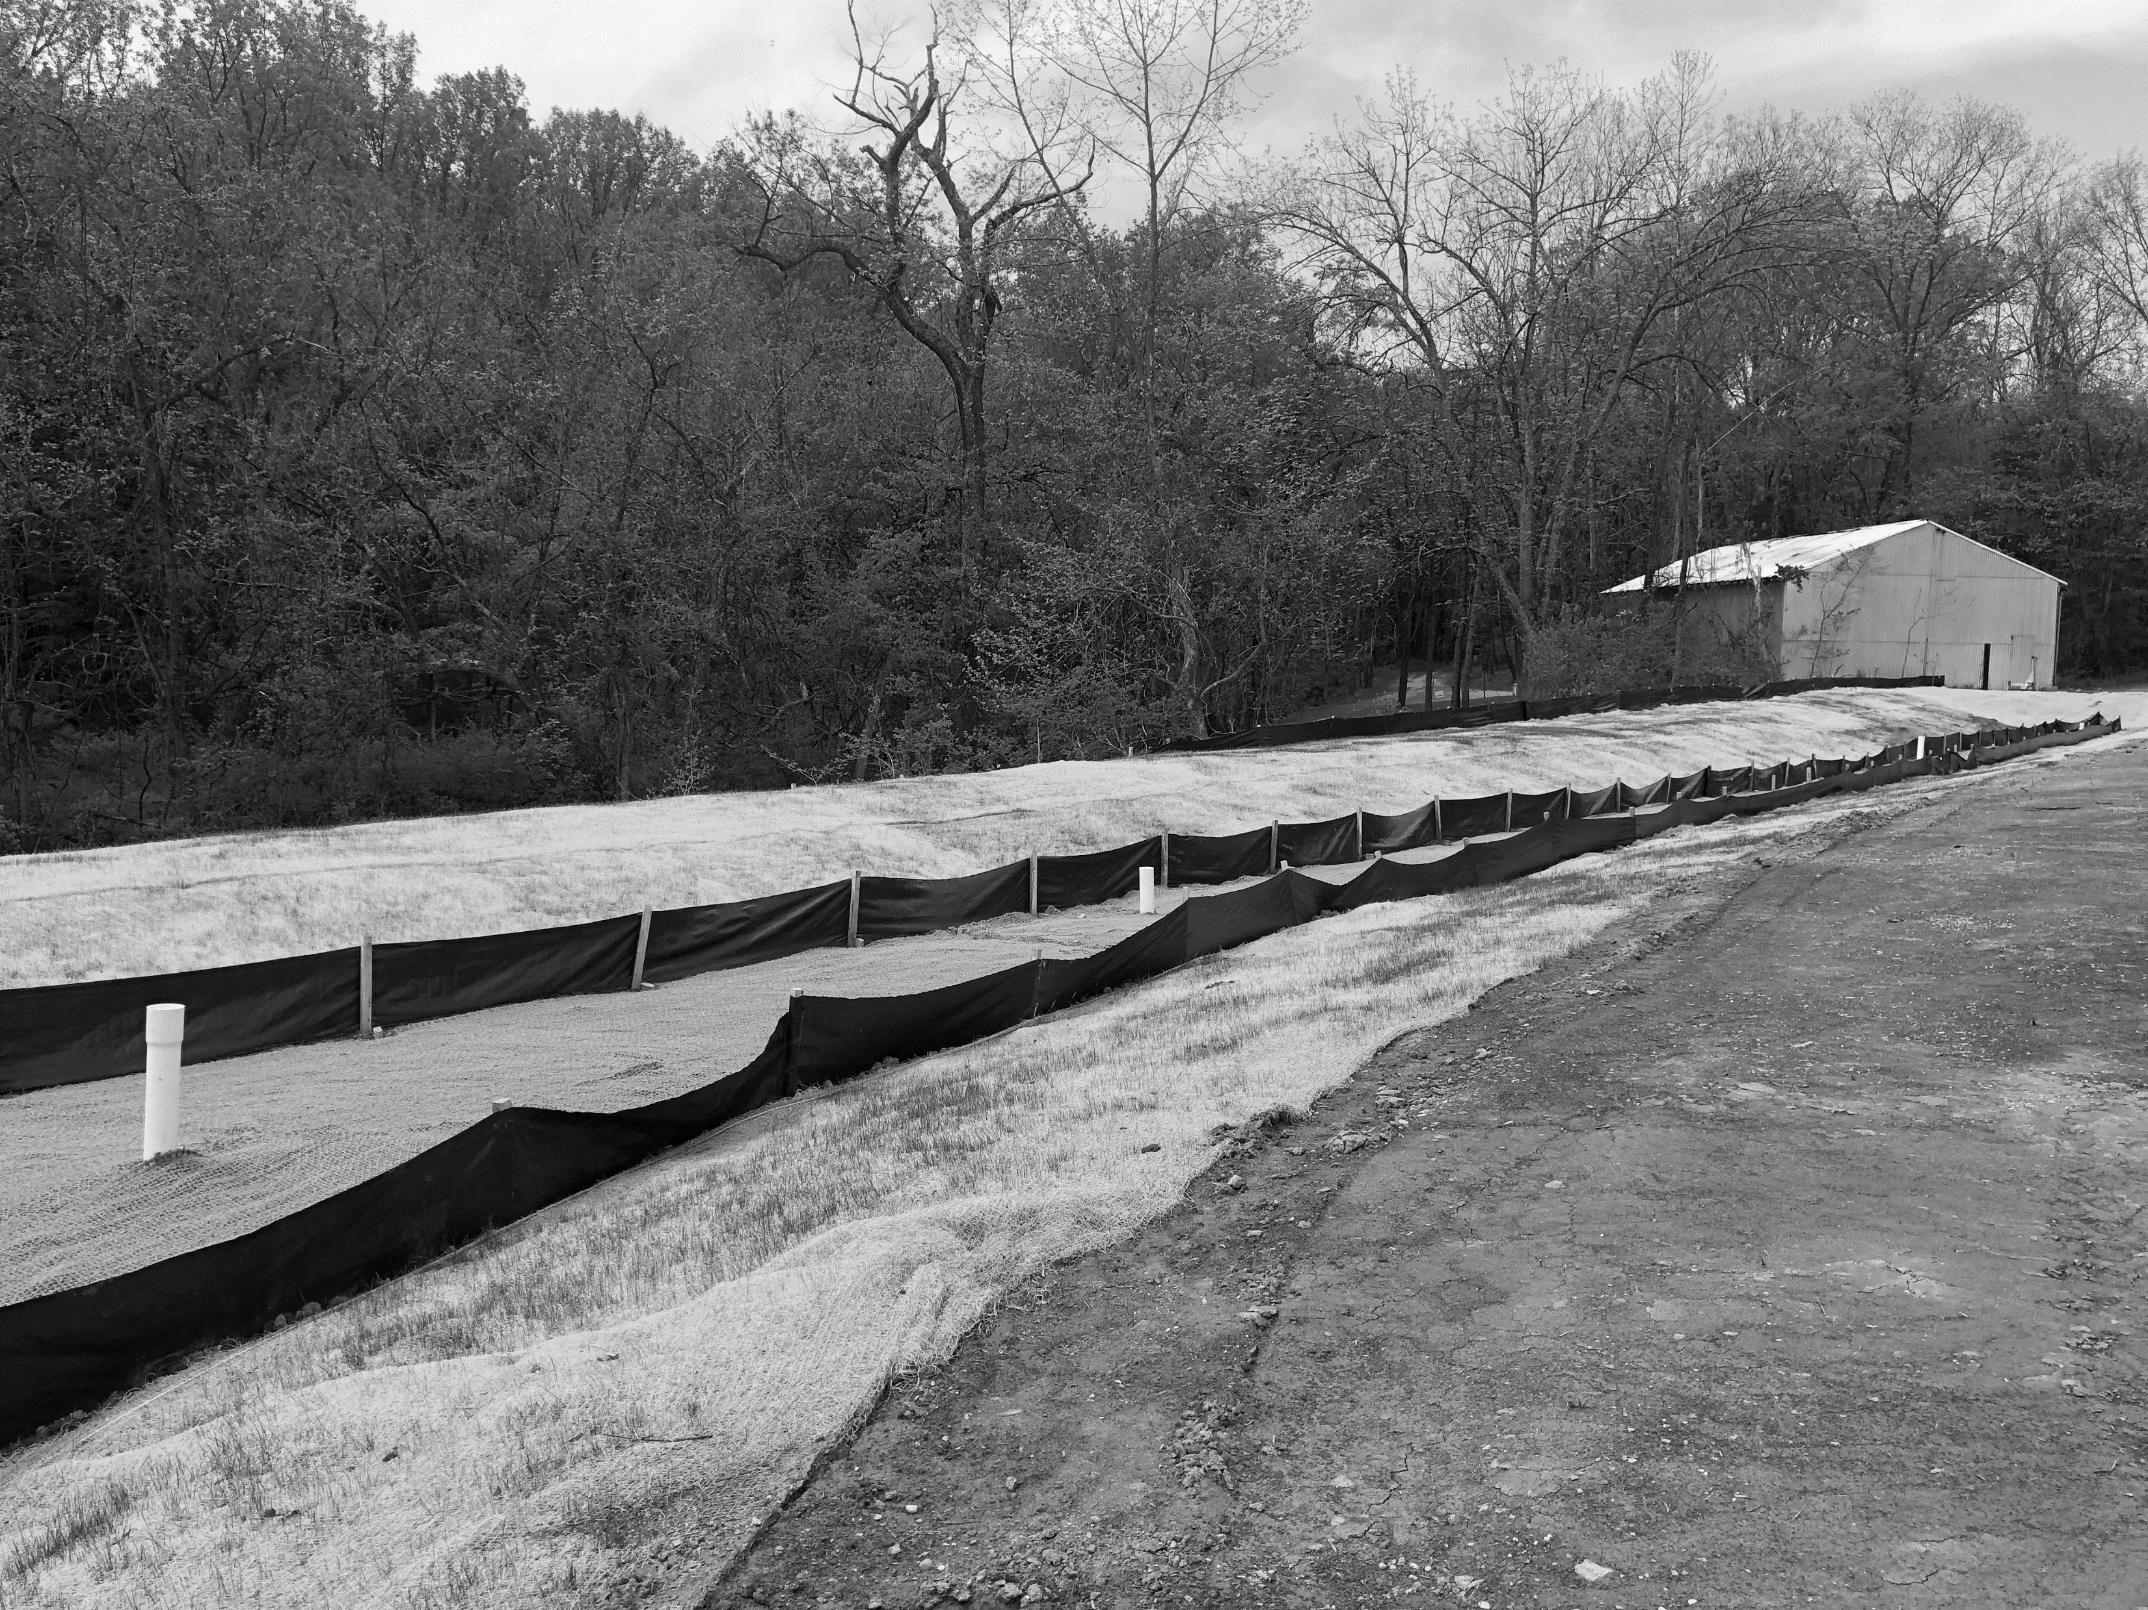



Best Practices for Plan Submissions
Erosion and Sediment Control (ESC) for minor projects
TAG THIS PRESENTATION @DOEE_DC
Notes:
Thank you for joining the Best Practices for Plan Submissions training. We hope that this training will guide designers to include pertinent information in erosion and sediment control plan submissions so plan reviewers can efficiently review plans and reduce the amount of comments necessary. This training was developed because plan reviewers found that submittals had similar errors and misunderstandings. This training assumes some basic understand of ESC regulations and practices. I recommend watching or attending the other overview trainings prior to this one if you are not familiar with these.

Slide 2

Objectives
Know what information plan reviewers are checking
Know the most common comments and errors and how to avoid them
Review commonly misunderstood parts of the ESC manual/submission
Provide resources
Provide examples of good plan submissions
https://doee.dc.gov/swtraining
@DOEE_DC
Notes:
The objectives for this training are to learn what specific information plan reviewers are checking, learn the most common plan reviewer comments and the most common errors and how to avoid them, review commonly misunderstood parts of the ESC manual and the submission process, provide resources, and provide examples of good plan submissions. Overall, the goal of this training is to improve plan submittals to create a more efficient review process. Not everything in this training will be required, it may just be helpful for a plan reviewer to clearly understand the plans.
Additional training can be found at the website at the bottom of the slide

Slide 3
Basic Plan Reviewer Methodology
Review plans to understand project
  Drawings are clear and easy to understand
  All basic necessary components are shown and labeled on plans
  Plans are consistent with other disciplines, including LOD
Check that ESC measures meet design requirements
@DOEE_DC
Notes:
For a plan reviewer, they will typically first go through and review the plans to understand the overall project. The drawings should be clear and easy to understand and all required pieces should be included.

Slide 4
Basic Plan components
ESC
@DOEE_DC

Slide 5
Summary: Items to Include
Vicinity plan
Area for approval stamp
Project description/narrative
Address, lot, square
Engineer/architect stamp and signature
North arrow
Scale
Lines, hatching and symbols in legend
Property boundaries
Street/alley labels
Clear, easy to read plans in a single PDF
Consistent information in Surface and Groundwater System (SGS)
Existing conditions
  Trees
  Grading
  Water areas
@DOEE_DC

Slide 6
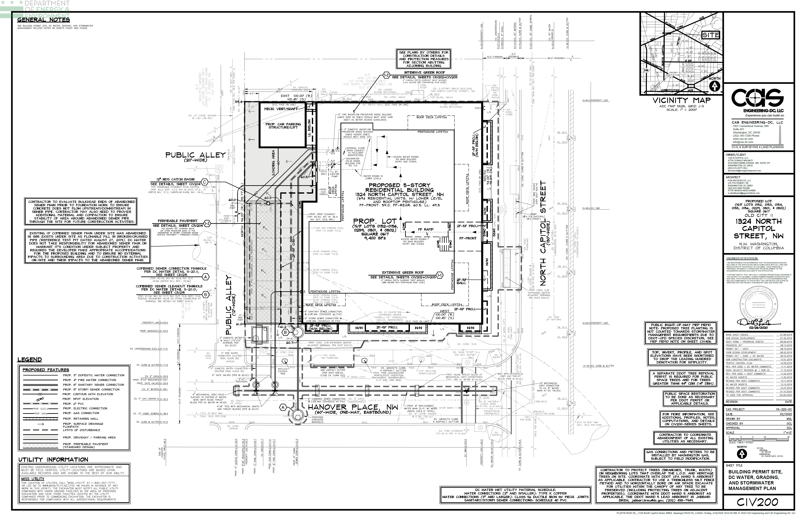
Basic Plan Components – Example
Lines are different weight and type to distinguish layer
Text is clear
@DOEE_DC
Notes:
Here is an example plan sheet that is very easy for a plan reviewer to read. Everything is clearly marked with differing line type of hatching and a legend.

Slide 7
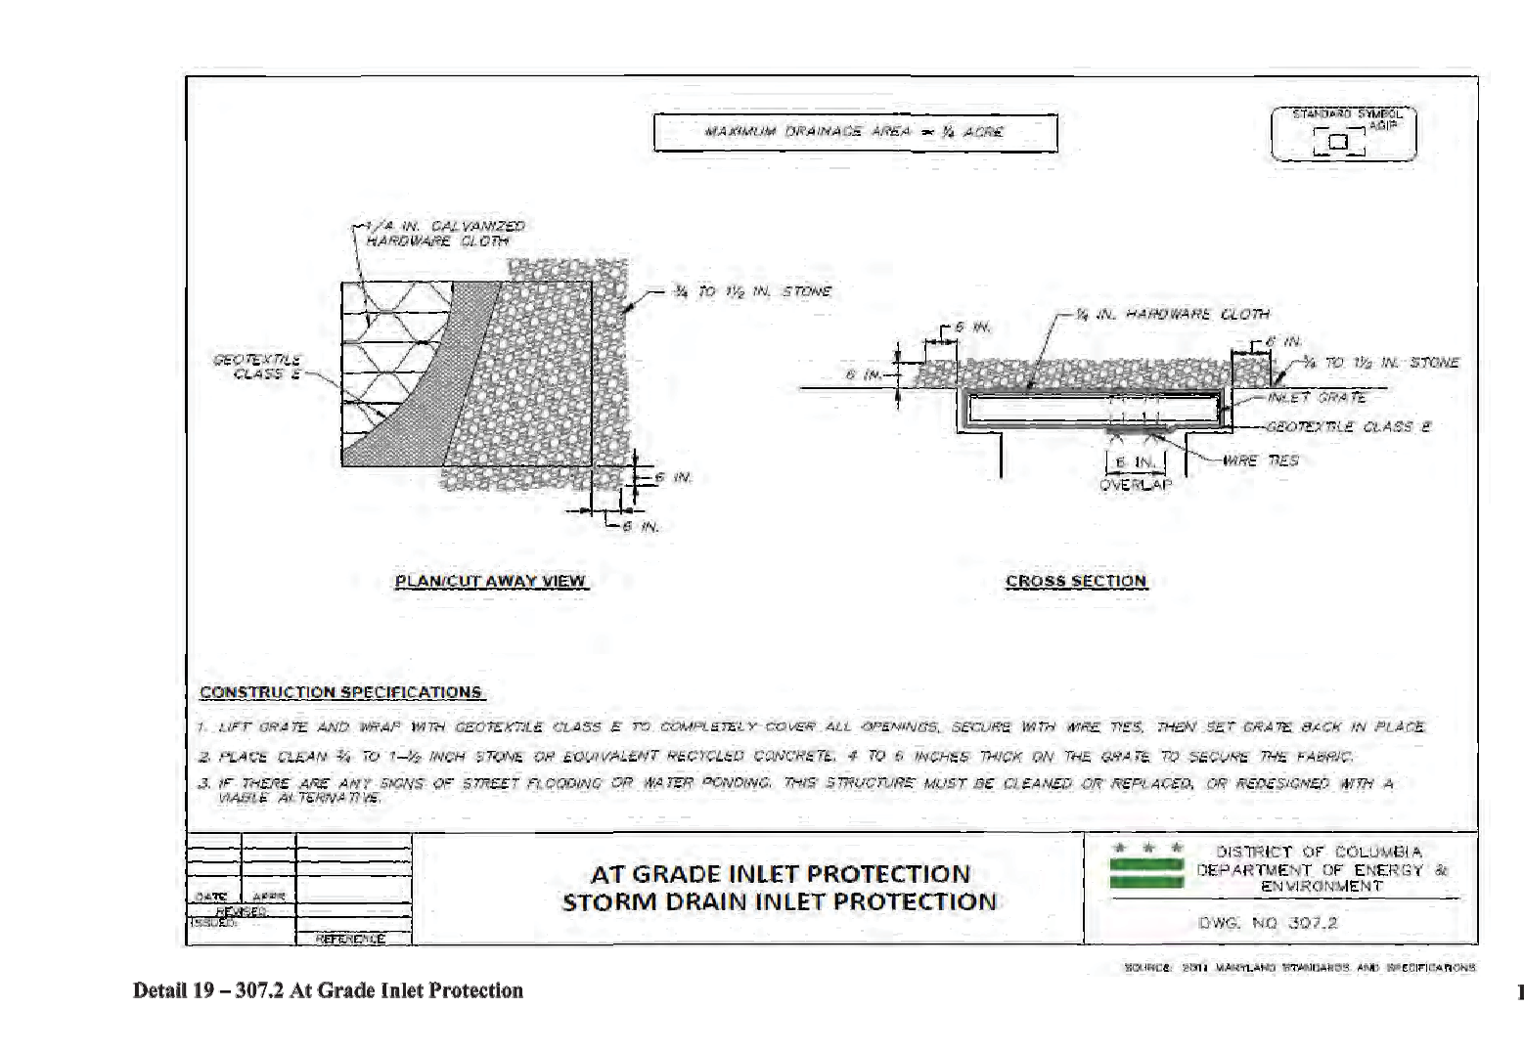
Basic Plan Components – Example
Overlapping layers obscures information
Lines look too similar to distinguish
Illegible references
@DOEE_DC
Notes:
Here are examples of plans that are difficult to read and difficult for the plan reviewer to understand what is being represented. Overlapping layers that obscure the information below, such as spot elevations. Multiple lines with the same thickness and type make it very difficult to know what the lines are representing. Illegible references are also not allowed on plans.

Slide 8
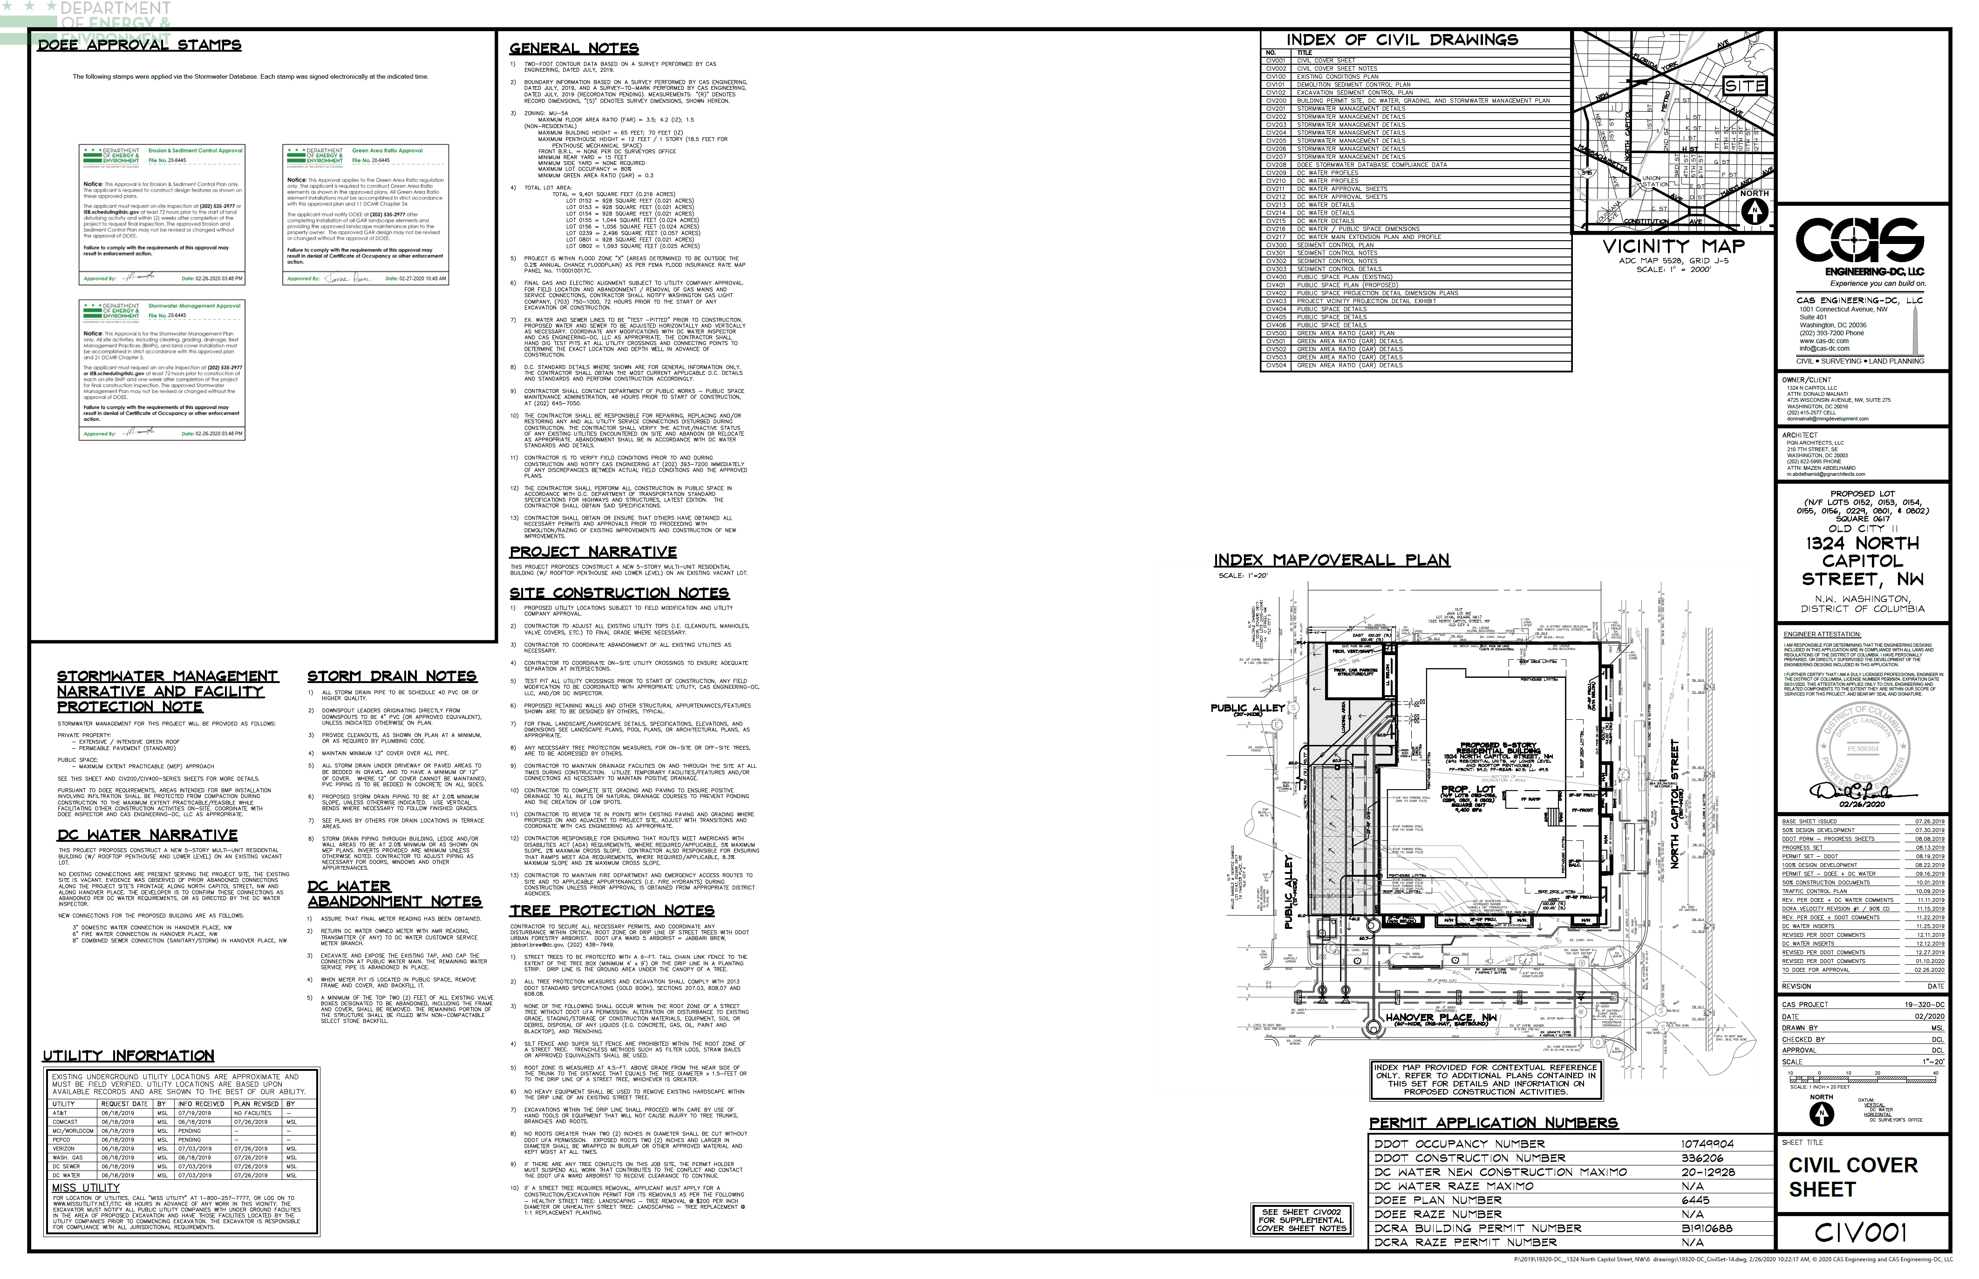
Basic Plan Components – Example
Blank area- 7″ wide by 9.5″ tall and have a 1″ margin
Area for approval stamp
Vicinity map
Address, lot and square
Narrative
Signature and Stamp
@DOEE_DC
Notes:
5907

Slide 9
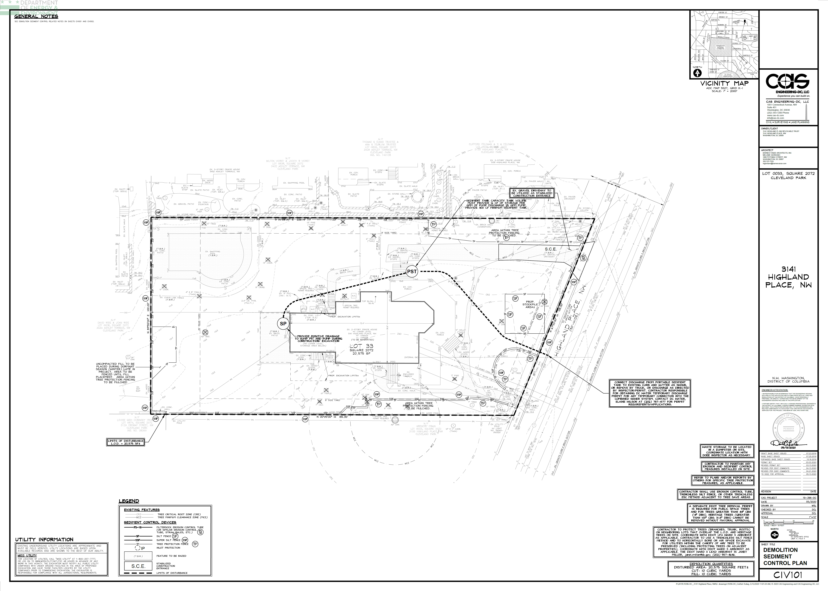
Basic Plan Components – Example
Include property lines
Trees – show diameter at breast height (DBH) and critical root zone (CRZ: 1.5’ radius per inch DBH)
North arrow and scale
Legend, include all line types, hatching and symbols
Street/alley label
@DOEE_DC
Notes:
6617

Slide 10
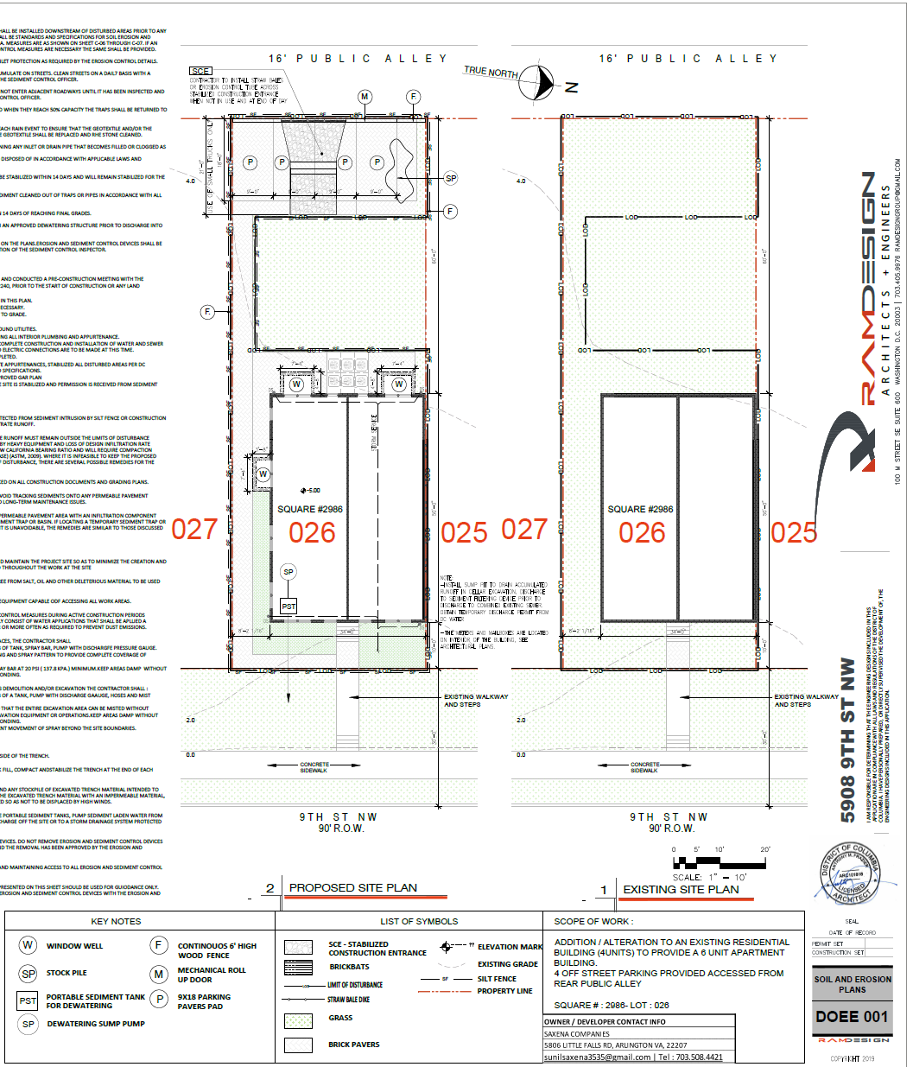
Basic Plan Components – Example
North arrow
Street labels
Address, lot and square
Symbols in legend match plans
Graphic scale
Property lines
Signature and Stamp
@DOEE_DC
Notes:
s16733

Slide 11
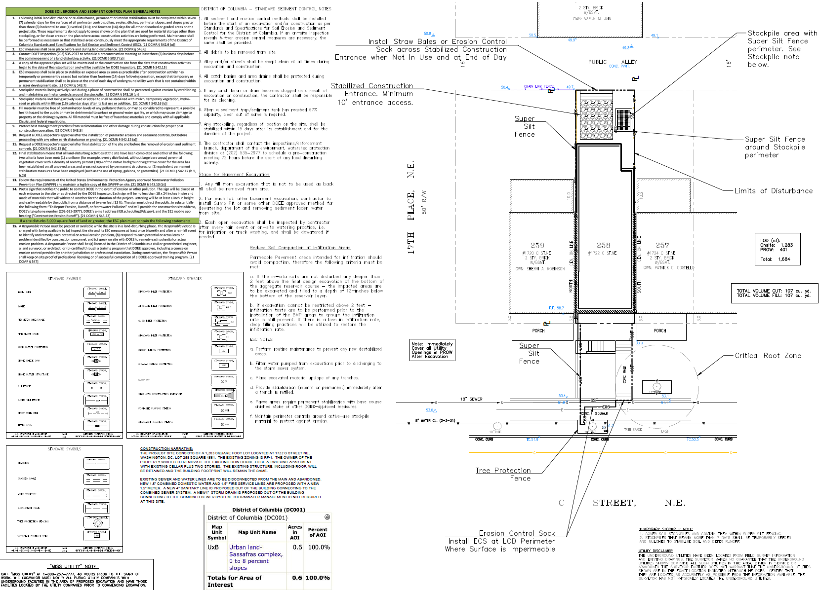
Basic Plan Components – Example
Legends do not match plans
Property lines
Street labels
@DOEE_DC
Notes:
s16504

Slide 12
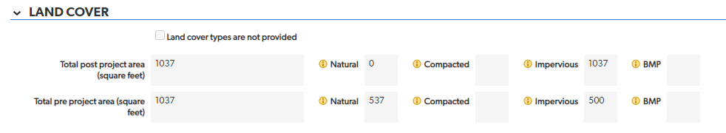
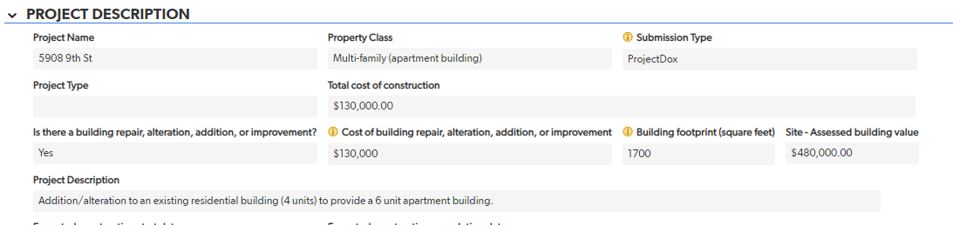
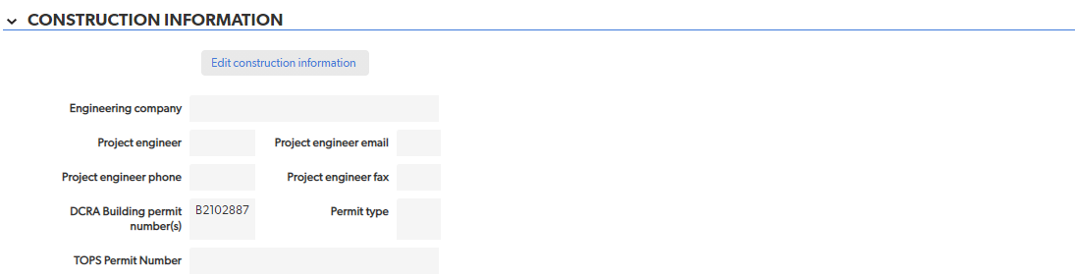
Basic Plan Components – SGS
@DOEE_DC

Slide 13
ESC Measures
ESC
@DOEE_DC

Slide 14
Summary: Items to Include
Demolition plans
LOD
  PROW & utility work
Perimeter controls
Tree protection
Inlet protection
SCE
Stockpile
Sequence of construction
Area of disturbance
Cut/fill volumes
General description of the predominant soil type
DOEE General Notes
Dust Control Notes
Vegetative stabilization
ESC detail drawings
@DOEE_DC

Slide 15
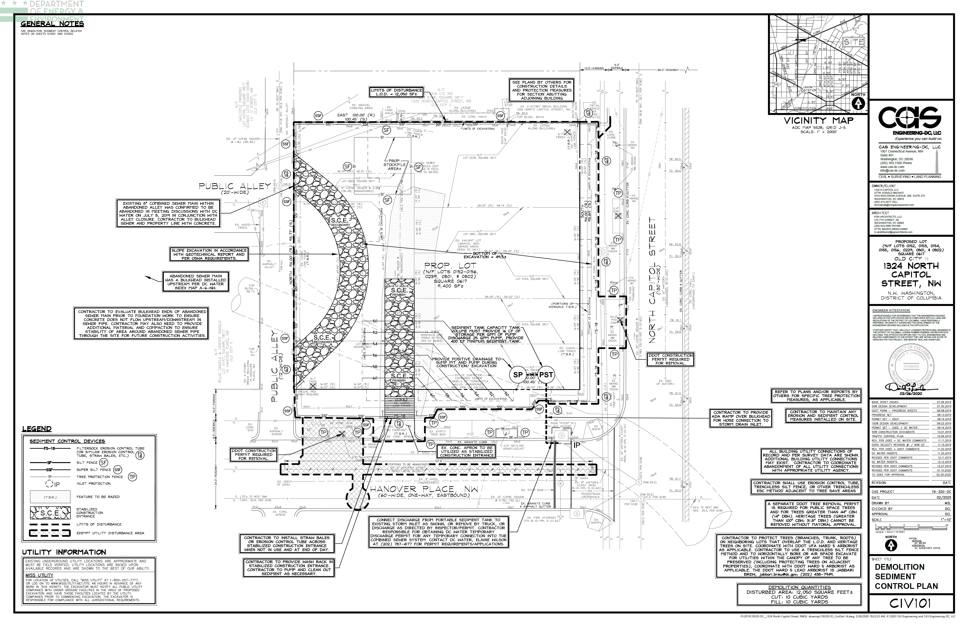
ESC Measures – Example
LOD
ESC measures required before demo
Notes:
5907

Slide 16
ESC Measures – Example
Special and heritage trees- show critical root zone if in or near LOD (CRZ: 1.5’ radius per inch DBH in tree diameter)
Tree Protection
Special and heritage trees- coordinate with DDOT UFD
@DOEE_DC
Notes:
s16348

Slide 17
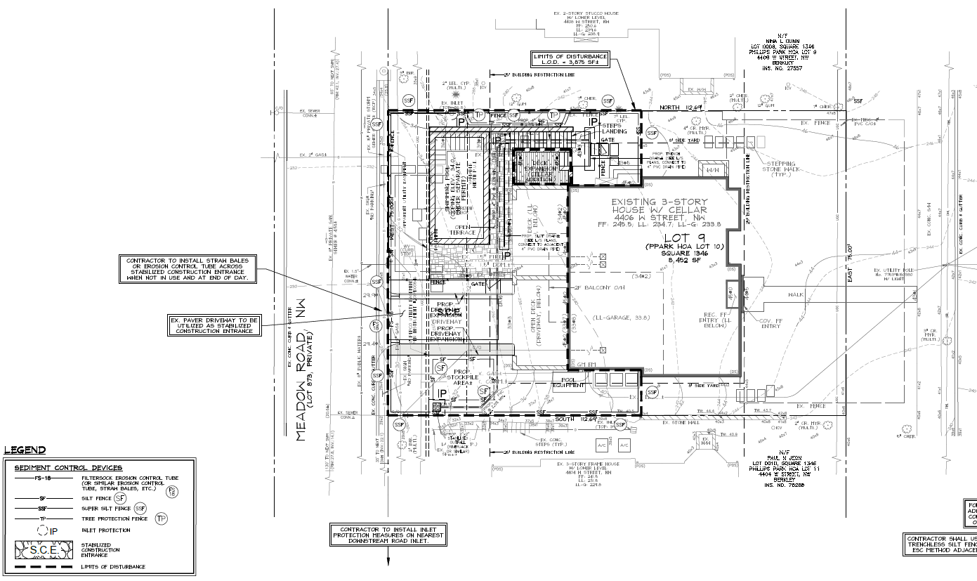
ESC Measures – Example
Tree Protection
Perimeter Controls
Stockpile
LOD
Inlet Protection
Grading
@DOEE_DC
Notes:
s15772

Slide 18
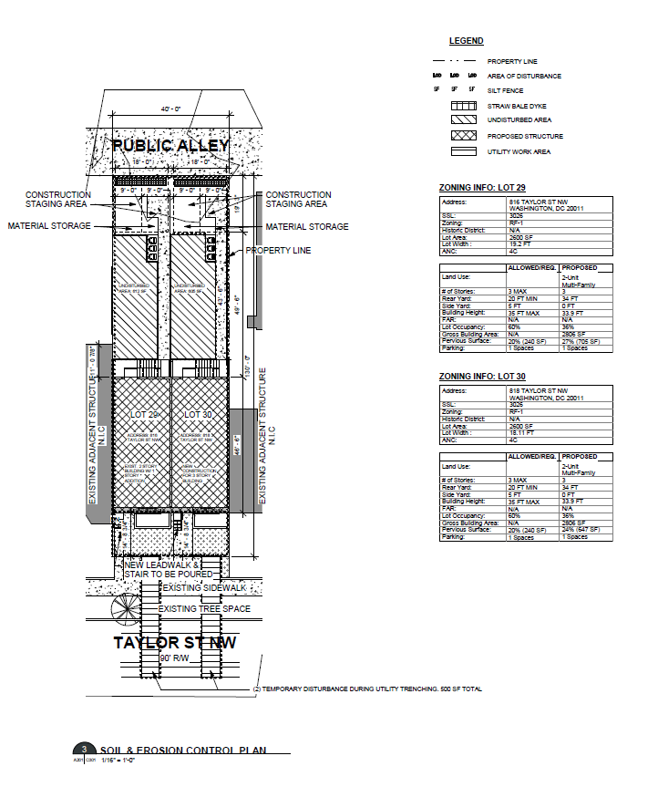
ESC Measures – Example
LOD and perimeter controls in legend but not on plan view
@DOEE_DC
Notes:
s15952

Slide 19
ESC Measures – Example
Stockpile with perimeter controls
DOEE general notes
Disturbed area and cut/fill volume
SCE
LOD includes PROW & utility work
perimeter controls fit site conditions
Predominant soil type
(matches SGS)
tree protection & CRZ
@DOEE_DC
Notes:
s16504

Slide 20
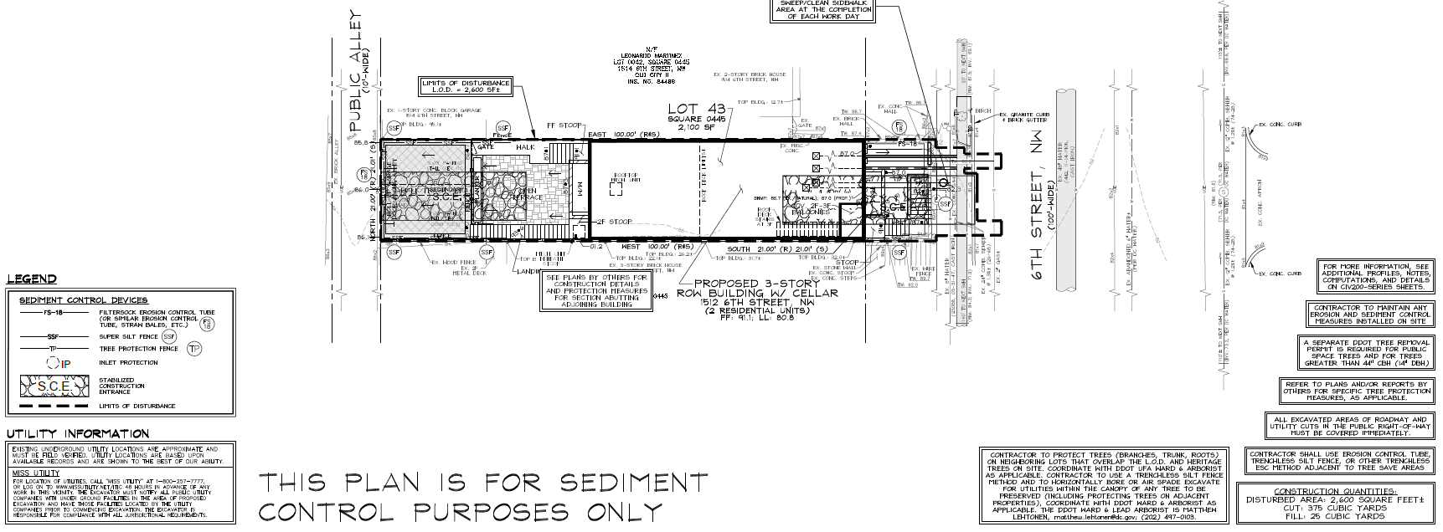
ESC Measures – Example
SCE
@DOEE_DC
Notes:
s16348

Slide 21
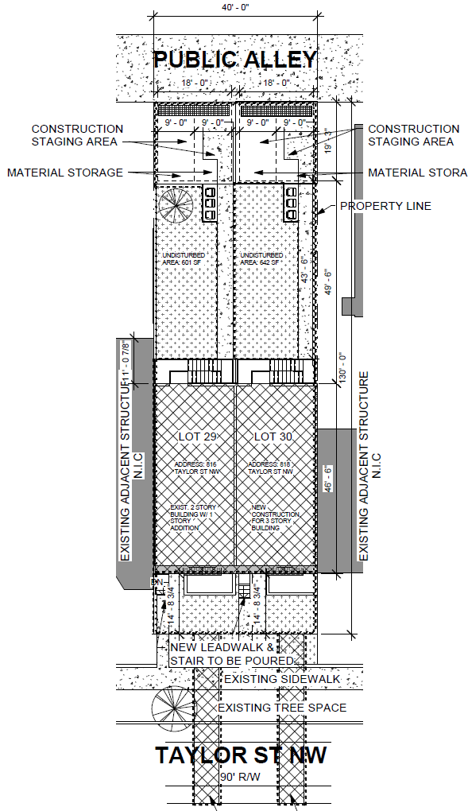
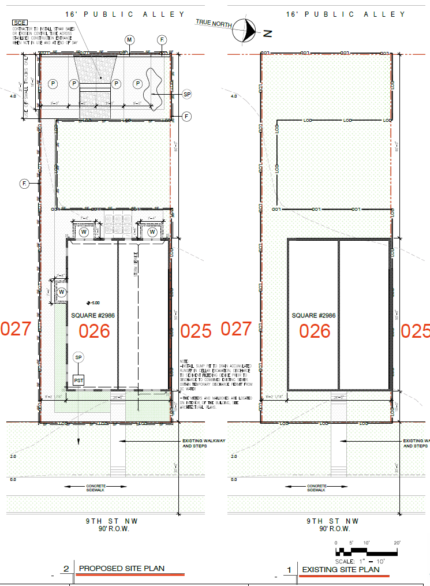
ESC Measures – Example
Area outside LOD likely to be disturbed
@DOEE_DC
Notes:
S16733 & s15952

Slide 22
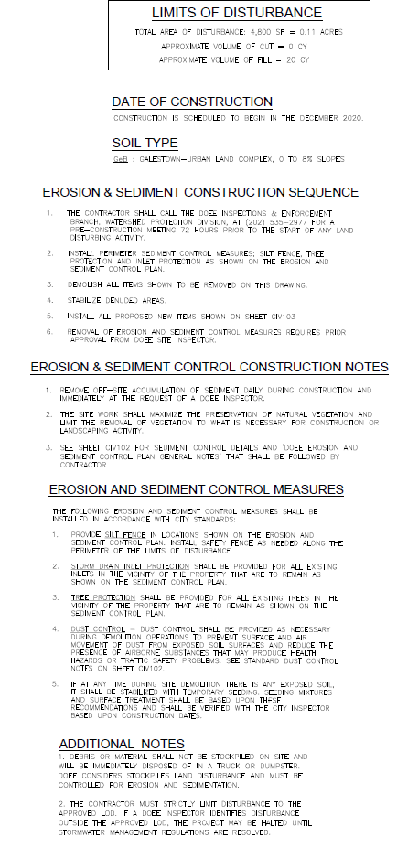
ESC Measures – Example
Stockpile note
Note on LOD close to 5,000 sf
@DOEE_DC
Notes:
s15984

Slide 23
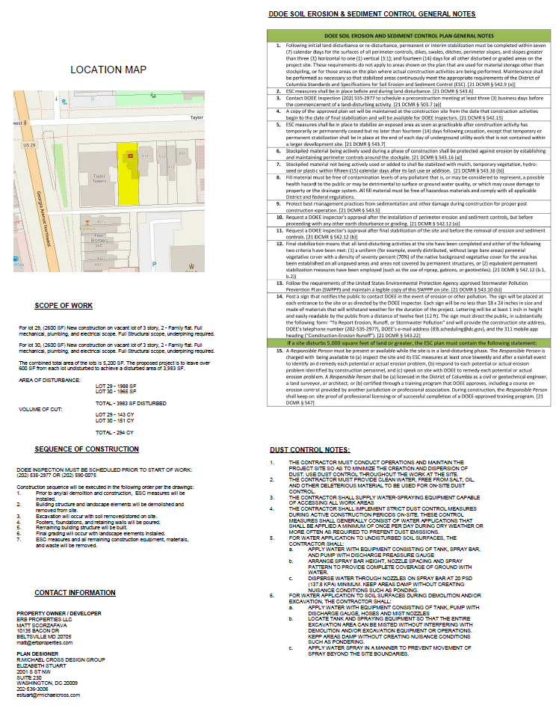
ESC Measures – Example
DOEE ESC General Notes
Area of Disturbance (square feet),
Volume of cut/fill (cubic yards)
Dust control notes – Section 9.1
@DOEE_DC
Notes:
s15952

Slide 24
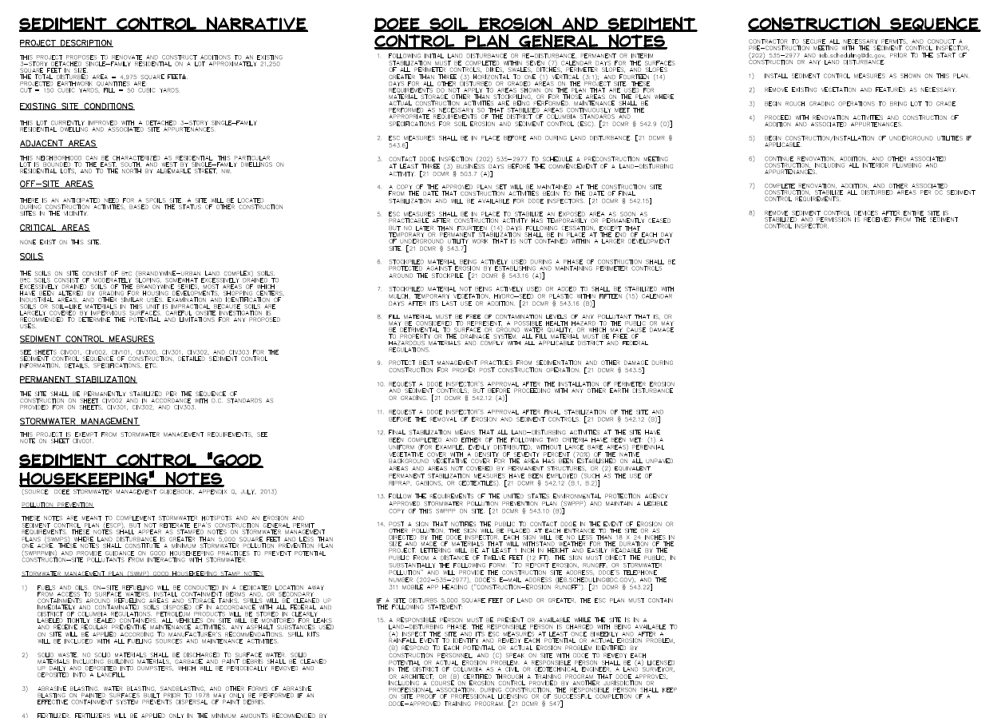
ESC Measures – Example
Sequence of Construction
Disturbed area (square feet),
Volume of cut/fill (cubic yards)
DOEE ESC General Notes
Soil type
@DOEE_DC
Notes:
s15858

Slide 25
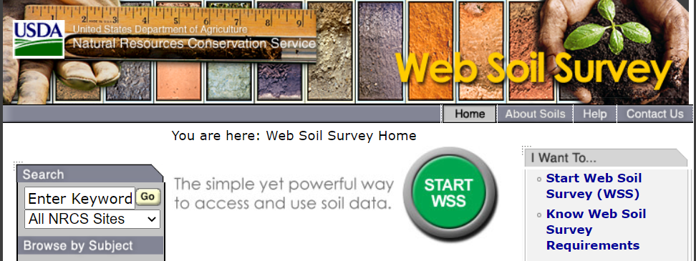
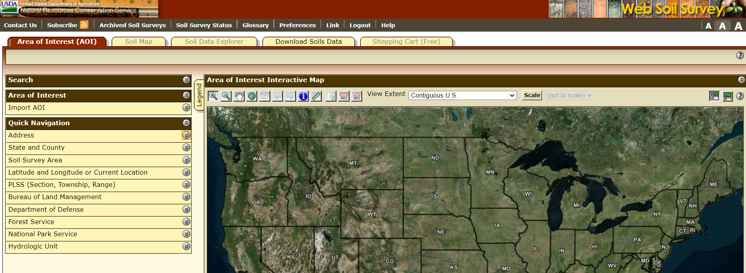
USDA Soil Survey
Click “START WSS”
Search by address
@DOEE_DC

Slide 26
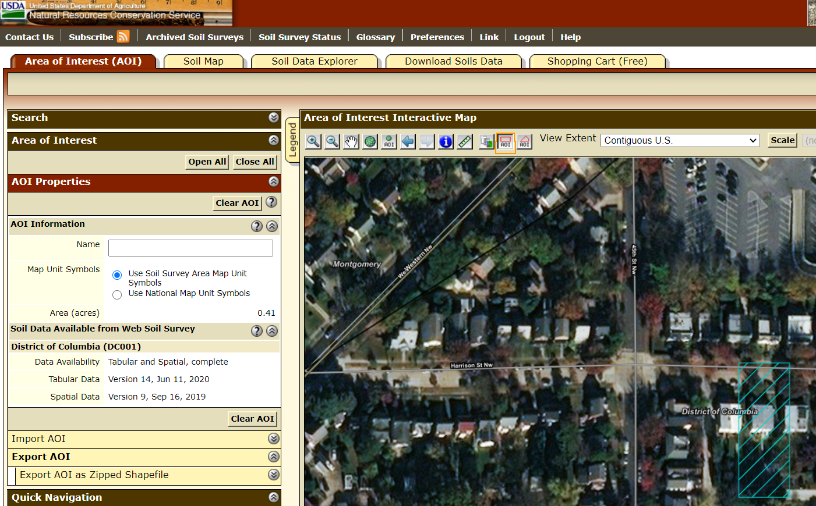
USDA Soil Survey
Define AOI by rectangle
@DOEE_DC
Notes:
Probably many ways to do this

Slide 27
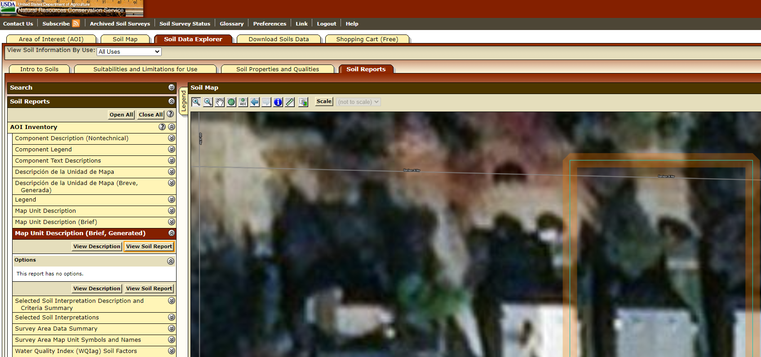
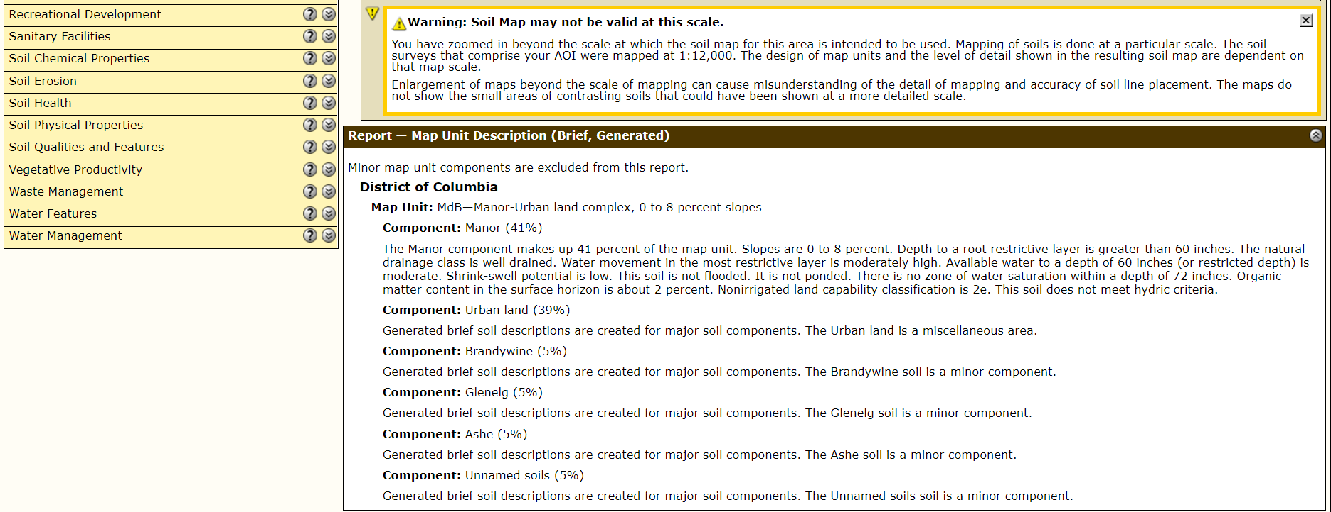
USDA Soil Survey
Soil Reports tab
Map Unit
Description (Brief, Generated)
View Soil Report
General description of predominant soil type
@DOEE_DC
Notes:
Probably many ways to do this

Slide 28
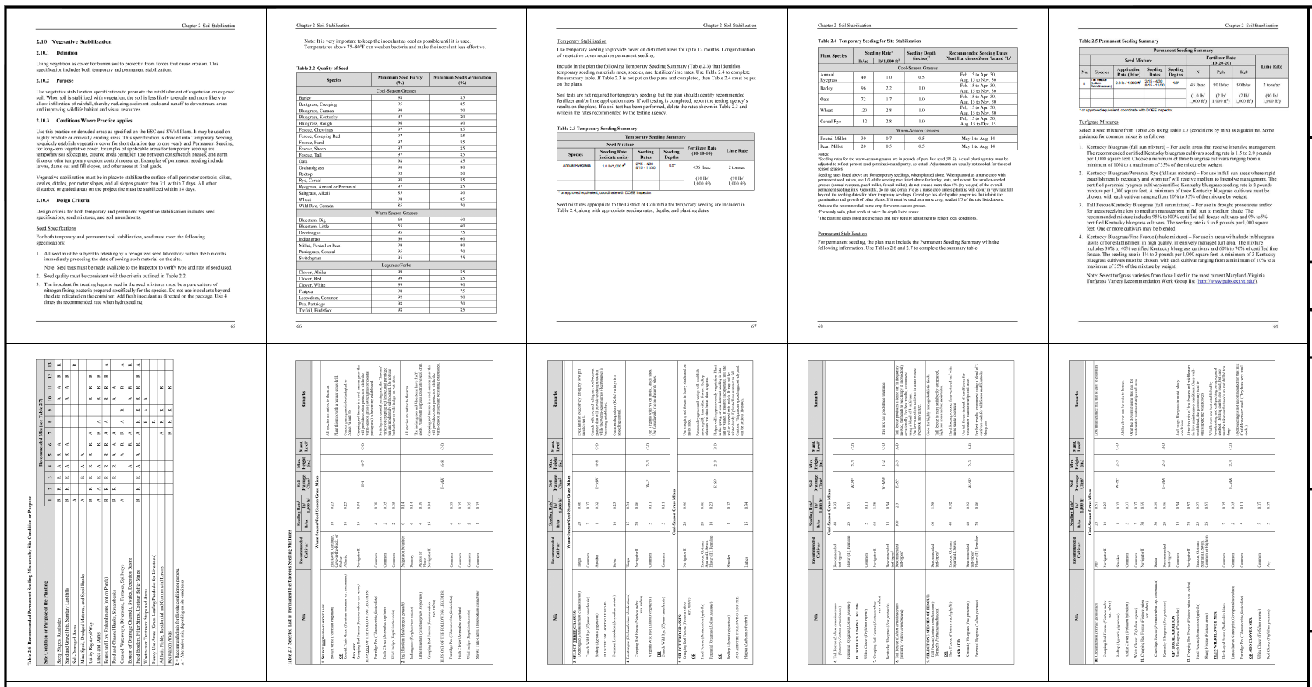
ESC Measures – Example
Vegetative stabilization notes – Section 2.10
Completed Tables 2.3 (or 2.4) and 2.5
@DOEE_DC
Notes:
s15772

Slide 29
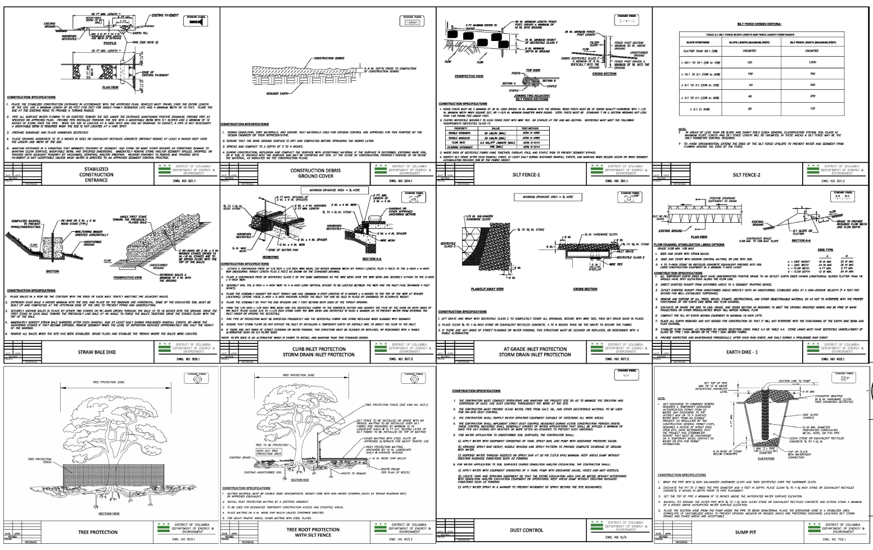
ESC Measures – Example
2nd sheet
Relevant, legible details
@DOEE_DC
Notes:
s15952

Slide 30
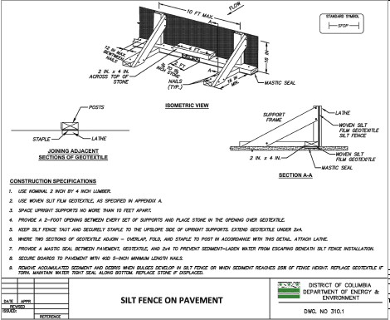
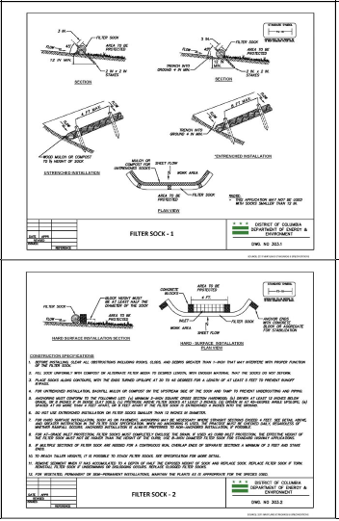
ESC Measures – Perimeter Controls
Straw bale dike requires trenching
Cannot use on pavement or tree CRZ
Paved Areas
Silt fence on pavement or filter sock
Tree CRZ
Tree root protection with silt fence or filter sock
@DOEE_DC

Slide 31
Comments and comment response letters
ESC
@DOEE_DC

Slide 32
Comment Responses – Good Example
Each comment is addressed
Specify location of addressed comment (sheet)
Notes:
Comment Response Letter
Respond to each part of a comment if it's multi-part
Specify on which sheets the comment was addressed
If there is any land disturbance in the PROW, follow procedure as outlined in Appendix B

Slide 33
Comment Responses – Bad Example
Does not explain how comment was addressed or which sheet
Does not indicate where information was added

Slide 34
Common Comments
ESC
@DOEE_DC

Slide 35
Common Comments
Upload the proposed plat to the SGS.
Enter all applicable DCRA building permit numbers associated with this project in the SGS.
Provide a blank area in the upper left-hand corner (must be 7 inches wide by 9.5 inches tall and have a 1-inch margin from top and left edge of page). This can be on a coversheet, if desired.
Enter the engineer/architect information in the SGS.
Provide the following documents:
  Environmental Intake Form – signed by DCRA
  Complete EISF report – if required by EIF
All plans must have a Sequence of Construction that describes implementation and maintenance of ESC measures and identifies permanent and interim stabilization practices. Include stages or phases of earth disturbance and construction.
Show the location of any stockpile areas and specify perimeter controls and stabilization methods.
Add a note indicating: The contractor must strictly limit disturbance to the approved LOD. If a DOEE inspector identifies disturbance outside the approved LOD, the project may be halted until stormwater management regulations are resolved.
@DOEE_DC

Slide 36
Common Comments
Straw bale dike is not recommended as a primary sediment control device. Use tree protection with untrenched silt fence (DOEE Standard Detail 903.2) or untrenched filter sock (DOEE Standard Detail 303.1 and 303.2) within the critical root zone of trees to be preserved.
The architecture plans show that underpinning is to be done and new walls created in the basement. This is all considered land disturbance, and must be included in the LOD and cut/fill numbers.
Show a stabilized construction entrance (SCE).
Use silt fence on pavement (DOEE Standard Detail 310.1) or filter sock (DOEE Standard Detail 303.1 and 303.2) in paved areas.
Update the DOEE ESC General Notes with those found here: https://doee.dc.gov/esc.
Add Vegetative Stabilization notes to match the DC ESC Manual. Include completed Tables 2.3 (or Table 2.4) and 2.5.
Update the ESC details with the new specifications from the DC ESC Manual.
The ESC plan must include a general description of the predominant soil types on the site, as described by the appropriate soil survey information available from the USDA-NRCS.
Include the Dust Control construction specifications from Section 9.1 of the DC ESC Manual.
@DOEE_DC

Slide 37
Common Comments
Show all existing trees on-site or close to the project. Including the trunk diameter at breast height (DBH) and the critical root zone (CRZ). The CRZ is defined as 1.5 ft of radius per 1 inch of DBH.
Show tree protection measures on the plan and provide details.
Streetview shows special and/or heritage trees along the back property lines. How will these be protected during construction?
Include a note on the plan to contact the Ward Arborist as soon as possible before construction begins to discuss tree protection measures. The Ward Arborist for this property is: xxxxxx, and their contact information is xxxx.xxxxx@dc.gov or 202-xxx-xxxx.
Enter all DDOT TOPS permit numbers in the Surface and Groundwater System (SGS), including tree removal permits.
Add inlet protection to the nearest down-grade stormwater catch basin.
@DOEE_DC

Slide 38
Resources available
ESC
@DOEE_DC

Slide 39
Resources Available
DOEE ESC webpage
  https://doee.dc.gov/esc
DOEE ESC Detail Drawings (CAD file), DOEE General Notes
  https://doee.dc.gov/node/619312
USDA-NRCS Web Soil Survey
  https://websoilsurvey.sc.egov.usda.gov/App/HomePage.htm
DDOT Urban Forestry – Tree Preservation
  https://ddot-urban-forestry-dcgis.hub.arcgis.com/pages/tree-preservation
PropertyQuest
  https://propertyquest.dc.gov/
Open Data DC – Arborist Zones
  https://opendata.dc.gov/datasets/arborist-zones?geometry=-77.063%2CNaN%2C-76.503%2CNaN
@DOEE_DC

